Slide 1
CIS 538
Web Search and Mining
Introduction

Slide 2
Textbooks
Bing Liu, Web Data Mining: Exploring Hyperlinks, Contents, and Usage Data, Springer,2011, ISBN: 3540378812.
Christopher D. Manning, Prabhakar Raghavan and Hinrich Schütze, Introduction to Information Retrieval, Cambridge University Press. 2008.
Soumen Chakrabarti, Mining the Web: Discovering Knowledge from Hypertext Data, Morgan-Kaufmann Publishers, 2003, ISBN 1-55860-754-4
Pierre Baldi,Paolo Frasconi, Padhraic Smyth, Modeling the Internet and the Web, John Wiley and Sons Ltd, 2003, ISBN 0470849061
Mark Levene, An Introduction to Search Engines and Web Navigation, Pearson Education, 2010, ISBN 0321306775

Slide 3
Web Search and Mining
Information retrieval (IR) is finding material (usually documents) of an unstructured nature (usually text) that satisfies an information need from within large collections (usually stored on computers).
The term “unstructured data” refers to data which does not have clear, semantically overt, easy-for-a-computer structure. It is the opposite of structured data, the canonical example of which is a relational database, of the sort companies usually use to maintain product inventories and personnel records.
“In modern parlance, the word “search” has tended to replace “(information) retrieval”; the term “search” is quite ambiguous, but in context we use the two synonymously.” (Manning)
Web Search is an application of IR to Web documents on the World Wide Web.

Slide 4
Web Search and Mining
Web Mining is the extraction of interesting and potentially useful patterns and implicit information from artifacts or activity related to the World­Wide Web.
Web mining is the application of data mining techniques to discover patterns from the Web
There are roughly three knowledge discovery domains that pertain to web mining: Web Content Mining, Web Structure Mining, and Web Usage Mining.

Slide 5
Unstructured (text) vs. structured (database) data in 1996

Slide 6




Unstructured (text) vs. structured (database) data in 2009

Slide 7
The Web
No design/co-ordination
Distributed content creation, linking
Content includes truth, lies, obsolete information, contradictions …
Structured (databases), semi-structured …
Scale larger than previous text corpora … (now, corporate records)
Growth – slowed down from initial “volume doubling every few months”
Content can be dynamically generated
The Web

Slide 8
The web: size
What is being measured?
  Number of hosts
  Number of (static) html pages
    Volume of data
Number of hosts – netcraft survey
  http://news.netcraft.com/archives/web_server_survey.html
  Gives monthly report on how many web servers are out there
Number of pages – numerous estimates
  More to follow later in this course
  For a Web engine: how big its index is

Slide 9
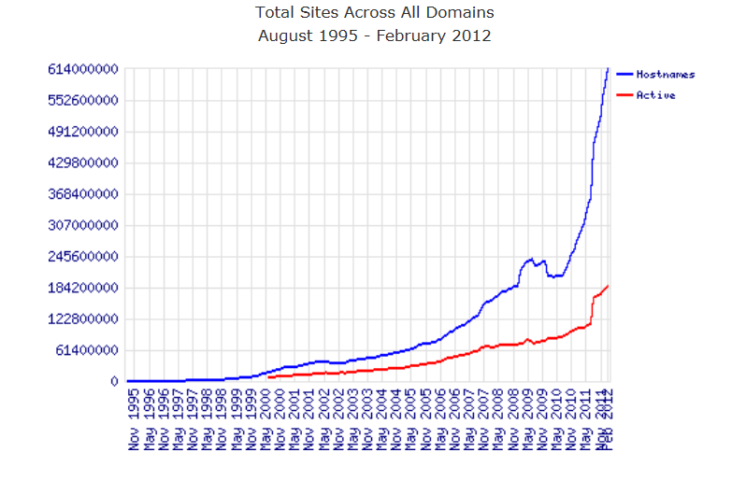
http://news.netcraft.com/archives/category/web-server-survey/

Slide 10
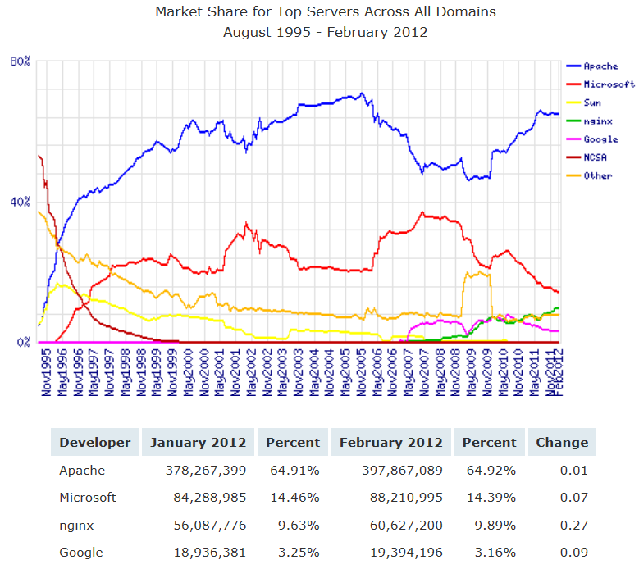
http://news.netcraft.com/archives/category/web-server-survey/

Slide 11
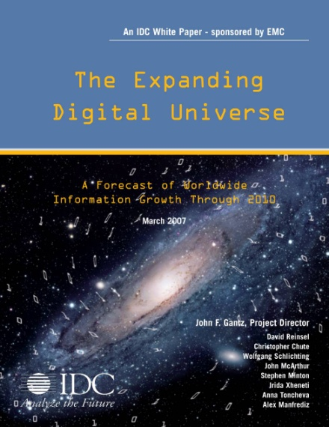
Digital Information
Created, Captured, Replicated Worldwide
Exabytes
10-fold Growth in 5 Years!
DVD
RFID
Digital TV
MP3 players
Digital cameras
Camera phones, VoIP
Medical imaging, Laptops,
Data center applications, Games
Satellite images, GPS, ATMs, Scanners
Sensors, Digital radio, DLP theaters, Telematics
Peer-to-peer, Email, Instant messaging, Videoconferencing,
CAD/CAM, Toys, Industrial machines, Security systems, Appliances
Jim Gray
Source: IDC, 2008

Slide 12
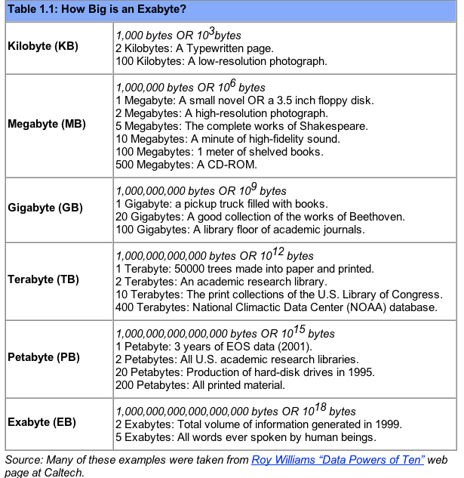
UNITS

Slide 13



How much information is there?
Yotta
Zetta
Exa
Peta
Tera
Giga
Mega
Kilo
Everything!
Recorded
Soon most everything will be recorded and indexed
Most bytes will never be seen by humans.
Search, data summarization, trend detection, information and knowledge extraction and discovery are key technologies
So will be infrastructure to manage this.
See Mike Lesk:
How much information is there: http://www.lesk.com/mlesk/ksg97/ksg.html
See Lyman & Varian:
How much information
http://www.sims.berkeley.edu/research/projects/how-much-info/
All Books
MultiMedia
All books
(words)
.Movie
A Photo
A Book
24 Yecto, 21 zepto, 18 atto, 15 femto, 12 pico, 9 nano, 6 micro, 3 milli
From Jim Gray

Slide 14
Some More Statistics
Slides from C.Lee Giles

Slide 15

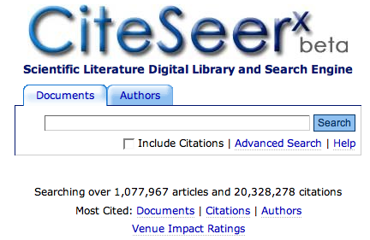
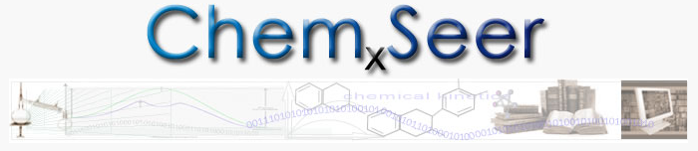
Research directions: C.Lee Giles
Intelligent search and search engines, digital libraries, cyberinfrastructure for science, academia and government
  Modular, scalable, robust, automatic cyberinfrastructure and search engine creation and maintenance
  Large heteogenous data and information systems
  Specialty search engines and portals for knowledge integration
    SeerSuite (open source infrastructure for Seers)
    CiteSeer^{x}(computer and information science)
    Chem_{X}Seer (e-chemistry portal)
    BotSeer (robots.txt search and analysis)
    ArchSeer (archaeology)
    YouSeer (open source search engine)
    MobiSNA (open source mobile video search and social networking)
    Other Seers that could be built: CensorSeer, eBizSeer, IntellSeer, etc.
  Strategic impact of search engines on business
Scalable intelligent tools/agents/methods/algorithms
  Information, knowledge and data integration
  Information and metadata extraction; entity disambiguation
  Unique search, knowledge discovery, information integration, data mining algorithms
  Web 2.0 and Web 3.0 methods
    Automated tagging for search and information retrieval
    Social network analysis
Strong collaboration record.
Funded by: NSF, DARPA, Microsoft, Lockheed-Martin, FAST, NASA, Raytheon, IBM, Ford, Alcatel/Lucent, Smithsonian, Internet Archive

Slide 16
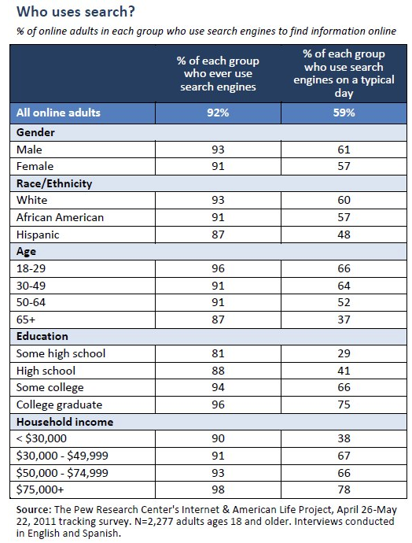

Slide 17
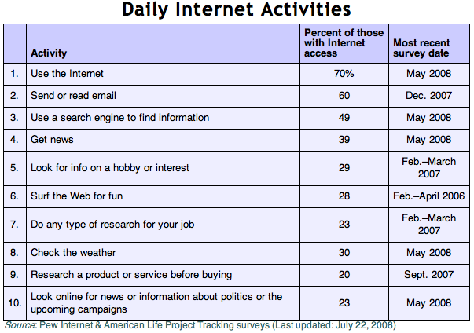
Search gains on email
July 2008 Pew Internet Study
manyeyes visualization

Slide 18
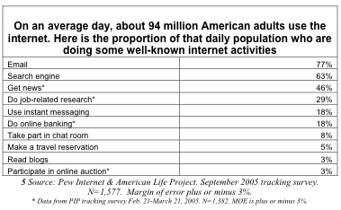
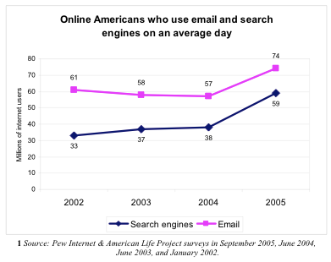
Web Search Engine Use and Commerce Continues to Grow
Pew Internet & American Life Internet Project Survey: Sept, 2005
- Search Engine News:
Search engine advertising revenues exceed TV networks
Walmart and other retailers express concern over Google
FOG replaces FOM
http://www.pewinternet.org

Slide 19
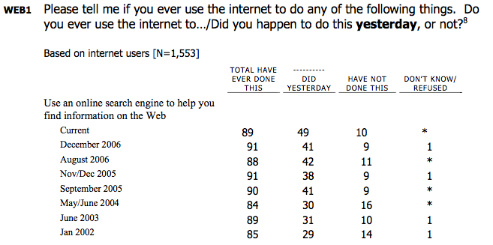
Web Search Engine Use and Commerce Continues to Grow
Pew Internet & American Life Internet Project Survey: August, 2008
PewInternet

Slide 20
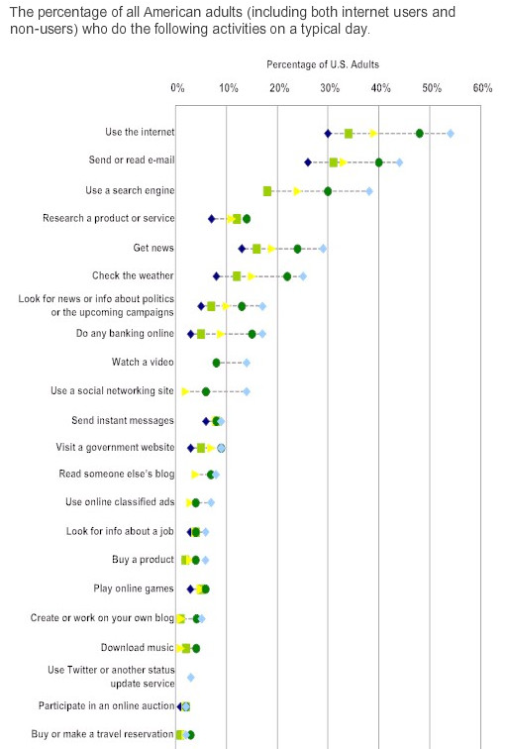
Web search engine use has new activities
Pew Internet & American Life Internet Project Survey: 2009
PewInternet

Slide 21
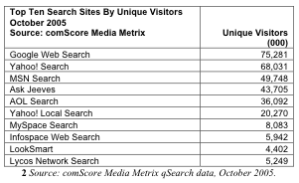
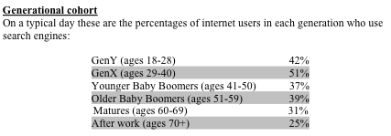
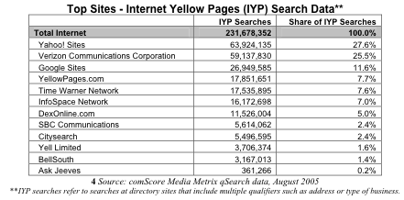
Web Search Engine Use and Commerce Continues to Grow
http://www.pewinternet.org

Slide 22
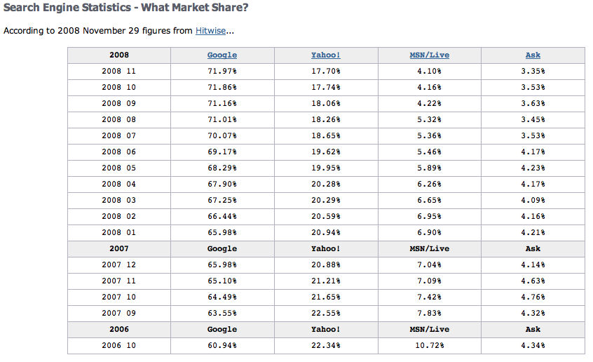
Search Engine Market Share
http://www.pewinternet.org

Slide 23
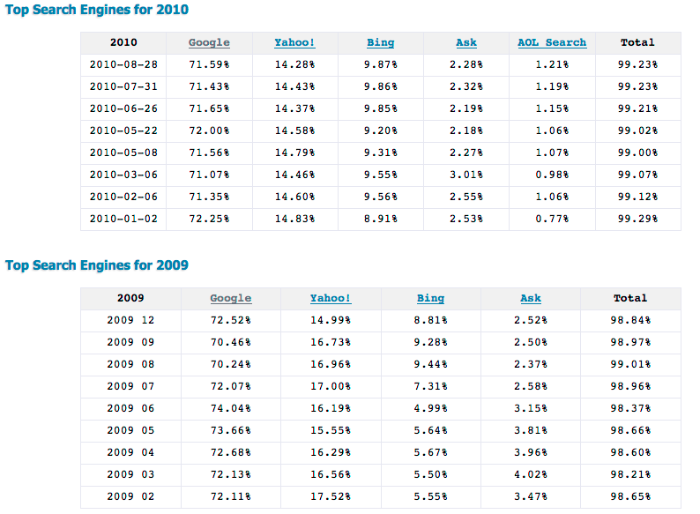
Search Engine Market Share - US
seoconsultants

Slide 24
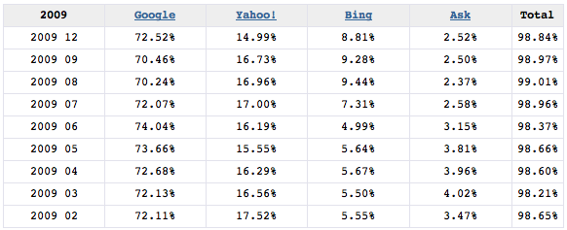
2009 Search Engine Market Share - US
seoconsultants

Slide 25
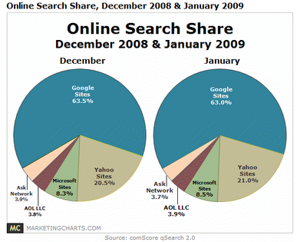
Search Engine Market Share - US

Slide 26
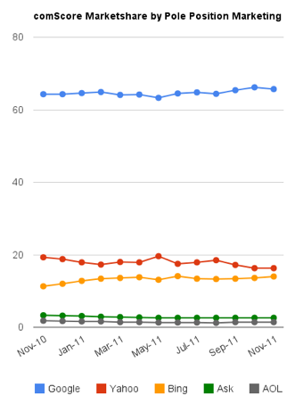
Search Engine Market Share - US

Slide 27
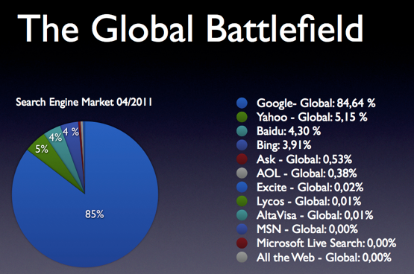

Slide 28
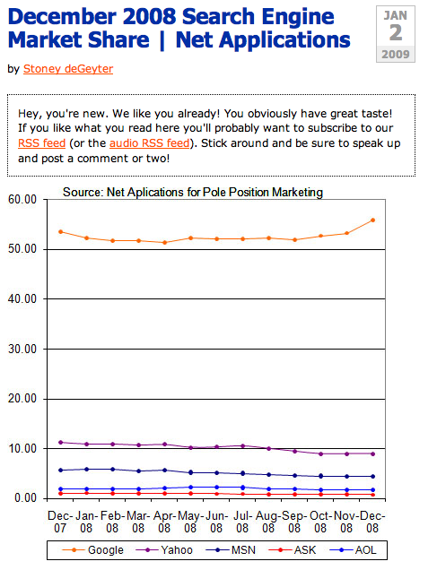
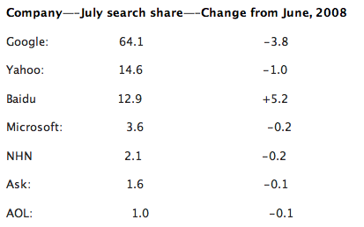
Marketshare
Search engine market share seems to be debatable
ComScore global share

Slide 29
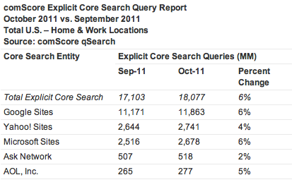
Number of search engine queries - US
About 500M per day
ComScore global share

Slide 30
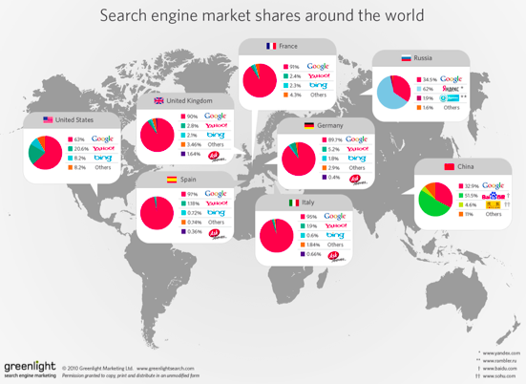

Slide 31
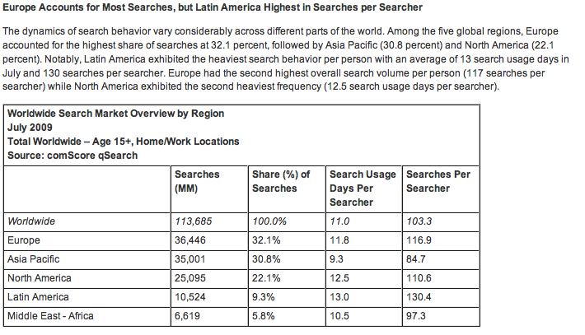
ComScore global share

Slide 32
Information Retrieval
IR
“Information retrieval is a field concerned with the structure, analysis, organization, storage, searching, and retrieval of information.” (Salton, 1968)
General definition that can be applied to many types of information and search applications
Primary focus of IR since the 50s has been on text and documents

Slide 33
Information Retrieval
(IR)
Involves the indexing and retrieval of textual documents.
Searching for pages on the World Wide Web is the most recent “killer app.”
Concerned firstly with retrieving relevant documents to a query.
Concerned secondly with retrieving from large sets of documents efficiently.

Slide 34
Typical IR Task
Given:
  A corpus of textual natural-language documents.
  A user query in the form of a textual string.
Find:
  A ranked set of documents that are relevant to the query.

Slide 35
IR System
Document
corpus
IR
System
Query String
1. Doc1
2. Doc2
3. Doc3
.
.
Ranked
Documents

Slide 36
Relevance
Relevance is a subjective judgment and may include:
  Being on the proper subject.
  Being timely (recent information).
  Being authoritative (from a trusted source).
  Satisfying the goals of the user and his/her intended use of the information (information need).

Slide 37
Keyword Search
Simplest notion of relevance is that the query string appears verbatim in the document.
Slightly less strict notion is that the words in the query appear frequently in the document, in any order (bag of words).

Slide 38
Problems with Keywords
May not retrieve relevant documents that include synonymous terms.
  “restaurant” vs. “café”
  “PRC” vs. “China”
May retrieve irrelevant documents that include ambiguous terms.
  “bat” (baseball vs. mammal)
  “Apple” (company vs. fruit)
  “bit” (unit of data vs. act of eating)

Slide 39
Intelligent IR
Taking into account the meaning of the words used.
Taking into account the order of words in the query.
Adapting to the user based on direct or indirect feedback.
Taking into account the authority of the source.

Slide 40
IR System Architecture
User Interface
Text
User
Need
Text Operations
Logical View
User
Feedback
Query
Operations
Indexing
Database
Manager
Inverted
file
Query
Searching
Index
Text
Database
Ranked
Docs
Ranking
Retrieved
Docs

Slide 41
IR System Components
Text Operations forms index words (tokens).
  Stopword removal
  Stemming
Indexing constructs an inverted index of word to document pointers.
Searching retrieves documents that contain a given query token from the inverted index.
Ranking scores all retrieved documents according to a relevance metric.

Slide 42
IR System Components (continued)
User Interface manages interaction with the user:
  Query input and document output.
  Relevance feedback.
  Visualization of results.
Query Operations transform the query to improve retrieval:
  Query expansion using a thesaurus.
  Query transformation using relevance feedback.

Slide 43
IR and Search Engines
IR
A search engine is the practical application of information retrieval techniques to large scale text collections
Web search engines are best-known examples, but many others
  Open source search engines are important for research and development
    e.g., Lucene, Lemur/Indri, Galago
Big issues include main IR issues but also some others

Slide 44
IR and Search Engines
IR
Information Retrieval
Search Engines
Performance
-Efficient search and indexing
Incorporating new data
-Coverage and freshness
Scalability
-Growing with data and users
Adaptability
-Tuning for applications
Specific problems
-e.g. Spam
Relevance
-Effective ranking
Evaluation
-Testing and measuring
Information needs
-User interaction

Slide 45
Search Engine Issues
Search Engine
Performance
  Measuring and improving the efficiency of search
    e.g., reducing response time, increasing query throughput, increasing indexing speed
  Indexes are data structures designed to improve search efficiency
    designing and implementing them are major issues for search engines

Slide 46
Search Engine Issues
Search Engine
Dynamic data (Incorporating new data)
  The “collection” for most real applications is constantly changing in terms of updates, additions, deletions
    e.g., web pages
  Acquiring or “crawling” the documents is a major task
    Typical measures are coverage (how much has been indexed) and freshness (how recently was it indexed)
  Updating the indexes while processing queries is also a design issue

Slide 47
Search Engine Issues
Search Engine
Scalability
  Making everything work with millions of users every day, and many terabytes of documents
  Distributed processing is essential
Adaptability
  Changing and tuning search engine components such as ranking algorithm, indexing strategy, interface for different applications

Slide 48
Search Engine Issues
Search Engine
Spam
  For Web search, spam in all its forms is one of the major issues
  Affects the efficiency of search engines and, more seriously, the effectiveness of the results
  Many types of spam
    e.g. spamdexing or term spam, link spam, “optimization”
  New subfield called adversarial IR, since spammers are “adversaries” with different goals

Slide 49
Architecture of SE
Search Engine
How do search engines like Google work?

Slide 50
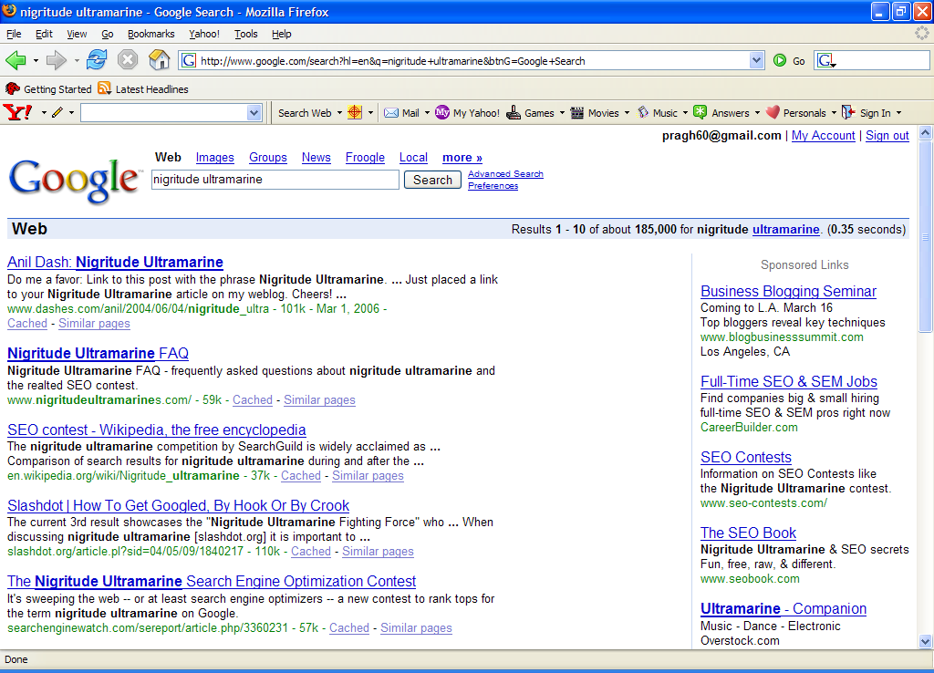
Search Engine
Paid
Search Ads
Algorithmic results.

Slide 51

Architecture
Search Engine
User
Web spider
Search
Indexer
The Web
Indexes
Ad indexes

Slide 52
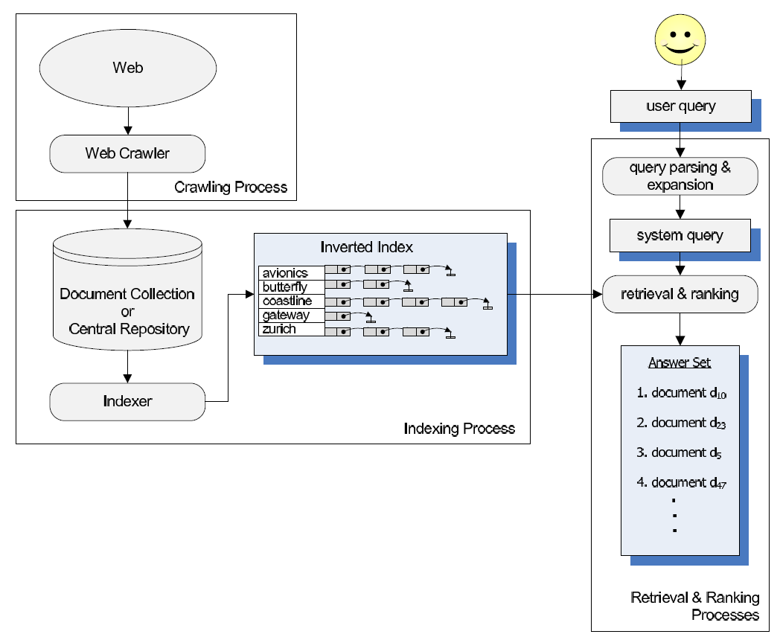

Slide 53
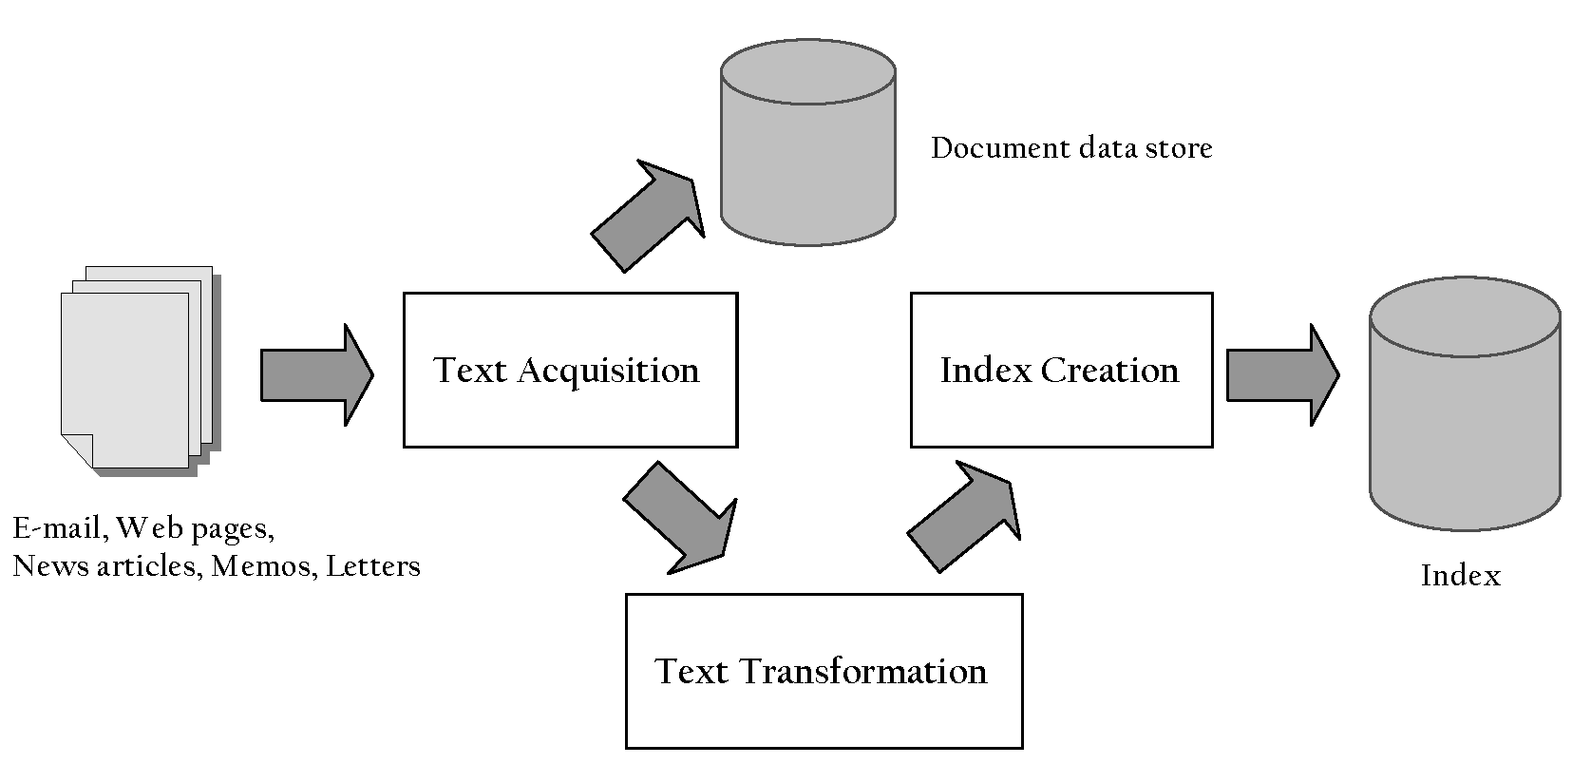
Indexing Process
Search Engine

Slide 54
Indexing Process
Search Engine
Text acquisition
  identifies and stores documents for indexing
Text transformation
  transforms documents into index terms or features
Index creation
  takes index terms and creates data structures (indexes) to support fast searching

Slide 55
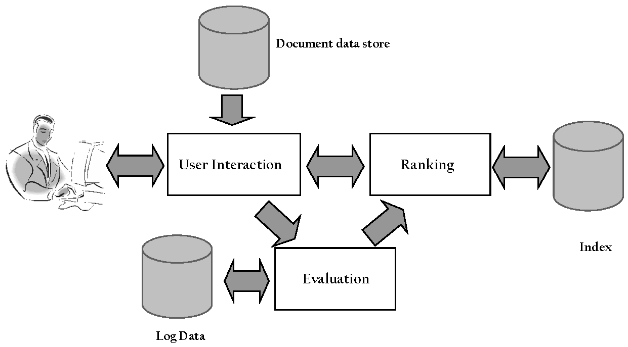
Query Process
Search Engine

Slide 56
Query Process
Search Engine
User interaction
  supports creation and refinement of query, display of results
Ranking
  uses query and indexes to generate ranked list of documents
Evaluation
  monitors and measures effectiveness and efficiency (primarily offline)

Slide 57
Details: Text Acquisition
Indexing Process
Crawler
  Identifies and acquires documents for search engine
  Many types – web, enterprise, desktop
  Web crawlers follow links to find documents
    Must efficiently find huge numbers of web pages (coverage) and keep them up-to-date (freshness)
    Single site crawlers for site search
    Topical or focused crawlers for vertical search
  Document crawlers for enterprise and desktop search
    Follow links and scan directories

Slide 58
Web Crawler
Indexing Process
Starts with a set of seeds, which are a set of URLs given to it as parameters
Seeds are added to a URL request queue
Crawler starts fetching pages from the request queue
Downloaded pages are parsed to find link tags that might contain other useful URLs to fetch
New URLs added to the crawler’s request queue, or frontier
Continue until no more new URLs or disk full

Slide 59
Crawling picture
Indexing Process
URLs crawled
and parsed
Unseen Web
Seed
pages
URLs frontier
Web

Slide 60
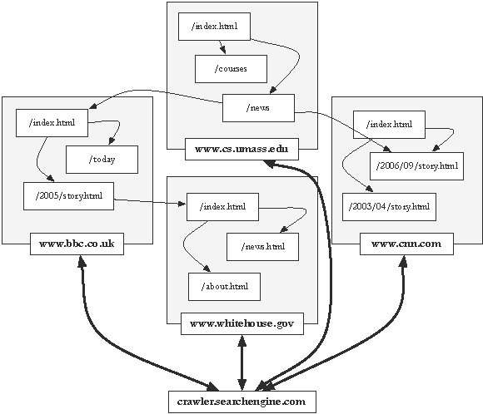
Crawling the Web
Indexing Process

Slide 61
Other IR-Related Tasks
Automated document categorization
Information filtering (spam filtering)
Information routing
Automated document clustering
Recommending information or products
Information extraction
Information integration
Question answering

Slide 62
History of IR
1960-70’s:
  Initial exploration of text retrieval systems for “small” corpora of scientific abstracts, and law and business documents.
  Development of the basic Boolean and vector-space models of retrieval.
  Prof. Salton and his students at Cornell University are the leading researchers in the area.

Slide 63
IR History Continued
1980’s:
  Large document database systems, many run by companies:
    Lexis-Nexis
    Dialog
    MEDLINE

Slide 64
IR History Continued
1990’s:
  Searching FTPable documents on the Internet
    Archie
    WAIS
  Searching the World Wide Web
    Lycos
    Yahoo
    Altavista

Slide 65
IR History Continued
1990’s continued:
  Organized Competitions
    NIST TREC
  Recommender Systems
    Ringo
    Amazon
    NetPerceptions
  Automated Text Categorization & Clustering

Slide 66
Recent IR History
2000’s
  Link analysis for Web Search
    Google
  Automated Information Extraction
    Whizbang
    Fetch
    Burning Glass
  Question Answering
    TREC Q/A track

Slide 67
Recent IR History
2000’s continued:
  Multimedia IR
    Image
    Video
    Audio and music
  Cross-Language IR
    DARPA Tides
  Document Summarization

Slide 68
Related Areas
Database Management
Library and Information Science
Artificial Intelligence
Natural Language Processing
Machine Learning

Slide 69
Database Management
Focused on structured data stored in relational tables rather than free-form text.
Focused on efficient processing of well-defined queries in a formal language (SQL).
Clearer semantics for both data and queries.
Recent move towards semi-structured data (XML) brings it closer to IR.

Slide 70
Library and Information Science
Focused on the human user aspects of information retrieval (human-computer interaction, user interface, visualization).
Concerned with effective categorization of human knowledge.
Concerned with citation analysis and bibliometrics (structure of information).
Recent work on digital libraries brings it closer to CS & IR.

Slide 71
Artificial Intelligence
Focused on the representation of knowledge, reasoning, and intelligent action.
Formalisms for representing knowledge and queries:
  First-order Predicate Logic
  Bayesian Networks
Recent work on web ontologies and intelligent information agents brings it closer to IR.

Slide 72
Natural Language Processing
Focused on the syntactic, semantic, and pragmatic analysis of natural language text and discourse.
Ability to analyze syntax (phrase structure) and semantics could allow retrieval based on meaning rather than keywords.

Slide 73
Natural Language Processing:
IR Directions
Methods for determining the sense of an ambiguous word based on context (word sense disambiguation).
Methods for identifying specific pieces of information in a document (information extraction).
Methods for answering specific NL questions from document corpora.

Slide 74
Machine Learning
Focused on the development of computational systems that improve their performance with experience.
Automated classification of examples based on learning concepts from labeled training examples (supervised learning).
Automated methods for clustering unlabeled examples into meaningful groups (unsupervised learning).

Slide 75
Machine Learning:
IR Directions
Text Categorization
  Automatic hierarchical classification (Yahoo).
  Adaptive filtering/routing/recommending.
  Automated spam filtering.
Text Clustering
  Clustering of IR query results.
  Automatic formation of hierarchies (Yahoo).
Learning for Information Extraction
Text Mining

Slide 76
Web Mining
Web Mining is the extraction of interesting and potentially useful patterns and implicit information from artifacts or activity related to the World­Wide Web.
Web mining is the application of data mining techniques to discover patterns from the Web

Slide 77
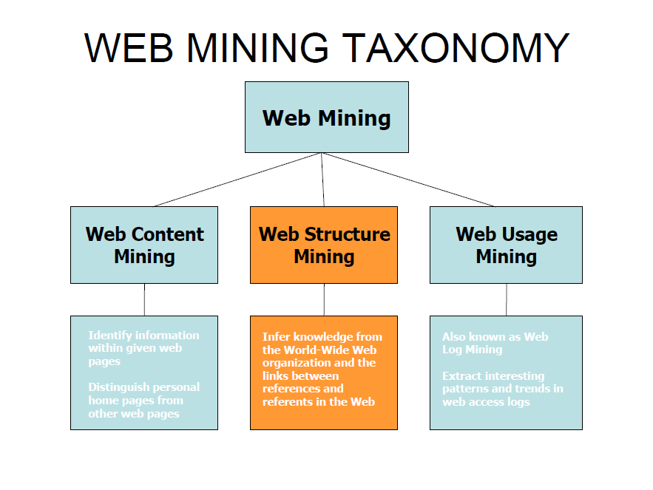
Web Mining

Slide 78
WEB CONTENT MINING
Discovery of useful information from web contents / data / documentsWeb data contents: text, image, audio, video, metadata and hyperlinks
Pre-processing data before web content mining: featureselection
Post-processing data can reduce ambiguous searching results
Web Page Content Mining:Mines the contents of documents directly
Search Engine Mining: Improves on the content search of other tools like search engines
Web Content Mining is related to data mining and text miningIt is related to data mining because many data mining techniques can be appliedin Web content mining
It is related to text mining because much of the web content is text

Slide 79
WEB STRUCTURE MINING
The structure of a typical Web graph consists of Web pages as nodes, and hyperlinks as edges connecting two related pages
Web Structure Mining is the process of discovering information from the Web
Finding information about the web pages and inference on Hyperlink
Retrieving information about the relevance and the quality of the web page
This type of mining can be performed either at the (intra-page) document level or at the (inter-page) hyperlink level
Finding authoritative Web pages
  Retrievingpagesthat are not only relevantbut are also of high quality, or authoritativeon the topic

Slide 80
WEB STRUCTURE MINING
Hyperlinks can infer the notion of authority
  The Web consists not only of pages, but also of hyperlinks pointing from one page to another
  These hyperlinks contain an enormous amountof latent human annotation
  A hyperlink pointing to another Web page, this can be considered as the author's endorsement of the other page
To discover the link structure of the hyperlinks at the inter-document level and to generate structural summary about the Website and Web page:
  Based on the hyperlinks, categorizing the Webpagesand generated information
  Discovering the structure of Web document itself
  Discovering the nature of the hierarchy or network of hyperlinks in the Website of a particular domain
The research at the hyperlink level is also called Hyperlink Analysis

Slide 81
WEB USAGE MINING
Web usage mining also known as Web log mining
What is Usage mining?
  Discovering user ‘navigation patterns’from web data
  Prediction of user behavior while he interacts with the web
  Helps to improve large collection of resources
Typical sources of data:
  Automatically generated data stored in server access logs, referrer logs, agent logs and client-side cookies
  User profiles
  Metadata: Page attributes, content attributes, usage data

Slide 82
A web server log file sample
The following is a fragment from the server logs for JafSoft Limited. All the relative URLs are for the base URL http://www.jafsoft.com/.
First lets look at a fragment of log file....
fcrawler.looksmart.com - - [26/Apr/2000:00:00:12 -0400] "GET /contacts.html HTTP/1.0" 200 4595 "-" "FAST-WebCrawler/2.1-pre2 (ashen@looksmart.net)"
fcrawler.looksmart.com - - [26/Apr/2000:00:17:19 -0400] "GET /news/news.html HTTP/1.0" 200 16716 "-" "FAST-WebCrawler/2.1-pre2 (ashen@looksmart.net)"
ppp931.on.bellglobal.com - - [26/Apr/2000:00:16:12 -0400] "GET /download/windows/asctab31.zip HTTP/1.0" 200 1540096 "http://www.htmlgoodies.com/downloads/freeware/webdevelopment/15.html" "Mozilla/4.7 [en]C-SYMPA (Win95; U)"
123.123.123.123 - - [26/Apr/2000:00:23:48 -0400] "GET /pics/wpaper.gif HTTP/1.0" 200 6248 "http://www.jafsoft.com/asctortf/" "Mozilla/4.05 (Macintosh; I; PPC)"
123.123.123.123 - - [26/Apr/2000:00:23:47 -0400] "GET /asctortf/ HTTP/1.0" 200 8130 "http://search.netscape.com/Computers/Data_Formats/Document/Text/RTF" "Mozilla/4.05 (Macintosh; I; PPC)"
123.123.123.123 - - [26/Apr/2000:00:23:48 -0400] "GET /pics/5star2000.gif HTTP/1.0" 200 4005 "http://www.jafsoft.com/asctortf/" "Mozilla/4.05 (Macintosh; I; PPC)" 123.123.123.123 - - [26/Apr/2000:00:23:50 -0400] "GET /pics/5star.gif HTTP/1.0" 200 1031 "http://www.jafsoft.com/asctortf/" "Mozilla/4.05 (Macintosh; I; PPC)"
123.123.123.123 - - [26/Apr/2000:00:23:51 -0400] "GET /pics/a2hlogo.jpg HTTP/1.0" 200 4282 "http://www.jafsoft.com/asctortf/" "Mozilla/4.05 (Macintosh; I; PPC)"
123.123.123.123 - - [26/Apr/2000:00:23:51 -0400] "GET /cgi-bin/newcount?jafsof3&width=4&font=digital&noshow HTTP/1.0" 200 36 "http://www.jafsoft.com/asctortf/" "Mozilla/4.05 (Macintosh; I; PPC)"
(Note, I've added some space for clarity, and changed the IP number to 123.123.123.123 to protect the privacy of the actual visitor

Slide 83
A web server log file sample
The fragment shown represents three visitors to my web site
  A visit from the "FAST-WebCrawler" web spider from the www.looksmart.com site. This retrieved my contacts and news pages, and presumably (re-)indexed them for their search engine.
  Someone using the bellglobal.com ISP to download my AscToTab program in a .zip file. This person came from the www.htmlgoodies.com website.
  Someone from IP address 123.123.123.123 (changed to protect identity) who looked at my AscToRTF - text to RTF converter homepage. This person came from the web directory at Netscape's site, and was using a Macintosh (which is a shame, because this is Windows software :-)
  REST (HTML)

