Slide 1
CSE 538
Web Search and Mining
Web Crawling

Slide 2
Ch. 8: Web Crawling
By Filippo Menczer
Indiana University School of Informatics
in Web Data Mining by Bing Liu
Springer, 2010

Slide 3
Outline
Motivation and taxonomy of crawlers
Basic crawlers and implementation issues
Universal crawlers
Preferential (focused and topical) crawlers
Evaluation of preferential crawlers
Crawler ethics and conflicts
New developments: social, collaborative, federated crawlers

Slide 4
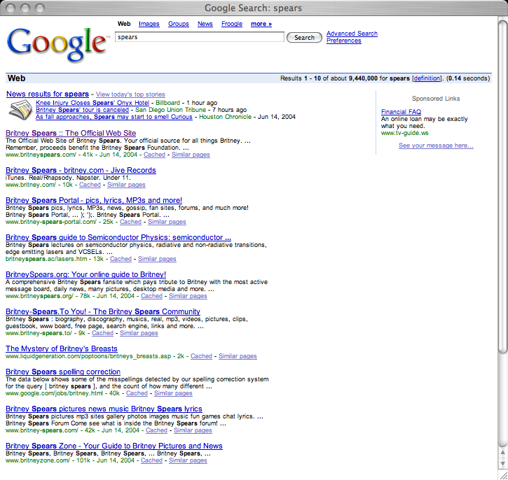
Q: How does a search engine know that all these pages contain the query terms?
A: Because all of those pages have been crawled

Slide 5

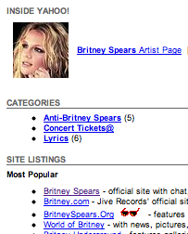
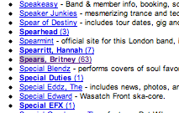
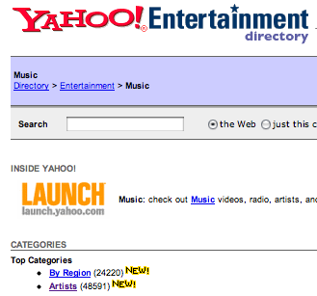
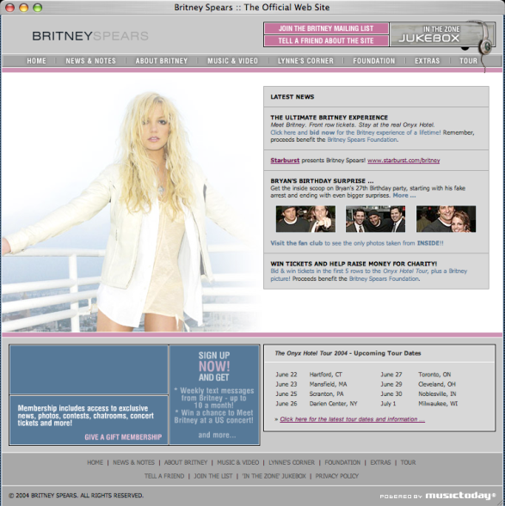
starting
pages
(seeds)
Crawler:
basic
idea

Slide 6
Many names
Crawler
Spider
Robot (or bot)
Web agent
Wanderer, worm, …
And famous instances: googlebot, scooter, slurp, msnbot, …

Slide 7
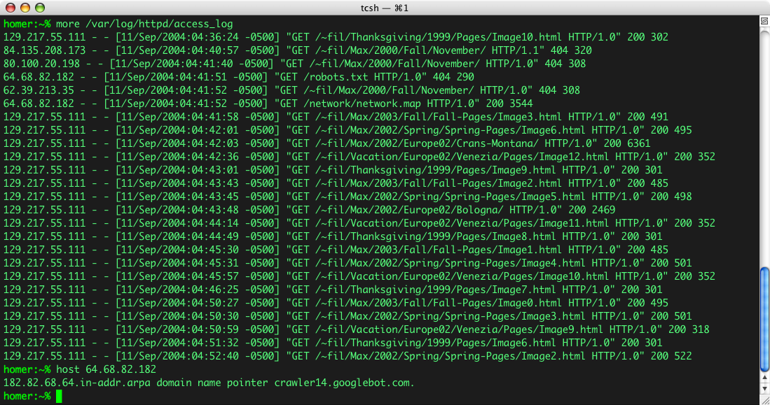
Googlebot & you

Slide 8
Motivation for crawlers
Support universal search engines (Google, Yahoo, MSN/Windows Live, Ask, etc.)
Vertical (specialized) search engines, e.g. news, shopping, papers, recipes, reviews, etc.
Business intelligence: keep track of potential competitors, partners
Monitor Web sites of interest
Evil: harvest emails for spamming, phishing…
… Can you think of some others?…

Slide 9
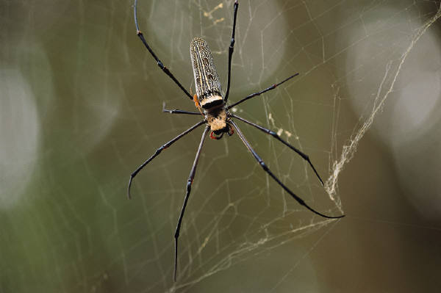
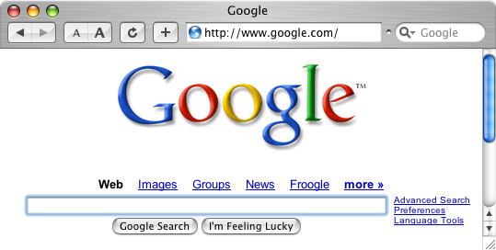
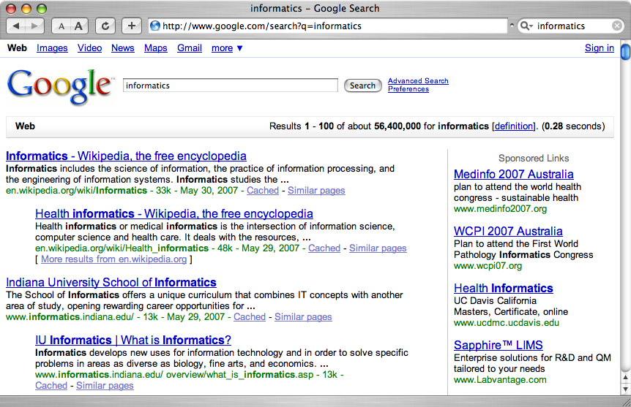
A crawler within a search engine
Web
Page repository
googlebot
Text & link analysis
Query
hits
Text index
PageRank
Ranker

Slide 10
One taxonomy of crawlers
Many other criteria could be used:
  Incremental, Interactive, Concurrent, Etc.

Slide 11
Outline
Motivation and taxonomy of crawlers
Basic crawlers and implementation issues
Universal crawlers
Preferential (focused and topical) crawlers
Evaluation of preferential crawlers
Crawler ethics and conflicts
New developments: social, collaborative, federated crawlers

Slide 12
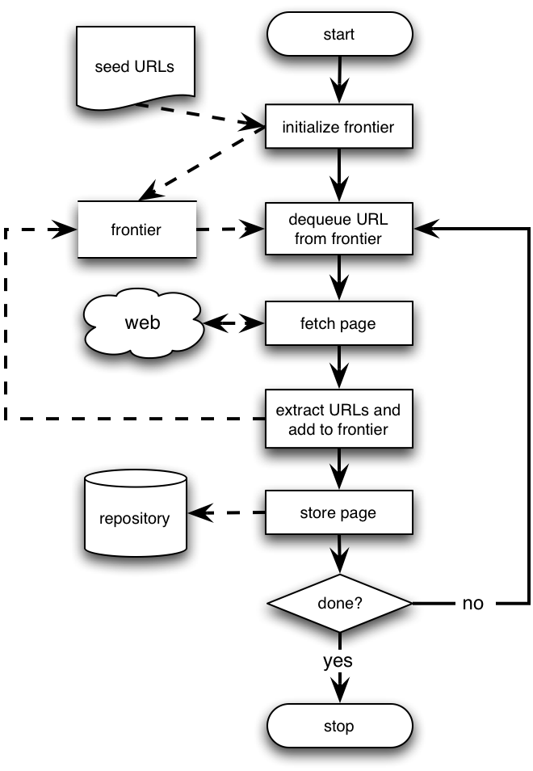
Basic crawlers
This is a sequential crawler
Seeds can be any list of starting URLs
Order of page visits is determined by frontier data structure
Stop criterion can be anything

Slide 13
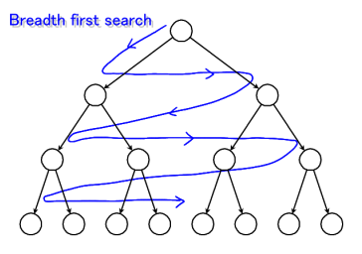
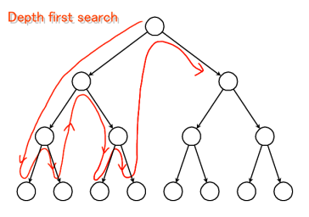
Graph traversal
(BFS or DFS?)
Breadth First Search
  Implemented with QUEUE (FIFO)
  Finds pages along shortest paths
  If we start with “good” pages, this keeps us close; maybe other good stuff…
Depth First Search
  Implemented with STACK (LIFO)
  Wander away (“lost in cyberspace”)

Slide 14
A basic crawler in Perl
Queue: a FIFO list (shift and push)
  my @frontier = read_seeds($file);
  while (@frontier && $tot < $max) {
    my $next_link = shift @frontier;
    my $page = fetch($next_link);
    add_to_index($page);
    my @links = extract_links($page, $next_link);
    push @frontier, process(@links);
  }

Slide 15
Implementation issues
Don’t want to fetch same page twice!
  Keep lookup table (hash) of visited pages
  What if not visited but in frontier already?
The frontier grows very fast!
  May need to prioritize for large crawls
Fetcher must be robust!
  Don’t crash if download fails
  Timeout mechanism
Determine file type to skip unwanted files
  Can try using extensions, but not reliable
  Can issue ‘HEAD’ HTTP commands to get Content-Type (MIME) headers, but overhead of extra Internet requests

Slide 16
More implementation issues
Fetching
  Get only the first 10-100 KB per page
  Take care to detect and break redirection loops
  Soft fail for timeout, server not responding, file not found, and other errors

Slide 17
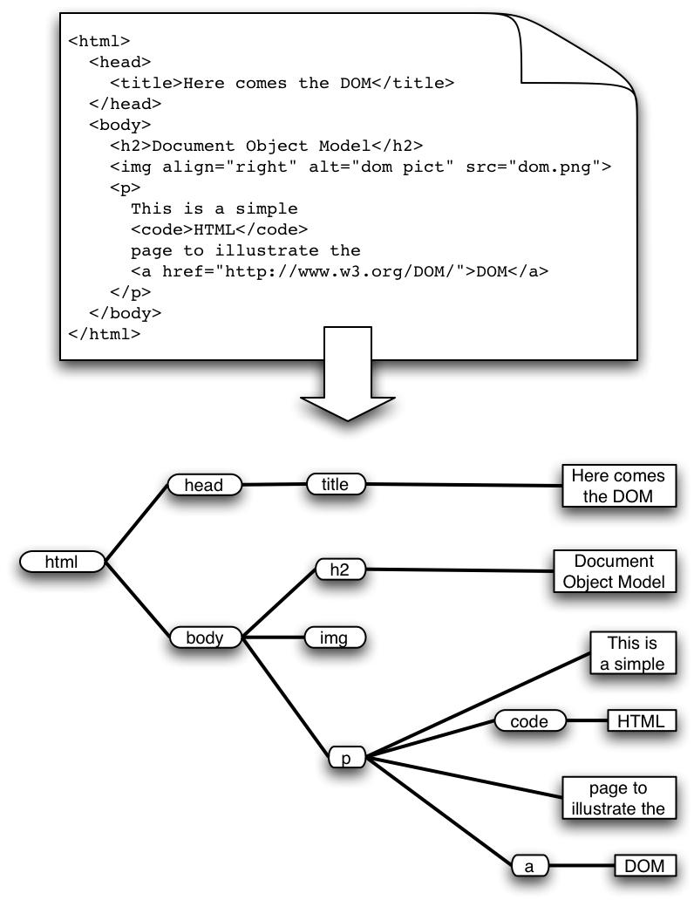
More implementation issues: Parsing
HTML has the structure of a DOM (Document Object Model) tree
Unfortunately actual HTML is often incorrect in a strict syntactic sense
Crawlers, like browsers, must be robust/forgiving
Fortunately there are tools that can help
  E.g. tidy.sourceforge.net
Must pay attention to HTML entities and unicode in text
What to do with a growing number of other formats?
  Flash, SVG, RSS, AJAX…

Slide 18
More implementation issues
Stop words
  Noise words that do not carry meaning should be eliminated (“stopped”) before they are indexed
  E.g. in English: AND, THE, A, AT, OR, ON, FOR, etc…
  Typically syntactic markers
  Typically the most common terms
  Typically kept in a negative dictionary
    10–1,000 elements
    E.g. http://ir.dcs.gla.ac.uk/resources/linguistic_utils/stop_words
  Parser can detect these right away and disregard them

Slide 19
More implementation issues
Conflation and thesauri
Idea: improve recall by merging words with same meaning
We want to ignore superficial morphological features, thus merge semantically similar tokens
  {student, study, studying, studious} => studi
We can also conflate synonyms into a single form using a thesaurus
  30-50% smaller index
  Doing this in both pages and queries allows to retrieve pages about ‘automobile’ when user asks for ‘car’
  Thesaurus can be implemented as a hash table

Slide 20
More implementation issues
Stemming
  Morphological conflation based on rewrite rules
  Language dependent!
  Porter stemmer very popular for English
    http://www.tartarus.org/~martin/PorterStemmer/
    Context-sensitive grammar rules, eg:
      “IES” except (“EIES” or “AIES”) --> “Y”
    Versions in Perl, C, Java, Python, C#, Ruby, PHP, etc.
  Porter has also developed Snowball, a language to create stemming algorithms in any language
    http://snowball.tartarus.org/
    Ex. Perl modules: Lingua::Stem and Lingua::Stem::Snowball

Slide 21
More implementation issues
Static vs. dynamic pages
  Is it worth trying to eliminate dynamic pages and only index static pages?
  Examples:
    http://www.census.gov/cgi-bin/gazetteer
    http://informatics.indiana.edu/research/colloquia.asp
    http://www.amazon.com/exec/obidos/subst/home/home.html/002-8332429-6490452
    http://www.imdb.com/Name?Menczer,+Erico
    http://www.imdb.com/name/nm0578801/
  Why or why not? How can we tell if a page is dynamic? What about ‘spider traps’?
  What do Google and other search engines do?

Slide 22
More implementation issues
Relative vs. Absolute URLs
  Crawler must translate relative URLs into absolute URLs
  Need to obtain Base URL from HTTP header, or HTML Meta tag, or else current page path by default
  Examples
    Base: http://www.cnn.com/linkto/
    Relative URL: intl.html
    Absolute URL: http://www.cnn.com/linkto/intl.html
    Relative URL: /US/
    Absolute URL: http://www.cnn.com/US/

Slide 23
More implementation issues
URL canonicalization
  All of these:
    http://www.cnn.com/TECH
    http://WWW.CNN.COM/TECH/
    http://www.cnn.com:80/TECH/
    http://www.cnn.com/bogus/../TECH/
  Are really equivalent to this canonical form:
    http://www.cnn.com/TECH/
  In order to avoid duplication, the crawler must transform all URLs into canonical form
  Definition of “canonical” is arbitrary, e.g.:
    Could always include port
    Or only include port when not default :80

Slide 24
More on Canonical URLs
Some transformation are trivial, for example:
  http://informatics.indiana.edu
  http://informatics.indiana.edu/
  http://informatics.indiana.edu/index.html#fragment
  http://informatics.indiana.edu/index.html
  http://informatics.indiana.edu/dir1/./../dir2/
  http://informatics.indiana.edu/dir2/
  http://informatics.indiana.edu/%7Efil/
  http://informatics.indiana.edu/~fil/
  http://INFORMATICS.INDIANA.EDU/fil/
  http://informatics.indiana.edu/fil/

Slide 25
More on Canonical URLs
Other transformations require heuristic assumption about the intentions of the author or configuration of the Web server:
Removing default file name
  http://informatics.indiana.edu/fil/index.html
  http://informatics.indiana.edu/fil/
  This is reasonable in general but would be wrong in this case because the default happens to be ‘default.asp’ instead of ‘index.html’
Trailing directory
  http://informatics.indiana.edu/fil
  http://informatics.indiana.edu/fil/
  This is correct in this case but how can we be sure in general that there isn’t a file named ‘fil’ in the root dir?

Slide 26
More implementation issues
Spider traps
  Misleading sites: indefinite number of pages dynamically generated by CGI scripts
  Paths of arbitrary depth created using soft directory links and path rewriting features in HTTP server
  Only heuristic defensive measures:
    Check URL length; assume spider trap above some threshold, for example 128 characters
    Watch for sites with very large number of URLs
    Eliminate URLs with non-textual data types
    May disable crawling of dynamic pages, if can detect

Slide 27
More implementation issues
Page repository
  Naïve: store each page as a separate file
    Can map URL to unique filename using a hashing function, e.g. MD5
    This generates a huge number of files, which is inefficient from the storage perspective
  Better: combine many pages into a single large file, using some XML markup to separate and identify them
    Must map URL to {filename, page_id}
  Database options
    Any RDBMS -- large overhead
    Light-weight, embedded databases such as Berkeley DB

Slide 28
Concurrency
A crawler incurs several delays:
  Resolving the host name in the URL to an IP address using DNS
  Connecting a socket to the server and sending the request
  Receiving the requested page in response
Solution: Overlap the above delays by fetching many pages concurrently

Slide 29
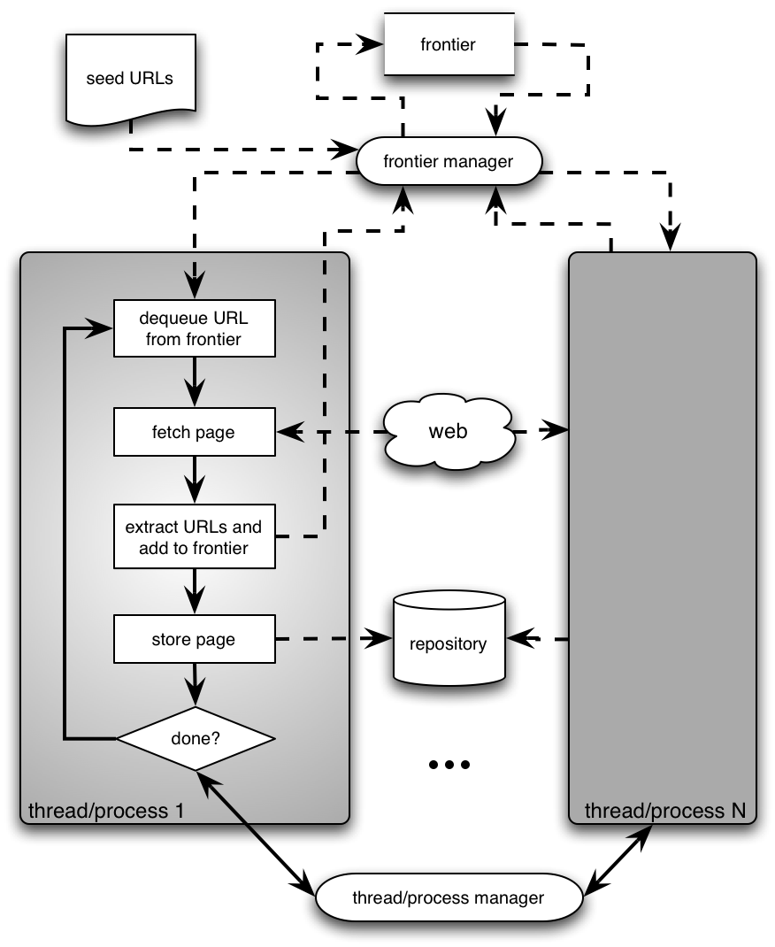
Architecture of a concurrent crawler

Slide 30
Concurrent crawlers
Can use multi-processing or multi-threading
Each process or thread works like a sequential crawler, except they share data structures: frontier and repository
Shared data structures must be synchronized (locked for concurrent writes)
Speedup of factor of 5-10 are easy this way

Slide 31
Outline
Motivation and taxonomy of crawlers
Basic crawlers and implementation issues
Universal crawlers
Preferential (focused and topical) crawlers
Evaluation of preferential crawlers
Crawler ethics and conflicts
New developments: social, collaborative, federated crawlers

Slide 32
Universal crawlers
Support universal search engines
Large-scale
Huge cost (network bandwidth) of crawl is amortized over many queries from users
Incremental updates to existing index and other data repositories

Slide 33
Large-scale universal crawlers
Two major issues:
Performance
  Need to scale up to billions of pages
Policy
  Need to trade-off coverage, freshness, and bias (e.g. toward “important” pages)

Slide 34
Large-scale crawlers: scalability
Need to minimize overhead of DNS lookups
Need to optimize utilization of network bandwidth and disk throughput (I/O is bottleneck)
Use asynchronous sockets
  Multi-processing or multi-threading do not scale up to billions of pages
  Non-blocking: hundreds of network connections open simultaneously
  Polling socket to monitor completion of network transfers

Slide 35
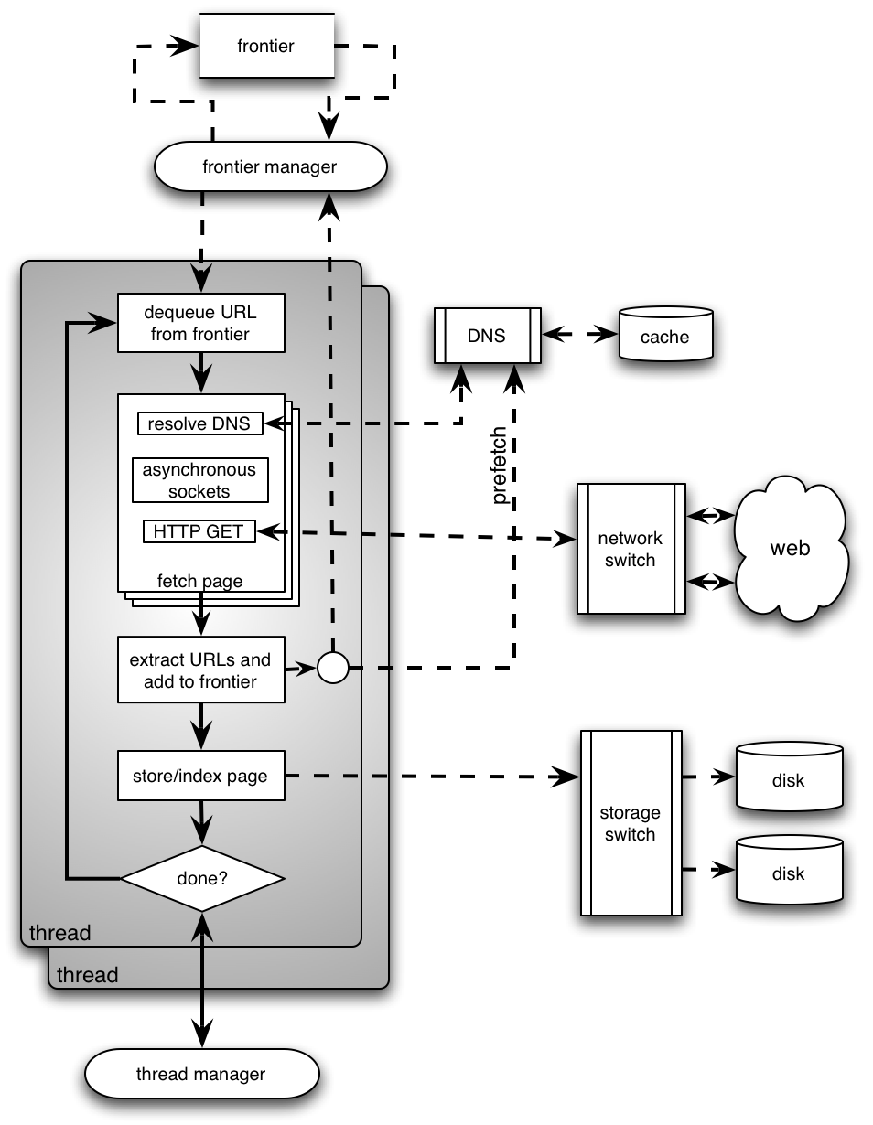
High-level architecture of a scalable universal crawler
Several parallel queues to spread load across servers (keep connections alive)
DNS server using UDP (less overhead than TCP), large persistent in-memory cache, and prefetching
Optimize use of network bandwidth
Huge farm of crawl machines
Optimize disk I/O throughput

Slide 36
Universal crawlers: Policy
Coverage
  New pages get added all the time
  Can the crawler find every page?
Freshness
  Pages change over time, get removed, etc.
  How frequently can a crawler revisit ?
Trade-off!
  Focus on most “important” pages (crawler bias)?
  “Importance” is subjective

Slide 37
Web coverage by search engine crawlers
This assumes we know the size of the entire the Web. Do we? Can you define “the size of the Web”?

Slide 38
Maintaining a “fresh” collection
Universal crawlers are never “done”
High variance in rate and amount of page changes
HTTP headers are notoriously unreliable
  Last-modified
  Expires
Solution
  Estimate the probability that a previously visited page has changed in the meanwhile
  Prioritize by this probability estimate

Slide 39
Estimating page change rates
Algorithms for maintaining a crawl in which most pages are fresher than a specified epoch
  Brewington & Cybenko; Cho, Garcia-Molina & Page
Assumption: recent past predicts the future (Ntoulas, Cho & Olston 2004)
  Frequency of change not a good predictor
  Degree of change is a better predictor

Slide 40
Do we need to crawl the entire Web?
If we cover too much, it will get stale
There is an abundance of pages in the Web
For PageRank, pages with very low prestige are largely useless
What is the goal?
  General search engines: pages with high prestige
  News portals: pages that change often
  Vertical portals: pages on some topic
What are appropriate priority measures in these cases? Approximations?

Slide 41
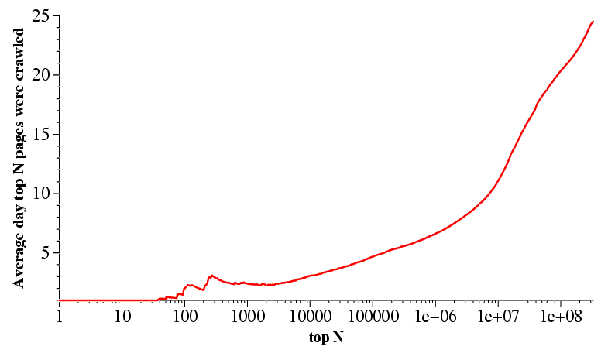
Breadth-first crawlers
BF crawler tends to crawl high-PageRank pages very early
Therefore, BF crawler is a good baseline to gauge other crawlers
But why is this so?
Najork and Weiner 2001

Slide 42
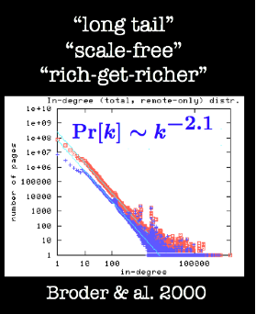
Bias of breadth-first crawlers
The structure of the Web graph is very different from a random network
Power-law distribution of in-degree
Therefore there are hub pages with very high PR and many incoming links
These are attractors: you cannot avoid them!

Slide 43
Outline
Motivation and taxonomy of crawlers
Basic crawlers and implementation issues
Universal crawlers
Preferential (focused and topical) crawlers
Evaluation of preferential crawlers
Crawler ethics and conflicts
New developments: social, collaborative, federated crawlers

Slide 44
Preferential crawlers
Assume we can estimate for each page an importance measure, I(p)
Want to visit pages in order of decreasing I(p)
Maintain the frontier as a priority queue sorted by I(p)
precision is the fraction of retrieved instances that are relevant, while recall is the fraction of relevant instances that are retrieved.
Possible figures of merit:
  Precision ~
  | p: crawled(p) & I(p) > threshold | / | p: crawled(p) |
  Recall ~
  | p: crawled(p) & I(p) > threshold | / | p: I(p) > threshold |

Slide 45
Preferential crawlers
Selective bias toward some pages, eg. most “relevant”/topical, closest to seeds, most popular/largest PageRank, unknown servers, highest rate/amount of change, etc…
Focused crawlers
  Supervised learning: classifier based on labeled examples
Topical crawlers
  Best-first search based on similarity(topic, parent)
  Adaptive crawlers
    Reinforcement learning
    Evolutionary algorithms/artificial life

Slide 46
Preferential crawling algorithms: Examples
Breadth-First
  Exhaustively visit all links in order encountered
Best-N-First
  Priority queue sorted by similarity, explore top N at a time
  Variants: DOM context, hub scores
PageRank
  Priority queue sorted by keywords, PageRank
SharkSearch
  Priority queue sorted by combination of similarity, anchor text, similarity of parent, etc. (powerful cousin of FishSearch)
InfoSpiders
  Adaptive distributed algorithm using an evolving population of learning agents

Slide 47
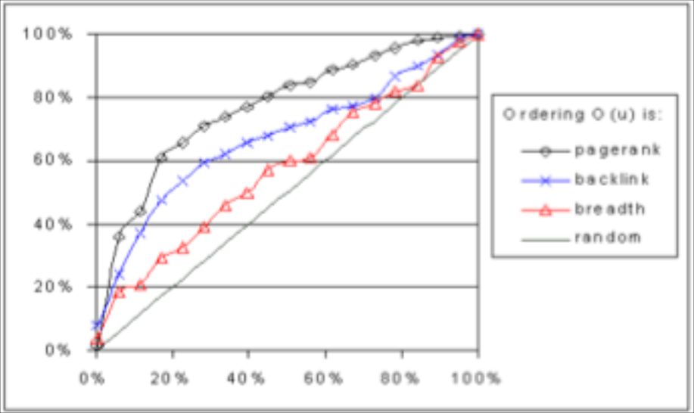
Preferential crawlers: Examples
For I(p) = PageRank (estimated based on pages crawled so far), we can find high-PR pages faster than a breadth-first crawler (Cho, Garcia-Molina & Page 1998)
Recall
Crawl size

Slide 48
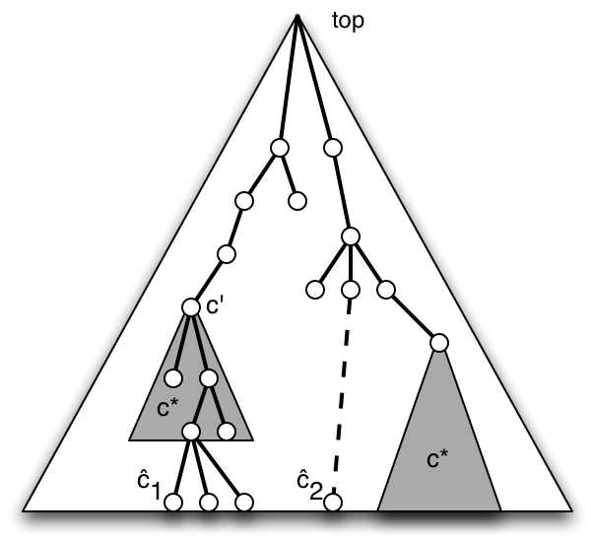
Focused crawlers: Basic idea
Naïve-Bayes classifier based on example pages in desired topic, c*
Score(p) = Pr(c*|p)
  Soft focus: frontier is priority queue using page score
  Hard focus:
    Find best leaf ĉ for p
    If an ancestor c’ of ĉ is in c* then add links from p to frontier, else discard
  Soft and hard focus work equally well empirically
Example: Open Directory

Slide 49
Focused crawlers
Can have multiple topics with as many classifiers, with scores appropriately combined (Chakrabarti et al. 1999)
Can use a distiller to find topical hubs periodically, and add these to the frontier
Can accelerate with the use of a critic (Chakrabarti et al. 2002)
Can use alternative classifier algorithms to naïve-Bayes, e.g. SVM and neural nets have reportedly performed better (Pant & Srinivasan 2005)

Slide 50
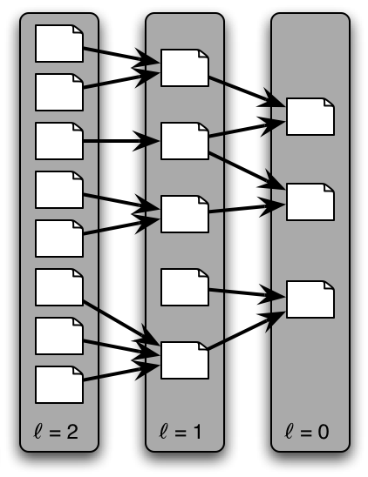
Context-focused crawlers
Same idea, but multiple classes (and classifiers) based on link distance from relevant targets
  ℓ=0 is topic of interest
  ℓ=1 link to topic of interest
  Etc.
Initially needs a back-crawl from seeds (or known targets) to train classifiers to estimate distance
Links in frontier prioritized based on estimated distance from targets
Outperforms standard focused crawler empirically
Context graph

Slide 51
Topical crawlers
For many preferential crawling tasks, labeled (positive and negative)
examples of pages are not available in sufficient numbers to train a
focused crawler before the crawl starts. Instead, we typically have a small
set of seed pages and a description of a topic of interest to a user or user
community. The topic can consist of one or more example pages (possibly
the seeds) or even a short query. Preferential crawlers that start with only
such information are often called topical crawlers [8, 14, 38]. They do not
have text classifiers to guide crawling.
All we have is a topic (query, description, keywords) and a set of seed pages (not necessarily relevant)
No labeled examples
Must predict relevance of unvisited links to prioritize
Original idea: Menczer 1997, Menczer & Belew 1998

Slide 52
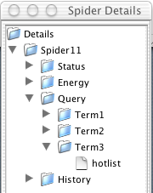
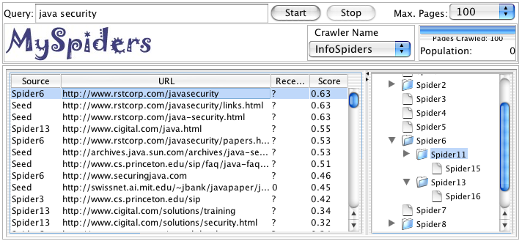

Example: myspiders.informatics.indiana.edu

Slide 53
Topical locality
Topical locality is a necessary condition for a topical crawler to work, and for surfing to be a worthwhile activity for humans
Links must encode semantic information, i.e. say something about neighbor pages, not be random
It is also a sufficient condition if we start from “good” seed pages
Indeed we know that Web topical locality is strong :
  Indirectly (crawlers work and people surf the Web)
  From direct measurements (Davison 2000; Menczer 2004, 2005)

Slide 54
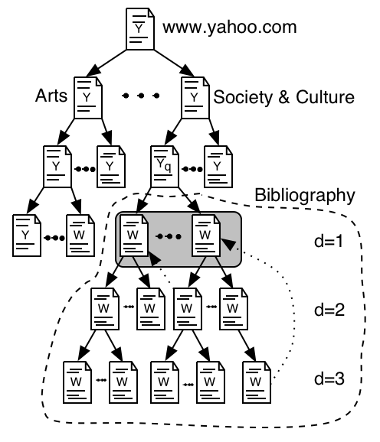
Quantifying topical locality
Different ways to pose the question:
  How quickly does semantic locality decay?
  How fast is topic drift?
  How quickly does content change as we surf away from a starting page?
To answer these questions, let us consider exhaustive breadth-first crawls from 100 topic pages

Slide 55
The “link-cluster” conjecture
Connection between semantic topology (relevance) and link topology (hypertext)
  G = Pr[rel(p)] ~ fraction of relevant/topical pages (topic generality)
  R = Pr[rel(p) | rel(q) AND link(q,p)] ~ cond. prob. Given neighbor on topic
Related nodes are clustered if R > G
  Necessary and
  sufficient
  condition for a
  random crawler
  to find pages related
  to start points
  Example:
  2 topical clusters
  with stronger
  modularity within
  each cluster than outside
G = 5/15
C = 2
R = 3/6
= 2/4

Slide 56
Link-cluster conjecture
Stationary hit rate for a random crawler:
Conjecture
Value added of links

Slide 57
Link-cluster conjecture
Preservation of semantics (meaning) across links
1000 times more likely to be on topic if near an on-topic page!

Slide 58
The “link-content” conjecture
Correlation of lexical (content) and linkage topology
L(δ): average link distance
S(δ): average content similarity to start (topic) page from pages up to distance δ
Correlation ρ(L,S) = –0.76

Slide 59
Heterogeneity of link-content correlation
edu
net
gov
org
.com has more drift
com
signif. diff. a only (α=0.05)
signif. diff. a & b (α=0.05)

Slide 60
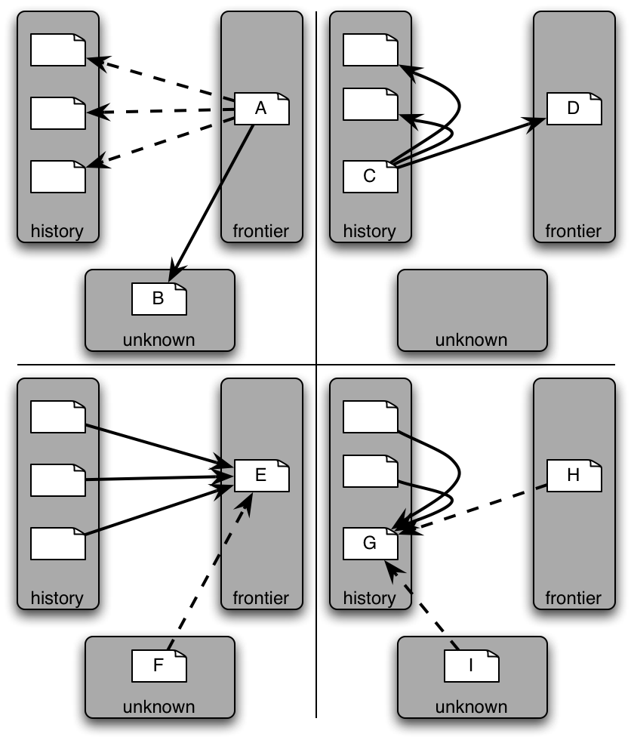
Topical locality-inspired tricks for topical crawlers
Co-citation (a.k.a. sibling locality): A and C are good hubs, thus A and D should be given high priority
Co-reference (a.k.a. blbliographic coupling):
E and G are good authorities, thus E and H should be given high priority

Slide 61
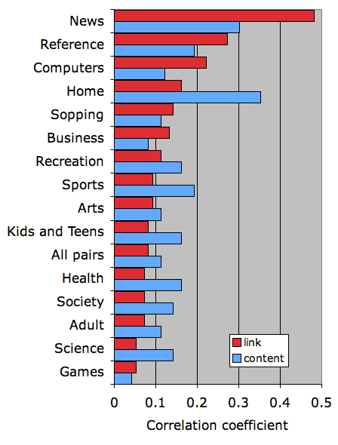
Correlations between different similarity measures
Semantic similarity measured from ODP, correlated with:
  Content similarity: TF or TF-IDF vector cosine
  Link similarity: Jaccard coefficient of (in+out) link neighborhoods
Correlation overall is significant but weak
Much stronger topical locality in some topics, e.g.:
  Links very informative in news sources
  Text very informative in recipes

Slide 62
Naïve Best-First
BestFirst(topic, seed_urls) {
foreach link (seed_urls) {
enqueue(frontier, link);
}
while (#frontier > 0 and visited < MAX_PAGES) {
link := dequeue_link_with_max_score(frontier);
doc := fetch_new_document(link);
score := sim(topic, doc);
foreach outlink (extract_links(doc)) {
if (#frontier >= MAX_BUFFER) {
dequeue_link_with_min_score(frontier);
}
enqueue(frontier, outlink, score);
}
}
}
Simplest topical crawler: Frontier is priority queue based on text similarity between topic and parent page

Slide 63
Best-first variations
Many in literature, mostly stemming from different ways to score unvisited URLs. E.g.:
  Giving more importance to certain HTML markup in parent page
  Extending text representation of parent page with anchor text from “grandparent” pages (SharkSearch)
  Limiting link context to less than entire page
  Exploiting topical locality (co-citation)
  Exploration vs exploitation: relax priorities
Any of these can be (and many have been) combined

Slide 64
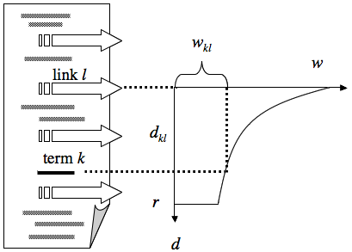
Link context based on text neighborhood
Often consider a fixed-size window, e.g. 50 words around anchor
Can weigh links based on their distance from topic keywords within the document (InfoSpiders, Clever)
Anchor text deserves extra importance

Slide 65
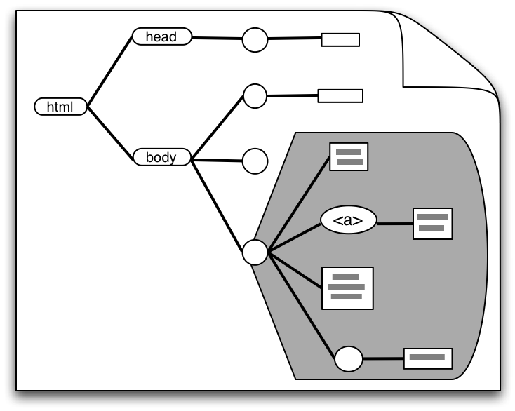
Link context based on DOM tree
Consider DOM subtree rooted at parent node of link’s <a> tag
Or can go further up in the tree (Naïve Best-First is special case of entire document body)
Trade-off between noise due to too small or too large context tree (Pant 2003)

Slide 66
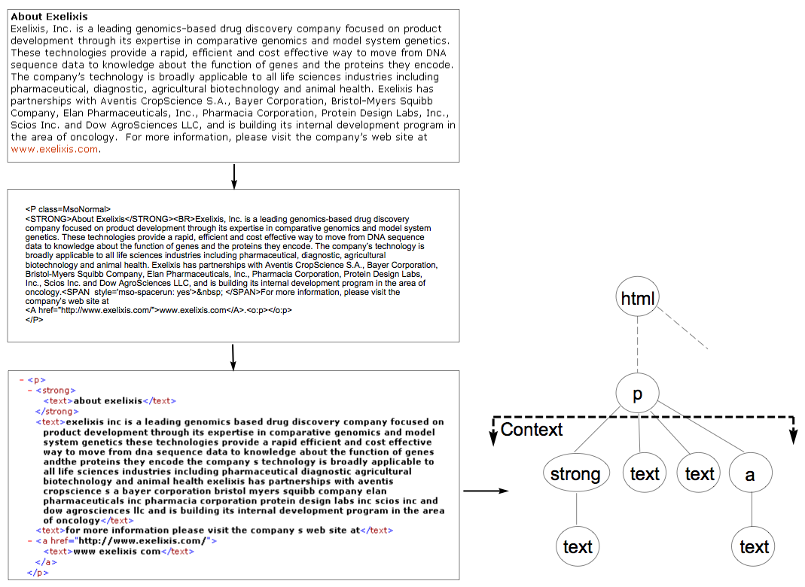
DOM context
Link score = linear combination between page-based and context-based similarity score

Slide 67
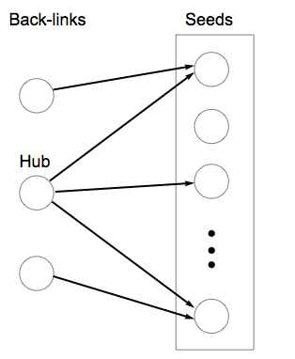
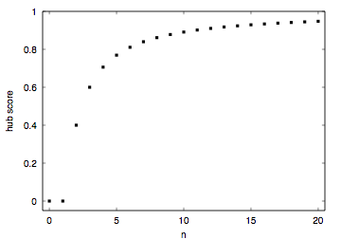
Co-citation: hub scores
Link score_{hub} = linear combination between link and hub score
Number of seeds linked from page

Slide 68
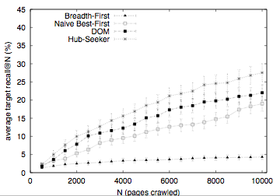
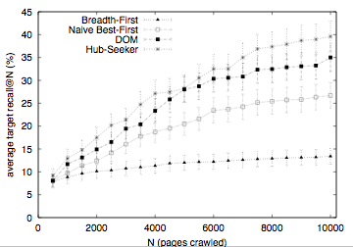
Combining DOM context and hub scores
Split ODP URLs between seeds and targets
Add 10 best hubs to seeds for 94 topics
Experiment based on 159 ODP topics (Pant & Menczer 2003)

Slide 69
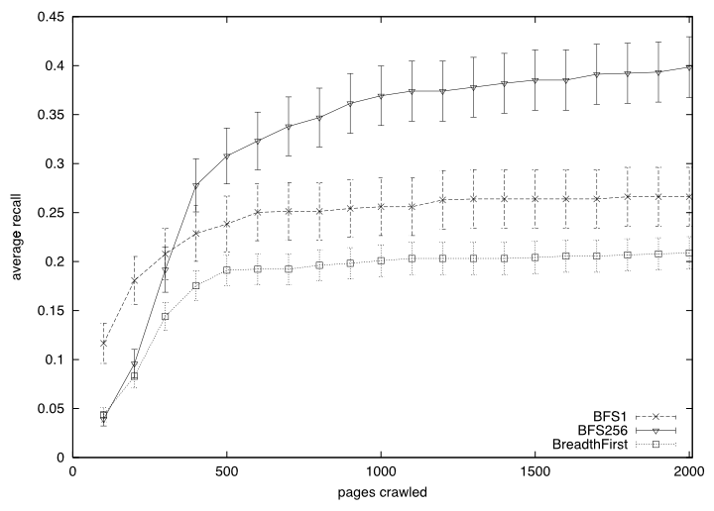
Exploration vs Exploitation
Best-N-First (or BFSN)
Rather than re-sorting the frontier every time you add links, be lazy and sort only every N pages visited
Empirically, being less greedy helps crawler performance significantly: escape “local topical traps” by exploring more
Pant et al. 2002

Slide 70
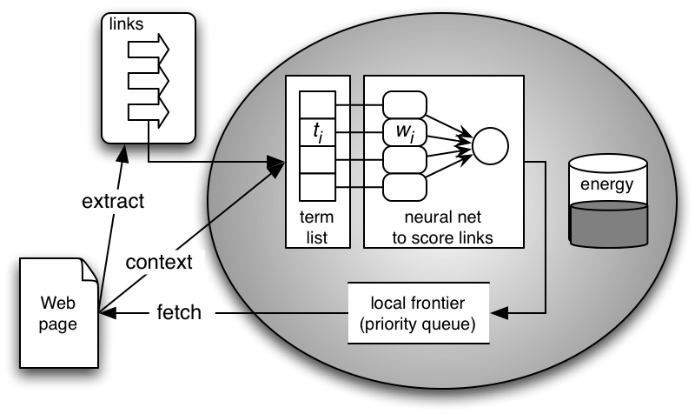
InfoSpiders
A series of intelligent multi-agent topical crawling algorithms employing various adaptive techniques:
  Evolutionary bias of exploration/exploitation
  Selective query expansion
  (Connectionist) reinforcement learning
Menczer & Belew 1998, 2000; Menczer et al. 2004

Slide 71
Link scoring and selection by each crawling agent

Slide 72
Artificial life-inspired Evolutionary Local Selection Algorithm (ELSA)
Foreach agent thread:
Pick & follow link from local frontier
Evaluate new links, merge frontier
Adjust link estimator
E := E + payoff - cost
    If E < 0:
    Die
    Elsif E > Selection_Threshold:
    Clone offspring
    Split energy with offspring
    Split frontier with offspring
    Mutate offspring
Reinforcement
learning
match
resource
bias
selective
query
expansion

Slide 73
Adaptation in InfoSpiders
Unsupervised population evolution
  Select agents to match resource bias
  Mutate internal queries: selective query expansion
  Mutate weights
Unsupervised individual adaptation
  Q-learning: adjust neural net weights to predict relevance locally

Slide 74

InfoSpiders evolutionary bias: an agent in a relevant area will spawn other agents to exploit/explore that neighborhood
local frontier
keyword
vector
neural net
offspring

Slide 75
Multithreaded InfoSpiders (MySpiders)
Different ways to compute the cost of visiting a document:
  Constant: cost_{const} = E₀ p₀ / T_{max}
  Proportional to download time:
  cost_{time} = f(cost_{const} t / timeout)
The latter is of course more efficient (faster crawling), but it also yields better quality pages!

Slide 76
Selective Query Expansion in InfoSpiders:
Internalization of local text features
When a new agent is spawned, it picks up a common term from the current page (here ‘th’)
POLIT
0.84
CONSTITUT
0.18
TH
0.31
0.99
SYSTEM
0.22
GOVERN
0.19

Slide 77
Reinforcement Learning
In general, reward function R: S  A ➔ ℜ
Learn policy (π: S ➔ A) to maximize reward over time, typically discounted in the future:
Q-learning: optimal policy
a1
s1
s
s2
a2
Value of following optimal policy in future

Slide 78
Q-learning in InfoSpiders
Use neural nets to estimate Q scores
Compare estimated relevance of visited page with Q score of link estimated from parent page to obtain feedback signal
Learn neural net weights using back-propagation of error with teaching input: E(D) + γ max_{l(D)} λ_{l}

Slide 79
Other Reinforcement Learning Crawlers
Rennie & McCallum (1999):
  Naïve-Bayes classifier trained on text nearby links in pre-labeled examples to estimate Q values
  Immediate reward R=1 for “on-topic” pages (with desired CS papers for CORA repository)
  All RL algorithms outperform Breath-First Search
Future discounting: “For spidering, it is always better to choose immediate over delayed rewards” -- Or is it?
  But we cannot possibly cover the entire search space, and recall that by being greedy we can be trapped in local topical clusters and fail to discover better ones
  Need to explore!

Slide 80
Outline
Motivation and taxonomy of crawlers
Basic crawlers and implementation issues
Universal crawlers
Preferential (focused and topical) crawlers
Evaluation of preferential crawlers
Crawler ethics and conflicts
New developments: social, collaborative, federated crawlers

Slide 81
Evaluation of topical crawlers
Goal: build “better” crawlers to support applications (Srinivasan & al. 2005)
Build an unbiased evaluation framework
  Define common tasks of measurable difficulty
  Identify topics, relevant targets
  Identify appropriate performance measures
    Effectiveness: quality of crawler pages, order, etc.
    Efficiency: separate CPU & memory of crawler algorithms from bandwidth & common utilities
Notes:
-A “good” crawler would make “good” choices and hence retrieve “good” pages early.
-how do we measure the “goodness” of crawlers?
-some work on evaluation has been done but is often limited in terms of number of topics or same set of measures are used to crawl and to evaluate.

Slide 82
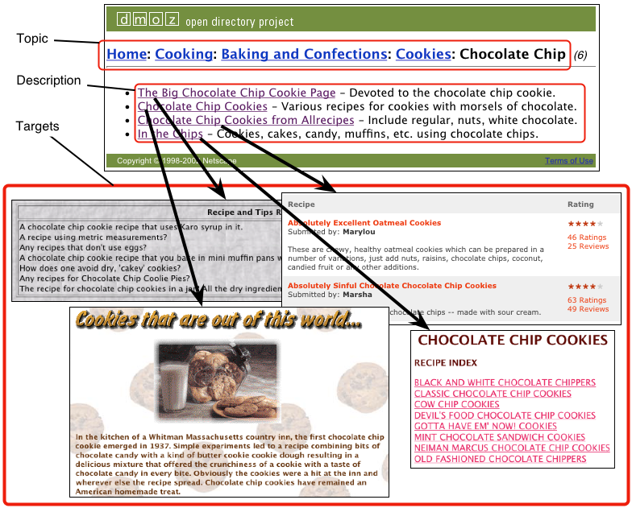
Evaluation corpus = ODP + Web
Automate evaluation using edited directories
Different sources of relevance assessments

Slide 83
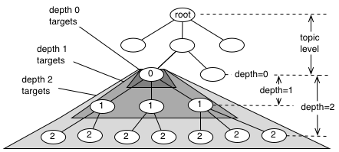
Topics and Targets
topic level ~ specificity
depth ~ generality

Slide 84
Tasks
Start from seeds, find targets
and/or pages similar to target descriptions
d=2
d=3
Back-crawl from targets to get seeds

Slide 85
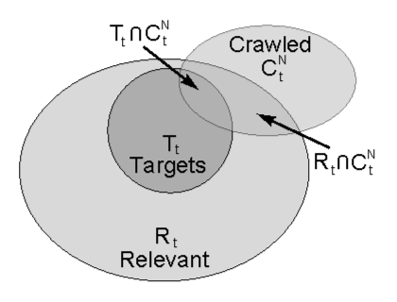
Target based performance measures
Q: What assumption are we making?
A: Independence!…

Slide 86
Performance matrix
target
pages
target
descriptions
target
depth
d=2
d=1
d=0
“recall”
“precision”

Slide 87
Crawling evaluation framework
Keywords
Seed URLs
Main
Crawler 1
Logic
Crawler N
Logic
Private Data
Structures
(limited resource)
Common
Data
Structures
URL
Concurrent Fetch/Parse/Stem Modules
Web
HTTP
HTTP
HTTP

Slide 88
Using framework to compare crawler performance
_{Average target page recall}
_{Pages crawled}

Slide 89
Efficiency & scalability
_{Performance/cost}
_{Link frontier size}

Slide 90
Topical crawler performance depends on topic characteristics
C = target link cohesiveness
A = target authoritativeness
P = popularity (topic kw generality)
L = seed-target similarity
Target pages
Target descriptions
Crawler
C
A
P
L
C
A
P
L
BreadthFirst
+
+
+
+
BFS-1
+
+
+
BFS-256
+
+
+
InfoSpiders
+
+
+
+

Slide 91
Outline
Motivation and taxonomy of crawlers
Basic crawlers and implementation issues
Universal crawlers
Preferential (focused and topical) crawlers
Evaluation of preferential crawlers
Crawler ethics and conflicts
New developments: social, collaborative, federated crawlers

Slide 92
Crawler ethics and conflicts
Crawlers can cause trouble, even unwillingly, if not properly designed to be “polite” and “ethical”
For example, sending too many requests in rapid succession to a single server can amount to a Denial of Service (DoS) attack!
  Server administrator and users will be upset
  Crawler developer/admin IP address may be blacklisted

Slide 93
Crawler etiquette (important!)
Identify yourself
  Use ‘User-Agent’ HTTP header to identify crawler, website with description of crawler and contact information for crawler developer
  Use ‘From’ HTTP header to specify crawler developer email
  Do not disguise crawler as a browser by using their ‘User-Agent’ string
Always check that HTTP requests are successful, and in case of error, use HTTP error code to determine and immediately address problem
Pay attention to anything that may lead to too many requests to any one server, even unwillingly, e.g.:
  redirection loops
  spider traps

Slide 94
Crawler etiquette (important!)
Spread the load, do not overwhelm a server
  Make sure that no more than some max. number of requests to any single server per unit time, say < 1/second
Honor the Robot Exclusion Protocol
  A server can specify which parts of its document tree any crawler is or is not allowed to crawl by a file named ‘robots.txt’ placed in the HTTP root directory, e.g. http://www.indiana.edu/robots.txt
  Crawler should always check, parse, and obey this file before sending any requests to a server
  More info at:
    http://www.google.com/robots.txt
    http://www.robotstxt.org/wc/exclusion.html

Slide 95
More on robot exclusion
Make sure URLs are canonical before checking against robots.txt
Avoid fetching robots.txt for each request to a server by caching its policy as relevant to this crawler
Let’s look at some examples to understand the protocol…

Slide 96
www.apple.com/robots.txt
# robots.txt for http://www.apple.com/
User-agent: *
Disallow:
All crawlers…
…can go anywhere!

Slide 97
www.microsoft.com/robots.txt
# Robots.txt file for http://www.microsoft.com
User-agent: *
Disallow: /canada/Library/mnp/2/aspx/
Disallow: /communities/bin.aspx
Disallow: /communities/eventdetails.mspx
Disallow: /communities/blogs/PortalResults.mspx
Disallow: /communities/rss.aspx
Disallow: /downloads/Browse.aspx
Disallow: /downloads/info.aspx
Disallow: /france/formation/centres/planning.asp
Disallow: /france/mnp_utility.mspx
Disallow: /germany/library/images/mnp/
Disallow: /germany/mnp_utility.mspx
Disallow: /ie/ie40/
Disallow: /info/customerror.htm
Disallow: /info/smart404.asp
Disallow: /intlkb/
Disallow: /isapi/
#etc…
All crawlers…
…are not allowed in these paths…

Slide 98
www.springer.com/robots.txt
# Robots.txt for http://www.springer.com (fragment)
User-agent: Googlebot
Disallow: /chl/*
Disallow: /uk/*
Disallow: /italy/*
Disallow: /france/*
User-agent: slurp
Disallow:
Crawl-delay: 2
User-agent: MSNBot
Disallow:
Crawl-delay: 2
User-agent: scooter
Disallow:
# all others
User-agent: *
Disallow: /
Google crawler is allowed everywhere except these paths
Yahoo and MSN/Windows Live are allowed everywhere but should slow down
AltaVista has no limits
Everyone else keep off!

Slide 99
More crawler ethics issues
Is compliance with robot exclusion a matter of law?
  No! Compliance is voluntary, but if you do not comply, you may be blocked
  Someone (unsuccessfully) sued Internet Archive over a robots.txt related issue
Some crawlers disguise themselves
  Using false User-Agent
  Randomizing access frequency to look like a human/browser
  Example: click fraud for ads

Slide 100
More crawler ethics issues
Servers can disguise themselves, too
  Cloaking: present different content based on User-Agent
  E.g. stuff keywords on version of page shown to search engine crawler
  Search engines do not look kindly on this type of “spamdexing” and remove from their index sites that perform such abuse
    Case of bmw.de made the news

Slide 101
Gray areas for crawler ethics
If you write a crawler that unwillingly follows links to ads, are you just being careless, or are you violating terms of service, or are you violating the law by defrauding advertisers?
  Is non-compliance with Google’s robots.txt in this case equivalent to click fraud?
If you write a browser extension that performs some useful service, should you comply with robot exclusion?

Slide 102
Outline
Motivation and taxonomy of crawlers
Basic crawlers and implementation issues
Universal crawlers
Preferential (focused and topical) crawlers
Evaluation of preferential crawlers
Crawler ethics and conflicts
New developments

Slide 103
New developments: social, collaborative, federated crawlers
Idea: go beyond the “one-fits-all” model of centralized search engines
Extend the search task to anyone, and distribute the crawling task
Each search engine is a peer agent
Agents collaborate by routing queries and results

Slide 104

6S: Collaborative Peer Search
WWW
bookmarks
Crawler
Index
Peer
query
query
local
storage
query
A
query
B
query
hit
hit
C
Data mining & referral
opportunities
Emerging communities

Slide 105

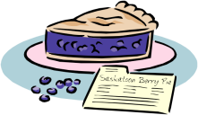






Basic idea: Learn based on prior query/response interactions

Slide 106
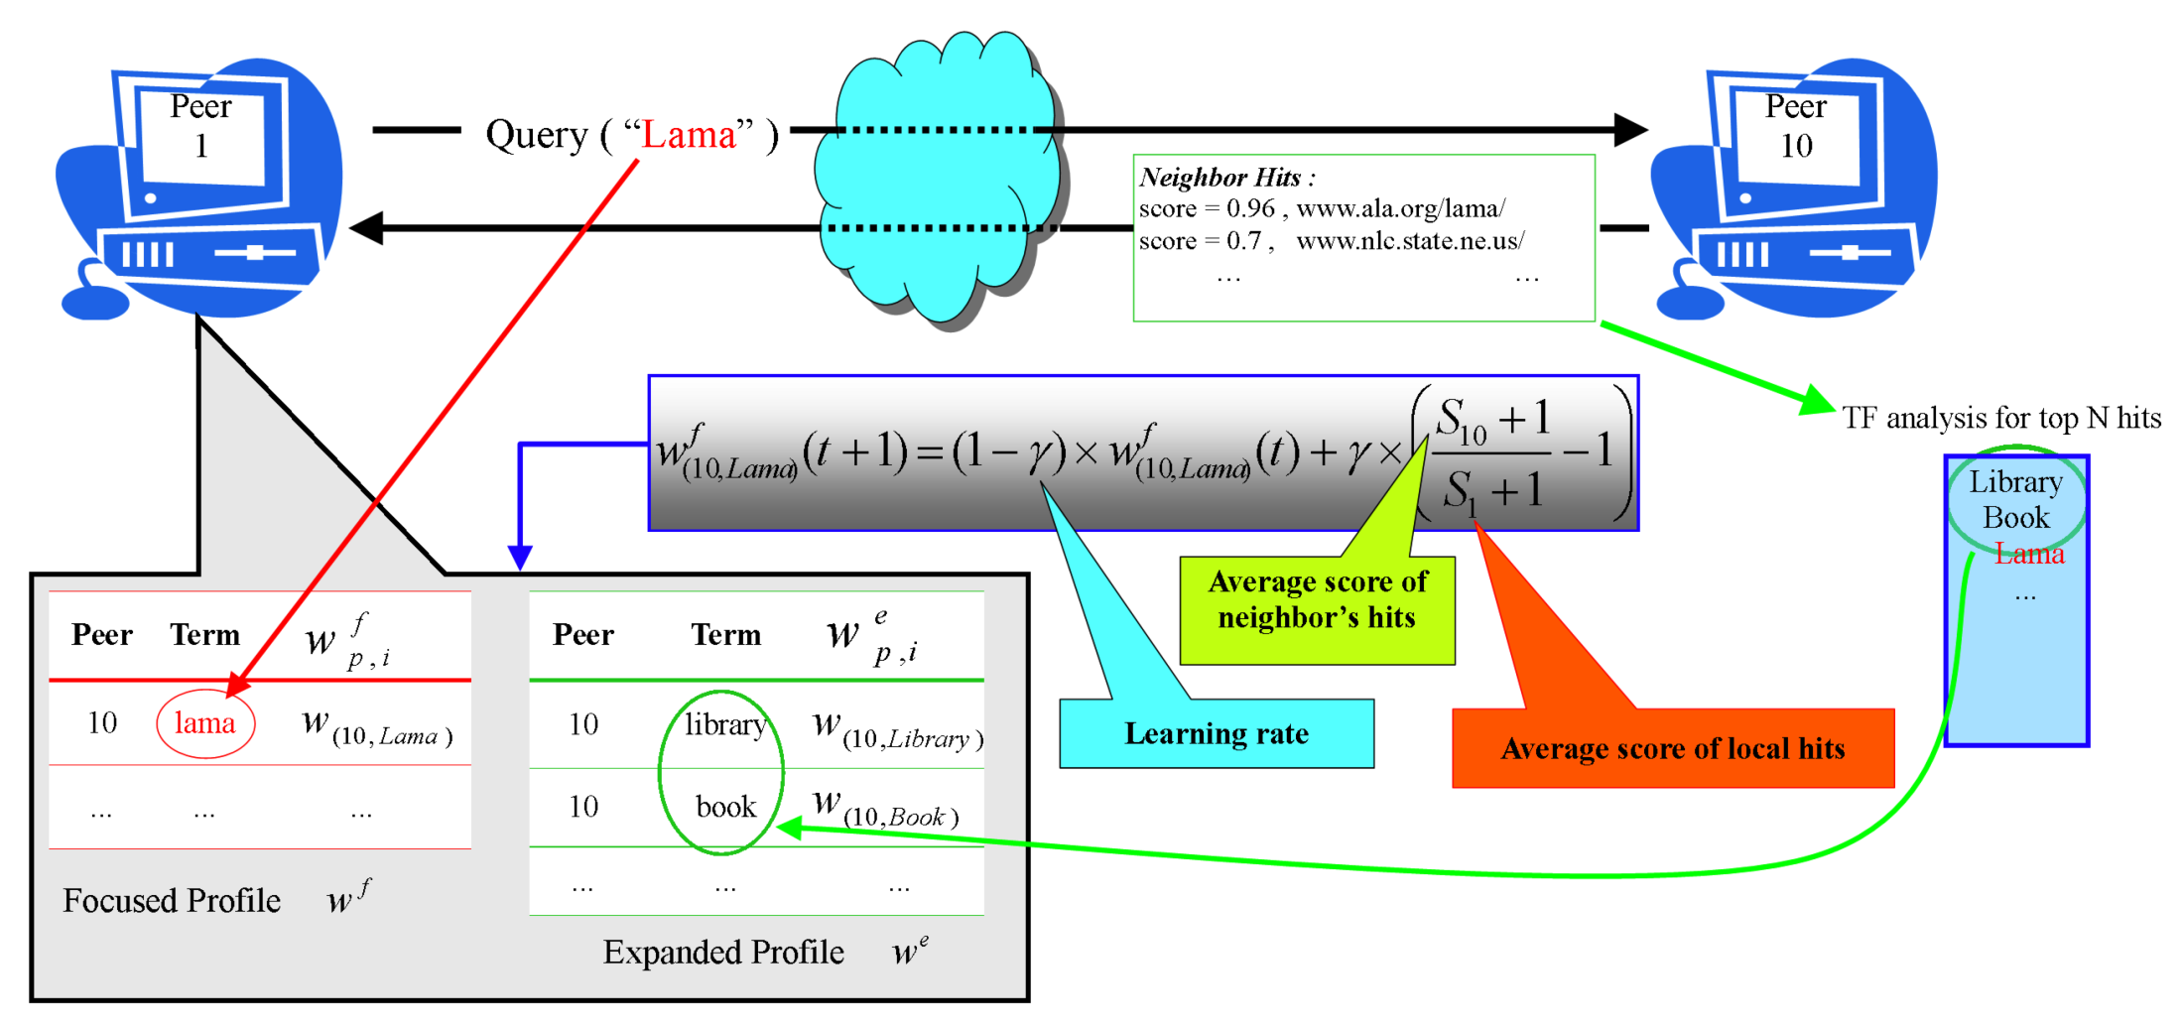
Learning about other peers

Slide 107
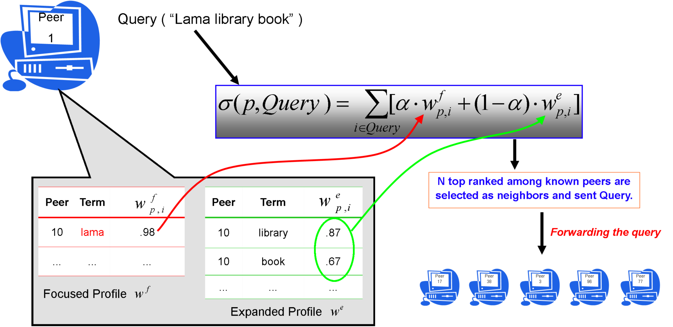
Query routing in 6S

Slide 108
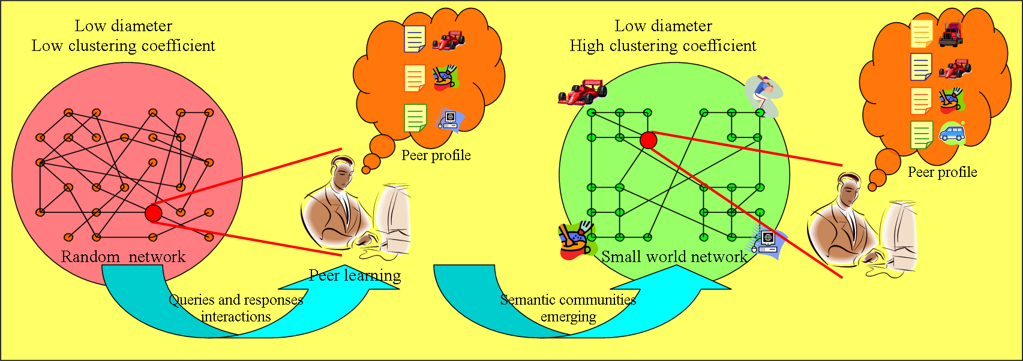
Emergent semantic clustering

Slide 109
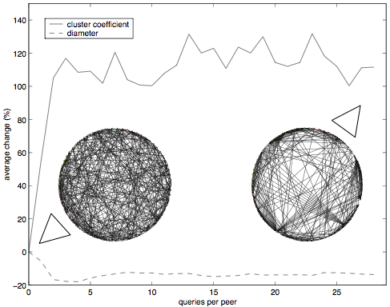
Simulation 1: 70 peers, 7 groups
The dynamic network of queries and results exchanged among 6S peer agents quickly forms a small-world, with small diameter and high clustering (Wu & al. 2005)

Slide 110





Simulation 2:
500 Users
ODP (dmoz.org)
Each synthetic user associated with a topic

Slide 111
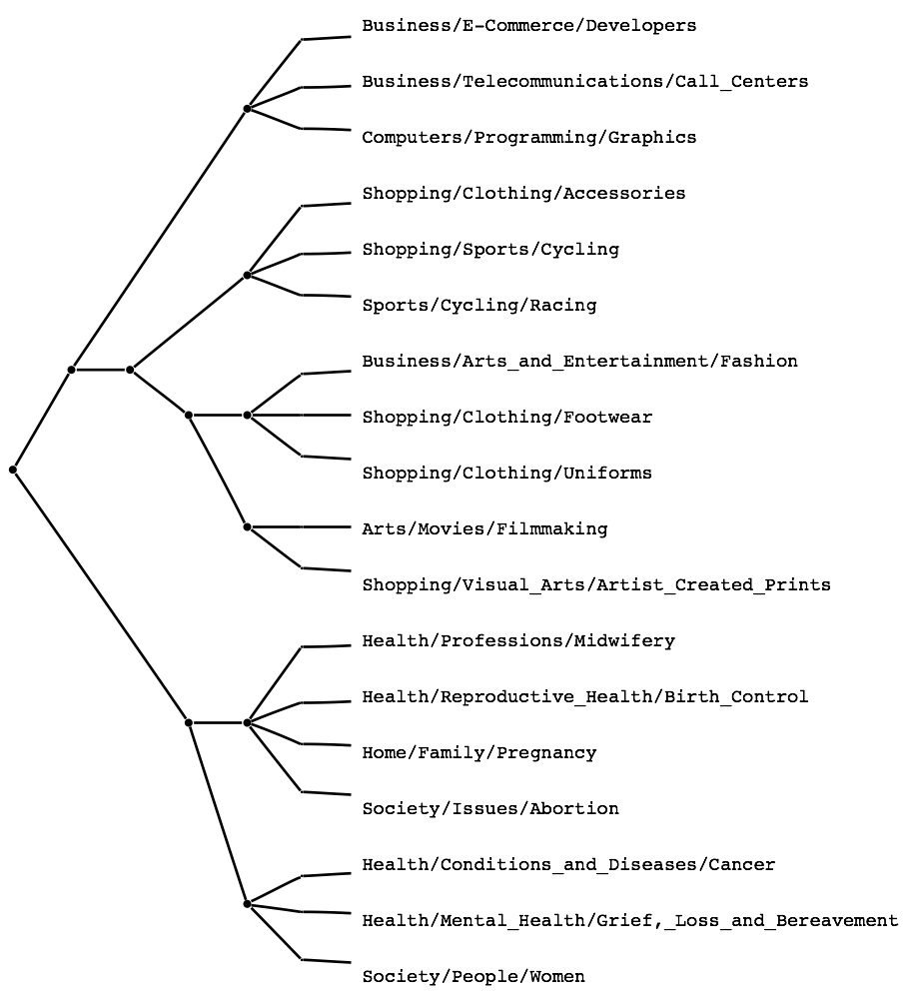
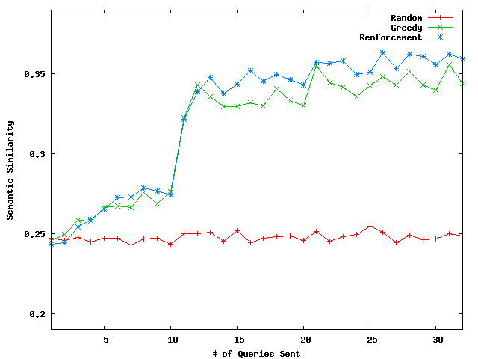
Semantic similarity
Peers with similar interests are more likely to talk to each other (Akavipat & al. 2006)

Slide 112
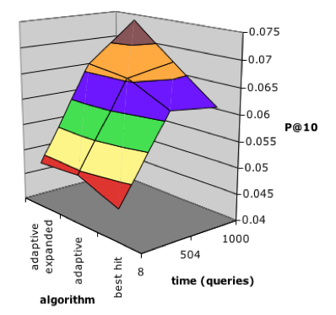
Quality of results
More sophisticated learning algorithms do better
The more interactions, the better

Slide 113
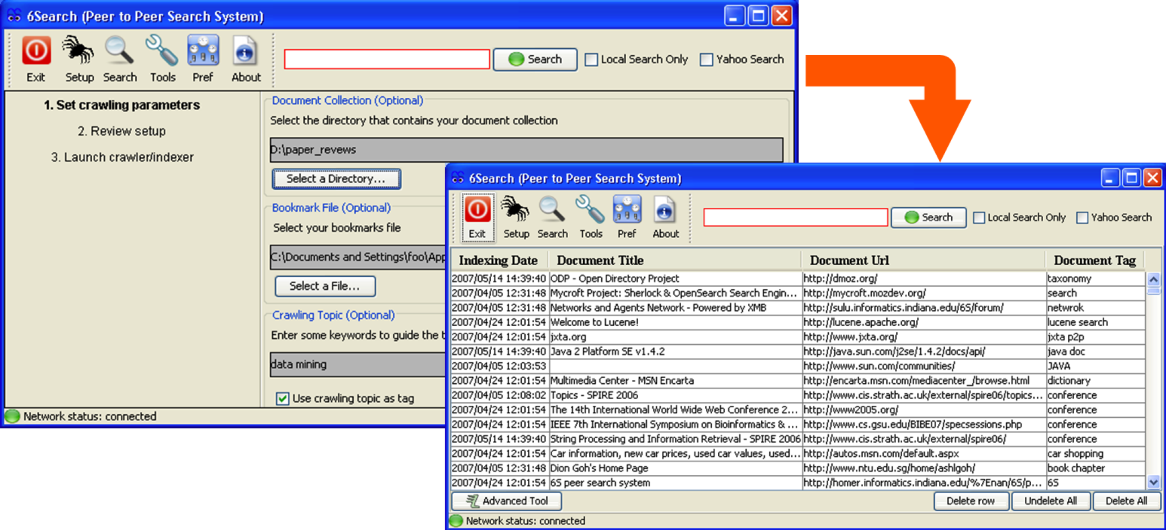
http://homer.informatics.indiana.edu/~nan/6S/
Download and try free 6S prototype:
1-click configuration of personal crawler and setup of search engine

Slide 114
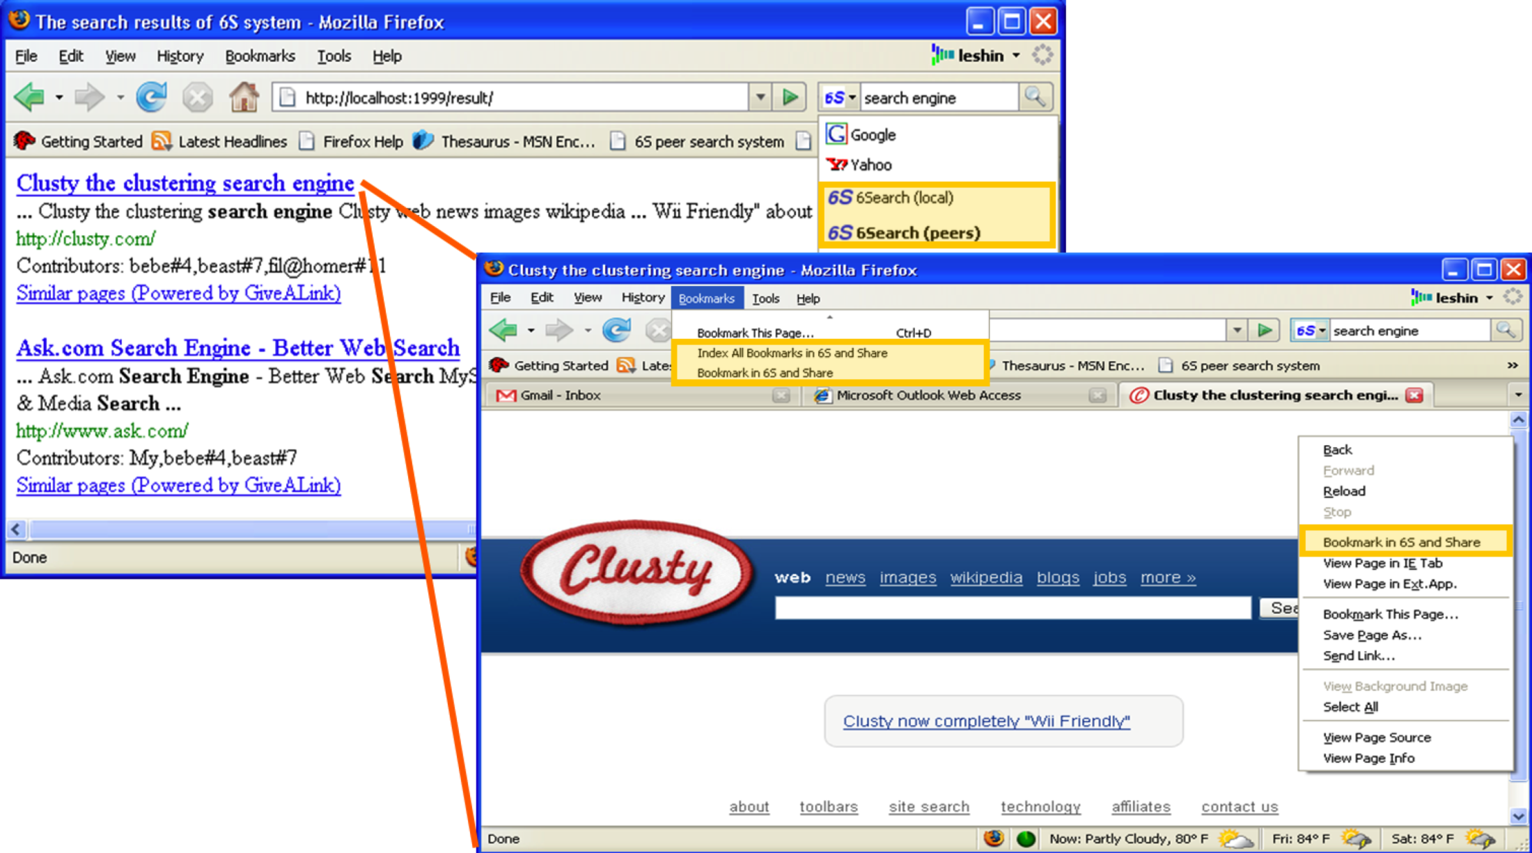
http://homer.informatics.indiana.edu/~nan/6S/
Download and try free 6S prototype:
Search via Firefox browser extension

Slide 115
Need crawling code?
Reference C implementation of HTTP, HTML parsing, etc
  w3c-libwww package from World-Wide Web Consortium: www.w3c.org/Library/
LWP (Perl)
  http://www.oreilly.com/catalog/perllwp/
  http://search.cpan.org/~gaas/libwww-perl-5.804/
Open source crawlers/search engines
  Nutch: http://www.nutch.org/ (Jakarta Lucene: jakarta.apache.org/lucene/)
  Heretrix: http://crawler.archive.org/
  WIRE: http://www.cwr.cl/projects/WIRE/
  Terrier: http://ir.dcs.gla.ac.uk/terrier/
Open source topical crawlers, Best-First-N (Java)
  http://informatics.indiana.edu/fil/IS/JavaCrawlers/
Evaluation framework for topical crawlers (Perl)
  http://informatics.indiana.edu/fil/IS/Framework/

