Slide 1
CSE 538
MRS BOOK – CHAPTER I
Boolean Model

Slide 2
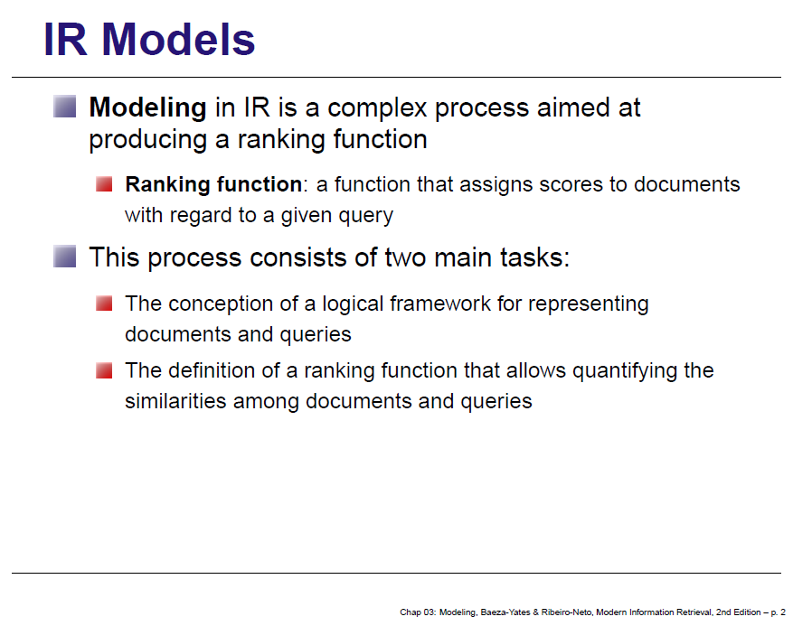

Slide 3
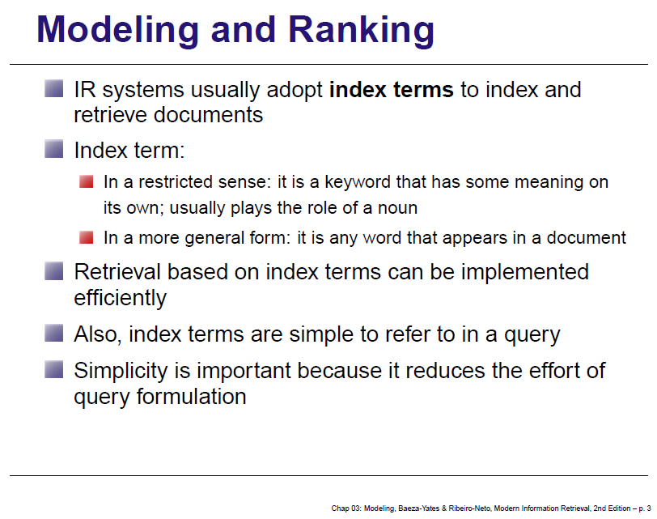

Slide 4
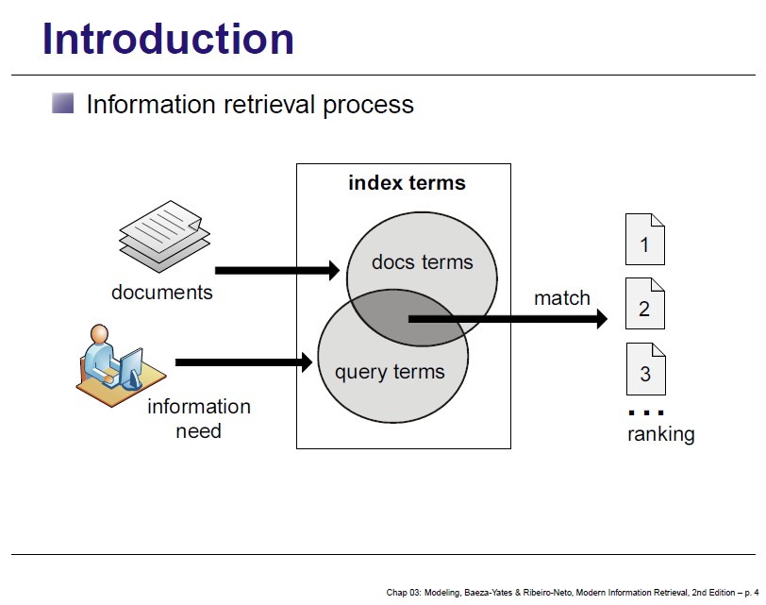

Slide 5
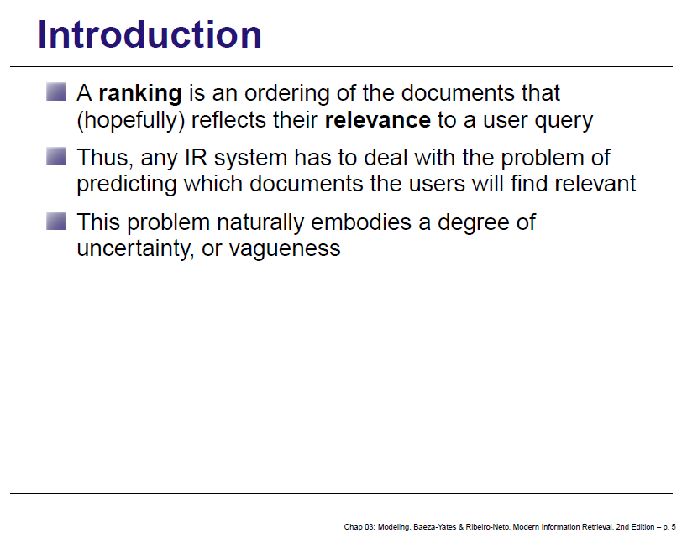

Slide 6
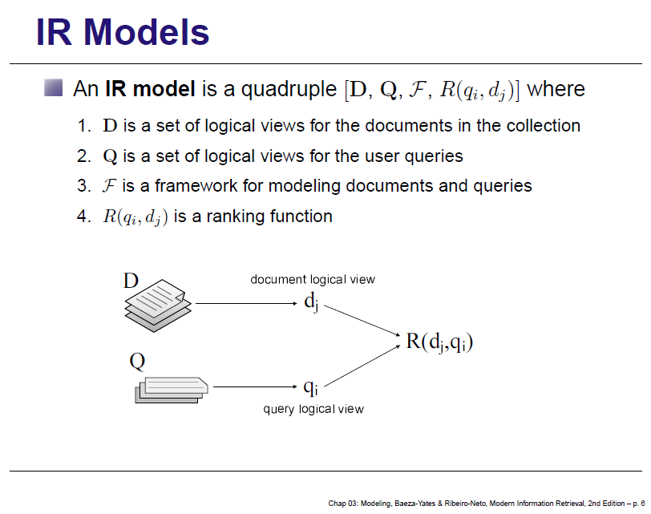

Slide 7
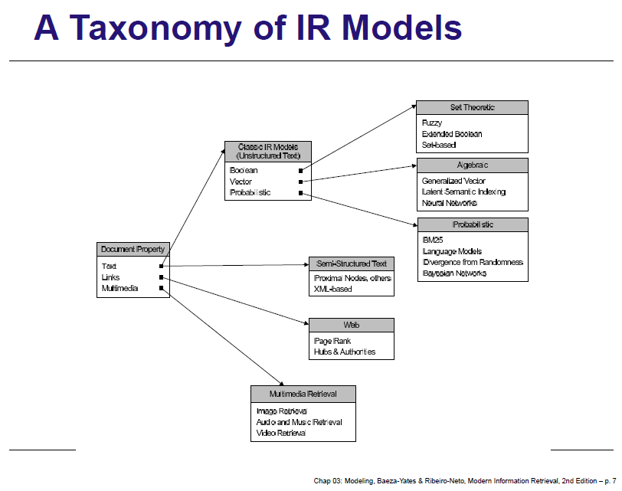

Slide 8
Boolean Retrieval
  BOOLEAN MODEL
  OR BOOLEAN RETRIEVAL
  CHAPTER I FROM IRBOOK
  Boolean Retrieval: Design and data structures of a simple information retrieval system

Slide 9
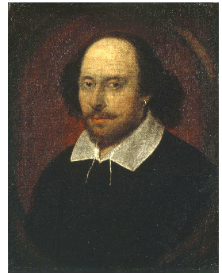
Unstructured data in 1680
A fat book which many people own is Shakespeare’s Collected Works.
Suppose you wanted to determine which plays of Shakespeare contain the words Brutus AND Caesar AND NOT Calpurnia. One way to do that is to start at the beginning and to read through all the text, noting for each play whether it contains Brutus and Caesar and excluding it from consideration if it contains Calpurnia.
The simplest form of document retrieval is for a computer to do this sort of linear scan through documents. This process is commonly referred to as grepping through text, after the Unix command grep, which performs this process.

Slide 10
Unstructured data in 1680
Sec. 1.1
Which plays of Shakespeare contain the words Brutus AND Caesar but NOT Calpurnia?
One could grep all of Shakespeare’s plays for Brutus and Caesar, then strip out lines containing Calpurnia?
Why is that not the answer?
  Slow (for large corpora)
  NOT Calpurnia is non-trivial
  Other operations (e.g., find the word Romans near countrymen) not feasible
  Ranked retrieval (best documents to return)
    Later lectures
Notes:
Grep is line-oriented; IR is document oriented.

Slide 11
Term-document incidence
Sec. 1.1
1 if play contains word, 0 otherwise
Brutus AND Caesar BUT NOT Calpurnia

Slide 12
Incidence vectors
Sec. 1.1
So we have a 0/1 vector for each term.
To answer query: take the vectors for Brutus, Caesar and Calpurnia (complemented) ➔ bitwise AND.
110100 AND 110111 AND 101111 = 100100.

Slide 13
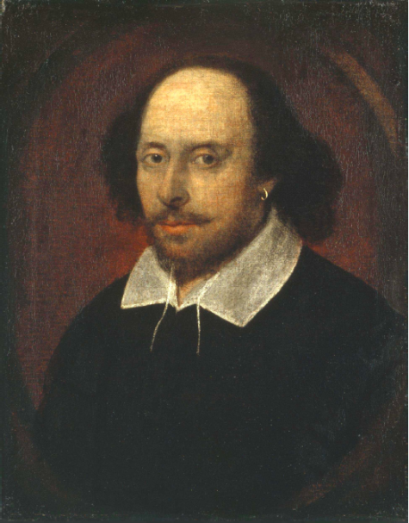
Answers to query
Sec. 1.1
Antony and Cleopatra, Act III, Scene ii
Agrippa [Aside to DOMITIUS ENOBARBUS]: Why, Enobarbus,
When Antony found Julius Caesar dead,
He cried almost to roaring; and he wept
When at Philippi he found Brutus slain.
Hamlet, Act III, Scene ii
Lord Polonius: I did enact Julius Caesar I was killed i' the
Capitol; Brutus killed me.

Slide 14
Basic assumptions of Information Retrieval
Sec. 1.1
Collection: Fixed set of documents
  Also called corpus (a body of texts)
Goal: Retrieve documents with information that is relevant to the user’s information need and helps the user complete a task

Slide 15

The classic search model
TASK
Get rid of mice in a politically correct way
Misconception?
Info Need
Info about removing mice
without killing them
Mistranslation?
Verbal form
How do I trap mice alive?
Misformulation?
Query
mouse trap
SEARCH
ENGINE
Query
Refinement
Results
Corpus

Slide 16
How good are the retrieved docs?
Sec. 1.1
Precision : Fraction of retrieved docs that are relevant to user’s information need
Recall : Fraction of relevant docs in collection that are retrieved
More precise definitions and measurements to follow in later lectures

Slide 17
Bigger collections
Sec. 1.1
Consider N = 1 million documents, each with about 1000 words.
Avg 6 bytes/word including spaces/punctuation
  6GB of data in the documents.
Say there are M = 500K distinct terms among these.

Slide 18
Can’t build the matrix
Sec. 1.1
500K x 1M matrix has half-a-trillion 0’s and 1’s.
But it has no more than one billion 1’s.
  matrix is extremely sparse.
What’s a better representation?
  We only record the 1 positions.
Why?

Slide 19
Inverted index
Sec. 1.2
For each term t, we must store a list of all documents that contain t.
  Identify each by a docID, a document serial number
Can we use fixed-size arrays for this?
Brutus
1
2
4
11
31
45
173
174
Caesar
1
2
4
5
6
16
57
132
Calpurnia
2
31
54
101
What happens if the word Caesar is added to document 14?

Slide 20
Inverted index
Sec. 1.2
We need variable-size postings lists
  On disk, a continuous run of postings is normal and best
  In memory, can use linked lists or variable length arrays
    Some tradeoffs in size/ease of insertion
Posting
Brutus
1
2
4
11
31
45
173
174
Caesar
1
2
4
5
6
16
57
132
Calpurnia
2
31
54
101
Dictionary
Postings
Sorted by docID (more later on why).
Notes:
Linked lists generally preferred to arrays
Dynamic space allocation
Insertion of terms into documents easy
Space overhead of pointers

Slide 21



Inverted index construction
Collect the documents to be indexed:
Tokenize the text, turning each document into a list of tokens:
Do linguistic preprocessing, producing a list of normalized tokens, which are the indexing terms:
Index the documents that each term occurs in by creating an
inverted index, consisting of a dictionary and postings.

Slide 22





Inverted index construction
Sec. 1.2
Documents to
be indexed
Friends, Romans, countrymen.
Tokenizer
Token stream
Friends
Romans
Countrymen
More on
these later.
Linguistic modules
friend
roman
countryman
Modified tokens
Indexer
friend
2
4
roman
1
2
Inverted index
countryman
13
16

Slide 23
Indexer steps: Token sequence
Sec. 1.2
Sequence of (Modified token, Document ID) pairs.
Doc 1
Doc 2
I did enact Julius
Caesar I was killed
i' the Capitol;
Brutus killed me.
So let it be with
Caesar. The noble
Brutus hath told you
Caesar was ambitious

Slide 24
Indexer steps: Sort
Sec. 1.2
Sort by terms
  And then docID
Core indexing step

Slide 25
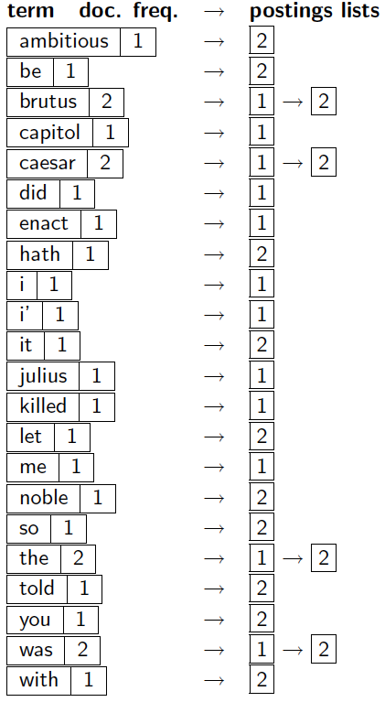
Indexer steps: Dictionary & Postings
Sec. 1.2
Multiple term entries in a single document are merged.
Split into Dictionary and Postings
Doc. frequency information is added.
Why frequency?
Will discuss later.

Slide 26
Where do we pay in storage?
Sec. 1.2
Lists of docIDs
Terms and counts
Later in the course:
How do we index efficiently?
How much storage do we need?
Pointers

Slide 27
The index we just built
Sec. 1.3
How do we process a query?
  Later - what kinds of queries can we process?
Today’s focus

Slide 28
Query processing: AND
Sec. 1.3
Consider processing the query:
  Brutus AND Caesar
  Locate Brutus in the Dictionary;
    Retrieve its postings.
  Locate Caesar in the Dictionary;
    Retrieve its postings.
  “Merge” the two postings:
2
4
8
16
32
64
128
Brutus
1
2
3
5
8
13
21
34
Caesar

Slide 29
The merge
Sec. 1.3
Walk through the two postings simultaneously, in time linear in the total number of postings entries
2
2
4
4
8
8
16
16
32
64
128
32
64
128
Brutus
2
8
1
Caesar
1
2
2
3
5
5
8
8
13
13
21
21
34
3
34
If list lengths are x and y, merge takes O(x+y) operations.
Crucial: postings sorted by docID.

Slide 30
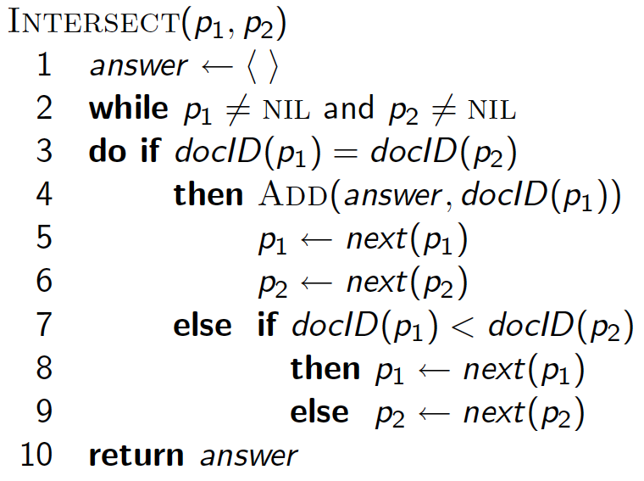
Intersecting two postings lists
(a “merge” algorithm)

Slide 31
Boolean queries: Exact match
Sec. 1.3
The Boolean retrieval model is being able to ask a query that is a Boolean expression:
  Boolean Queries use AND, OR and NOT to join query terms
    Views each document as a set of words
    Is precise: document matches condition or not.
  Perhaps the simplest model to build an IR system on
Primary commercial retrieval tool for 3 decades.
Many search systems you still use are Boolean:
  Email, library catalog, Mac OS X Spotlight

Slide 32
Example: WestLaw http://www.westlaw.com/
Sec. 1.4
Largest commercial (paying subscribers) legal search service (started 1975; ranking added 1992)
Tens of terabytes of data; 700,000 users
Majority of users still use boolean queries
Example query:
  What is the statute of limitations in cases involving the federal tort claims act?
  LIMIT! /3 STATUTE ACTION /S FEDERAL /2 TORT /3 CLAIM
    /3 = within 3 words, /S = in same sentence

Slide 33
Example: WestLaw http://www.westlaw.com/
Sec. 1.4
Another example query:
  Requirements for disabled people to be able to access a workplace
  disabl! /p access! /s work-site work-place (employment /3 place)
Note that SPACE is disjunction, not conjunction!
Long, precise queries; proximity operators; incrementally developed; not like web search
Many professional searchers still like Boolean search
  You know exactly what you are getting
But that doesn’t mean it actually works better….

Slide 34
Boolean queries:
More general merges
Sec. 1.3
Exercise: Adapt the merge for the queries:
Brutus AND NOT Caesar
Brutus OR NOT Caesar
Can we still run through the merge in time O(x+y)?
What can we achieve?

Slide 35
Merging
Sec. 1.3
What about an arbitrary Boolean formula?
(Brutus OR Caesar) AND NOT
(Antony OR Cleopatra)
Can we always merge in “linear” time?
  Linear in what?
Can we do better?

Slide 36
Query optimization
Sec. 1.3
What is the best order for query processing?
Consider a query that is an AND of n terms.
For each of the n terms, get its postings, then AND them together.
Brutus
2
4
8
16
32
64
128
Caesar
1
2
3
5
8
16
21
34
Calpurnia
13
16
Query: Brutus AND Calpurnia AND Caesar
36

Slide 37
Query optimization example
Sec. 1.3
Process in order of increasing freq:
  start with smallest set, then keep cutting further.
This is why we kept
document freq. in dictionary
Brutus
2
4
8
16
32
64
128
Caesar
1
2
3
5
8
16
21
34
Calpurnia
13
16
Execute the query as (Calpurnia AND Brutus) AND Caesar.

Slide 38
More general optimization
Sec. 1.3
e.g., (madding OR crowd) AND (ignoble OR strife)
Get doc. freq.’s for all terms.
Estimate the size of each OR by the sum of its doc. freq.’s (conservative).
Process in increasing order of OR sizes.

Slide 39
Exercise
Recommend a query processing order for
(tangerine OR trees) AND
(marmalade OR skies) AND
(kaleidoscope OR eyes)

Slide 40
Query processing exercises
Exercise: If the query is friends AND romans AND (NOT countrymen), how could we use the freq of countrymen?
Exercise: Extend the merge to an arbitrary Boolean query. Can we always guarantee execution in time linear in the total postings size?
Hint: Begin with the case of a Boolean formula query where each term appears only once in the query.

Slide 41
Exercise
Try the search feature at http://www.rhymezone.com/shakespeare/
Write down five search features you think it could do better

Slide 42
Ranking search results
Boolean queries give inclusion or exclusion of docs.
Often we want to rank/group results
  Need to measure proximity from query to each doc.
  Need to decide whether docs presented to user are singletons, or a group of docs covering various aspects of the query.

Slide 43
Resources for today’s lecture
Introduction to Information Retrieval, chapter 1
Shakespeare:
  http://www.rhymezone.com/shakespeare/
  Try the neat browse by keyword sequence feature!
Managing Gigabytes, chapter 3.2
Modern Information Retrieval, chapter 8.2
Any questions?

