Slide 1
CSE 538
MRS BOOK – CHAPTER VII
Scores in a Complete Search System

Slide 2
Overview
Recap
Why rank?
More on cosine
Implementation of ranking
The complete search system

Slide 3
Outline
Recap
Why rank?
More on cosine
Implementation of ranking
The complete search system

Slide 4

Term frequency weight
  The log frequency weight of term t in d is defined as follows
4

Slide 5

idf weight
  The document frequency dft is defined as the number of documents that t occurs in.
  We define the idf weight of term t as follows:
  idf is a measure of the informativeness of the term.
5

Slide 6

tf-idf weight
  The tf-idf weight of a term is the product of its tf weight and its idf weight.
6

Slide 7

Cosine similarity between query and document
  q_{i} is the tf-idf weight of term i in the query.
  d_{i} is the tf-idf weight of term i in the document.
  and are the lengths of and
  and are length-1 vectors (= normalized).
7

Slide 8
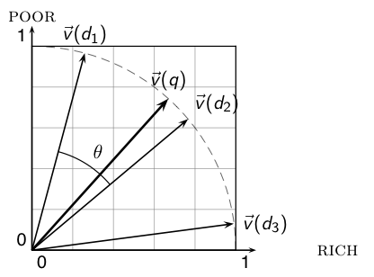
Cosine similarity illustrated
8

Slide 9
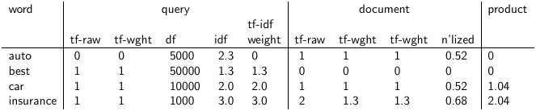
tf-idf example: lnc.ltn
  Query: “best car insurance”. Document: “car insurance auto insurance”. (N=1000000)
term frequency, df: document frequency, idf: inverse document frequency, weight:the final
weight of the term in the query or document, n’lized: document weights after cosine
normalization, product: the product of final query weight and final document weight
1/1.92 = 0.52
1.3/1.92 = 0.68 Final similarity score between query and
document: _{i} w_{qi} · w_{di} = 0 + 0 + 1.04 + 2.04 = 3.08
9

Slide 10
Take-away today
  The importance of ranking: User studies at Google
  Length normalization: Pivot normalization
  Implementation of ranking
  The complete search system
10

Slide 11
Outline
Recap
Why rank?
More on cosine
Implementation of ranking
The complete search system

Slide 12
Why is ranking so important?
  Last lecture: Problems with unranked retrieval
    Users want to look at a few results – not thousands.
    It’s very hard to write queries that produce a few results.
    Even for expert searchers
    → Ranking is important because it effectively reduces a large set of results to a very small one.
  Next: More data on “users only look at a few results”
  Actually, in the vast majority of cases they only examine 1, 2, or 3 results.
12

Slide 13
Empirical investigation of the effect of ranking
  How can we measure how important ranking is?
  Observe what searchers do when they are searching in a controlled setting
    Videotape them
    Ask them to “think aloud”
    Interview them
    Eye-track them
    Time them
    Record and count their clicks
  The following slides are from Dan Russell’s JCDL talk
  Dan Russell is the “Über Tech Lead for Search Quality & User Happiness” at Google.
13

Slide 14
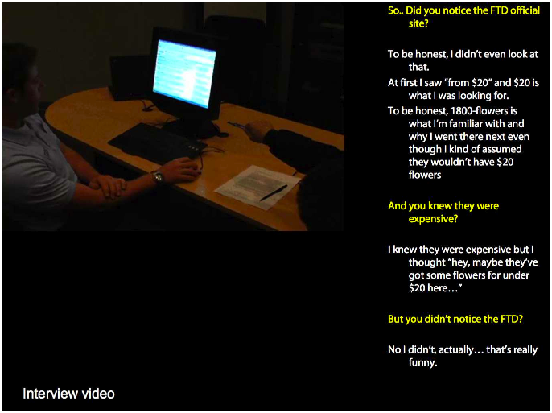
14

Slide 15
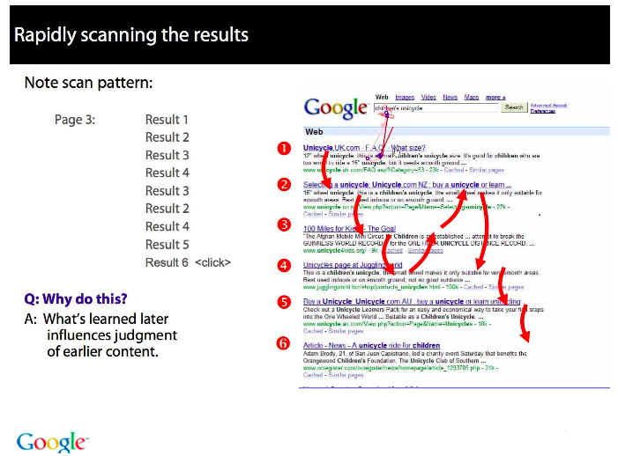
15

Slide 16
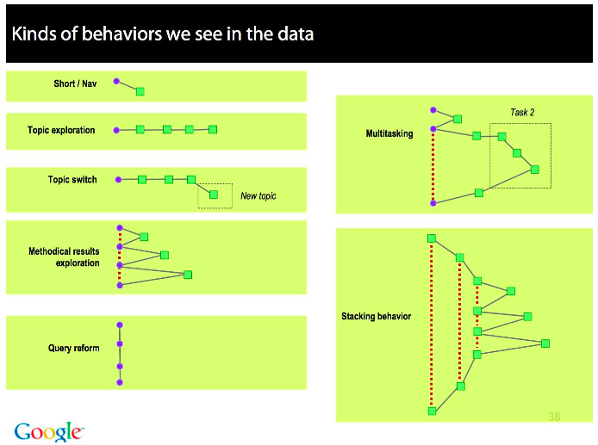
16

Slide 17
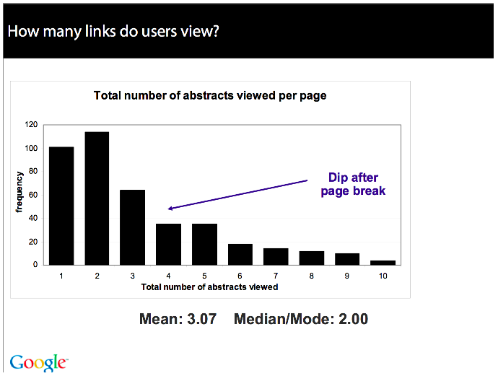
17

Slide 18
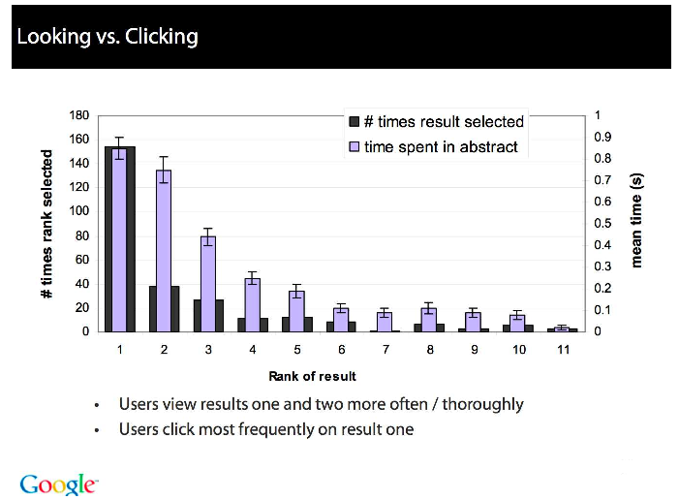
18

Slide 19
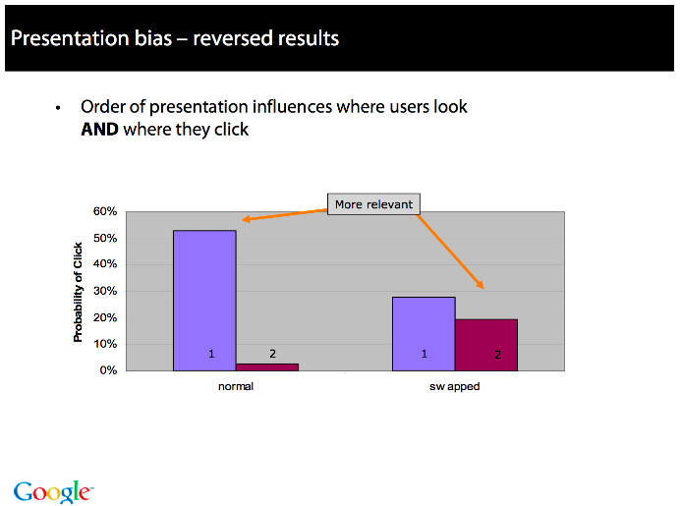
19

Slide 20
Importance of ranking: Summary
  Viewing abstracts: Users are a lot more likely to read the abstracts of the top-ranked pages (1, 2, 3, 4) than the abstracts of the lower ranked pages (7, 8, 9, 10).
  Clicking: Distribution is even more skewed for clicking
  In 1 out of 2 cases, users click on the top-ranked page.
  Even if the top-ranked page is not relevant, 30% of users will click on it.
  → Getting the ranking right is very important.
  → Getting the top-ranked page right is most important.
20

Slide 21
Outline
Recap
Why rank?
More on cosine
Implementation of ranking
The complete search system

Slide 22
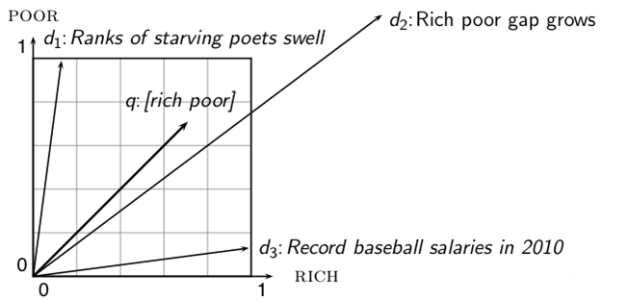
Why distance is a bad idea
The Euclidean distance of and is large although the distribution of terms in the query q and the distribution of terms in the document d₂ are very similar. That’s why we do length normalization or, equivalently, use cosine to compute query-document matching scores.
22

Slide 23
Exercise: A problem for cosine normalization
  Query q: “anti-doping rules Beijing 2008 olympics”
  Compare three documents
    d₁: a short document on anti-doping rules at 2008 Olympics
    d₂: a long document that consists of a copy of d₁ and 5 other news stories, all on topics different from Olympics/anti-doping
    d₃: a short document on anti-doping rules at the 2004 Athens Olympics
  What ranking do we expect in the vector space model?
  What can we do about this?
23

Slide 24
Pivot normalization
In Section 6.3.1we normalized each document vector by the Euclidean length of the vector, so that all document vectors turned into unit vectors. In doing so, we eliminated all information on the length of the original document; this masks some subtleties about longer documents. First, longer documents will – as a result of containing more terms – have higher tf values. Second, longer documents contain more distinct terms.
To this end, we introduce a form of normalizing the vector representations of documents in the collection, so that the resulting “normalized” documents are not necessarily of unit length. Then, when we compute the dot product score between a (unit) query vector and such a normalized document, the score is skewed to account for the effect of document length on relevance. This form of compensation for document length is known as pivoted document length normalization.

Slide 25
Pivot normalization
  Cosine normalization produces weights that are too large for short documents and too small for long documents (on average).
  Adjust cosine normalization by linear adjustment: “turning” the average normalization on the pivot
  Effect: Similarities of short documents with query decrease; similarities of long documents with query increase.
  This removes the unfair advantage that short documents have.
25

Slide 26
Pivot normalization
Consider a document collection together with an ensemble of queries for that collection. Suppose that we were given, for each query q and for each document d, a Boolean judgment of whether or not d is relevant to the query q; in Chapter 8 we will see how to procure such a set of relevance judgments for a query ensemble and a document collection.
Given this set of relevance judgments, we may compute a probability of relevance as a function of document length, averaged over all queries in the ensemble. The resulting plot may look like the curve drawn in thick lines in Figure 6.16. To compute this curve, we bucket documents by length and compute the fraction of relevant documents in each bucket, then plot this fraction against the median document length of each bucket. (Thus even though the “curve” in Figure 6.16 appears to be continuous, it is in fact a histogram of discrete buckets of document length.)
crossover at a point p corresponding to document length ℓp, which we refer to as the pivot length; dashed lines mark this point on the x− and y− axes.

Slide 27
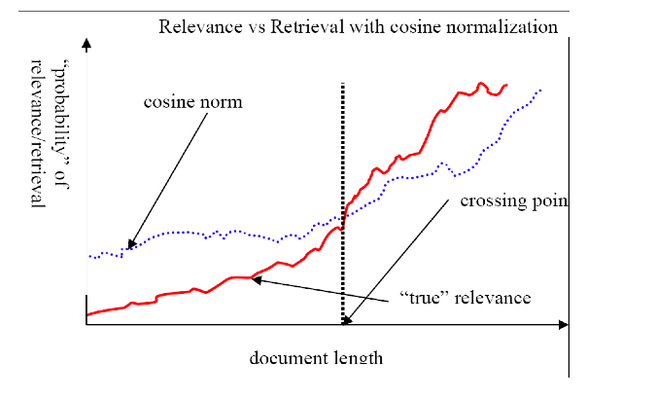
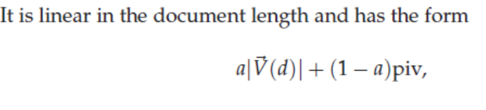
Predicted and true probability of relevance
  source:
  Lillian Lee
27

Slide 28
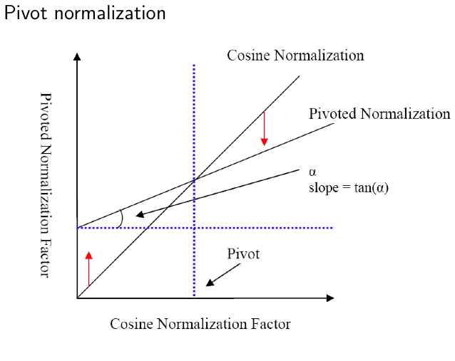
Pivot normalization
  source:
  Lillian Lee
28

Slide 29
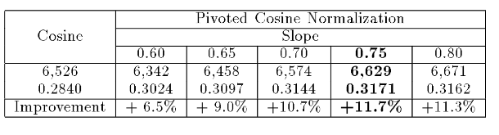
Pivoted normalization: Amit Singhal’s experiments
  (relevant documents retrieved and (change in) average precision)
http://citeseerx.ist.psu.edu/viewdoc/summary?doi=10.1.1.50.9950
29

Slide 30
Outline
Recap
Why rank?
More on cosine
Implementation of ranking
The complete search system

Slide 31
This lecture
Ch. 7
Speeding up vector space ranking
Putting together a complete search system
  Will require learning about a number of miscellaneous topics and heuristics

Slide 32
Efficient cosine ranking
Sec. 7.1
Find the K docs in the collection “nearest” to the query ⇒ K largest query-doc cosines.
Efficient ranking:
  Computing a single cosine efficiently.
  Choosing the K largest cosine values efficiently.
    Can we do this without computing all N cosines?

Slide 33
Efficient cosine ranking
Sec. 7.1
What we’re doing in effect: solving the K-nearest neighbor problem for a query vector
In general, we do not know how to do this efficiently for high-dimensional spaces
But it is solvable for short queries, and standard indexes support this well

Slide 34
  Speedup Method 1– Computing a single cosine efficiently.
Sec. 7.1
No weighting on query terms
  Assume each query term occurs only once
Compute the cosine similarity from each document unit vector ~v(d) to ~V (q) (in which all non-zero components of the query vector are set to 1), rather than to the unit vector ~v(q).
For the purpose of ranking the documents matching this query, we are really interested in the relative (rather than absolute) scores of the documents in the collection.
Slight simplification of algorithm from Lecture 6 (Figure 6.14)

Slide 35
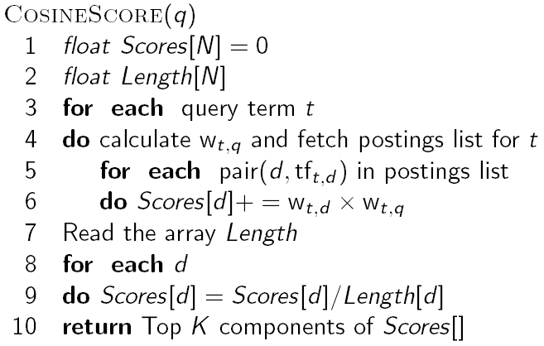
Computing cosine scores (Figure 6.14)
Sec. 6.3.3

Slide 36
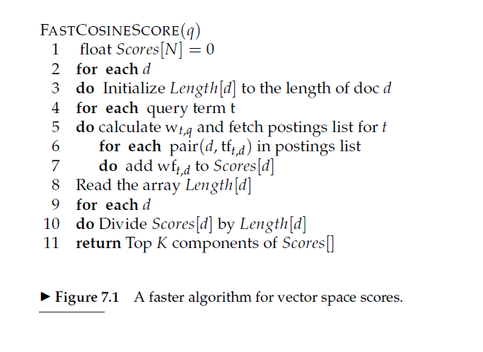
This in turn can be computed by a postings intersection exactly as in the algorithm of Figure 6.14, with line 8 altered since we take wt,q to be 1 so that the multiply-add in that step becomes just an addition; the result is shown in Figure 7.1.

Slide 37
Speedup Method 2: Use a HEAP
  How do we compute the top k in ranking?
  In many applications, we don’t need a complete ranking.
  We just need the top k for a small k (e.g., k = 100).
  If we don’t need a complete ranking, is there an efficient way of computing just the top k?
  Naive:
    Compute scores for all N documents
    Sort
    Return the top k
  What’s bad about this?
  Alternative?
    While one could sort the complete set of scores, a better approach is to use a heap to retrieve only the top K documents in order.
37

Slide 38
Use min heap for selecting top k ouf of N
  Use a binary min heap
  A binary min heap is a binary tree in which each node’s value is less than the values of its children.
  Takes O(N log k) operations to construct (where N is the number of documents) . . .
  . . . then read off k winners in O(k log k) steps
38

Slide 39
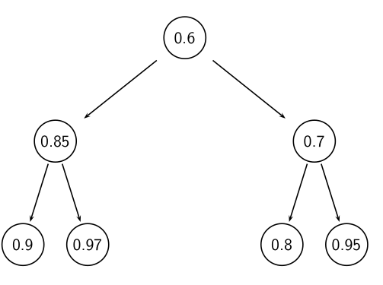
Binary min heap
A min-heap is a binary tree such that
the data contained in each node is less than (or equal to) the data in that node’s children.
the binary tree is complete, that is, all levels of the tree, except possibly the last one (deepest) are fully filled
39

Slide 40
Selecting top k scoring documents in O(N log k)
  Goal: Keep the top k documents seen so far
  Use a binary min heap
  To process a new document d′ with score s′:
    Get current minimum h_{m} of heap (O(1))
    If s′ ˂ h_{m} skip to next document
    If s′ > h_{m} heap-delete-root (O(log k))
    Heap-add d′/s′ (O(log k))
40

Slide 41
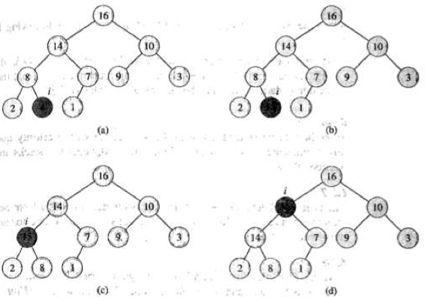
Priority queue example (insert 15)
15
41

Slide 42
Bottlenecks
Sec. 7.1.1
Primary computational bottleneck in scoring: cosine computation
Can we avoid all this computation?
Yes, but may sometimes get it wrong
  a doc not in the top K may creep into the list of K output docs
  Is this such a bad thing?

Slide 43
Inexact top K document retrieval
Thus far, we have focused on retrieving precisely the K highest-scoring documents for a query. We now consider schemes by which we produce K documents that are likely to be among the K highest scoring documents for a query.
In doing so, we hope to dramatically lower the cost of computing the K documents we output, without materially altering the user’s perceived relevance of the top K results. Consequently, in most applications it suffices to retrieve K documents whose scores are very close to those of the K best.
In the sections that follow we detail schemes that retrieve K such documents while potentially avoiding computing scores for most of the N documents in the collection.

Slide 44
Reducing the number of documents in cosine computation
The principal cost in computing the output stems from computing cosine similarities between the query and a large number of documents.
Having a large number of documents in contention also increases the selection cost in the final stage of collecting the top K documents from a heap.
We now consider a series of ideas designed to eliminate a large number of documents without computing their cosine scores.

Slide 45
The Generic approach for reduction
Sec. 7.1.1
Find a set A of contenders, with K < |A| << N
  A does not necessarily contain the top K, but has many docs from among the top K
  Return the top K docs in A
Think of A as pruning non-contenders
The same approach is also used for other (non-cosine) scoring functions
Will look at several schemes following this approach

Slide 46
Index elimination
Sec. 7.1.2
Basic algorithm cosine computation algorithm only considers docs containing at least one query term.
(1) Consider documents containing terms whose idf exceeds a preset threshold. Thus, in the postings traversal, we only traverse the postings for terms with high idf. This has a fairly significant benefit: the postings lists of low-idf terms are generally long; with these removed from contention, the set of documents for which we compute cosines is greatly reduced.
(2) Only consider docs containing many query terms

Slide 47
High-idf query terms only
Sec. 7.1.2
For a query such as catcher in the rye
Only accumulate scores from catcher and rye
Intuition: in and the contribute little to the scores and so don’t alter rank-ordering much
Benefit:
  Postings of low-idf terms have many docs → these (many) docs get eliminated from set A of contenders

Slide 48
Docs containing many query terms
Sec. 7.1.2
Any doc with at least one query term is a candidate for the top K output list
For multi-term queries, only compute scores for docs containing several of the query terms
  Say, at least 3 out of 4
  Imposes a “soft conjunction” on queries seen on web search engines (early Google)
Easy to implement in postings traversal

Slide 49
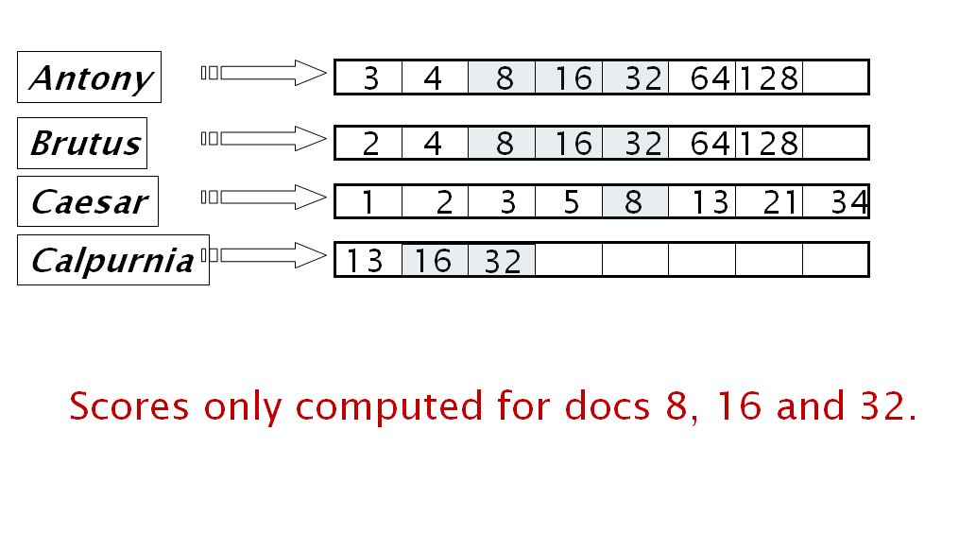
3 of 4 query terms

Slide 50
Champion lists
The idea of champion lists (sometimes also called fancy lists or top docs) is to precompute, for each term t in the dictionary, the set of the r documents with the highest weights for t; the value of r is chosen in advance. For tf-idf weighting, these would be the r documents with the highest tf values for term t. We call this set of r documents the champion list for term t.

Slide 51
Champion lists
Sec. 7.1.3
Precompute for each dictionary term t, the r docs of highest weight in t’s postings
  Call this the champion list for t
  (aka fancy list or top docs for t)
Note that r has to be chosen at index build time
  Thus, it’s possible that r < K
At query time, only compute scores for docs in the champion list of some query term
  Pick the K top-scoring docs from amongst these

Slide 52
Static quality scores
Sec. 7.1.4
We want top-ranking documents to be both relevant and authoritative
Relevance is being modeled by cosine scores
Authority is typically a query-independent property of a document
Examples of authority signals
  Wikipedia among websites
  Articles in certain newspapers
  A paper with many citations
  Many bitly’s, diggs or del.icio.us marks
  (Pagerank)
Quantitative

Slide 53
Modeling authority
Sec. 7.1.4
Assign to each document a query-independent quality score in [0,1] to each document d
  Denote this by g(d)
Thus, a quantity like the number of citations is scaled into [0,1]
  Exercise: suggest a formula for this.

Slide 55
Net score
Sec. 7.1.4
Consider a simple total score combining cosine relevance and authority
net-score(q,d) = g(d) + cosine(q,d)
  Can use some other linear combination
  Indeed, any function of the two “signals” of user happiness – more later
Now we seek the top K docs by net score

Slide 56
Top K by net score – fast methods
Sec. 7.1.4
First idea: Order all postings by g(d)
Key: this is a common ordering for all postings
Thus, can concurrently traverse query terms’ postings for
  Postings intersection
  Cosine score computation
Exercise: write pseudocode for cosine score computation if postings are ordered by g(d)

Slide 57
Why order postings by g(d)?
Sec. 7.1.4
Under g(d)-ordering, top-scoring docs likely to appear early in postings traversal
In time-bound applications (say, we have to return whatever search results we can in 50 ms), this allows us to stop postings traversal early
  Short of computing scores for all docs in postings

Slide 58
Champion lists in g(d)-ordering
Sec. 7.1.4
Can combine champion lists with g(d)-ordering
Maintain for each term a champion list of the r docs with highest g(d) + tf-idf_{td}
Seek top-K results from only the docs in these champion lists

Slide 59
More efficient computation of top k: Heuristics
  Idea 1: Reorder postings lists
    Instead of ordering according to docID . . .
    . . . order according to some measure of “expected relevance”.
  Idea 2: Heuristics to prune the search space
    Not guaranteed to be correct . . .
    . . . but fails rarely.
    In practice, close to constant time.
    For this, we’ll need the concepts of document-at-a-time processing and term-at-a-time processing.
59

Slide 60
Non-docID ordering of postings lists
  So far: postings lists have been ordered according to docID.
  Alternative: a query-independent measure of “goodness” of a page
  Example: PageRank g(d) of page d, a measure of how many “good” pages hyperlink to d (chapter 21)
  Order documents in postings lists according to PageRank: g(d₁) > g(d₂) > g(d₃) > . . .
  Define composite score of a document: net-score(q, d) = g(d) + cos(q, d)
  This scheme supports early termination: We do not have to process postings lists in their entirety to find top k.
60

Slide 61
Non-docID ordering of postings lists (2)
  Order documents in postings lists according to PageRank: g(d₁) > g(d₂) > g(d₃) > . . .
  Define composite score of a document: net-score(q, d) = g(d) + cos(q, d)
  Suppose:
  (i) g → [0, 1];
  (ii) g(d) < 0.1 for the document d we’re currently processing;
  (iii) smallest top k score we’ve found so far is 1.2
  Then all subsequent scores will be < 1.1.
  So we’ve already found the top k and can stop processing the remainder of postings lists.
61

Slide 62
Document-at-a-time processing
  Both docID-ordering and PageRank-ordering impose a consistent ordering on documents in postings lists.
  Computing cosines in this scheme is document-at-a-time.
  We complete computation of the query-document similarity score of document d_{i} before starting to compute the query-document similarity score of d_{i+1}.
  Alternative: term-at-a-time processing
62

Slide 63
Weight-sorted postings lists
  Idea: don’t process postings that contribute little to final score
  Order documents in postings list according to weight
  Simplest case: normalized tf-idf weight (rarely done: hard to compress)
  Documents in the top k are likely to occur early in these ordered lists.
  → Early termination while processing postings lists is unlikely to change the top k.
  But:
    We no longer have a consistent ordering of documents in postings lists.
    We no longer can employ document-at-a-time processing.
63

Slide 64
Term-at-a-time processing
  Simplest case: completely process the postings list of the first query term
  Create an accumulator for each docID you encounter
  Then completely process the postings list of the second query term
  . . . and so forth
64

Slide 65
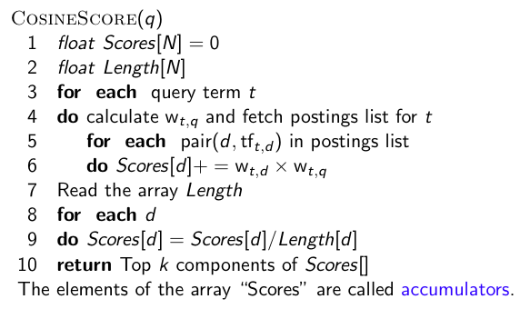
Term-at-a-time processing
65

Slide 66
Computing cosine scores
  For the web (20 billion documents), an array of accumulators A in memory is infeasible.
  Thus: Only create accumulators for docs occurring in postings lists
  This is equivalent to: Do not create accumulators for docs with zero scores (i.e., docs that do not contain any of the query terms)
66

Slide 67
Cluster pruning

Slide 68
Cluster pruning

Slide 69
Removing bottlenecks
  Use heap / priority queue as discussed earlier
  Can further limit to docs with non-zero cosines on rare (high idf) words
  Or enforce conjunctive search (a la Google): non-zero cosines on all words in query
  Example: just one accumulator for [Brutus Caesar] in the example above . . .
  . . . because only d₁ contains both words.
69

Slide 70
Outline
Recap
Why rank?
More on cosine
Implementation of ranking
The complete search system

Slide 71
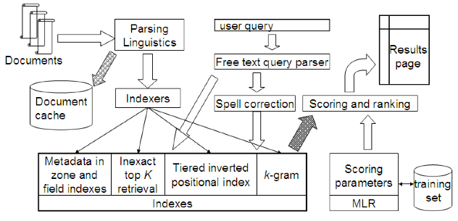
Complete search system
71

Slide 72
Tiered indexes
  Basic idea:
    Create several tiers of indexes, corresponding to importance of indexing terms
    During query processing, start with highest-tier index
    If highest-tier index returns at least k (e.g., k = 100) results: stop and return results to user
    If we’ve only found < k hits: repeat for next index in tier cascade
  Example: two-tier system
    Tier 1: Index of all titles
    Tier 2: Index of the rest of documents
    Pages containing the search words in the title are better hits than pages containing the search words in the body of the text.
72

Slide 73
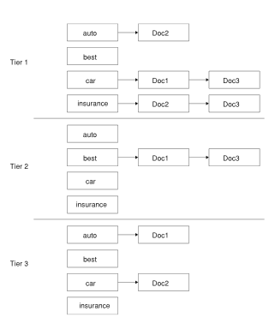
Tiered index
We illustrate this idea in Figure 7.4, where we represent the documents and terms of Figure 6.9. In this example we set a tf threshold of 20 for tier 1 and 10 for tier 2, meaning that the tier 1 index only has postings entries with tf values exceeding 20, while the tier 2 index only has postings entries with tf values exceeding 10. In this example we have
chosen to order the postings entries within a tier by document ID.
73

Slide 74
Tiered indexes
  The use of tiered indexes is believed to be one of the reasons that Google search quality was significantly higher initially (2000/01) than that of competitors.
  (along with PageRank, use of anchor text and proximity constraints)
74

Slide 75
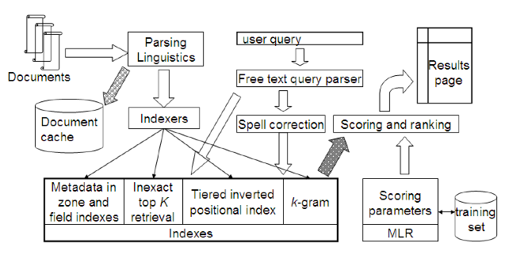
Complete search system
75

Slide 76
Components we have introduced thus far
  Document preprocessing (linguistic and otherwise)
  Positional indexes
  Tiered indexes
  Spelling correction
  k-gram indexes for wildcard queries and spelling correction
  Query processing
  Document scoring
  Term-at-a-time processing
76

Slide 77
Components we haven’t covered yet
  Document cache: we need this for generating snippets (=dynamic summaries)
  Zone indexes: They separate the indexes for different zones: the body of the document, all highlighted text in the document, anchor text, text in metadata fields etc
  Machine-learned ranking functions
  Proximity ranking (e.g., rank documents in which the query terms occur in the same local window higher than documents in which the query terms occur far from each other)
  Query parser
77

Slide 78
Take-away today
  The importance of ranking: User studies at Google
  Length normalization: Pivot normalization
  Implementation of ranking
  The complete search system
78

Slide 79
Resources
  Chapters 6 and 7 of IIR
  Resources at http://ifnlp.org/ir
    How Google tweaks its ranking function
    Interview with Google search guru Udi Manber
    Yahoo Search BOSS: Opens up the search engine to developers. For example, you can rerank search results.
    Compare Google and Yahoo ranking for a query
    How Google uses eye tracking for improving search
79

