Slide 1
CSE 538
MRS BOOK – CHAPTER VIII
Evaluation & Result Summaries

Slide 2
Overview
Recap
Unranked evaluation
Ranked evaluation
Evaluation benchmarks
Result summaries

Slide 3
Outline
Recap
Unranked evaluation
Ranked evaluation
Evaluation benchmarks
Result summaries

Slide 4
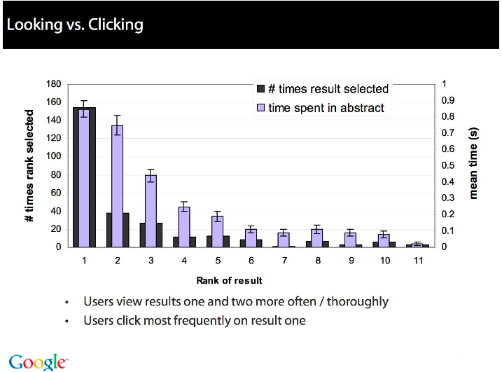
4

Slide 5
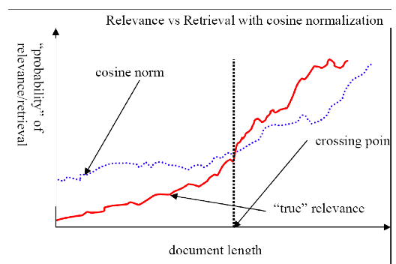
Pivot normalization
  source:
  Lilian Lee
5

Slide 6
Heuristics for finding the top k even faster
  Document-at-a-time processing
    We complete computation of the query-document similarity score of document d_{i} before starting to compute the query-document similarity score of d_{i+1}.
    Requires a consistent ordering of documents in the postings lists
  Term-at-a-time processing
    We complete processing the postings list of query term t_{i} before starting to process the postings list of t_{i+1}.
    Requires an accumulator for each document “still in the running”
  The most effective heuristics switch back and forth between term-at-a-time and document-at-a-time processing.
6

Slide 7
Use min heap for selecting top k ouf of N
  Use a binary min heap
  A binary min heap is a binary tree in which each node’s value is less than the values of its children.
  It takes O(N log k) operations to construct the k-heap containing the k largest values (where N is the number of documents).
  Essentially linear in N for small k and large N.
7

Slide 8
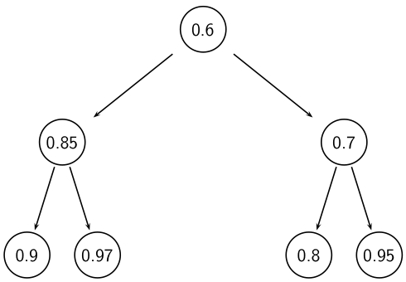
Binary min heap

Slide 9
Selecting k top scoring documents in O(N log k)
  Goal: Keep the k top documents seen so far
  Use a binary min heap
  To process a new document d′ with score s′:
    Get current minimum h_{m} of heap (in O(1))
    If s′ ≤ h_{m} skip to next document
    If s′ > h_{m} heap-delete-root (in O(log k))
    Heap-add d′/s′ (in O(1))
    Reheapify (in O(log k))
9

Slide 10
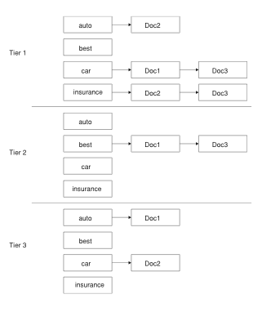
Tiered index
10

Slide 11
Outline
Recap
Unranked evaluation
Ranked evaluation
Evaluation benchmarks
Result summaries

Slide 12
Measures for a search engine
  How fast does it index
    e.g., number of bytes per hour
  How fast does it search
    e.g., latency as a function of queries per second
  What is the cost per query?
    in dollars
12

Slide 13
Measures for a search engine
  All of the preceding criteria are measurable: we can quantify speed / size / money
  However, the key measure for a search engine is user happiness.
  What is user happiness?
  Factors include:
    Speed of response
    Size of index
    Uncluttered UI
    Most important: relevance
  (actually, maybe even more important: it’s free)
  Note that none of these is sufficient: blindingly fast, but useless answers won’t make a user happy.
  How can we quantify user happiness?
13

Slide 14
Who is the user?
  Who is the user we are trying to make happy?
  Web search engine: searcher. Success: Searcher finds what she was looking for. Measure: rate of return to this search engine
  Web search engine: advertiser. Success: Searcher clicks on ad. Measure: clickthrough rate
  Ecommerce: buyer. Success: Buyer buys something. Measures: time to purchase, fraction of “conversions” of searchers to buyers
  Ecommerce: seller. Success: Seller sells something. Measure: profit per item sold
  Enterprise: CEO. Success: Employees are more productive (because of effective search). Measure: profit of the company
14

Slide 15
Most common definition of user happiness: Relevance
  User happiness is equated with the relevance of search results to the query.
  But how do you measure relevance?
  Standard methodology in information retrieval consists of three elements.
    A benchmark document collection
    A benchmark suite of queries
    An assessment of the relevance of each query-document pair
15

Slide 16
Relevance: query vs. information need
  Relevance to what?
  First take: relevance to the query
  “Relevance to the query” is very problematic.
  Information need i : “I am looking for information on whether drinking red wine is more effective at reducing your risk of heart attacks than white wine.”
  This is an information need, not a query.
  Query q: [red wine white wine heart attack]
  Consider document d′: At heart of his speech was an attack on the wine industry lobby for downplaying the role of red and white wine in drunk driving.
  d′ is an excellent match for query q . . .
  d′ is not relevant to the information need i .
16

Slide 17
Relevance: query vs. information need
  User happiness can only be measured by relevance to an information need, not by relevance to queries.
  Our terminology is sloppy in these slides and in IIR: we talk about query-document relevance judgments even though we mean information-need-document relevance judgments.
17

Slide 18


Precision and recall
  Precision (P) is the fraction of retrieved documents that are relevant
  Recall (R) is the fraction of relevant documents that are retrieved
18

Slide 19
Evaluation Metrics: Classification View
Action
Retrieved
Not Retrieved
Doc
Relevant
Relevant Retrieved
Relevant Rejected
Not relevant
Irrelevant Retrieved
Irrelevant Rejected

Slide 20
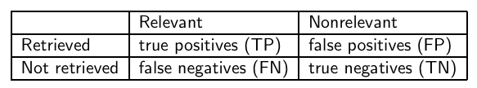
Precision and recall
  P = TP / ( TP + FP )
  R = TP / ( TP + FN )
20

Slide 21
Precision/recall tradeoff
  You can increase recall by returning more docs.
  Recall is a non-decreasing function of the number of docs retrieved.
  A system that returns all docs has 100% recall!
  The converse is also true (usually): It’s easy to get high precision for very low recall.
  Suppose the document with the largest score is relevant. How can we maximize precision?
21

Slide 22
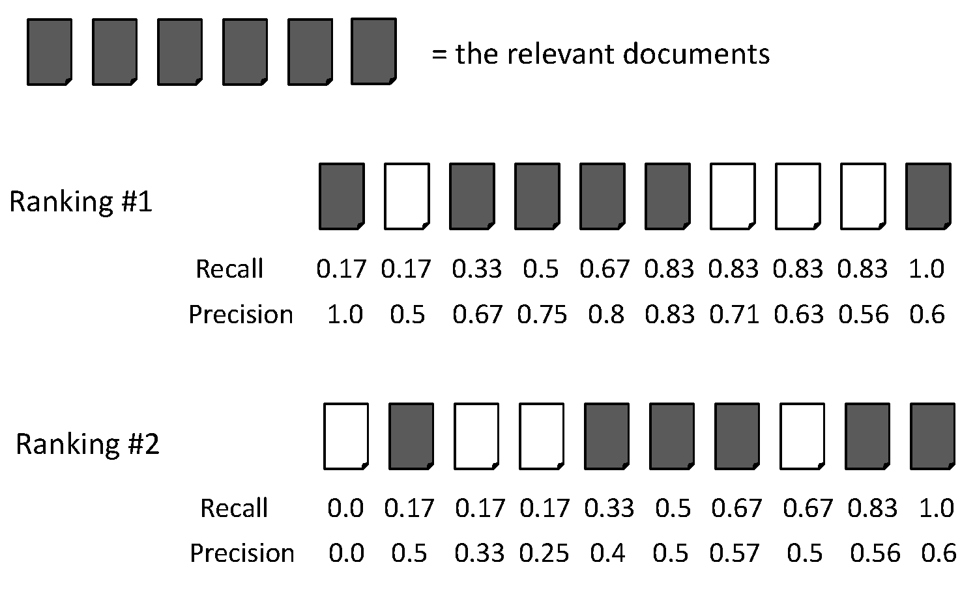
Evaluation Metrics: Example
When 3 documents retrieved:
Recall = 2/6 = 0.33
Precision = 2/3 = 0.67

Slide 23
Evaluation Metrics: Example
When 6 documents retrieved:
Recall = 5/6 = 0.83
Precision = 5/6 = 0.83

Slide 24
Evaluation Metrics: Example
For #1
Recall = 2/6 = 0.33
Precision = 2/3 = 0.67
For #2
Recall = 1/6 = 0.17
Precision = 1/3 = 0.67

Slide 25



A combined measure: F
  F allows us to trade off precision against recall.
  where
  α ϵ [0, 1] and thus β ² ϵ [0,∞]
  Most frequently used: balanced F with β = 1 or α = 0.5
    This is the harmonic mean of P and R:
  What value range of β weights recall higher than precision?
25

Slide 26
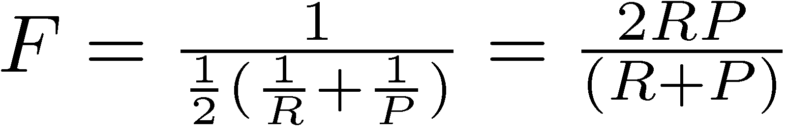
F Measure
Harmonic mean of recall and precision
  Why harmonic mean?
  harmonic mean emphasizes the importance of small values, whereas the arithmetic mean is affected more by outliers that are unusually large

Slide 27

F: Example
 | relevant | not relevant
retrieved | 20 | 40 | 60
not retrieved | 60 | 1,000,000 | 1,000,060
 | 80 | 1,000,040 | 1,000,120
  P = 20/(20 + 40) = 1/3
  R = 20/(20 + 60) = 1/4
27

Slide 28
Evaluation Metrics: Example
Recall = 2/6 = 0.33
Precision = 2/3 = 0.67
F = 2*Recall*Precision/(Recall + Precision)
= 2*0.33*0.67/(0.33 + 0.67) = 0.22

Slide 29
Evaluation Metrics: Example
Recall = 5/6 = 0.83
Precision = 5/6 = 0.83
F = 2*Recall*Precision/(Recall + Precision)
= 2*0.83*0.83/(0.83 + 0.83) = 0.83

Slide 30
Evaluation for Ranking
Average precision
  Averaging the precision values from the rank positions where a relevant document was retrieved
  Set precision values to be zero for the not retrieved documents

Slide 31
Average Precision: Example

Slide 32
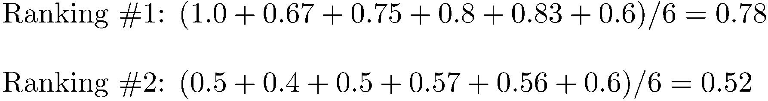
Average Precision: Example

Slide 33
Average Precision: Example

Slide 34
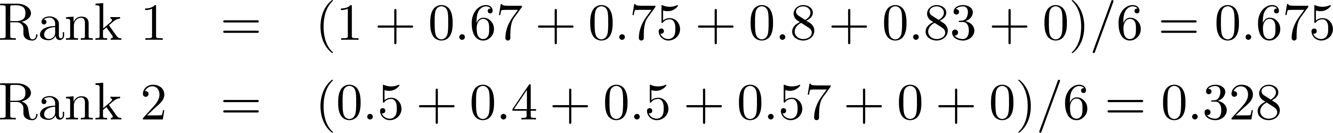
Average Precision: Example
Miss one relevant document

Slide 35
Average Precision: Example
Miss two relevant documents

Slide 36
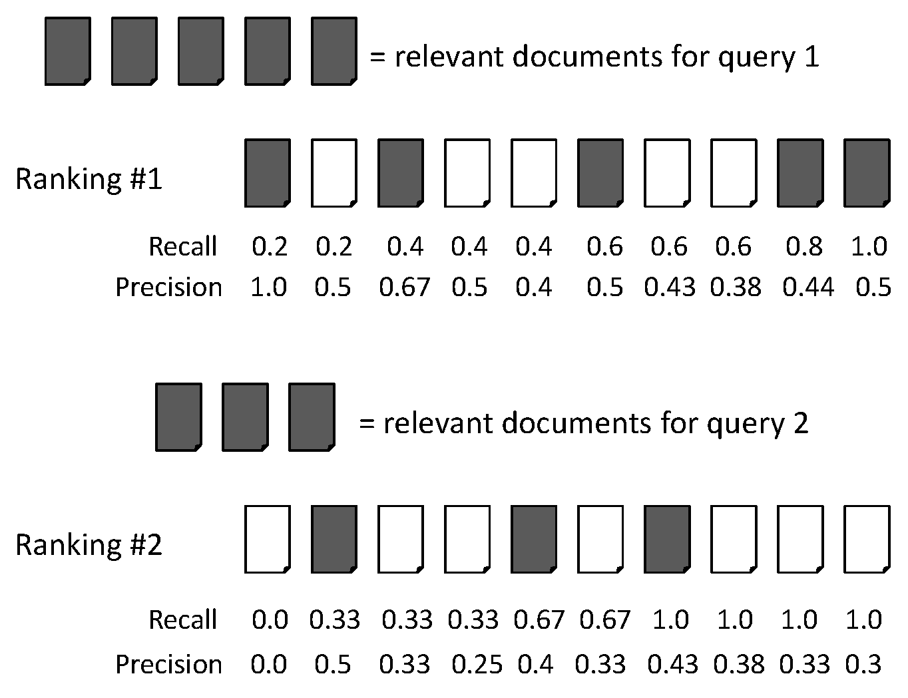
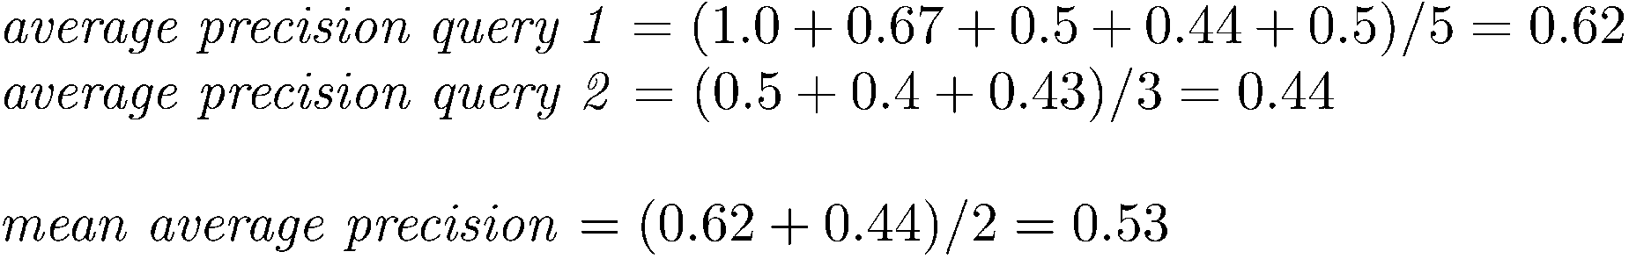
Mean Average Precision (MAP)

Slide 37
Mean Average Precision (MAP)
Summarize rankings from multiple queries by averaging average precision
Most commonly used measure in research papers
Assumes user is interested in finding many relevant documents for each query
Requires many relevance judgments in text collection

Slide 38
Accuracy
  Why do we use complex measures like precision, recall, and F?
  Why not something simple like accuracy?
  Accuracy is the fraction of decisions (relevant/nonrelevant) that are correct.
  In terms of the contingency table above,
  accuracy = (TP + TN)/(TP + FP + FN + TN).
  Why is accuracy not a useful measure for web information retrieval?
38

Slide 39

Exercise
  Compute precision, recall and F₁ for this result set:
  The snoogle search engine below always returns 0 results (“0 matching results found”), regardless of the query. Why does snoogle demonstrate that accuracy is not a useful measure in IR?
 | relevant | not relevant
retrieved | 18 | 2
not retrieved | 82 | 1,000,000,000
39

Slide 40
Why accuracy is a useless measure in IR
  Simple trick to maximize accuracy in IR: always say no and return nothing
  You then get 99.99% accuracy on most queries.
  Searchers on the web (and in IR in general) want to find something and have a certain tolerance for junk.
  It’s better to return some bad hits as long as you return something.
  →We use precision, recall, and F for evaluation, not accuracy.
40

Slide 41
F: Why harmonic mean?
  Why don’t we use a different mean of P and R as a measure?
    e.g., the arithmetic mean
  The simple (arithmetic) mean is 50% for “return-everything” search engine, which is too high.
  Desideratum: Punish really bad performance on either precision or recall.
  Taking the minimum achieves this.
  But minimum is not smooth and hard to weight.
  F (harmonic mean) is a kind of smooth minimum.
41

Slide 42
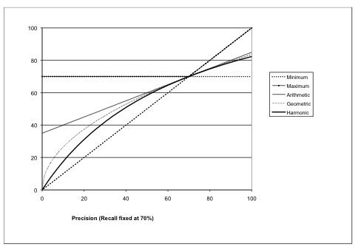
F₁ and other averages
Figure 8.1 Graph comparing the harmonic mean to other means. The graph shows a slice through the calculation of various means of precision and recall for the fixed recall value of 70%. The harmonic mean is always less than either the arithmetic or geometric mean, and often quite close to the minimum of the two numbers.
When the precision is also 70%, all the measures coincide.
  We can view the harmonic mean as a kind of soft minimum
42

Slide 43
Difficulties in using precision, recall and F
  We need relevance judgments for information-need-document pairs – but they are expensive to produce.
  For alternatives to using precision/recall and having to produce relevance judgments – see end of this lecture.
43

Slide 44
Outline
Recap
Unranked evaluation
Ranked evaluation
Evaluation benchmarks
Result summaries

Slide 45
Precision-recall curve
  Precision/recall/F are measures for unranked sets.
  We can easily turn set measures into measures of ranked lists.
  Just compute the set measure for each “prefix”: the top 1, top 2, top 3, top 4 etc results
  Doing this for precision and recall gives you a precision-recall curve.
45

Slide 46
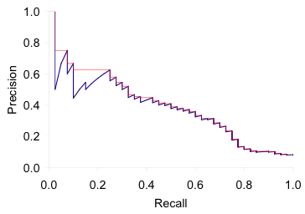
A precision-recall curve
  Each point corresponds to a result for the top k ranked hits (k = 1, 2, 3, 4, . . .).
  Interpolation (in red): Take maximum of all future points
  Rationale for interpolation: The user is willing to look at more stuff if both precision and recall get better.
  Questions?
46

Slide 47
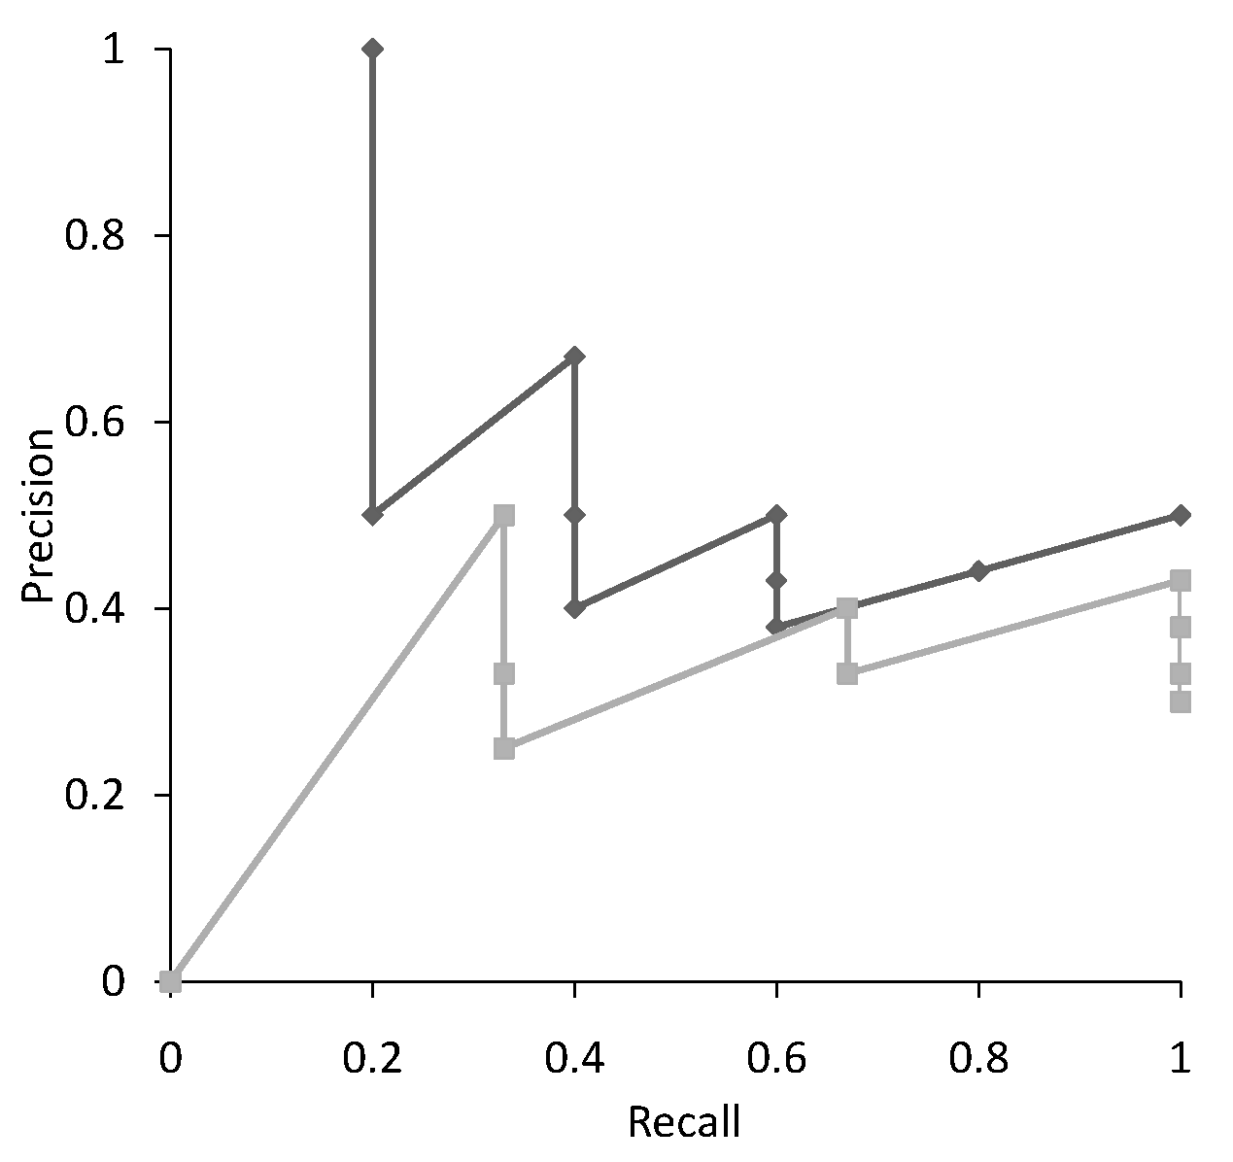
Recall-Precision Graph
Multiple precision for some recalls

Slide 48
Interpolation
  where S is the set of observed (R,P) points
Defines precision at any recall level as the maximum precision observed in any recall-precision point at a higher recall level
  produces a step function
  defines precision at recall 0.0

Slide 49
Interpolation
Recall
Interpolated
Precision
0.0 0.1 0.2 0.3 0.4 0.5 0.6 0.7 0.8 0.9 1.0
1.0

Slide 50
Interpolation
Recall
Interpolated
Precision
0.0 0.1 0.2 0.3 0.4 0.5 0.6 0.7 0.8 0.9 1.0
1.0

Slide 51
Interpolation
Recall
Interpolated
Precision
0.0 0.1 0.2 0.3 0.4 0.5 0.6 0.7 0.8 0.9 1.0
1.0 1.0

Slide 52
Interpolation
Recall
Interpolated
Precision
0.0 0.1 0.2 0.3 0.4 0.5 0.6 0.7 0.8 0.9 1.0
1.0 1.0 1.0

Slide 53
Interpolation
Recall
Interpolated
Precision
0.0 0.1 0.2 0.3 0.4 0.5 0.6 0.7 0.8 0.9 1.0
1.0 1.0 1.0

Slide 54
Interpolation
Recall
Interpolated
Precision
0.0 0.1 0.2 0.3 0.4 0.5 0.6 0.7 0.8 0.9 1.0
1.0 1.0 1.0 0.67

Slide 55
Interpolation
Recall
Interpolated
Precision
0.0 0.1 0.2 0.3 0.4 0.5 0.6 0.7 0.8 0.9 1.0
1.0 1.0 1.0 0.67 0.67 0.5 0.5 0.5 0.5 0.5 0.5

Slide 56
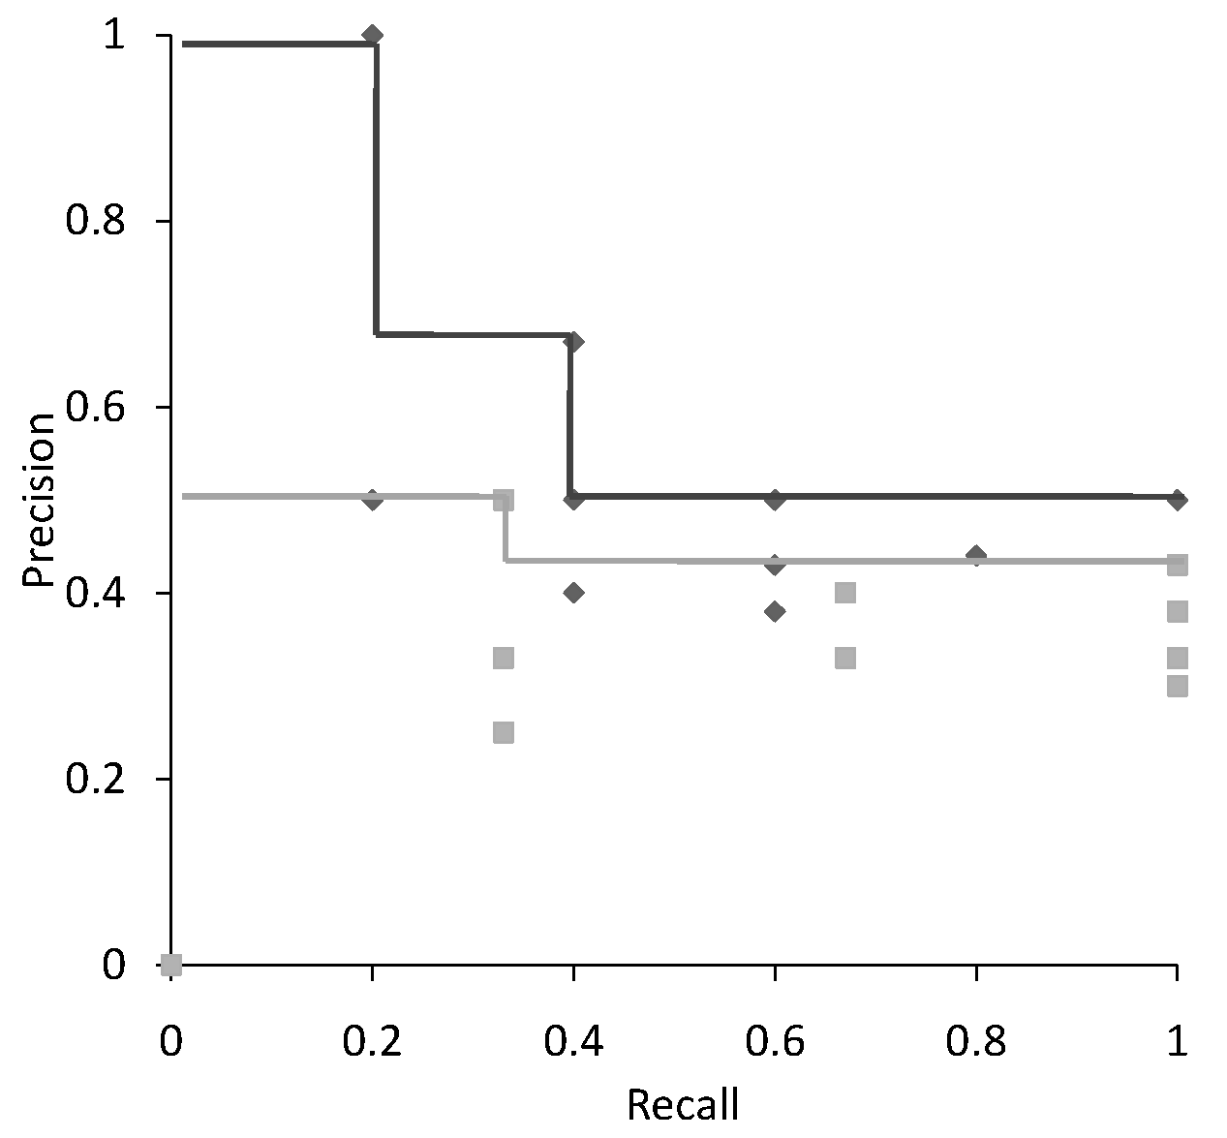
Interpolation

Slide 57
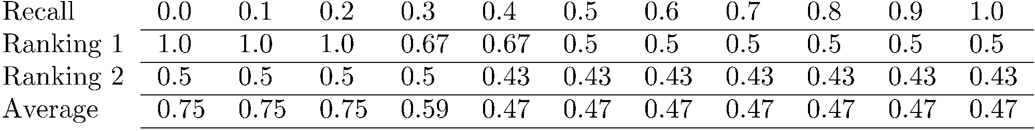
Average Precision at
Standard Recall Levels
Only consider standard recall levels: varying from 0.0
to 1.0 at the incremental of 0.1
Recall-precision graph plotted by simply joining the
average precision points at the standard recall levels

Slide 58
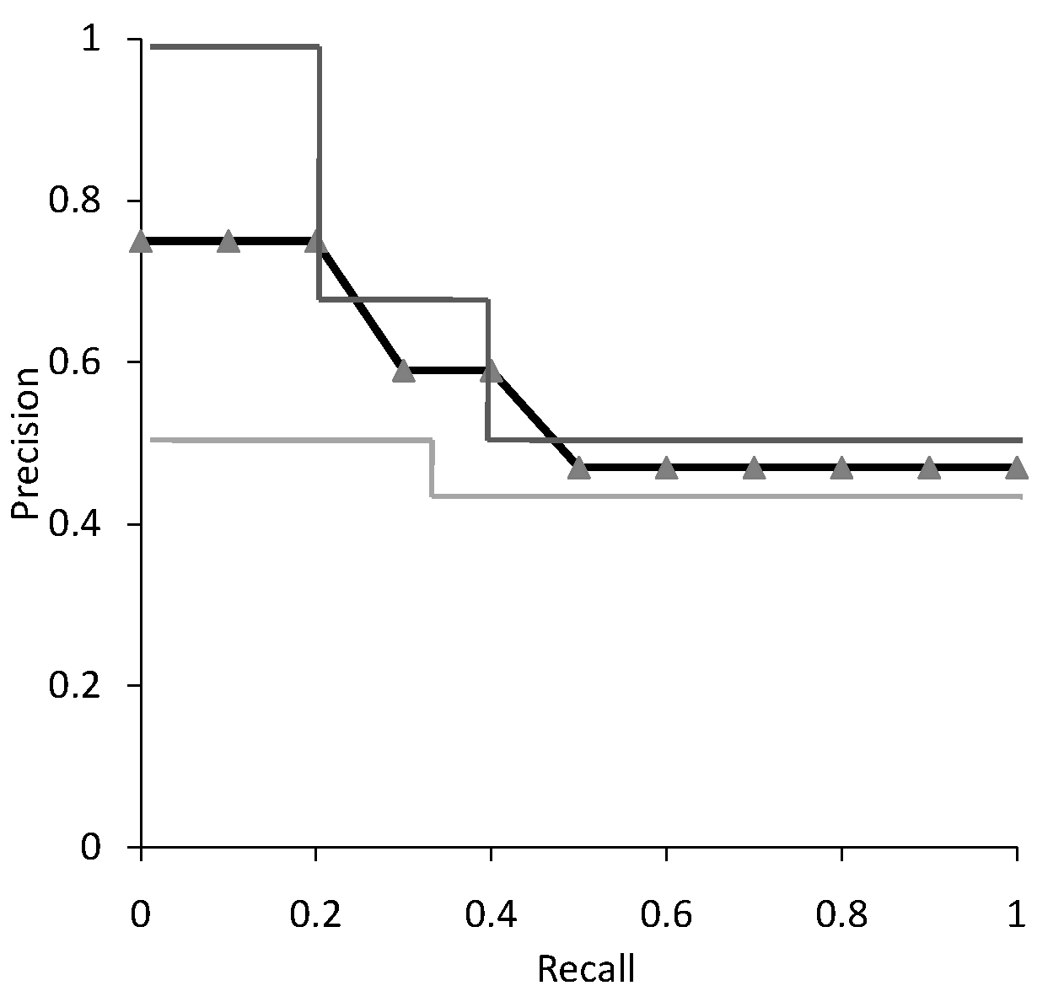
Average Recall-Precision Graph

Slide 59
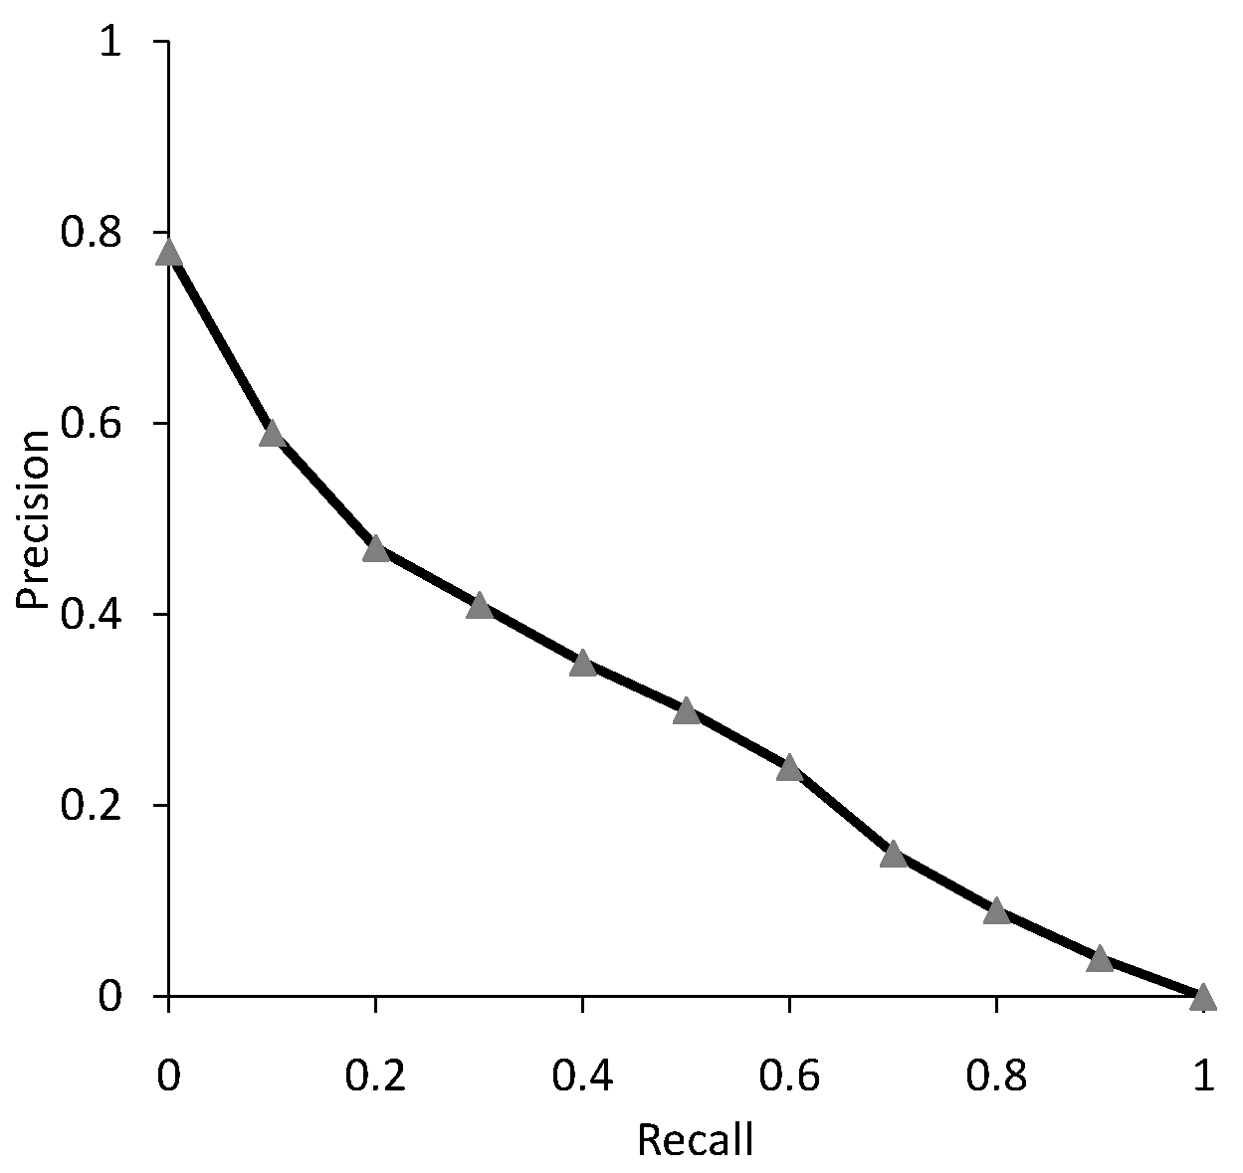
Graph for 50 Queries

Slide 60
Focusing on Top Documents
Users tend to look at only the top part of the ranked result list to find relevant documents
Some search tasks have only one relevant document
  e.g., navigational search, question answering
Recall not appropriate
  instead need to measure how well the search engine does at retrieving relevant documents at very high ranks

Slide 61
Focusing on Top Documents
Precision at Rank R
  R typically 5, 10, 20
  easy to compute, average, understand
  not sensitive to rank positions less than R
Reciprocal Rank
  reciprocal of the rank at which the first relevant document is retrieved (Consider rank position, K, of first relevant doc. Reciprocal Rank score = 1/K.)
  Mean Reciprocal Rank (MRR) is the average of the reciprocal ranks over a set of queries
  very sensitive to rank position

Slide 62
MRR
RR = 1/1 = 1
RR = 1/2 = 0.5
MRR = (1+0.5)/2 = 0.75

Slide 63
11-point interpolated average
Examining the entire precision-recall curve is very informative, but there is often a desire to boil this information down to a few numbers, or perhaps even a single number.
The traditional way of doing this (used for instance in the first 8 TREC Ad Hoc evaluations) is the 11-point interpolated average precision. For each information need, the interpolated precision is measured at the 11 recall levels of 0.0, 0.1, 0.2, . . . , 1.0.

Slide 64
11-point interpolated average precision
Recall | Interpolated Precision
0.0 0.1 0.2 0.3 0.4 0.5 0.6 0.7 0.8 0.9 1.0 | 1.00 0.67 0.63 0.55 0.45 0.41 0.36 0.29 0.13 0.10 0.08
11-pt interpolated average precision, you are looking at 11 recall levels (0.0, 0.1, 0.2, ..., 1.0) and finding the interpolated precision at each point. You average these scores across all of the different queries or information needs (as the Manning & Schuetze book put it) to find your system's score.
11-point average: ≈
0.425
64

Slide 65
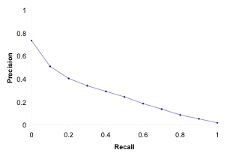
Averaged 11-point precision/recall graph
  Compute interpolated precision at recall levels 0.0, 0.1, 0.2, . . .
  Do this for each of the queries in the evaluation benchmark
  Average over queries
  This measure measures performance at all recall levels.
  The curve is typical of performance levels at TREC.
  Note that performance is not very good!
65

Slide 66
Discounted Cumulative Gain (DCG)
Popular measure for evaluating web search and related tasks
  Use graded relevance
Two assumptions:
  Highly relevant documents are more useful than marginally relevant document
  the lower the ranked position of a relevant document, the less useful it is for the user, since it is less likely to be examined

Slide 67
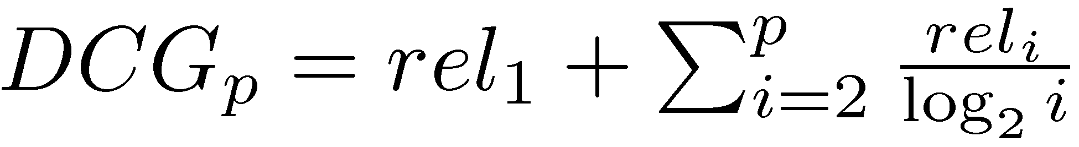
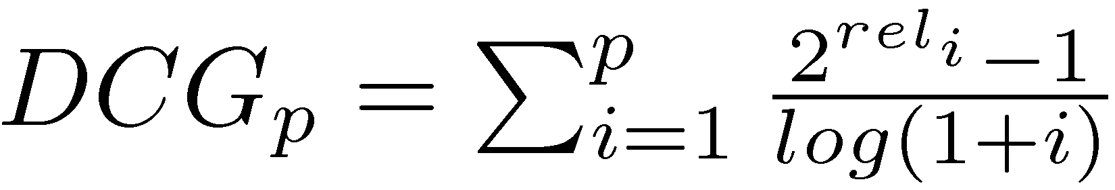
Discounted Cumulative Gain
Gain is accumulated starting at the top of the ranking and is discounted at lower ranks
  Typical discount is 1/log (rank)
  With base 2, the discount at rank 4 is 1/2, and at rank 8 it is 1/3

Slide 68
DCG Example
10 ranked documents judged on 0-3 relevance scale:
  3, 2, 3, 0, 0, 1, 2, 2, 3, 0
discounted gain:
  3, 2/1, 3/1.59, 0, 0, 1/2.59, 2/2.81, 2/3, 3/3.17, 0
  = 3, 2, 1.89, 0, 0, 0.39, 0.71, 0.67, 0.95, 0
DCG:
  3, 5, 6.89, 6.89, 6.89, 7.28, 7.99, 8.66, 9.61, 9.61

Slide 69
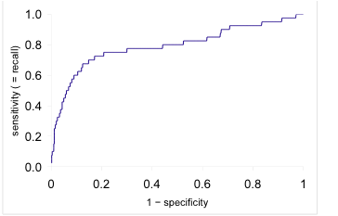
ROC curve
  Similar to precision-recall graph
  But we are only interested in the small area in the lower left corner.
  Precision-recall graph “blows up” this area.
69

Slide 70
Variance of measures like precision/recall
  For a test collection, it is usual that a system does badly on some information needs (e.g., P = 0.2 at R = 0.1) and really well on others (e.g., P = 0.95 at R = 0.1).
  Indeed, it is usually the case that the variance of the same system across queries is much greater than the variance of different systems on the same query.
  That is, there are easy information needs and hard ones.
70

Slide 71
Efficiency Metrics
Query throughput
  The number of queries processed per second
Query latency
  The time between issuing a query and receiving a response, measured in millisecond
  Users consider instantaneous if the latency is less than 150 millisecond
Relation between query throughput and latency
  High throughput → handle multiple queries simultaneously → high latency

Slide 72
Significance Tests
Given the results from a number of queries, how can we conclude that ranking algorithm A is better than algorithm B?
A significance test
  null hypothesis: no difference between A and B
  alternative hypothesis: B is better than A
  the power of a test is the probability that the test will reject the null hypothesis correctly
  increasing the number of queries in the experiment also increases power of test

Slide 73
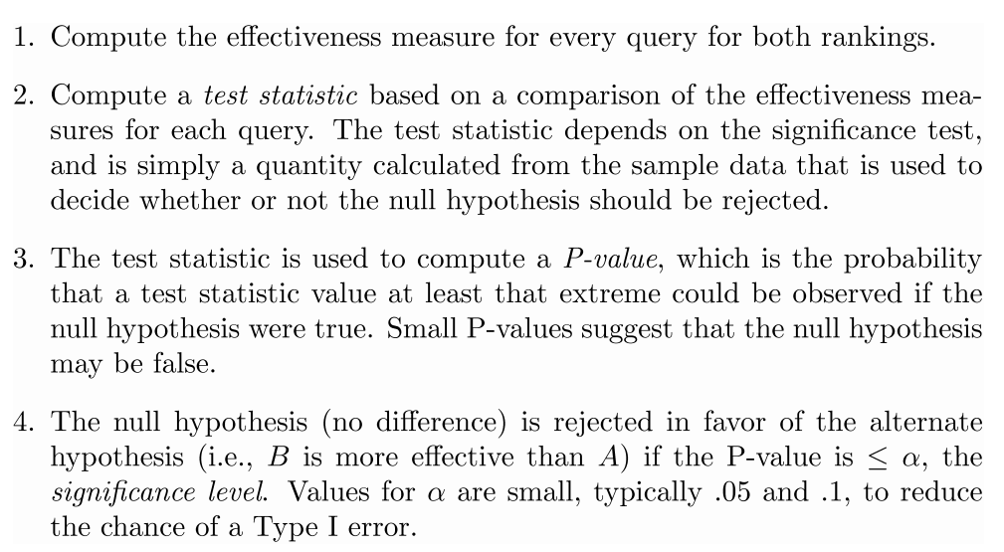
Significance Tests

Slide 74
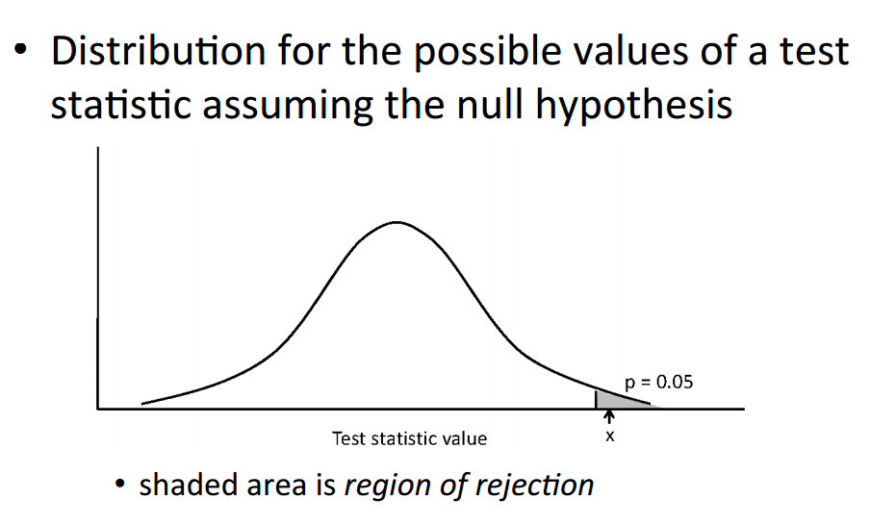
One-Sided Test

Slide 75
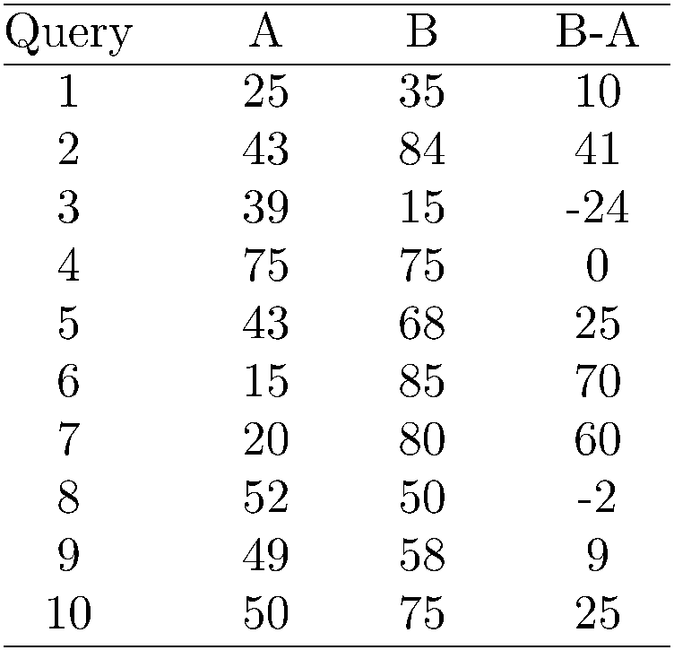
Example Experimental Results
Significance level: α = 0.05
Probability for B=A

Slide 76
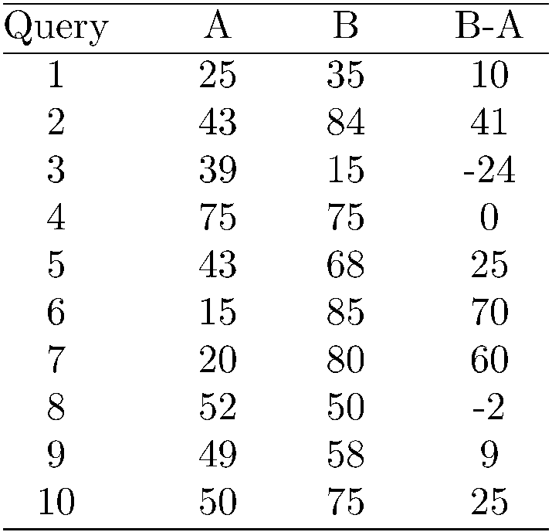
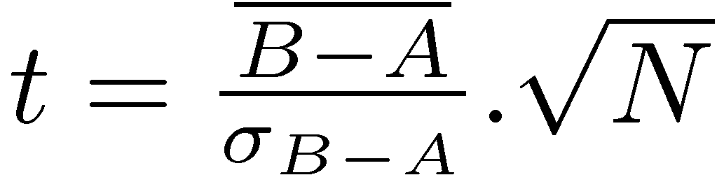
Example Experimental Results
t-test
t = 2.33 p-value = 0.02
Probability for B=A is 0.02
→ B is better than A
Avg 41.1 62.5
Significance level: α = 0.05
Probability for B=A

Slide 77
Outline
Recap
Unranked evaluation
Ranked evaluation
Evaluation benchmarks
Result summaries

Slide 78
What we need for a benchmark
  A collection of documents
    Documents must be representative of the documents we expect to see in reality.
  A collection of information needs
    . . .which we will often incorrectly refer to as queries
    Information needs must be representative of the information needs we expect to see in reality.
  Human relevance assessments
    We need to hire/pay “judges” or assessors to do this.
    Expensive, time-consuming
    Judges must be representative of the users we expect to see in reality.
78

Slide 79
Standard relevance benchmark: Cranfield
  Pioneering: first testbed allowing precise quantitative measures of information retrieval effectiveness
  Late 1950s, UK
  1398 abstracts of aerodynamics journal articles, a set of 225 queries, exhaustive relevance judgments of all query-document-pairs
  Too small, too untypical for serious IR evaluation today
79

Slide 80
Standard relevance benchmark: TREC
  TREC = Text Retrieval Conference (TREC)
  Organized by the U.S. National Institute of Standards and Technology (NIST)
  TREC is actually a set of several different relevance benchmarks.
  Best known: TREC Ad Hoc, used for first 8 TREC evaluations between 1992 and 1999
  1.89 million documents, mainly newswire articles, 450 information needs
  No exhaustive relevance judgments – too expensive
  Rather, NIST assessors’ relevance judgments are available only for the documents that were among the top k returned for some system which was entered in the TREC evaluation for which the information need was developed.
80

Slide 81
Standard relevance benchmarks: Others
  GOV2
    Another TREC/NIST collection
    25 million web pages
    Used to be largest collection that is easily available
    But still 3 orders of magnitude smaller than what Google/Yahoo/MSN index
  NTCIR
    East Asian language and cross-language information retrieval
  Cross Language Evaluation Forum (CLEF)
    This evaluation series has concentrated on European languages and cross-language information retrieval.
  Many others
81

Slide 82
Validity of relevance assessments
  Relevance assessments are only usable if they are consistent.
  If they are not consistent, then there is no “truth” and experiments are not repeatable.
  How can we measure this consistency or agreement among judges?
  → Kappa measure
82

Slide 83

Kappa measure
  Kappa is measure of how much judges agree or disagree.
  Designed for categorical judgments
  Corrects for chance agreement
  P(A) = proportion of time judges agree
  P(E) = what agreement would we get by chance
  k =? for (i) chance agreement (ii) total agreement
83

Slide 84
Kappa measure (2)
  Values of k in the interval [2/3, 1.0] are seen as acceptable.
  With smaller values: need to redesign relevance assessment methodology used etc.
84

Slide 85
Calculating the kappa statistic
Judge 1 Relevance | Judge 2 Relevance
 |  | Yes | No | Total
 | Yes | 300 | 20 | 320
 | No | 10 | 70 | 80
 | Total | 310 | 90 | 400
Observed proportion of
the times the judges agreed
P(A) = (300 + 70)/400 = 370/400 = 0.925
Pooled marginals
P(nonrelevant) = (80 + 90)/(400 + 400) = 170/800 = 0.2125
P(relevant) = (320 + 310)/(400 + 400) = 630/800 = 0.7878
Probability that the two judges agreed by chance P(E) =
P(nonrelevant)² + P(relevant)² = 0.2125² + 0.7878² = 0.665
Kappa statistic к = (P(A) − P(E))/(1 − P(E)) =
(0.925 − 0.665)/(1 − 0.665) = 0.776 (still in acceptable range)
85

Slide 86
Interjudge agreement at TREC
Information need | number of docs judged | disagreements
51 62 67 95 127 | 211 400 400 400 400 | 6 157 68 110 106
86

Slide 87
Impact of interjudge disagreement
  Judges disagree a lot. Does that mean that the results of information retrieval experiments are meaningless?
  No.
  Large impact on absolute performance numbers
  Virtually no impact on ranking of systems
  Suppose we want to know if algorithm A is better than algorithm B
  An information retrieval experiment will give us a reliable answer to this question . . .
  . . . even if there is a lot of disagreement between judges.
87

Slide 88
Evaluation at large search engines
  Recall is difficult to measure on the web
  Search engines often use precision at top k, e.g., k = 10 . . .
  . . . or use measures that reward you more for getting rank 1 right than for getting rank 10 right.
  Search engines also use non-relevance-based measures.
    Example 1: clickthrough on first result
    Not very reliable if you look at a single clickthrough (you may realize after clicking that the summary was misleading and the document is nonrelevant) . . .
    . . . but pretty reliable in the aggregate.
    Example 2: Ongoing studies of user behavior in the lab – recall last lecture
    Example 3: A/B testing
88

Slide 89
A/B testing
  Purpose: Test a single innovation
  Prerequisite: You have a large search engine up and running.
  Have most users use old system
  Divert a small proportion of traffic (e.g., 1%) to the new system that includes the innovation
  Evaluate with an “automatic” measure like clickthrough on first result
  Now we can directly see if the innovation does improve user happiness.
  Probably the evaluation methodology that large search engines trust most
89

Slide 90
Critique of pure relevance
  We’ve defined relevance for an isolated query-document pair.
  Alternative definition: marginal relevance
  The marginal relevance of a document at position k in the result list is the additional information it contributes over and above the information that was contained in documents d₁ . . . d_{k−1}.
  Exercise
    Why is marginal relevance a more realistic measure of user happiness?
    Give an example where a non-marginal measure like precision or recall is a misleading measure of user happiness, but marginal relevance is a good measure.
    In a practical application, what is the difficulty of using marginal measures instead of non-marginal measures?
90

Slide 91
Outline
Recap
Unranked evaluation
Ranked evaluation
Evaluation benchmarks
Result summaries

Slide 92
How do we present results to the user?
  Most often: as a list – aka “10 blue links”
  How should each document in the list be described?
  This description is crucial.
  The user often can identify good hits (= relevant hits) based on the description.
  No need to “click” on all documents sequentially
92

Slide 93
Doc description in result list
  Most commonly: doc title, url, some metadata . . .
  . . . and a summary
  How do we “compute” the summary?
93

Slide 94
Summaries
  Two basic kinds: (i) static (ii) dynamic
  A static summary of a document is always the same, regardless of the query that was issued by the user.
  Dynamic summaries are query-dependent. They attempt to explain why the document was retrieved for the query at hand.
94

Slide 95
Static summaries
  In typical systems, the static summary is a subset of the document.
  Simplest heuristic: the first 50 or so words of the document
  More sophisticated: extract from each document a set of “key” sentences
    Simple NLP heuristics to score each sentence
    Summary is made up of top-scoring sentences.
    Machine learning approach: see IIR 13
  Most sophisticated: complex NLP to synthesize/generate a summary
  For most IR applications: not quite ready for prime time yet
95

Slide 96
Dynamic summaries
  Present one or more “windows” or snippets within the document that contain several of the query terms.
  Prefer snippets in which query terms occurred as a phrase
  Prefer snippets in which query terms occurred jointly in a small window
  The summary that is computed this way gives the entire content of the window – all terms, not just the query terms.
96

Slide 97
A dynamic summary
Query: “new guinea economic development” Snippets (in bold)
that were extracted from a document: . . . In recent years, Papua
New Guinea has faced severe economic difficulties and
economic growth has slowed, partly as a result of weak governance
and civil war, and partly as a result of external factors such as the
Bougainville civil war which led to the closure in 1989 of the
Panguna mine (at that time the most important foreign exchange
earner and contributor to Government finances), the Asian
financial crisis, a decline in the prices of gold and copper, and a fall
in the production of oil. PNG’s economic development record
over the past few years is evidence that governance issues
underly many of the country’s problems. Good governance, which
may be defined as the transparent and accountable management of
human, natural, economic and financial resources for the purposes
of equitable and sustainable development, flows from proper public
sector management, efficient fiscal and accounting mechanisms,
and a willingness to make service delivery a priority in practice. . . .
97

Slide 98
  Google example for dynamic summaries
98

Slide 99
Generating dynamic summaries
  Where do we get these other terms in the snippet from?
  We cannot construct a dynamic summary from the positional inverted index – at least not efficiently.
  We need to cache documents.
  The positional index tells us: query term occurs at position 4378 in the document.
  Byte offset or word offset?
  Note that the cached copy can be outdated
  Don’t cache very long documents – just cache a short prefix
99

Slide 100
Dynamic summaries
  Real estate on the search result page is limited ! Snippets must be short . . .
  . . . but snippets must be long enough to be meaningful.
  Snippets should communicate whether and how the document answers the query.
  Ideally: linguistically well-formed snippets
  Ideally: the snippet should answer the query, so we don’t have to look at the document.
  Dynamic summaries are a big part of user happiness because . . .
    . . .we can quickly scan them to find the relevant document we then click on.
    . . . in many cases, we don’t have to click at all and save time.
100

Slide 101
Resources
  Chapter 8 of IIR
  Resources at http://ifnlp.org/ir
    The TREC home page – TREC had a huge impact on information retrieval evaluation.
    Originator of F-measure: Keith van Rijsbergen
    More on A/B testing
    Too much A/B testing at Google?
    Tombros & Sanderson 1998: one of the first papers on dynamic summaries
    Google VP of Engineering on search quality evaluation at Google
101

