Slide 1
Chapter 8: Deadlocks

Slide 2
Chapter 8: Deadlocks
System Model
Deadlock in Multithreaded Applications
Deadlock Characterization
Methods for Handling Deadlocks
Deadlock Prevention
Deadlock Avoidance
Deadlock Detection
Recovery from Deadlock

Slide 3
Chapter Objectives
Illustrate how deadlock can occur when mutex locks are used
Define the four necessary conditions that characterize deadlock
Identify a deadlock situation in a resource allocation graph
Evaluate the four different approaches for preventing deadlocks
Apply the banker’s algorithm for deadlock avoidance
Apply the deadlock detection algorithm
Evaluate approaches for recovering from deadlock

Slide 4
System Model
System consists of resources
Resource types R₁, R₂, . . ., R_{m}
CPU cycles, memory space, I/O devices
Each resource type R_{i} has W_{i} instances.
Each process utilizes a resource as follows:
request
use
release

Slide 5
Deadlock in Multithreaded Application
Two mutex locks are created an initialized:
The pthread mutex init() function initializes
an unlocked mutex. By passing NULL as a second
parameter, we initialize the mutex to its default attributes.
Mutex locks are acquired and released using
pthread mutex lock() and pthread mutex unlock(), respectively.
If a thread attempts to acquire a locked mutex, the call to pthread mutex lock() blocks the thread until the owner of the mutex lock invokes pthread mutex unlock()

Slide 6
Deadlock in Multithreaded Application
Deadlock
is possible if thread one acquires first mutex while thread two acquires
second mutex.

Slide 7
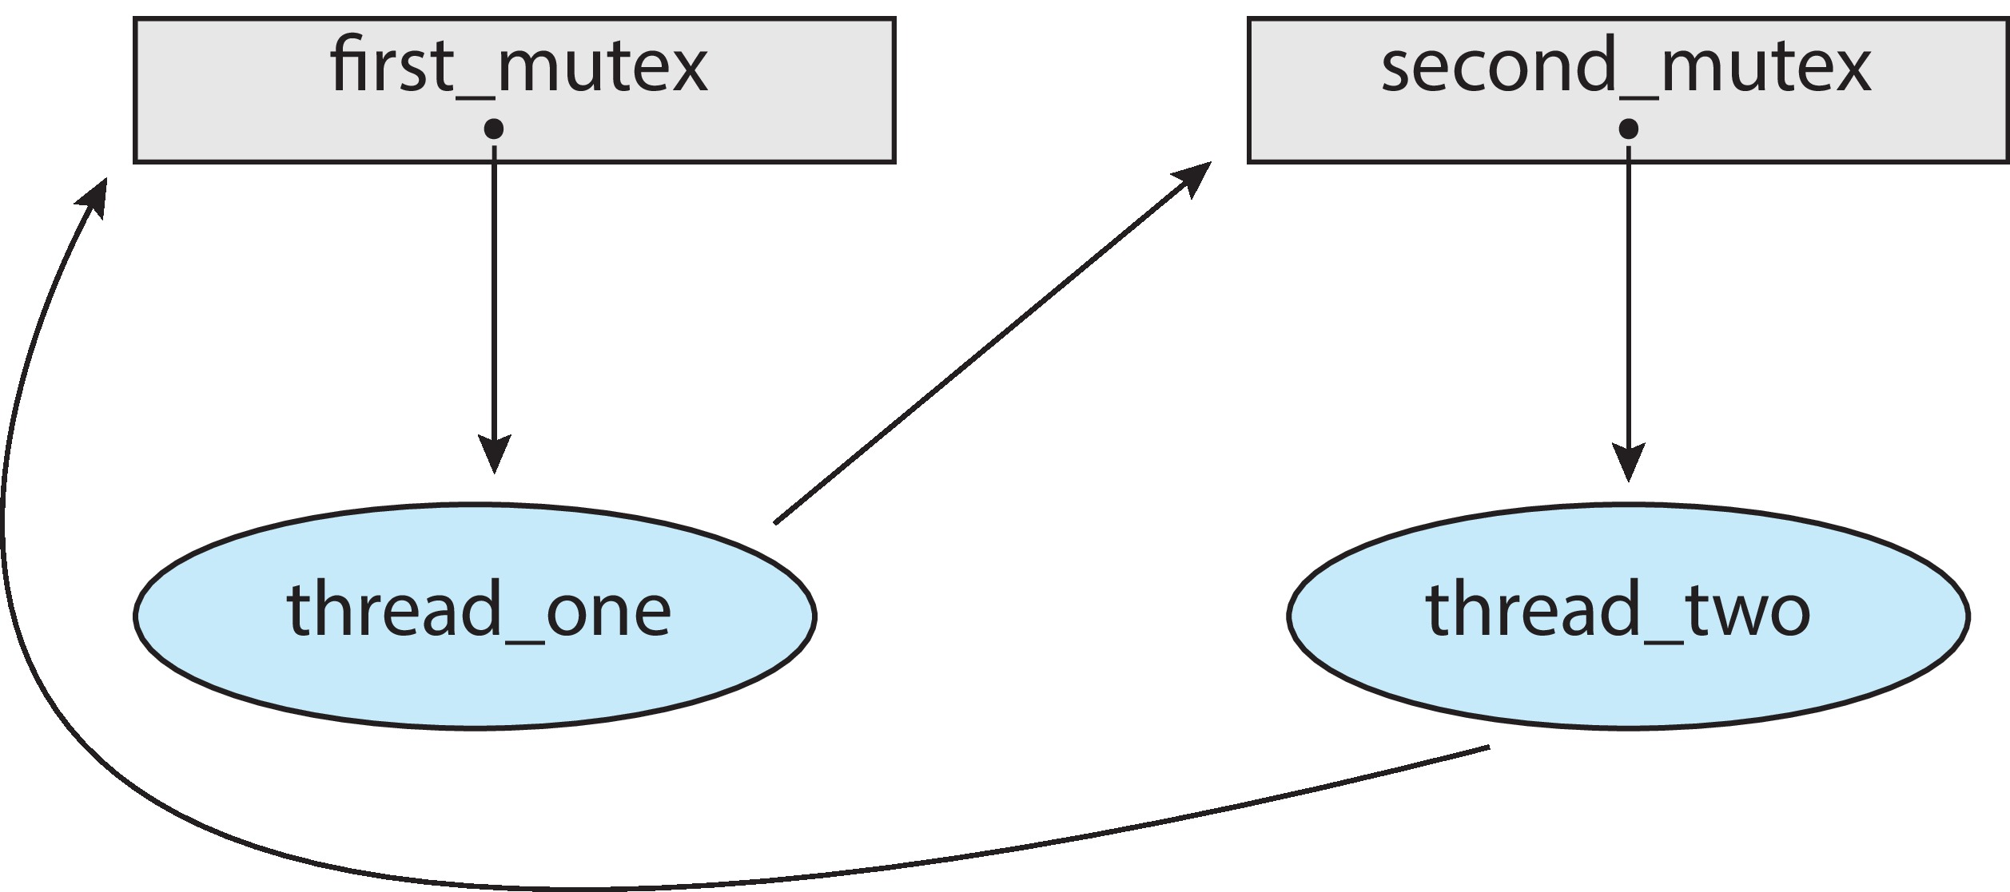
Deadlock in Multithreaded Application
Deadlock is possible if thread 1 acquires first_mutex and thread 2 acquires second_mutex. Thread 1 then waits for second_mutex and thread 2 waits for first_mutex.
Can be illustrated with a resource allocation graph:

Slide 8
Deadlock Characterization
Deadlock can arise if four conditions hold simultaneously.
Mutual exclusion: only one process at a time can use a resource
Hold and wait: a process holding at least one resource is waiting to acquire additional resources held by other processes
No preemption: a resource can be released only voluntarily by the process holding it, after that process has completed its task
Circular wait: there exists a set {P₀, P₁, …, P_{n}} of waiting processes such that P₀ is waiting for a resource that is held by P₁, P₁ is waiting for a resource that is held by P₂, …, P_{n–1} is waiting for a resource that is held by P_{n}, and P_{n} is waiting for a resource that is held by P₀.

Slide 9
Resource-Allocation Graph
A set of vertices V and a set of edges E.
V is partitioned into two types:
P = {P₁, P₂, …, P_{n}}, the set consisting of all the processes in the system
R = {R₁, R₂, …, R_{m}}, the set consisting of all resource types in the system
request edge – directed edge P_{i} → R_{j}
assignment edge – directed edge R_{j} → P_{i}

Slide 10
Resource-Allocation Graph (Cont.)
Process
Resource Type with 4 instances
P_{i} requests instance of R_{j}
P_{i} is holding an instance of R_{j}
P_{i}
R_{j}
P_{i}
R_{j}

Slide 11
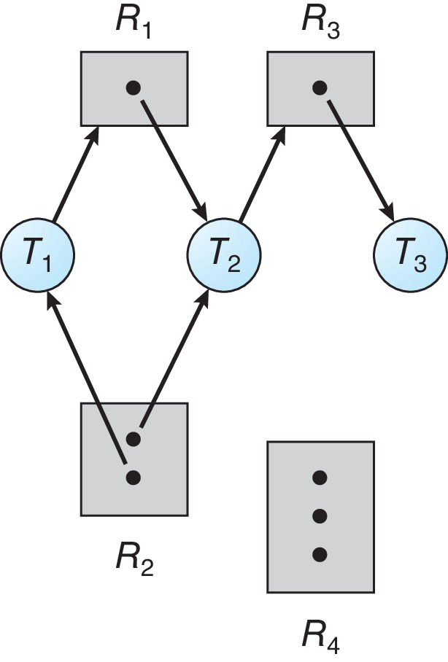
Resource Allocation Graph Example
One instance of R1
Two instances of R2
One instance of R3
Three instance of R4
T1 holds one instance of R2 and is waiting for an instance of R1
T2 holds one instance of R1, one instance of R2, and is waiting for an instance of R3
T3 is holds one instance of R3

Slide 12
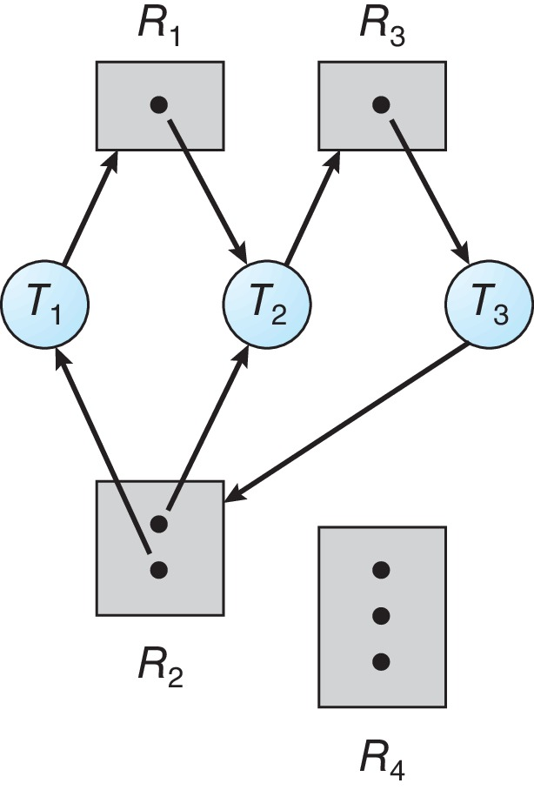
Resource Allocation Graph With A Deadlock
Given the definition of a resource-allocation graph, it can be shown that, if the graph contains no cycles, then no process in the system is deadlocked. If the graph does contain a cycle, then a deadlock may exist. If each resource type has exactly one instance, then a cycle implies that a deadlock has occurred. If each resource type has several instances, then a cycle does not necessarily imply that a deadlock has occurred. In this case, a cycle in the graph is a necessary but not a sufficient condition for the existence of deadlock.
Suppose that process T3 requests an instance of resource type R2. Since no resource instance is currently available,we add a request edge P3→ R2 to the graph (Figure 7.2). At this point, two minimal cycles exist in the
system:
T1 → R1 → T2 → R3 → T3 → R2 → T1
T2 → R3 → T3 → R2 → T2
Processes T1, T2, and T3 are deadlocked.

Slide 13
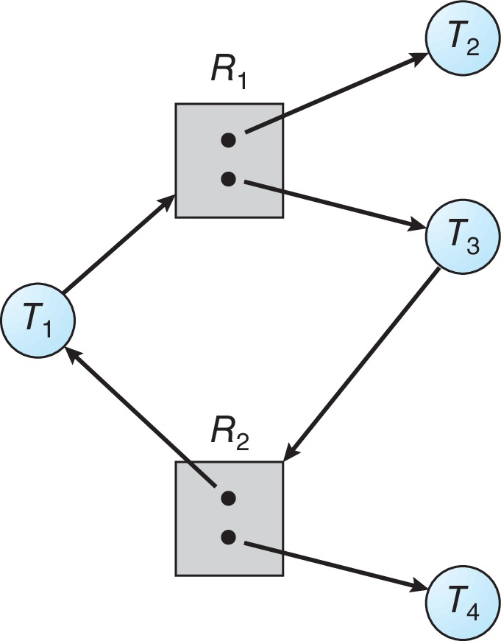
Graph With A Cycle But No Deadlock
Now consider the resource-allocation graph in Figure 7.3. In this example,
we also have a cycle:
T1 → R1 → T3 → R2 → T1
However, there is no deadlock. Observe that process T4 may release its instance of resource type R2. That resource can then be allocated to T3, breaking the cycle.
In summary, if a resource-allocation graph does not have a cycle, then the
system is not in a deadlocked state. If there is a cycle, then the system may or may not be in a deadlocked state.

Slide 14
Basic Facts
If graph contains no cycles ⇒ no deadlock
If graph contains a cycle ⇒
if only one instance per resource type, then deadlock
if several instances per resource type, possibility of deadlock

Slide 15
Methods for Handling Deadlocks
1. Ensure that the system will never enter a deadlock state:
Deadlock prevention
Deadlock avoidance
2. Allow the system to enter a deadlock state and then detect it, and recover
3. Ignore the problem and pretend that deadlocks never occur in the system.
The third solution is the one used by most operating systems, including Linux and Windows. It is then up to the application developer to write programs that handle deadlocks.

Slide 16
Deadlock Prevention
Invalidate one of the four necessary conditions for deadlock:
Mutual Exclusion – not required for sharable resources (e.g., read-only files); must hold for non-sharable resources
Hold and Wait – must guarantee that whenever a process requests a resource, it does not hold any other resources
Require process to request and be allocated all its resources before it begins execution, or allow process to request resources only when the process has none allocated to it.
Low resource utilization; starvation possible

Slide 17
Deadlock Prevention (Cont.)
No Preemption –
If a process that is holding some resources requests another resource that cannot be immediately allocated to it, then all resources currently being held are released
Preempted resources are added to the list of resources for which the process is waiting
Process will be restarted only when it can regain its old resources, as well as the new ones that it is requesting
Circular Wait – impose a total ordering of all resource types, and require that each process requests resources in an increasing order of enumeration

Slide 18
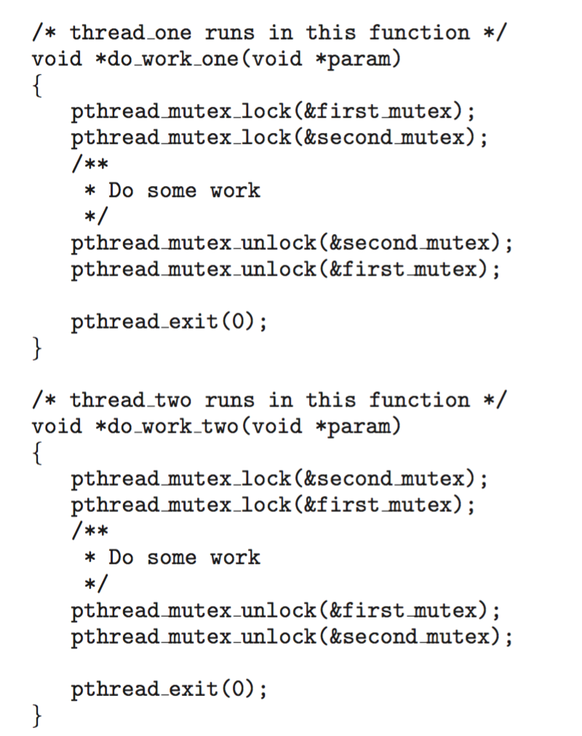
Circular Wait
Invalidating the circular wait condition is most common.
Simply assign each resource (i.e. mutex locks) a unique number.
Each process can request resources only in an increasing order of enumeration.
Resources must be acquired in order.
If: first_mutex = 1 second_mutex = 5 code for thread_two could not be written as follows:

Slide 19
Deadlock Avoidance
Requires that the system has some additional a priori information available
Simplest and most useful model requires that each process declare the maximum number of resources of each type that it may need
The deadlock-avoidance algorithm dynamically examines the resource-allocation state to ensure that there can never be a circular-wait condition
Resource-allocation state is defined by the number of available and allocated resources, and the maximum demands of the processes

Slide 20
Safe State
When a process requests an available resource, system must decide if immediate allocation leaves the system in a safe state
A state is safe if the system can allocate resources to each process (up to its maximum) in some order and still avoid a deadlock. More formally, a system is in a safe state only if there exists a safe sequence.
System is in safe state if there exists a sequence <P₁, P₂, …, P_{n}> of ALL the processes in the systems such that for each P_{i}, the resources that P_{i} can still request can be satisfied by currently available resources + resources held by all the P_{j}, with j < I
That is:
If P_{i} resource needs are not immediately available, then P_{i} can wait until all P_{j} have finished
When P_{j} is finished, P_{i} can obtain needed resources, execute, return allocated resources, and terminate
When P_{i} terminates, P_{i +1} can obtain its needed resources, and so on

Slide 21
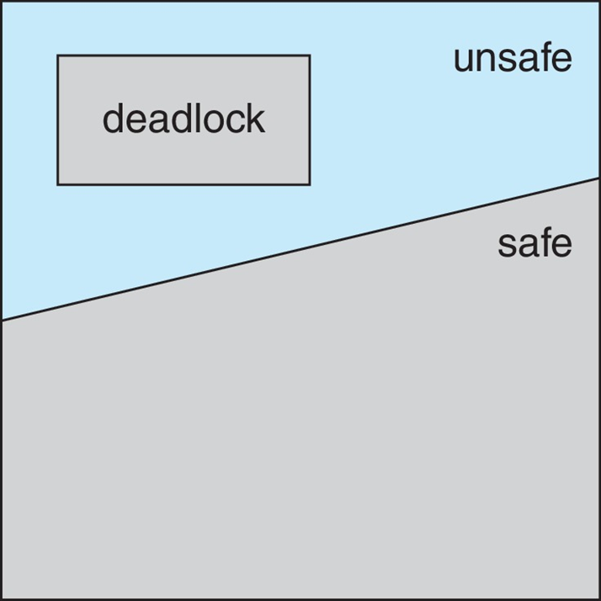
Basic Facts
If a system is in safe state ⇒ no deadlocks
If a system is in unsafe state ⇒ possibility of deadlock
Avoidance ⇒ ensure that a system will never enter an unsafe state.

Slide 22
Avoidance Algorithms
Single instance of a resource type
Use a resource-allocation graph
Multiple instances of a resource type
Use the Banker’s Algorithm

Slide 23
Resource-Allocation Graph Scheme
Claim edge P_{i} → R_{j} indicated that process P_{j} may request resource R_{j}; represented by a dashed line
Claim edge converts to request edge when a process requests a resource
Request edge converted to an assignment edge when the resource is allocated to the process
When a resource is released by a process, assignment edge reconverts to a claim edge
Resources must be claimed a priori in the system.
Suppose that process P_{i} requests a resource R_{j}
The request can be granted only if converting the request edge to an assignment edge does not result in the formation of a cycle in the resource allocation graph.

Slide 24
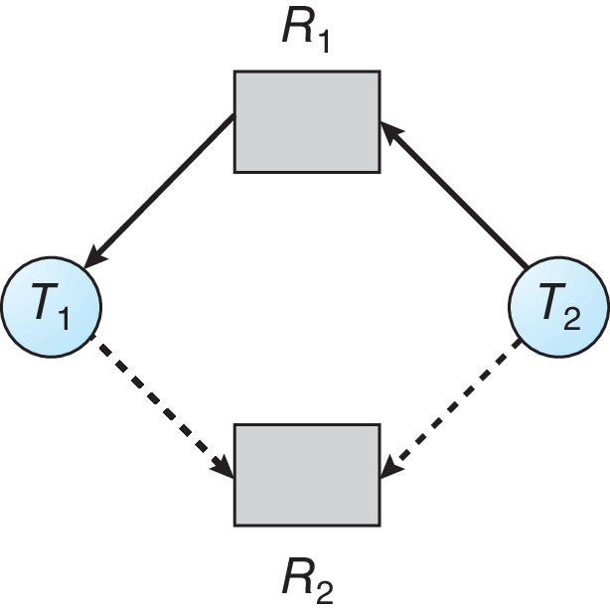
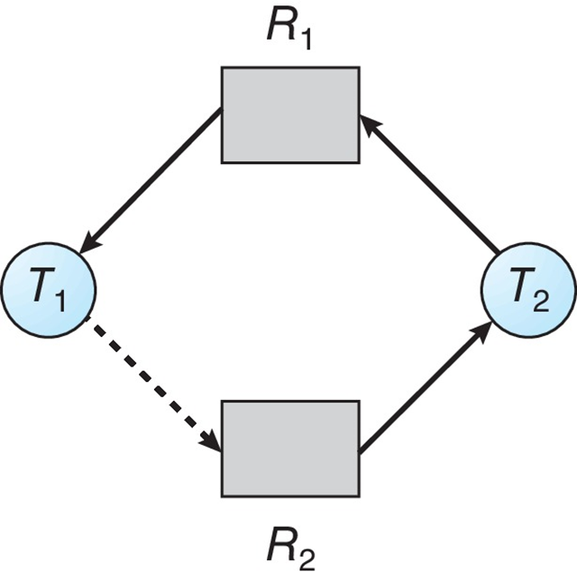
Resource-Allocation Graph
Consider the resource-allocation graph of Figure 7.7. Suppose that P2 requests R2. (P=T in graphs).
Although R2 is currently free, we cannot allocate it to P2, since this action will create a cycle in the graph (Figure 7.8). A cycle, as mentioned, indicates that the system is in an unsafe state. If P1 requests R2, and P2 requests R1, then a deadlock will occur.

Slide 25
Banker’s Algorithm
The resource-allocation-graph algorithm is not applicable to a resourceallocation system with multiple instances of each resource type.
For multiple instances of resources, the banker’s algorithm is used
Each process must a priori claim maximum use
When a process requests a resource it may have to wait
When a process gets all its resources it must return them in a finite amount of time

Slide 26
Data Structures for the Banker’s Algorithm
Let n = number of processes, and m = number of resources types.
Available: Vector of length m. If available [j] = k, there are k instances of resource type R_{j} available
Max: n x m matrix. If Max [i,j] = k, then process P_{i} may request at most k instances of resource type R_{j}
Allocation: n x m matrix. If Allocation[i,j] = k then P_{i} is currently allocated k instances of R_{j}
Need: n x m matrix. If Need[i,j] = k, then P_{i} may need k more instances of R_{j} to complete its task
Need [i,j] = Max[i,j] – Allocation [i,j]

Slide 27
Safety Algorithm
1. Let Work and Finish be vectors of length m and n, respectively. Initialize:
Work = Available
Finish [i] = false for i = 0, 1, …, n- 1
2. Find an i such that both:
(a) Finish [i] = false
(b) Need_{i} ≤ Work
If no such i exists, go to step 4
3. Work = Work + Allocation_{i} Finish[i] = true go to step 2
4. If Finish [i] == true for all i, then the system is in a safe state

Slide 28
Resource-Request Algorithm for Process P_{i}
Request_{i} = request vector for process P_{i}. If Request_{i} [j] = k then process P_{i} wants k instances of resource type R_{j}
1. If Request_{i} ≤ Need_{i} go to step 2. Otherwise, raise error condition, since process has exceeded its maximum claim
2. If Request_{i} ≤ Available, go to step 3. Otherwise P_{i} must wait, since resources are not available
3. Pretend to allocate requested resources to P_{i} by modifying the state as follows:
Available = Available – Request_{i};
Allocation_{i} = Allocation_{i} + Request_{i};
Need_{i} = Need_{i} – Request_{i};
If safe ⇒ the resources are allocated to P_{i}
If unsafe ⇒ P_{i} must wait, and the old resource-allocation state is restored

Slide 29
Example of Banker’s Algorithm
5 processes P₀ through P₄;
3 resource types:
A (10 instances), B (5instances), and C (7 instances)
Snapshot at time T₀:
Allocation Max Available
A B C A B C A B C
P₀ 0 1 0 7 5 3 3 3 2
P₁ 2 0 0 3 2 2
P₂ 3 0 2 9 0 2
P₃ 2 1 1 2 2 2
P₄ 0 0 2 4 3 3

Slide 30
Example (Cont.)
The content of the matrix Need is defined to be Max – Allocation
Need
A B C
P₀ 7 4 3
P₁ 1 2 2
P₂ 6 0 0
P₃ 0 1 1
P₄ 4 3 1
The system is in a safe state since the sequence < P₁, P₃, P₄, P₂, P₀> satisfies safety criteria

Slide 31
Example: P₁ Request (1,0,2)
Check that Request ≤ Available (that is, (1,0,2) ≤ (3,3,2) ⇒ true
Allocation Need Available
A B C A B C A B C
P₀ 0 1 0 7 4 3 2 3 0
P₁ 3 0 2 0 2 0
P₂ 3 0 2 6 0 0
P₃ 2 1 1 0 1 1
P₄ 0 0 2 4 3 1
Executing safety algorithm shows that sequence < P₁, P₃, P₄, P₀, P₂> satisfies safety requirement
Can request for (3,3,0) by P₄ be granted?
Can request for (0,2,0) by P₀ be granted?

Slide 32
Deadlock Detection
Allow system to enter deadlock state
Detection algorithm
Recovery scheme

Slide 33
Single Instance of Each Resource Type
Maintain wait-for graph
Nodes are processes
P_{i} → P_{j} if P_{i} is waiting for P_{j}
Periodically invoke an algorithm that searches for a cycle in the graph. If there is a cycle, there exists a deadlock
An algorithm to detect a cycle in a graph requires an order of n² operations, where n is the number of vertices in the graph

Slide 34
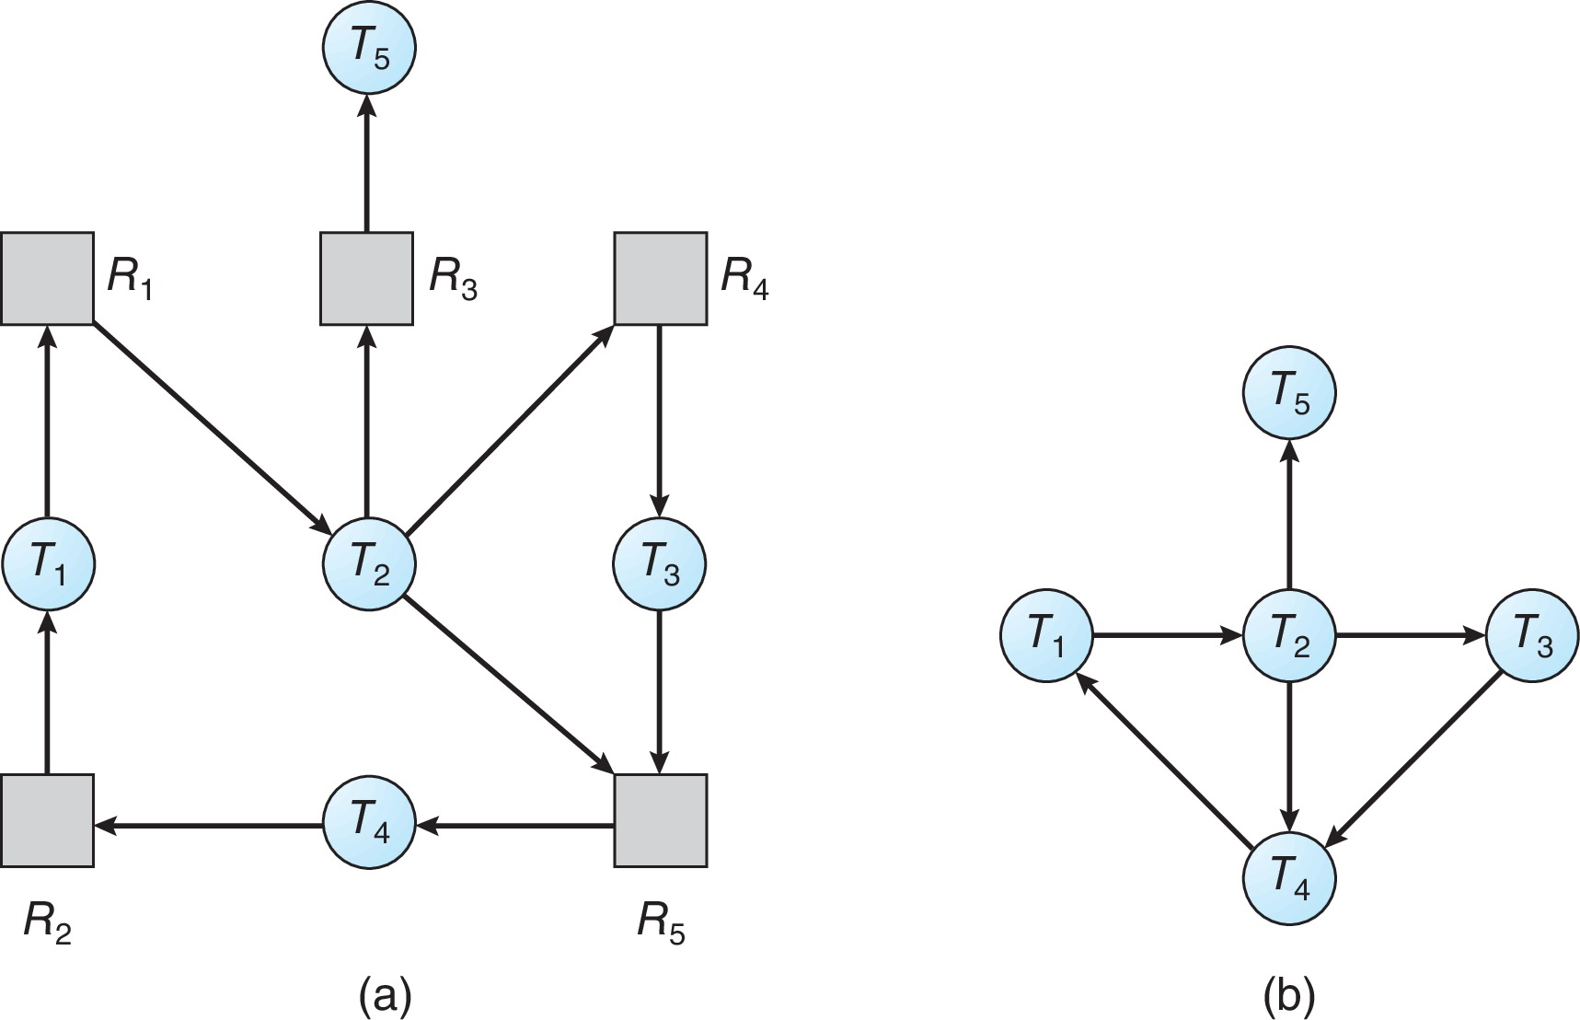
Resource-Allocation Graph and Wait-for Graph
Resource-Allocation Graph
Corresponding wait-for graph

Slide 35
Several Instances of a Resource Type
Available: A vector of length m indicates the number of available resources of each type
Allocation: An n x m matrix defines the number of resources of each type currently allocated to each process
Request: An n x m matrix indicates the current request of each process. If Request [i][j] = k, then process P_{i} is requesting k more instances of resource type R_{j}.

Slide 36
Detection Algorithm
1. Let Work and Finish be vectors of length m and n, respectively Initialize:
(a) Work = Available
(b) For i = 1,2, …, n, if Allocation_{i} ≠ 0, then Finish[i] = false; otherwise, Finish[i] = true
2. Find an index i such that both:
(a) Finish[i] == false
(b) Request_{i} ≤ Work
If no such i exists, go to step 4

Slide 37
Detection Algorithm (Cont.)
3. Work = Work + Allocation_{i} Finish[i] = true go to step 2
4. If Finish[i] == false, for some i, 1 ≤ i ≤ n, then the system is in deadlock state. Moreover, if Finish[i] == false, then P_{i} is deadlocked
Algorithm requires an order of O(m x n²) operations to detect whether the system is in deadlocked state

Slide 38
Example of Detection Algorithm
Five processes P₀ through P₄; three resource types A (7 instances), B (2 instances), and C (6 instances)
Snapshot at time T₀:
Allocation Request Available
A B C A B C A B C
P₀ 0 1 0 0 0 0 0 0 0
P₁ 2 0 0 2 0 2
P₂ 3 0 3 0 0 0
P₃ 2 1 1 1 0 0
P₄ 0 0 2 0 0 2
Sequence <P₀, P₂, P₃, P₁, P₄> will result in Finish[i] = true for all i

Slide 39
Example (Cont.)
P₂ requests an additional instance of type C
Request
A B C
P₀ 0 0 0
P₁ 2 0 2
P₂ 0 0 1
P₃ 1 0 0
P₄ 0 0 2
State of system?
Can reclaim resources held by process P₀, but insufficient resources to fulfill other processes; requests
Deadlock exists, consisting of processes P₁, P₂, P₃, and P₄

Slide 40
Detection-Algorithm Usage
When, and how often, to invoke depends on:
How often a deadlock is likely to occur?
How many processes will need to be rolled back?
one for each disjoint cycle
If detection algorithm is invoked arbitrarily, there may be many cycles in the resource graph and so we would not be able to tell which of the many deadlocked processes “caused” the deadlock.

Slide 41
Recovery from Deadlock: Process Termination
Abort all deadlocked processes
Abort one process at a time until the deadlock cycle is eliminated
In which order should we choose to abort?
Priority of the process
How long process has computed, and how much longer to completion
Resources the process has used
Resources process needs to complete
How many processes will need to be terminated
Is process interactive or batch?

Slide 42
Recovery from Deadlock: Resource Preemption
Selecting a victim – minimize cost
Rollback – return to some safe state, restart process for that state
Starvation – same process may always be picked as victim, include number of rollback in cost factor

Slide 43
End of Chapter 8

