Slide 1
Data Representation
Prof. Dr. Selim Akyokuş
sakyokus@medipol.edu.tr

Slide 2
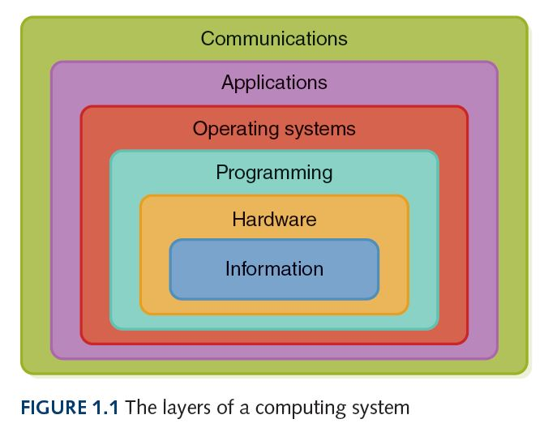
Layers of a Computing System
Data /
4

Slide 3
Data Representation
Computers can represent any INFORMATION that can be discretized and digitized
Algorithms (Programs) process and transform data
  Search for patterns
  Create simulations
  Generate knowledge and insight
How do computers store or represent data about common digital artifacts?
  Numbers, text, images, sounds, and video

Slide 4
Analog and Digital Information
Information can be represented in one of two ways: analog or digital
  Analog data
  A continuous representation, analogous to the actual information it represents
  Digital data
  A discrete representation, breaking the information up into separate elements

Slide 5
Analog and Digital Information
Computers cannot work well with analog data, so we digitize the data
Digitize
Breaking data into pieces and representing those pieces separately
Why do we use binary to represent digitized data?

Slide 6
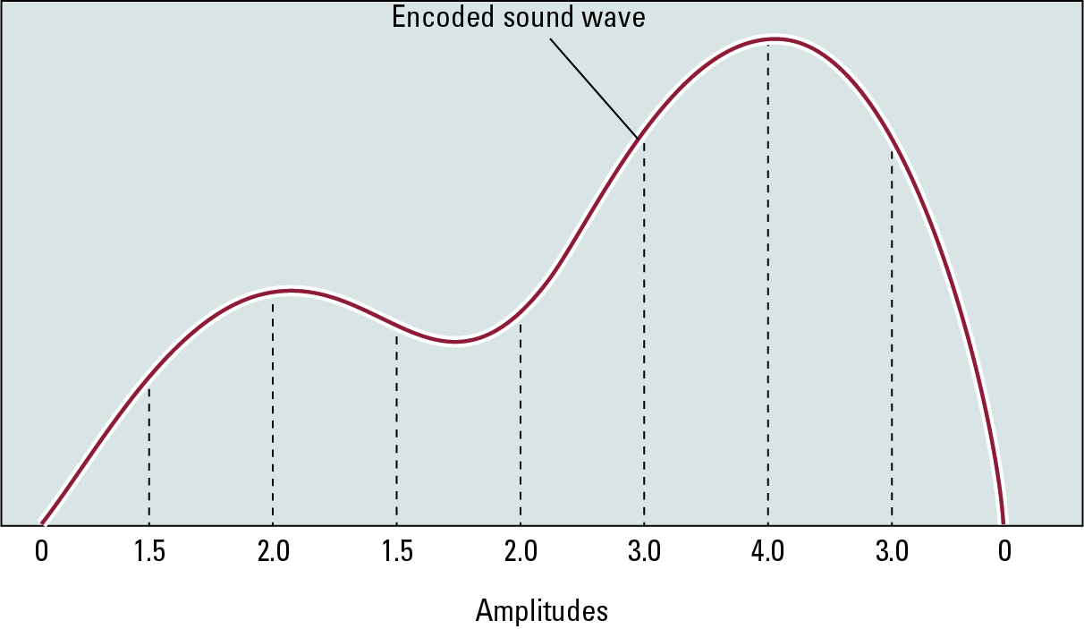
The sound wave represented by the sequence 0, 1.5, 2.0, 1.5, 2.0, 3.0, 4.0, 3.0, 0

Slide 7
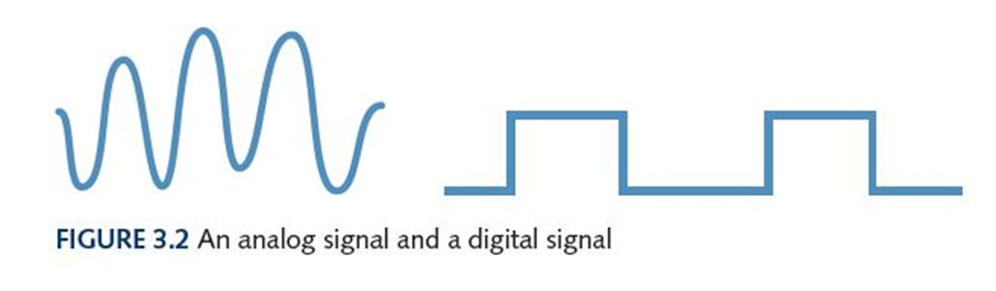
Electronic Signals
Important facts about electronic signals
An analog signal continually fluctuates in voltage up and down
A digital signal has only a high or low state, corresponding to the two binary digits
All electronic signals (both analog and digital) degrade as they move down a line
The voltage of the signal fluctuates due to environmental effects

Slide 8
Binary Numbers and Computers
Computers have storage units called binary digits or bits
Low Voltage = 0
High Voltage = 1 all bits have 0 or 1
… or the other way around, but we don’t need to worry about that
22

Slide 9
Number Systems
Natural Numbers
Zero and any number obtained by repeatedly adding one to it.
Examples: 100, 0, 45645, 32
Negative Numbers
A value less than 0, with a – sign
Examples: -24, -1, -45645, -32
2

Slide 10
Numbers
Integers
A natural number, a negative number
Examples: 249, 0, - 45645, - 32
Rational Numbers
An integer or the quotient of two integers
Examples: -249, -1, 0, 3/7, -2/5
3

Slide 11
Positional Notation
How many ones are there in 642?
600 + 40 + 2 ?
Or is it
384 + 32 + 2 ?
Or maybe…
1536 + 64 + 2 ?
4

Slide 12
Positional Notation
Aha!
642 is 600 + 40 + 2 in BASE 10
The base of a number determines the number of different digit symbols (numerals) and the values of digit positions
5

Slide 13
Positional Notation
Continuing with our example…
642 in base 10 positional notation is:
6 x 10² = 6 x 100 = 600
+ 4 x 10¹ = 4 x 10 = 40
+ 2 x 10º = 2 x 1 = 2 = 642 in base 10
The power indicates
the position of
the number
This number is in
base 10
6

Slide 14
Positional Notation
R is the base
of the number
As a formula:
d_{n} * R^{n-1} + d_{n-1} * R^{n-2} + ... + d₂ * R¹ + d₁ * R⁰
n is the number of
digits in the number
d is the digit in the
i^{th} position
in the number
642 is 6 * 10² + 4 * 10 ⁺ 2 * 1
7

Slide 15
Positional Notation
What if 642 has the base of 13?
642 in base 13 is equivalent to 1068
in base 10
+ 6 x 13² = 6 x 169 = 1014
+ 4 x 13¹ = 4 x 13 = 52
+ 2 x 13º = 2 x 1 = 2
= 1068 in base 10
6
8

Slide 16
Binary
Decimal is base 10 and has 10 digit symbols: 0,1,2,3,4,5,6,7,8,9
Binary is base 2 and has 2 digit symbols:
0,1
For a number to exist in a given base, it can only contain the digits in that base, which range from 0 up to (but not including) the base.
What bases can these numbers be in? 122, 198, 178, G1A4
9

Slide 17
Bases Higher than 10
How are digits in bases higher than 10 represented?
With distinct symbols for 10 and above.
Base 16 has 16 digits:
0,1,2,3,4,5,6,7,8,9,A,B,C,D,E, and F
10

Slide 18
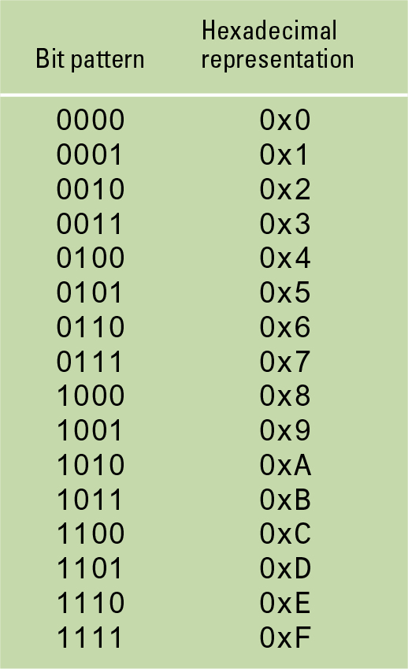
The hexadecimal coding system

Slide 19
Converting Octal to Decimal
- Octal means Base 8
- What is the decimal equivalent of the octal number 642?
6 x 8² = 6 x 64 = 384
+ 4 x 8¹ = 4 x 8 = 32
+ 2 x 8º = 2 x 1 = 2
= 418 in base 10
11

Slide 20
Converting Hexadecimal to Decimal
What is the decimal equivalent of the hexadecimal number DEF?
D x 16² = 13 x 256 = 3328
+ E x 16¹ = 14 x 16 = 224
+ F x 16º = 15 x 1 = 15
= 3567 in base 10
Remember, the digit symbols in base 16 are 0,1,2,3,4,5,6,7,8,9,A,B,C,D,E,F

Slide 21
Converting Binary to Decimal
What is the decimal equivalent of the binary number 1101110?
1 x 2⁶ = 1 x 64 = 64
+ 1 x 2⁵ = 1 x 32 = 32
+ 0 x 2⁴ = 0 x 16 = 0
+ 1 x 2³ = 1 x 8 = 8
+ 1 x 2² = 1 x 4 = 4
+ 1 x 2¹ = 1 x 2 = 2
+ 0 x 2º = 0 x 1 = 0
= 110 in base 10
13

Slide 22
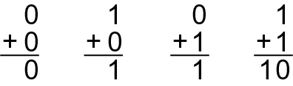
The binary addition

Slide 23
Arithmetic in Binary
Remember that there are only 2 digit symbols in binary, 0 and 1
1 + 1 is 0 with a carry
Carry Values
1 0 1 1 1 1 1
1 0 1 0 1 1 1
+1 0 0 1 0 1 1
1 0 1 0 0 0 1 0
14

Slide 24
Converting Binary to Octal
Mark groups of three (from right)
Convert each group
10101011 10 101 011
2 5 3
10101011 is 253 in base 8
17

Slide 25
Converting Binary to Hexadecimal
Mark groups of four (from right)
Convert each group
10101011 1010 1011
A B
10101011 is AB in base 16
18

Slide 26
Converting Decimal to Other Bases
Algorithm for converting number in base 10 to other bases
While (the quotient is not zero)
  Divide the decimal number by the new base
  Make the remainder the next digit to the left in the answer
  Replace the original decimal number with the quotient
19

Slide 27
Converting Decimal to Octal
What is 1988 (base 10) in base 8?
Try it!

Slide 28
Converting Decimal to Octal
248 31 3 0
8 1988 8 248 8 31 8 3
16 24 24 0
38 08 7 3
32 8
68 0
64
4
Answer is : 3 7 0 4

Slide 29
Converting Decimal to Hexadecimal
What is 3567 (base 10) in base 16?
Try it!
20

Slide 30
Converting Decimal to Hexadecimal
222 13 0
16 3567 16 222 16 13
32 16 0
36 62 13
32 48
47 14
32
15
D E F
21

Slide 31
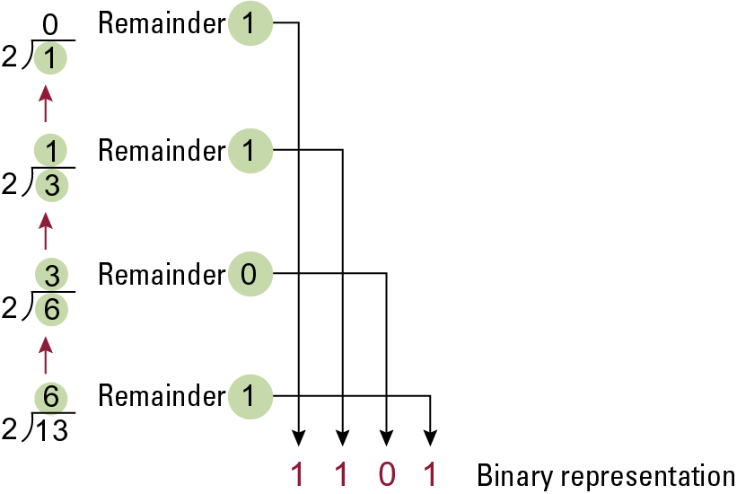
Applying the algorithm to obtain the binary representation of thirteen

Slide 32
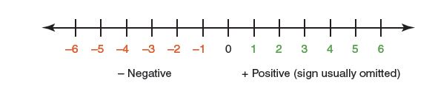
Representing Negative Values
Signed-magnitude number representation
Used by humans
The sign represents the ordering (the negatives come before the positives in ascending order)
The digits represent the magnitude (the distance from zero)

Slide 33
Representing Negative Values
Problem: Two zeroes (positive and negative)
No problem for humans, but would cause unnecessary complexity in computers
Solution: Represent integers by associating them with natural numbers
Half the natural numbers will represent themselves
The other half will represent negative integers

Slide 34
How to Represent Integer Numbers ?
Two’s complement notation: The most popular means of representing integer values with negative values
Allows the use of the same circuit for both addition and subtraction

Slide 35
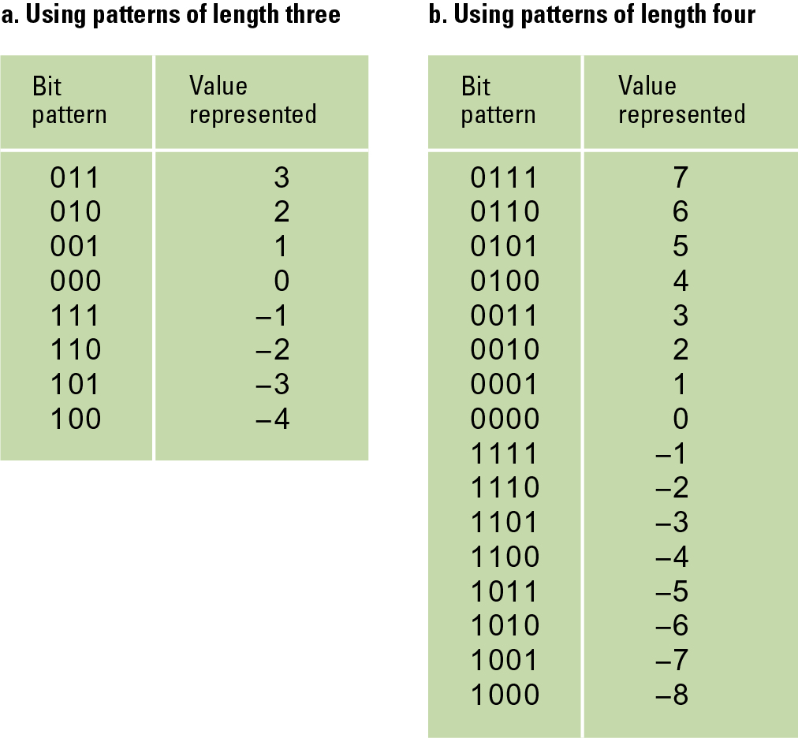
Two’s complement notation systems

Slide 36
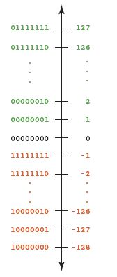
Representing Negative Values
Two’s Complement
(The binary number line is easier to read when written vertically)
Remember our table showing how to represent natural numbers?
Do you notice something interesting about the left-most bit?

Slide 37
Two’s Complement Conversion
Negate numbers (Change 1s to 0s and 0s to 1s, and add 1)
13₁₀ =1101₂
- 13₁₀ = 0011₂
  Two’s Complement Representation:
  0010 + 1 = 0011

Slide 38
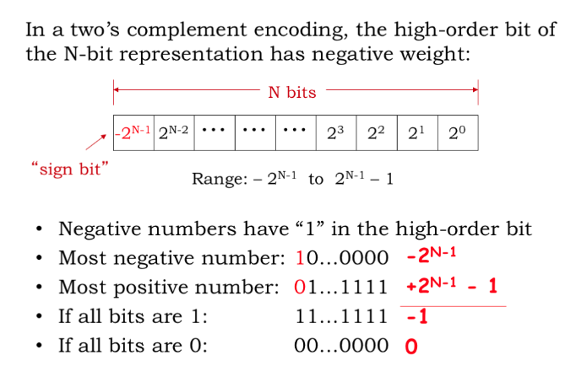
Signed Two’s Complement Representation

Slide 39
Representing Negative Values
Addition and subtraction are the same as in ten’s complement arithmetic
    -127 10000001
    + 1 00000001
    -126 10000010
What if the computed value won't fit?

Slide 40
Number Overflow
If each value is stored using 8 bits, then 127 + 3 overflows:
01111111
+ 00000011
10000010
Apparently, 127 + 3 is -126. Remember when we said we would always fail in our attempt to map an infinite world onto a finite machine?
Most computers use 32 or 64 bits for integers, but there are always infinitely many that aren’t represented

Slide 41
Representing Real Numbers
Real numbers are numbers with a whole part and a fractional part (either of which may be zero)
104.32
0.999999
357.0
3.14159
In decimal, positions to the right of the decimal point are the tenths, hundredths, thousandths, etc.:
10⁻¹, 10⁻² , 10⁻³ …

Slide 42
Representing Real Numbers
Same rules apply in binary as in decimal
Radix point is general term for “decimal point”
Positions to the right of the radix point in binary:
2⁻¹ (halves position),
2⁻² (quarters position),
2⁻³ (eighths position)
…

Slide 43
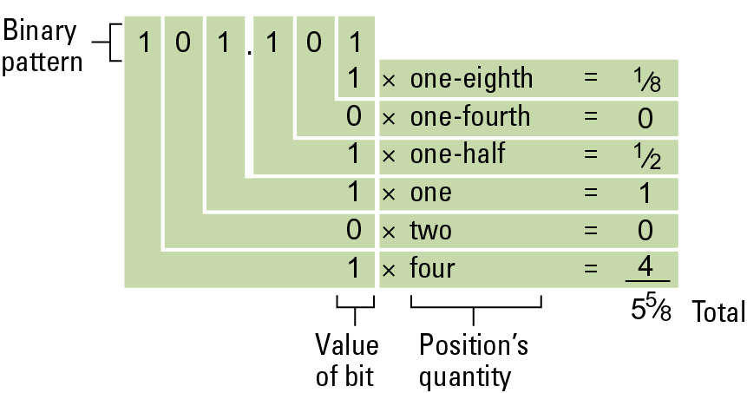
Decoding the binary representation 101.101

Slide 44
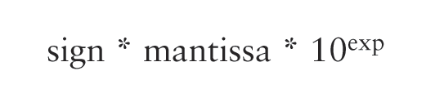
Representing Real Numbers
A real value in base 10 can be defined by the following formula where the mantissa is an integer
This representation is called floating point because the radix point “floats”
In analogy to the fixed number of bits that computers use to represent integers, we’ll treat the mantissa as having a fixed number of digits

Slide 45
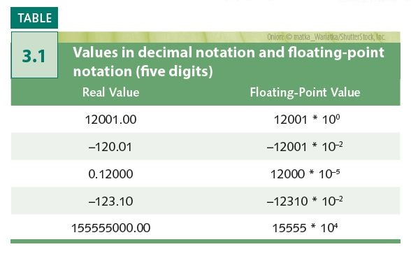
Representing Real Numbers
Floating-point in binary:
sign * mantissa * 2^{exp}
Only the base value is
different from decimal
Fundamentally, the
floating-point used by
computers is very similar,
but uses complicated
tricks to represent more
numbers and improve
efficiency

Slide 46
Storing Fractions in Binary
Floating-point Notation: Consists of a sign bit, a mantissa field, and an exponent field.
  Normalized form: fill the mantissa starting with the left-most 1

Slide 47
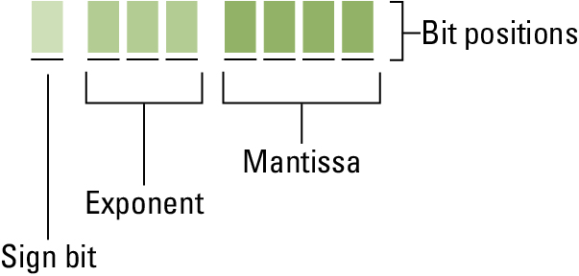
Floating-point notation components

Slide 48
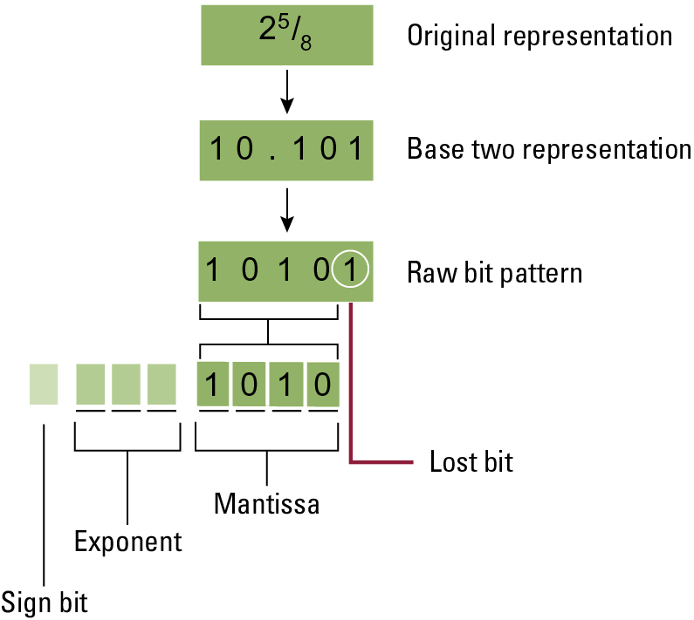
Encoding the value 2 ⁵⁄₈

Slide 49
Truncation (Round-off) Errors
Occur when part of the value being stored is lost because the mantissa is not large enough
Non-terminating expansions of fractions
  This happens more often with binary notation
  The value of one-tenth cannot be stored exactly binary notation
  Often these values are converted to integers

Slide 50
Representing Text
What must be provided to represent text?
The number of characters to represent is finite (whew!), so list them all and assign each a binary string
Character set
A list of characters and the codes used to represent each one
Computer manufacturers agreed to standardize

Slide 51
The ASCII Character Set
ASCII stands for American Standard Code for Information Interchange
ASCII originally used seven bits to represent each character, allowing for 128 unique characters
Later extended ASCII evolved so that all eight bits were used
How many characters could be represented?

Slide 52
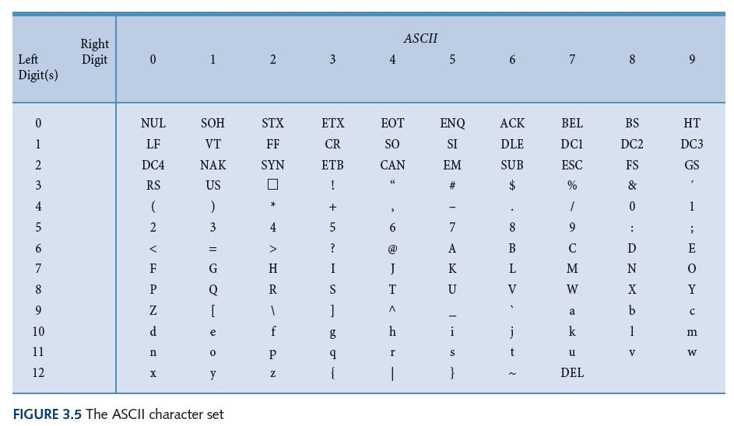
ASCII Character Set Mapping

Slide 53
The ASCII Character Set
The first 32 characters in the ASCII character chart do not have a simple character representation to print to the screen
What do you think they are used for?

Slide 54
The Unicode Character Set
Extended ASCII is not enough for international use
One Unicode mapping usually uses 16 bits per character
How many characters can this mapping represent?
The first 256 characters correspond exactly to the extended ASCII character set

Slide 55
The message “Hello.” in ASCII or UTF-8 encoding

Slide 56
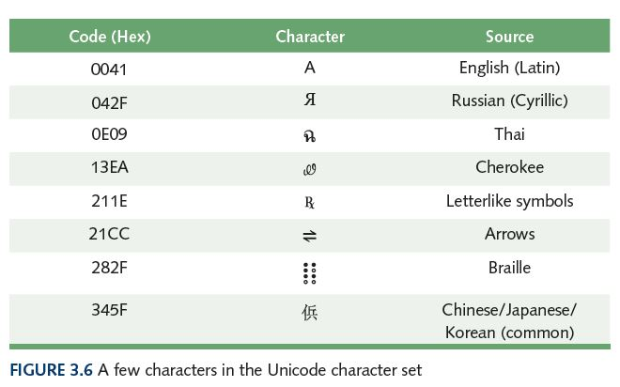
The Unicode Character Set

Slide 57
Summary of Text Coding Standards
Each character (letter, punctuation, etc.) is assigned a unique bit pattern.
  ASCII: Uses patterns of 7-bits to represent most symbols used in written English text
  Extended ASCII: uses 8-bits
  ISO developed a number of 8 bit extensions to ASCII, each designed to accommodate a major language group
  Unicode: Uses patterns up to 21-bits to represent the symbols used in languages world wide, 16-bits for world’s commonly used languages

Slide 58
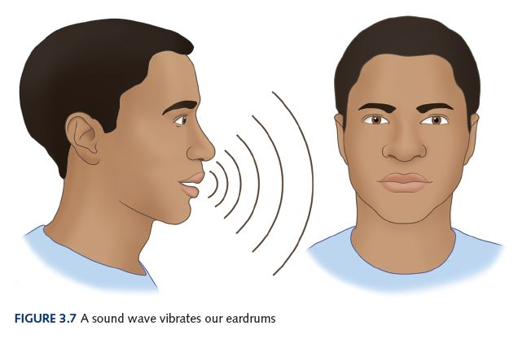
Representing Audio Information
We perceive sound when a series of air pressure waves vibrate a
membrane in our ear, which sends signals to our brain

Slide 59
Representing Audio Information
Your parents may use a “stereo” to listen to music at home. It sends an electrical signal to each speaker, which then vibrates to produce sound. Your MP3 player and ear buds do the same thing.
The signal controls the motion of a membrane in the speaker, which in turn creates the pressure waves that reach our ears
Thus, the signal is an analog representation of the sound wave

Slide 60
Representing Audio Information
Digitize the signal by
  Sampling: periodically measure the voltage
  Quantization: represent the voltage as a number using a finite number of bits
How often should we sample?
A sampling rate of about 40,000 times per second is enough to create a reasonable sound reproduction

Slide 61
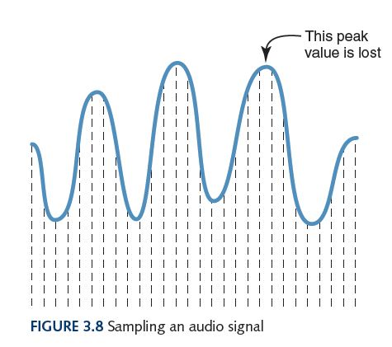
Representing Audio Information
Some data
is lost, but a
reasonable
sound is
reproduced

Slide 62
Audio Formats
Audio Formats
  WAV, AU, AIFF, VQF, and MP3
  Use various compression techniques
MP3 is dominant
  MPEG-2, audio layer 3 file
  MPEG = Motion Picture Experts Group
  Based on studies of interrelation between ear and brain, discards frequency information that isn’t perceived by humans (science!)
  Additional compression by a form of Huffman encoding
  Is this a lossy or lossless compression (or both)?

Slide 63
Representing Images and Graphics
Color
We take it for granted, but what is it really?
Retinas of our eyes have three types of photoreceptor cone cells
Each type responds to a different set of frequencies of light
Our brain translates that response into a perception of red, green, or blue

Slide 64
Representing Images and Graphics
Color is expressed as an RGB (red-green-blue) value – three numbers that indicate the relative contribution of each of these three primary colors
An RGB value of (255, 255, 0) maximizes the contribution of red and green, and minimizes the contribution of blue, which results in a bright yellow

Slide 65
Representing Images and Graphics
Color depth
The amount of data that is used to represent a color
HiColor
A 16-bit color depth: five bits used for each number in an RGB value with the extra bit sometimes used to represent transparency
TrueColor
A 24-bit color depth: eight bits used for each number in an RGB value

Slide 66
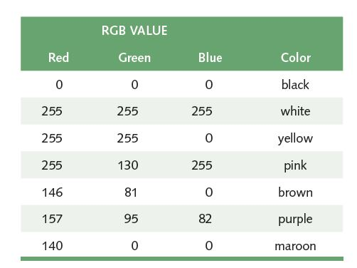
Representing Images and Graphics
A few TrueColor
RGB values and
the colors they
represent

Slide 67
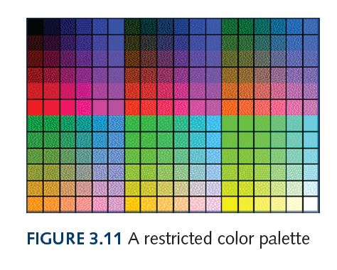
Representing Images and Graphics
A color palette is a set of colors, for example
Colors supported by a monitor
Web-safe colors for use with Internet browsers
Colors from which user can choose
Colors used in an image

Slide 68
Digitized Images and Graphics
Pixels (picture elements)
  Dots of color in image (or display device)
Resolution
  Number of pixels in image (or device)
Raster Graphics
  Treat image as collection of pixels
  Most common formats: BMP, GIF, PNG, and JPEG
Vector Graphics
  Treat image as collection of geometric objects
  Most important formats: Flash and SVG

Slide 69
Digitized Images and Graphics
BMP (bitmap)
  TrueColor color depth, or less to reduce file size
  Well suited for compression by run-length encoding
GIF (indexed color)
  File explicitly includes palette of 256 or fewer colors
  Each pixel thus requires only 8 or fewer bits
  Animated GIFs are short sequences of images
PNG (Portable Network Graphics)
  Intended to replace GIFs
  Greater compression with wider range of color depths
  No animation

Slide 70
Digitized Images and Graphics
JPEG (Joint Photographic Experts Group)
  Averages hues over short distances
    Why? Human vision tends to blur colors together within small areas (science!)
    How? Transform from the spatial domain to the frequency domain, then discard high frequency components (math!)
    Sound familiar? Essentially the same idea used in MP3
  Adjustable degree of compression
Raster graphics recap: BMP, GIF, PNG, and JPEG
Which use lossless compression? Lossy?
Which would you use for line art? For a color photograph?

Slide 71
Representing Video
Video codec COmpressor/DECompressor Methods used to shrink the size of a movie to allow it to be played on a computer or over a network
Almost all video codecs use lossy compression to minimize the huge amounts of data associated with video

Slide 72
Representing Video
Temporal compression
A technique based on differences between consecutive frames: If most of an image in two frames has not changed, why should we waste space duplicating information?
Spatial compression
A technique based on removing repetitive information within a frame: This problem is essentially the same as that faced when compressing still images

Slide 73
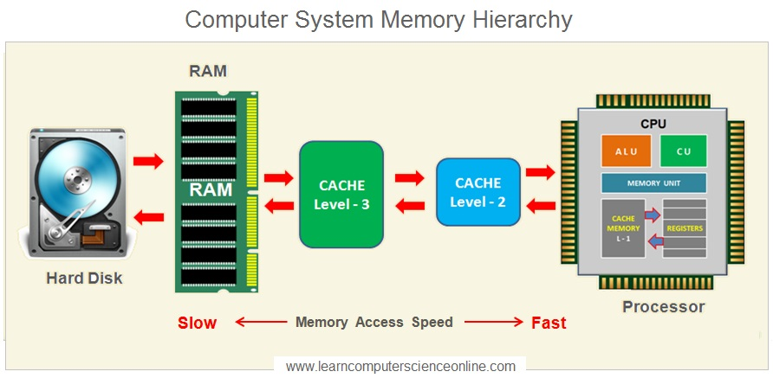
Data Storage Devices

Slide 74
Bit, Byte, and Word
Byte
8 bits
The number of bits in a word determines the word length of the computer, which is usually a multiple of 8
  32-bit machines
  64-bit machines etc.
23

Slide 75
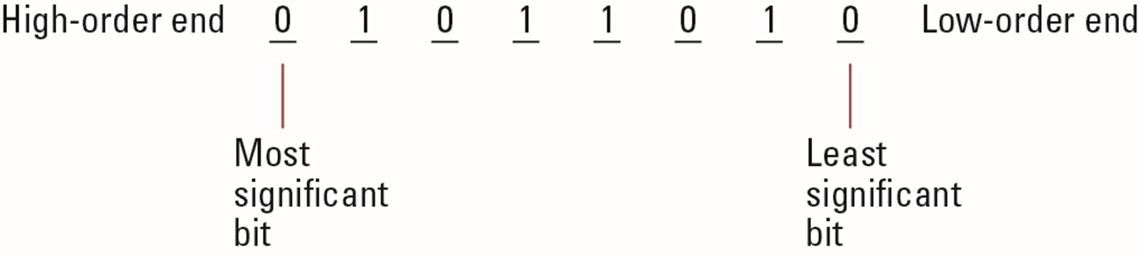
Main Memory
Cell: A unit of main memory (typically 8 bits which is one byte)
  Most significant bit: the bit at the left (high-order) end
  Least significant bit: the bit at the right (low-order) end

Slide 76
Main Memory Addresses
Address: A “name” that uniquely identifies one cell in the computer’s main memory
  The names are actually numbers.
  These numbers are assigned consecutively starting at zero.
  Numbering the cells in this manner associates an order with the memory cells.

Slide 77
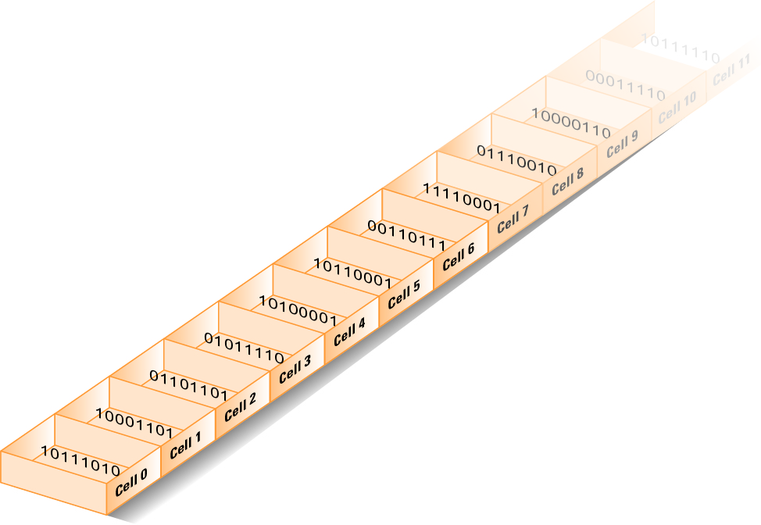
Memory cells arranged by address

Slide 78
Memory Terminology
Random Access Memory (RAM): Memory in which individual cells can be easily accessed in any order
Dynamic Memory (DRAM): RAM composed of volatile memory

Slide 79
Measuring Memory Capacity
Kilobyte: 2¹⁰ bytes = 1024 bytes
  Example: 3 KB = 3 times1024 bytes
Megabyte: 2²⁰ bytes = 1,048,576 bytes
  Example: 3 MB = 3 times 1,048,576 bytes
Gigabyte: 2³⁰ bytes = 1,073,741,824 bytes
  Example: 3 GB = 3 times 1,073,741,824 bytes

Slide 80
Mass Storage
Additional devices:
  Magnetic disks
  CDs
  DVDs
Advantages over main memory
  Less volatility
  Larger storage capacities
  Low cost
  In many cases can be removed
  Magnetic tapes
  Flash drives
  Solid-state drives

Slide 81
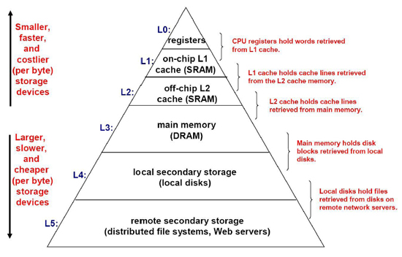
Memory Hierarchy

Slide 82
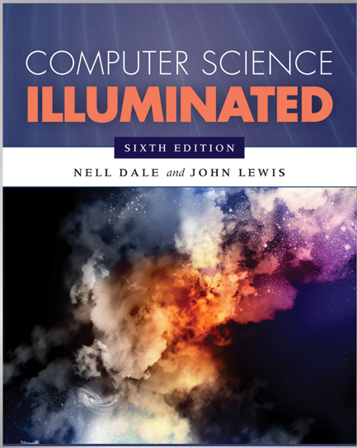
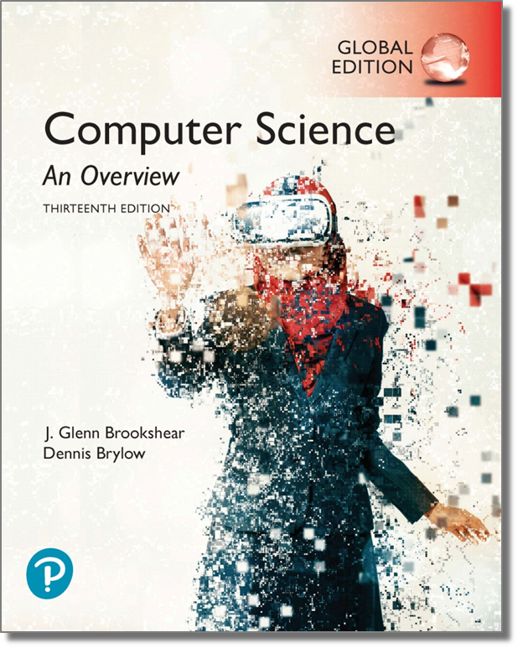
References

