Slide 1
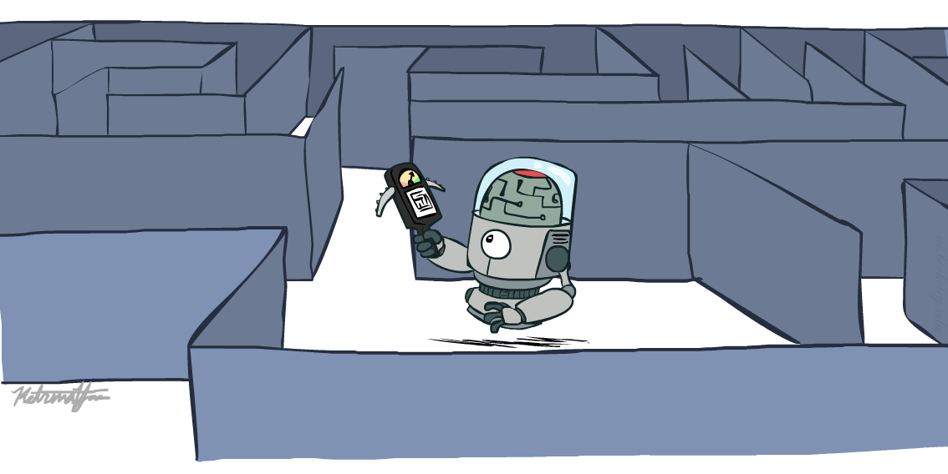
Introduction to Artificial Intelligence
Search in Complex Environments
Many slides are adapted from CS 188 (http://ai.berkeley.edu), CIS 521, CS 221, CS182, CS4420.
Notes:
Please retain proper attribution, including the reference to ai.berkeley.edu. Thanks!

Slide 2
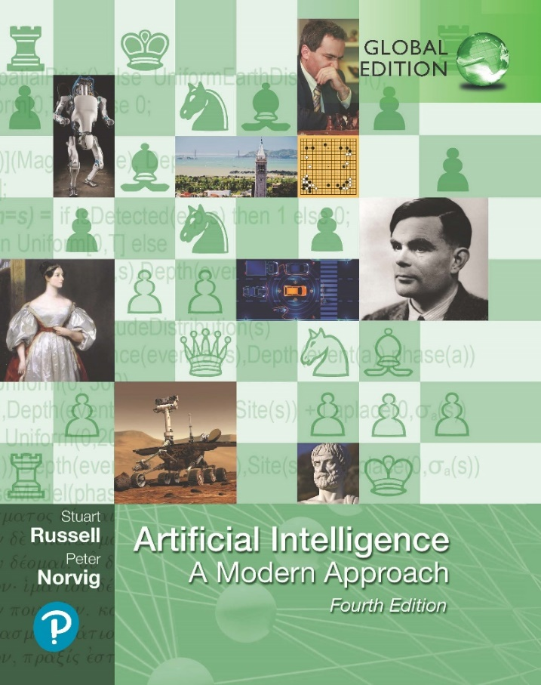
Search in Complex Environments
COE 4213564 : Introduction to Artificial Intelligence
Chapter 4
Fourth Edition, Global Edition
Artificial Intelligence: A Modern Approach
© 2022 Pearson Education Ltd.

Slide 3
Iterative Improvement Methods
The search algorithms that we have seen so far are designed to explore search spaces systematically.
  This systematicity is achieved by keeping one or more paths in memory and by recording which alternatives have been explored at each point along the path.
  When a goal is found, the path to that goal also constitutes a solution to the problem.
The best of these methods can currently handle search spaces of up to 10¹⁰⁰ states / ~1,000 binary variables. (where a set of variables define a state or configuration.)
What if we have much larger search spaces?
  Search spaces for some real-world problems may be much larger e.g.,
  10^{30,000} states as in certain reasoning and planning tasks
  State space is large/complex and keeping whole frontier in memory is impractical
Some of these problems can be solved by Iterative Improvement Methods

Slide 4
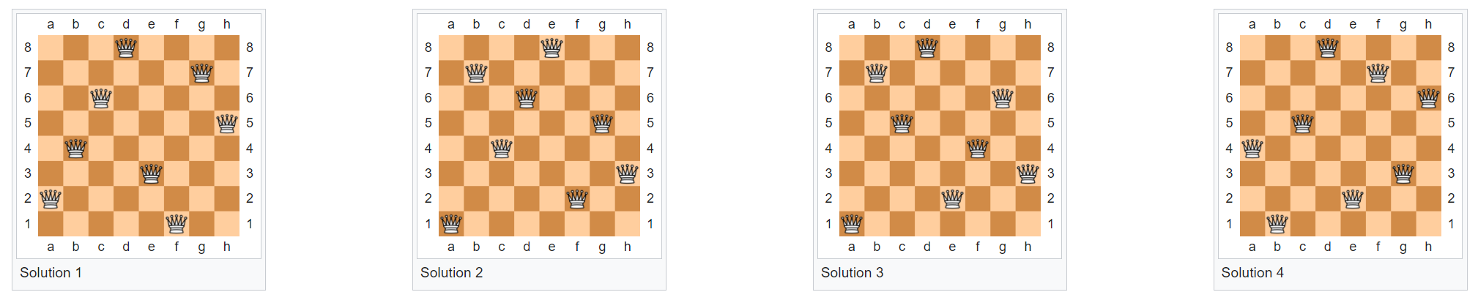
Finding a valid final configuration or state
In many problems, the path to the goal is irrelevant.
The goal state itself is the solution
For example, in the 8-queens problem, we care only about finding a valid final configuration (or state) of 8 queens.
A set of variables define a state or configuration. A valid configuration or state is defined by domains for every variable and constraints among variables.
The eight queens puzzle : is the problem of placing eight chess queens on an 8×8 chessboard so that no two queens threaten each other.
The eight queens puzzle has 92 distinct solutions.
If solutions that differ only by the symmetry operations of rotation and reflection of the board are counted as one, the puzzle has 12 solutions.

Slide 5
Iterative Improvement Methods
In many optimization problems, the goal state itself is the solution
A configuration is a specific way of setting all the variables in a problem. It’s a snapshot of a possible solution — whether it's optimal, feasible, or invalid.
  Complete Configuration: Every decision variable has a value assigned.
  Feasible Configuration: Satisfies all constraints.
  Optimal Configuration: Among all feasible ones, it minimizes or maximizes the objective function.
The state space is a set of complete configurations. Each state represents a complete assignment or arrangement of variables.
Search is about
  finding the optimal configuration (as in TSP) or
  just a feasible configuration (as in scheduling problems, timetable)
In such cases, one can use iterative improvement, or local search methods.
These methods are suitable for problems in which all that matters is the solution state, not the path cost to reach it.
An evaluation or objective function h must be available that measures the quality of each state.
Main Idea:
  Start with a random initial configuration and
  make small, local changes to it that improve its quality.
Many important applications : integrated-circuit design, factory floor layout, job shop scheduling, automatic programming, telecommunications network optimization, crop planning, and portfolio management.

Slide 6
Local Search and Optimization Problems
Local search algorithms operate by searching from a start state to neighboring states, without keeping track of the paths, nor the set of states that have been reached.
Two key advantages:
  they use very little memory; and
  they can often find reasonable solutions in large or infinite state spaces for which systematic algorithms are unsuitable.
They are not systematic—they might never explore a portion of the search space where a solution actually resides.
Local search algorithms can also solve optimization problems, in which the aim is to find the best state according to an objective function.

Slide 7
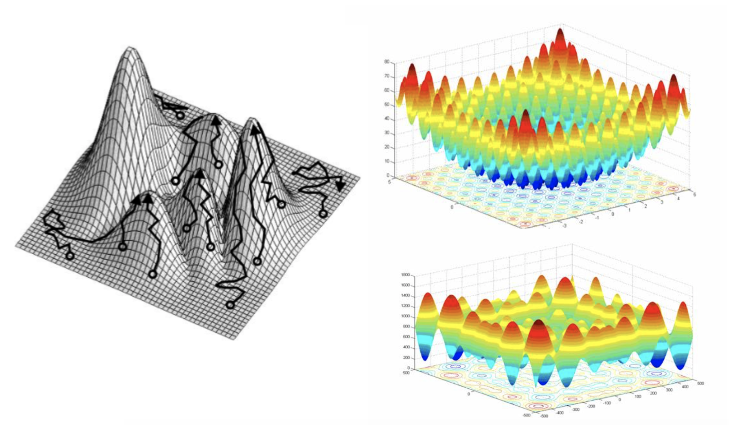
Trajectories, difficulties

Slide 8
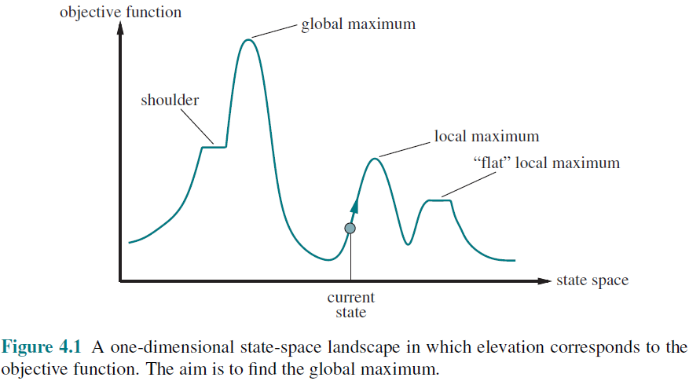
State-space landscape
To understand local search, consider the states of a problem laid out in a state-space landscape, as shown in Figure 4.1. Local search algorithms explore this landscape.
Each point (state) in the landscape has an “elevation” defined by the value of the objective function.
A complete local search algorithm always finds a goal if one exists;
An optimal algorithm always finds a global minimum/maximum
Problem: depending on initial state, can get stuck in local maxima/minima

Slide 9
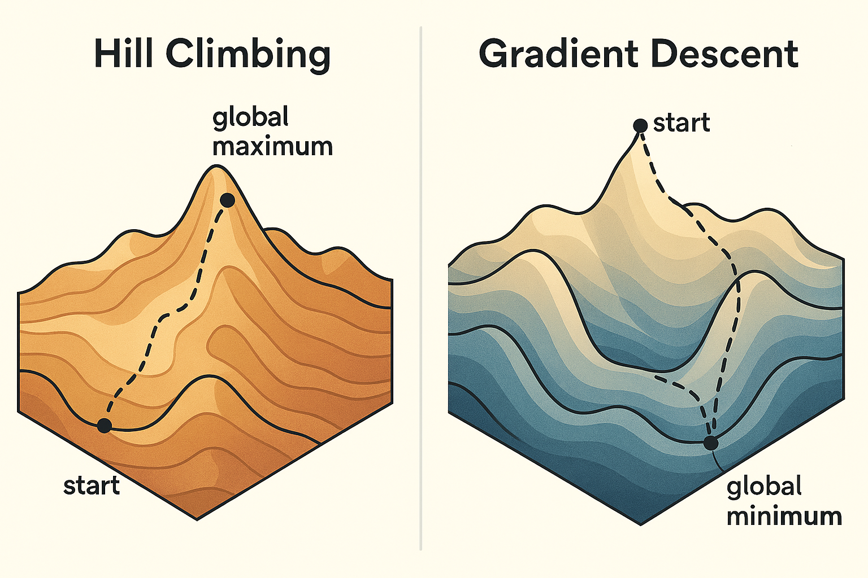
Hill Climbing and Gradient Descent
Each point (state) in the landscape has an “elevation” defined by the value of the objective function.
  If elevation corresponds to an objective function, then the aim is to find the highest peak—a global maximum—and we call the process hill climbing.
  If elevation corresponds to cost in continuous space, then the aim is to find the lowest valley—a global minimum—and we call it gradient descent. Gradient descent is a fundamental optimization technique used especially in machine learning.

Slide 10
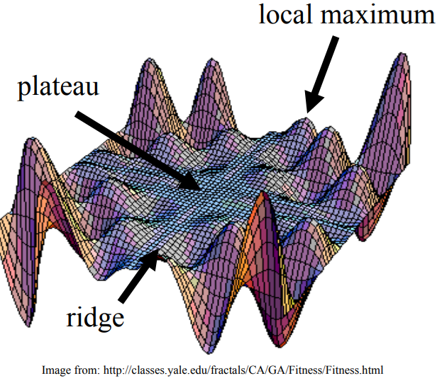
Exploring the Landscape
Local Maxima: peaks that arenʼt the highest point in the space
Plateaus: the space has a broad flat region that gives the search algorithm no direction (random walk)
Ridges: flat like a plateau, but with drop-offs to the sides; steps to the North, East, South and West may go down, but a step to the NW may go up.

Slide 11
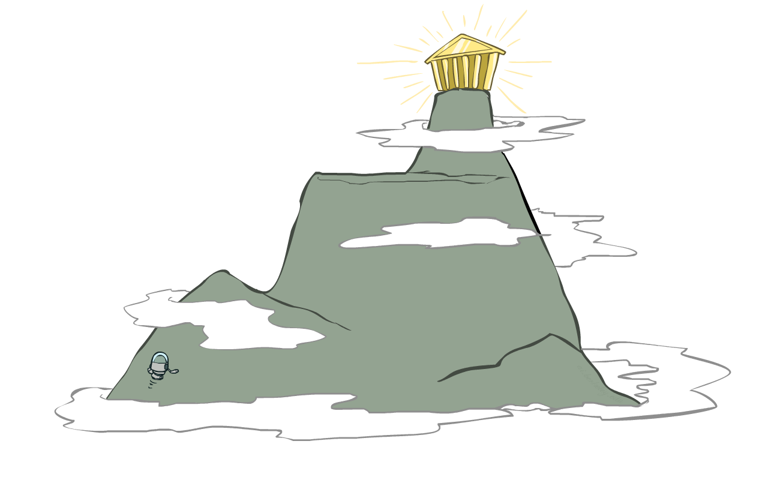
Hill-climbing search
Simple, general idea:
  Start wherever
  Repeat: move to the best neighboring state
  If no neighbors better than current, quit

Slide 12
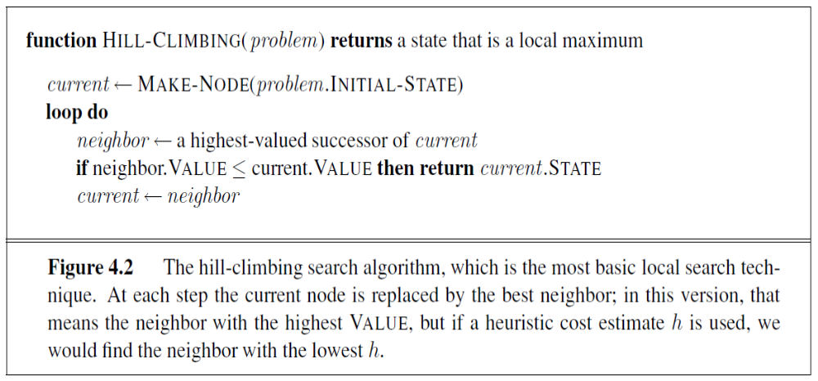
Hill-climbing search

Slide 13
Hill-climbing algorithm
function HILL-CLIMBING(problem) returns a state
current ← make-node(problem.initial-state)
loop do
neighbor ← a highest-valued successor of current
if neighbor.value ≤ current.value then
return current.state
current ← neighbor
“Like climbing Everest in thick fog with amnesia”

Slide 14
Hill-climbing search
It is simply a loop that continually moves in the direction of increasing value—that is, uphill. It terminates when it reaches a “peak” where no neighbor has a higher value.
The algorithm does
  not maintain a search tree,
  so the data structure for the current node need only record the state and
  the value of the objective function.
Hill climbing does not look ahead beyond the immediate neighbors of the current state. (This resembles trying to find the top of Mount Everest in a thick fog while suffering from amnesia (forgetting previous memories or stored information).)
Hill climbing is sometimes called greedy local search because it grabs a good neighbor state without thinking ahead about where to go next.

Slide 15
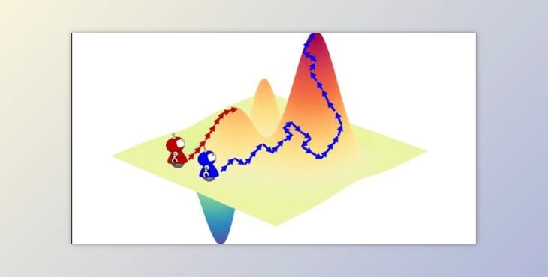
The heuristic objective(cost) function
An evaluation or objective function h must be available that measures the quality of each state
Main Idea: Start with a random initial configuration and make small, local changes to it that improve its quality.
Ideally, the evaluation function h should be monotonic: the closer a state to an optimal goal state the better its h-value.
Each state can be seen as a point on a surface.
The search consists in moving on the surface, looking for its highest peaks: the optimal solutions.
Similar to Greedy search in that it uses h, but does not allow backtracking or jumping to an alternative path since it doesnʼt “remember” where it has been.

Slide 16
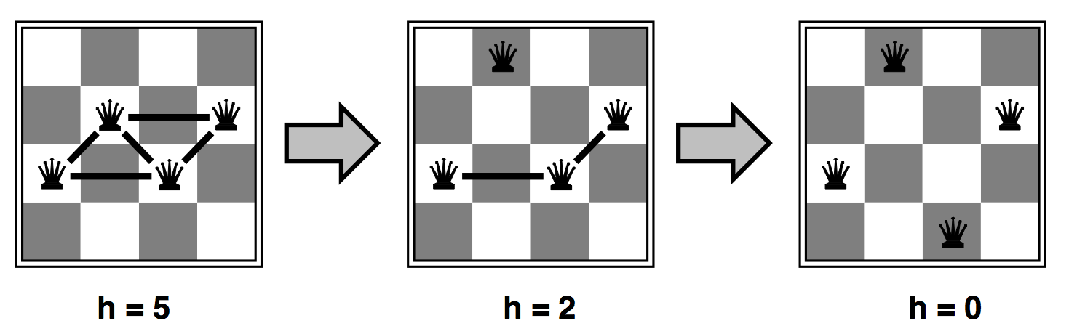
Ex: Heuristic for n-queens problem
Goal: n queens on board with no conflicts, i.e., no queen attacking another
Put n queens on an n × n board with no two queens on the same row, column, or diagonal
States: n queens on board, one per column
Actions: move a queen in its column
Heuristic value function h: number of conflicts (the number of pairs of queens that are attacking each other; this will be zero only for solutions.)
Strategy: Move a queen to reduce number of conflicts

Slide 17
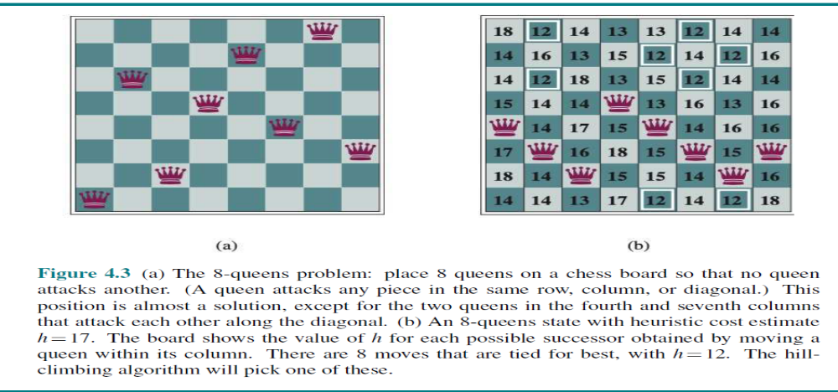
Ex: Heuristic for n-queens problem

Slide 18
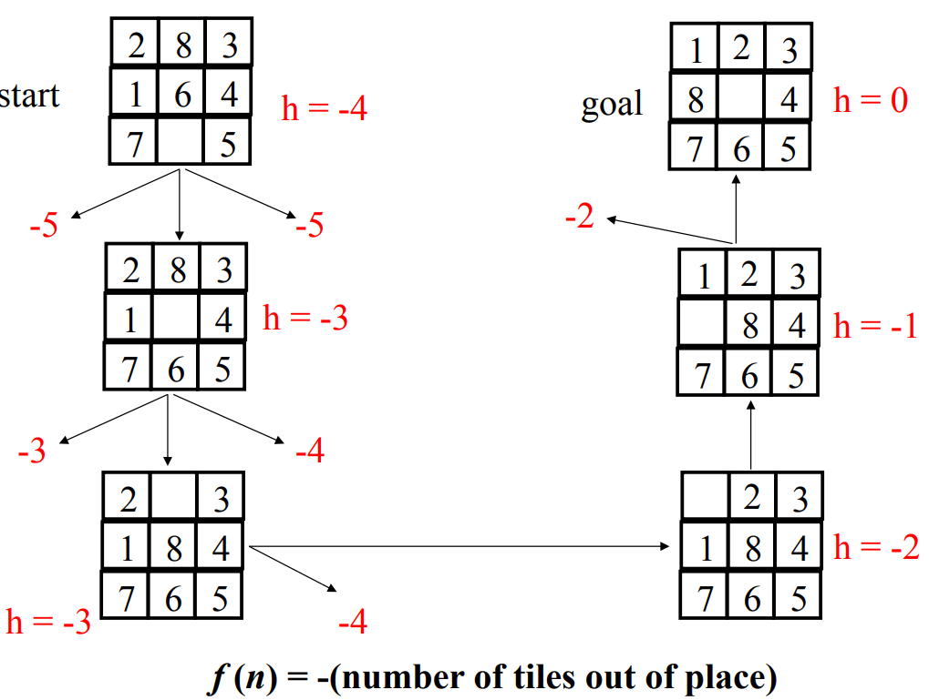
Ex: n-puzzle

Slide 19
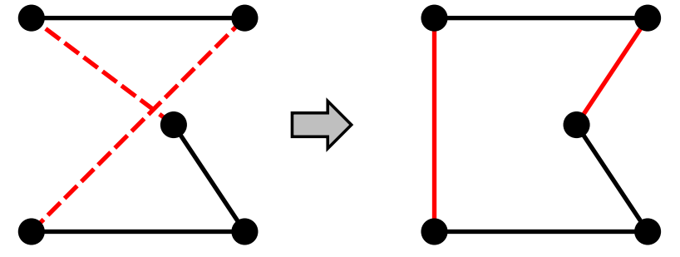
Example: TSP
Travelling Salesperson Problem (TSP) :
  Given a list of cities and the distances between each pair of cities, what is the shortest possible route that visits each city exactly once and returns to the origin city?"
  It is an NP-hard problem in combinatorial optimization, important in theoretical computer science and operations research.
Pairwise exchange method: The pairwise exchange or 2-opt technique involves iteratively removing two edges and replacing these with two different edges that reconnect the fragments created by edge removal into a new and shorter tour.
h = length of the tour
Strategy: Start with any complete tour, perform pairwise exchanges

Slide 20
Hill Climbing Drawbacks
Hill climbing, a fundamental greedy algorithm, works by iteratively moving to neighboring states that improve the objective function, but it can get stuck due to several landscape features in the search space.
Common Pitfalls of Hill Climbing:
  Local Maxima
    A state that is better than its neighbors but worse than the global maximum.
    The algorithm stops here because no neighboring state offers improvement.
  Ridges
    A sequence of local maxima that are difficult to navigate because the algorithm only considers immediate neighbors.
    Hill climbing may fail to follow the ridge if it requires diagonal or non-greedy moves.
  Plateaus
    A flat region where neighboring states have the same value.
    The algorithm has no direction to move, leading to stagnation.

Slide 21
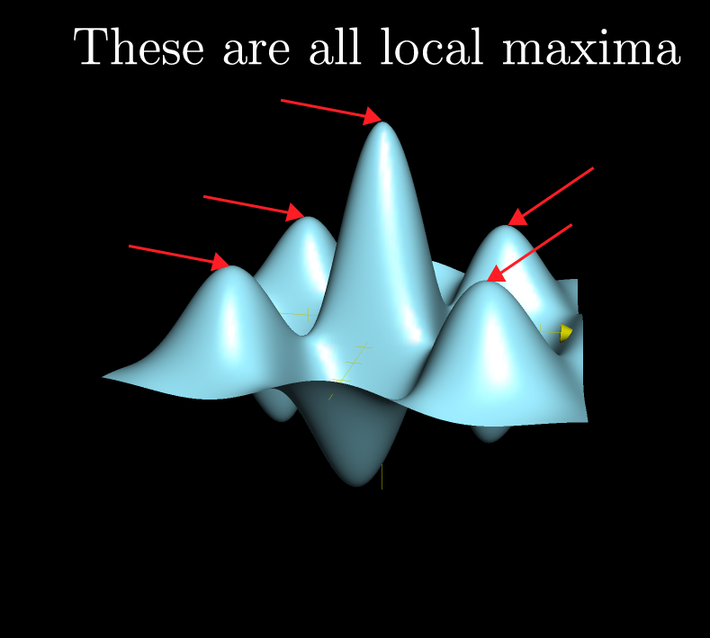
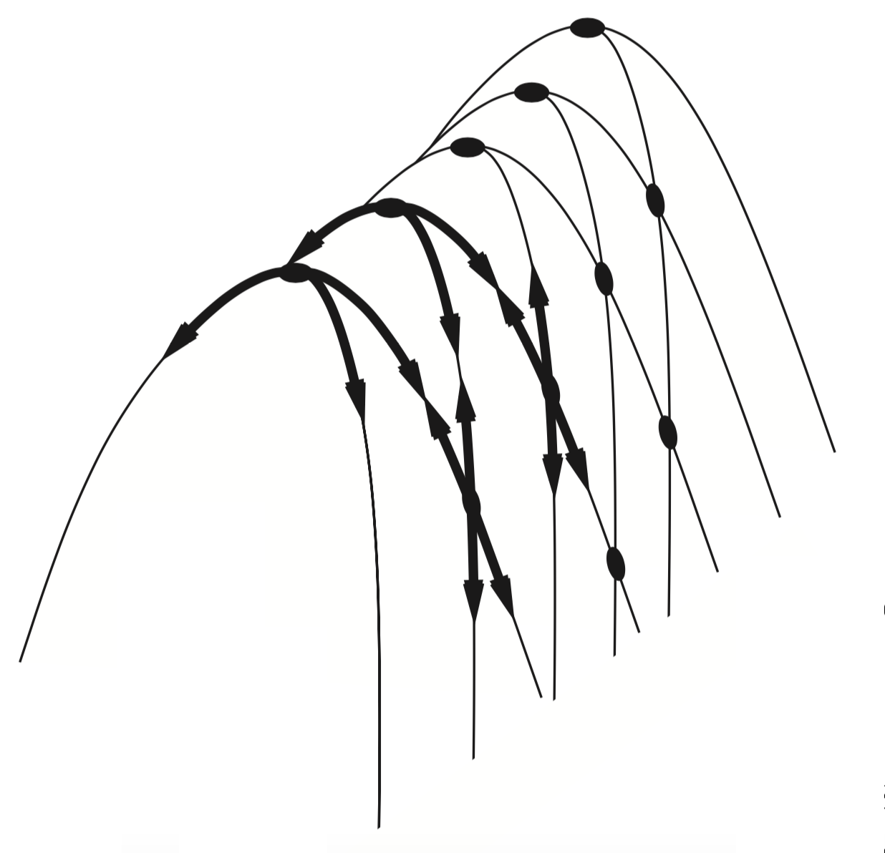
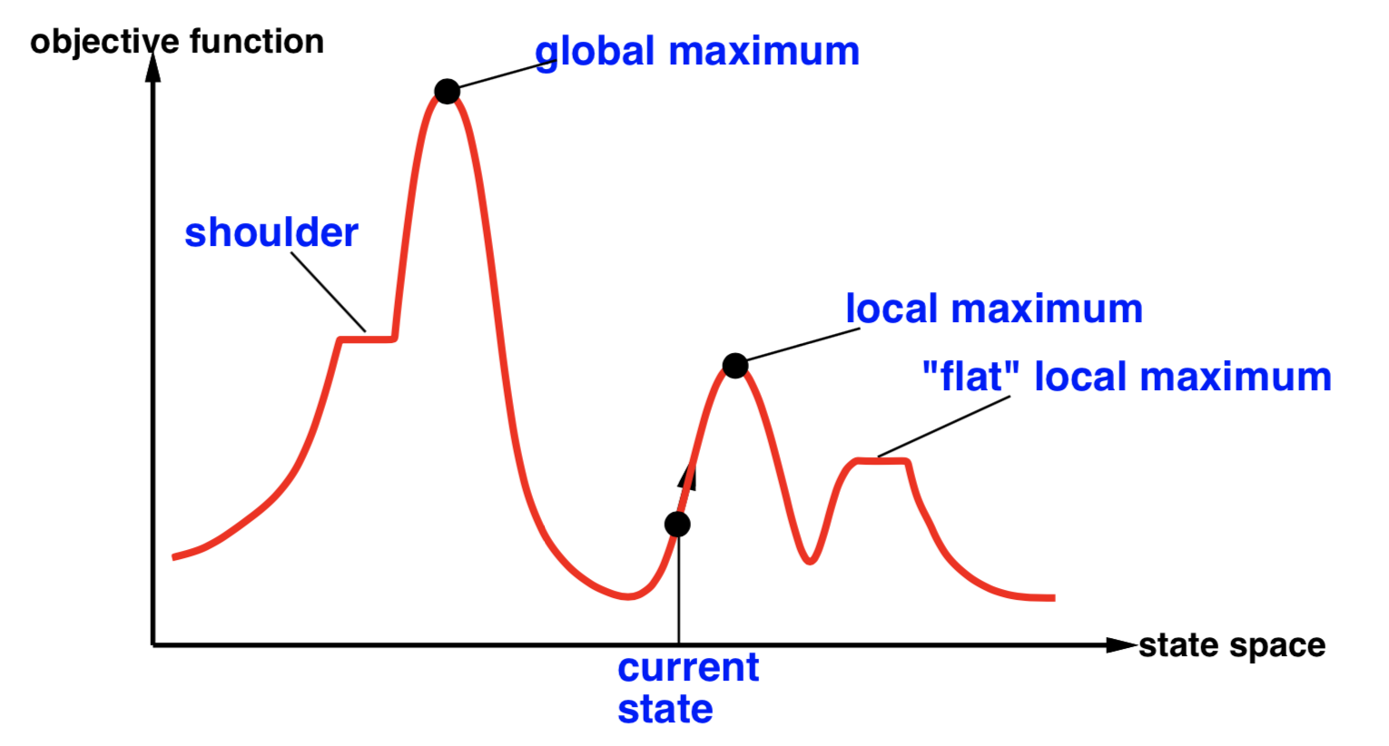
Hill Climbing Drawbacks
It is a greedy algorithm that often perform quite well. Unfortunately, hill climbing can get stuck for any of the following reasons: Local maxima, Ridges (a sequence of local maxima), Plateaus (a flat area of the state-space landscape).
Local maxima
Plateaus
Diagonal ridges:
Figure 4.4 Illustration of why ridges cause difficulties for hill climbing. The grid of states (dark circles) is superimposed on a ridge rising from left to right, creating a sequence of local maxima that are not directly connected to each other. From each local maximum, all the available actions point downhill.
Notes:
Diagonal ridges is about each move only changes one element of state vector, while the path to the hill requires all elements be changed in a move.

Slide 22
Trajectories, difficulties

Slide 23
Local search
Cost
local search can get stuck on a local maximum/minimum and not find the optimal solution
Hill Climbing: moves toward higher-value states (maximization).
Hill Descending: moves toward lower-value states (minimization).
States
From : CSC 361 - Dr. Yousef Al-Ohali

Slide 24
Local search
Current Solution

Slide 25
Local search
Current Solution

Slide 26
Local search
Current Solution

Slide 27
Local search
Current Solution

Slide 28
Local search
Best
Optimal
Solution

Slide 29
Hill-climbing search
It is a greedy algorithm that often perform quite well. Hill climbing can make rapid progress toward a solution because it is usually quite easy to improve a bad state.
Unfortunately, hill climbing can get stuck for any of the following reasons: Local maxima, Ridges (a sequence of local maxima), Plateaus (a flat area of the state-space landscape).
How could we solve more problems?
  One answer is to keep going when we reach a plateau—to allow a sideways move in the hope that the plateau is really a shoulder, from which progress is possible.
  Stochastic hill climbing chooses at random from among the uphill moves; the probability of selection can vary with the steepness of the uphill move.
  First-choice hill climbing implements stochastic hill climbing by generating successors randomly until one is generated that is better than the current state.
  Another variant is random-restart hill climbing, which adopts the adage, “If at first you don’t succeed, try, try again.” It conducts a series of hill-climbing searches from randomly generated initial states, until a goal is found.

Slide 30
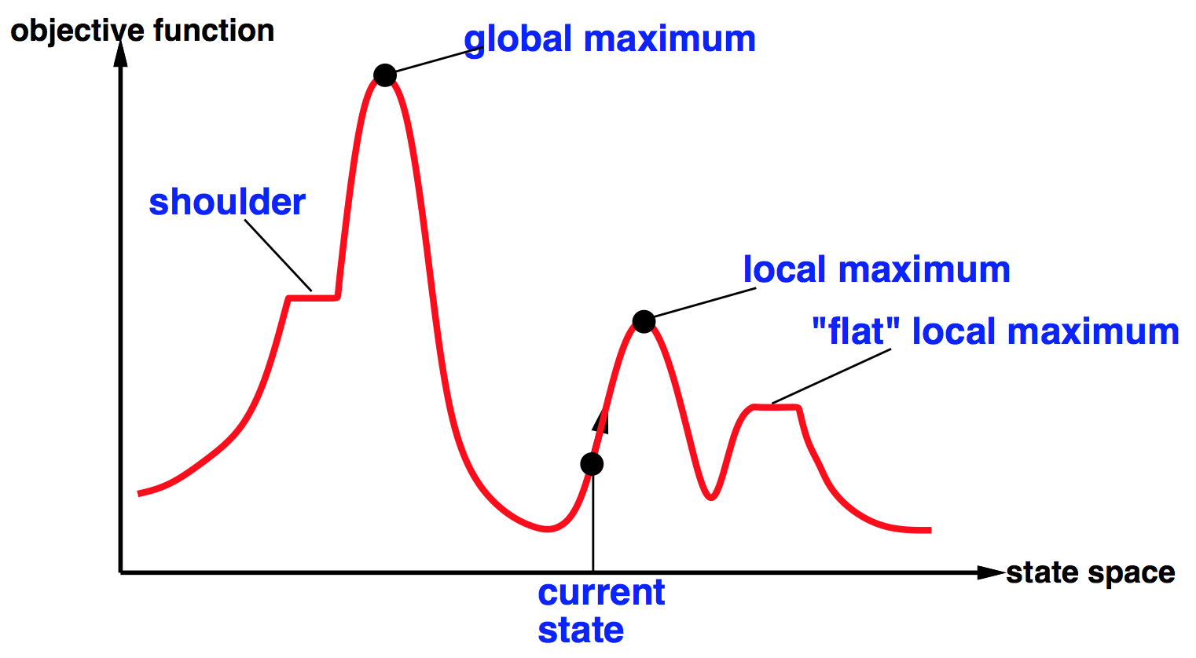




Global and local maxima
• A plateau is a flat area of the state-space landscape. It can be a flat local maximum, from which no uphill exit exists, or a shoulder, from which progress is possible.
• A hill-climbing search might get lost on the plateau.
• Random sideways moves can escape from shoulders but they loop forever on flat maxima.
- Random-restart hill climbing overcomes local maxima—trivially complete (find global optimum)
- Random sideways moves escape from shoulders but they may loop forever on flat maxima

Slide 31
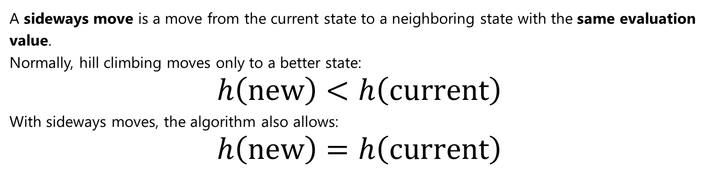
Sideways Moves in Hill Climbing
A sideways move is a move from the current state to a neighboring state with the same evaluation value.
Normally, hill climbing moves only to a better state:
$$h\left(\text{new}\right)<h\left(\text{current}\right)$$
With sideways moves, the algorithm also allows:
$$h\left(\text{new}\right)=h\left(\text{current}\right)$$
Benefits
Escapes plateaus.
Significantly improves success rates.
Simple modification to standard hill climbing.
Drawbacks
Can waste time moving around a plateau.
May enter loops if no limit is imposed.
Does not guarantee finding the global optimum.

Slide 32
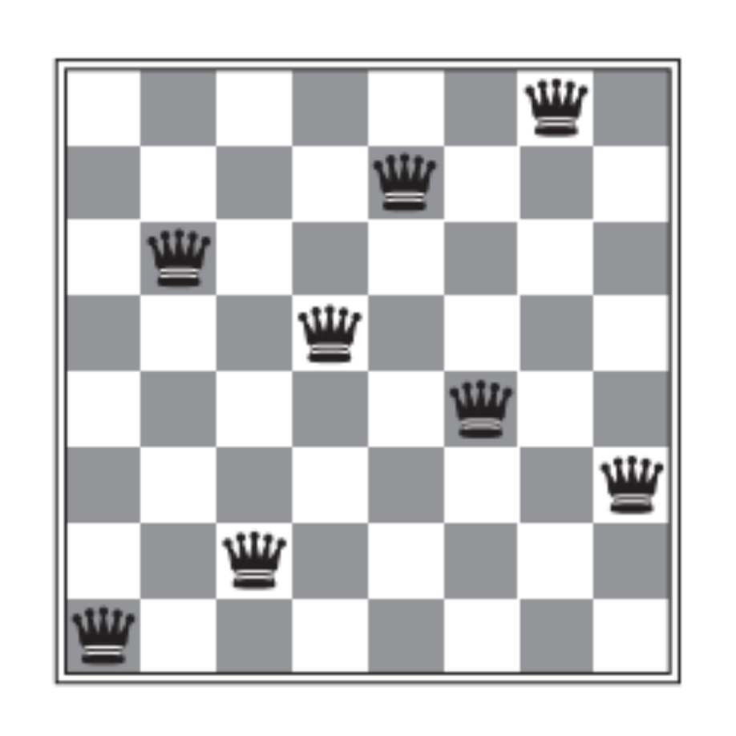
Sideways move on the 8-queens problem
Starting from a randomly generated 8-queens state, steepest-ascent hill climbing gets stuck 86% of the time, solving only 14% of problem instances.
We could allow up to, say, 100 consecutive sideways moves in the 8-queens problem. This raises the percentage of problem instances solved by hill climbing from 14% to 94%.
Success comes at a cost: the algorithm averages roughly 21 steps for each successful instance and 64 for each failure.

Slide 33
The success of hill climbing
The success of hill climbing depends very much on the shape of the state-space landscape: if there are few local maxima and plateaux, random-restart hill climbing will find a good solution very quickly.
On the other hand, many real problems have a landscape that looks more like a widely scattered family of balding porcupines on a flat floor
NP-hard problems typically have an exponential number of local maxima to get stuck on.
Despite this, a reasonably good local maximum can often be found after a small number of restarts.

Slide 34

argmax and argmin notation
The argmax and argmin concept is common in many AI and machine learning algorithms
See argmax on Wikipedia (argmin is similar)
Argmax_{x} f(x) finds the value of x for which f(x) is largest

Slide 35
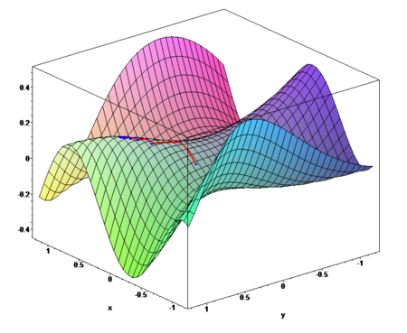
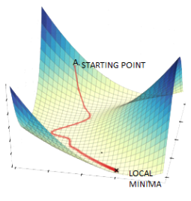
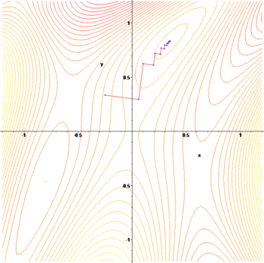
Gradient ascent / descent
Gradient descent procedure for finding the arg_{x} min f(x)
  choose initial x₀ randomly
  repeat
    x_{i+1} ← x_{i} – η f '(x_{i})
  until the sequence x₀, x₁, …, x_{i}, x_{i+1} converges
Step size η (eta) is small (perhaps 0.1 or 0.05)
Often used in machine learning algorithms
Images from http://en.wikipedia.org/wiki/Gradient_descent

Slide 36
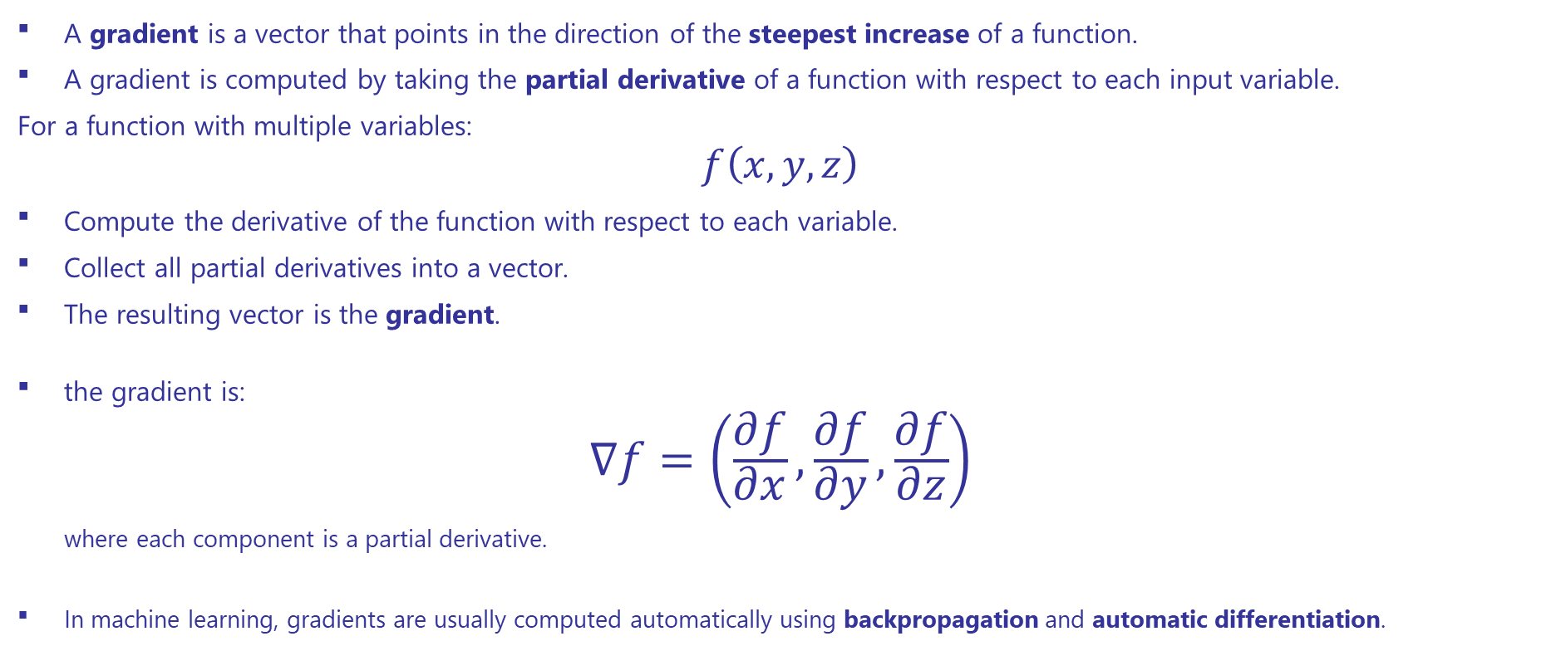
What is a Gradient?
A gradient is a vector that points in the direction of the steepest increase of a function.
A gradient is computed by taking the partial derivative of a function with respect to each input variable.
For a function with multiple variables:
$$f\left(x , y , z\right)$$
Compute the derivative of the function with respect to each variable.
Collect all partial derivatives into a vector.
The resulting vector is the gradient.
the gradient is:
$$∇f=\left(\frac{∂f}{∂x} , \frac{∂f}{∂y} , \frac{∂f}{∂z}\right)$$
where each component is a partial derivative.
In machine learning, gradients are usually computed automatically using backpropagation and automatic differentiation.

Slide 37
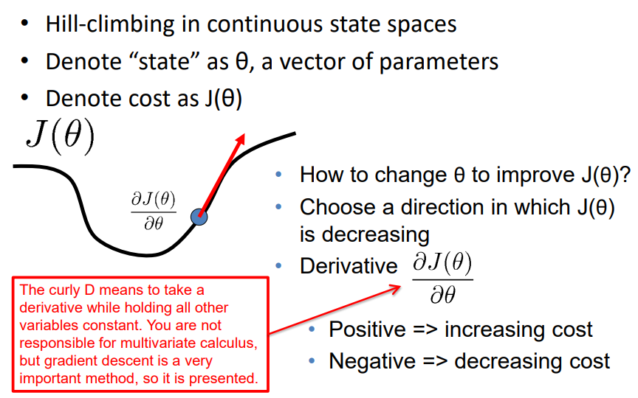
Gradient descent

Slide 38
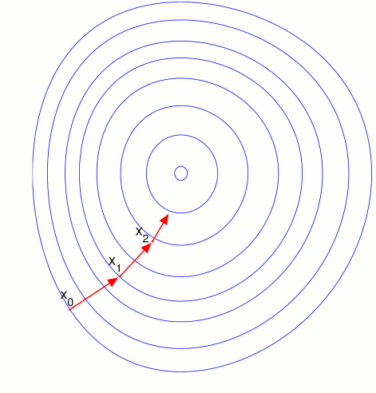
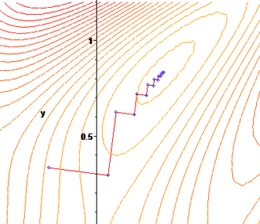

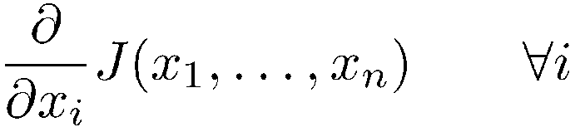
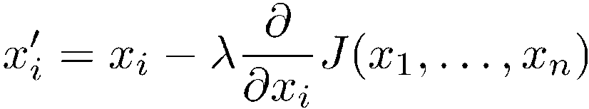
Gradient descent
Hill-climbing in continuous spaces
Gradient = the most direct direction up-hill in the objective (cost) function, so its negative minimizes the cost function.
* Assume we have some cost-function:
and we want minimize over continuous variables x₁,x₂,..,x_{n}
1. Compute the gradient :
2. Take a small step downhill in the direction of the gradient:
3. Check if
4. If true then accept move, if not “reject”.
5. Repeat.
(or, Armijo rule, etc.)
(decrease step size, etc.)

Slide 39
Determine the gradient?
Hill-climbing in continuous spaces
How do I determine the gradient?
  Derive formula using multivariate calculus.
  Ask a mathematician or a domain expert.
  Do a literature search.
Variations of gradient descent can improve performance for this or that special case.
  See Numerical Recipes in C (and in other languages) by Press, Teukolsky, Vetterling, and Flannery.
  Simulated Annealing, Linear Programming too
Works well in smooth spaces; poorly in rough.

Slide 40
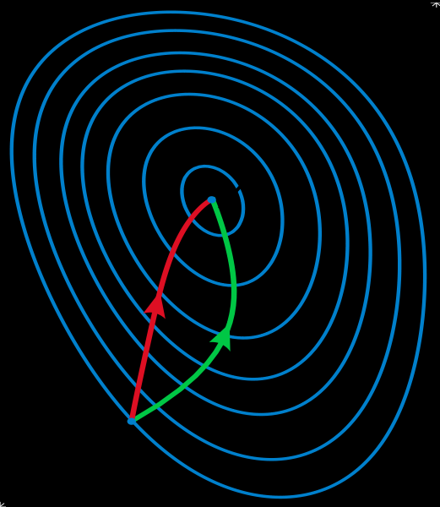
Gradient methods vs. Newton’s method
Gradient descent algorithms find local minima by moving along the direction of steepest descent while
Newton's method takes into account curvature information and thereby often improves convergence.
A reminder of Newton’s method from Calculus:
    x_{i+1} ← x_{i} – η f '(x_{i}) / f ''(x_{i})
Newton’s method uses 2nd order information (e.g., 2nd derivative) to take a faster route to a minimum
Second-order info. is more expensive to compute
Does not always converge; sometimes unstable
If converges, usually very fast
Works well for smooth, non-pathological functions, linearization accurate
Works poorly for wiggly, ill-behaved functions
See gradient descent
Contour lines of a function
Gradient descent (green)
Newton’s method (red)
Image from http://en.wikipedia.org/wiki/Newton's_method_in_optimization

Slide 41
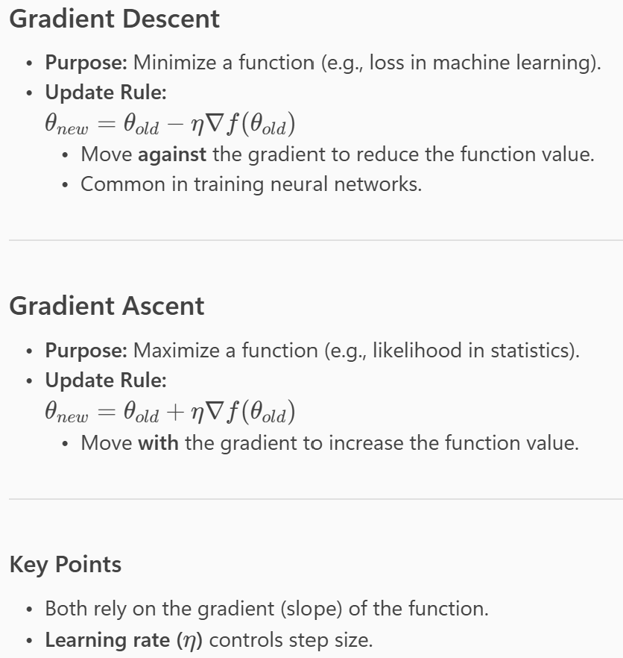
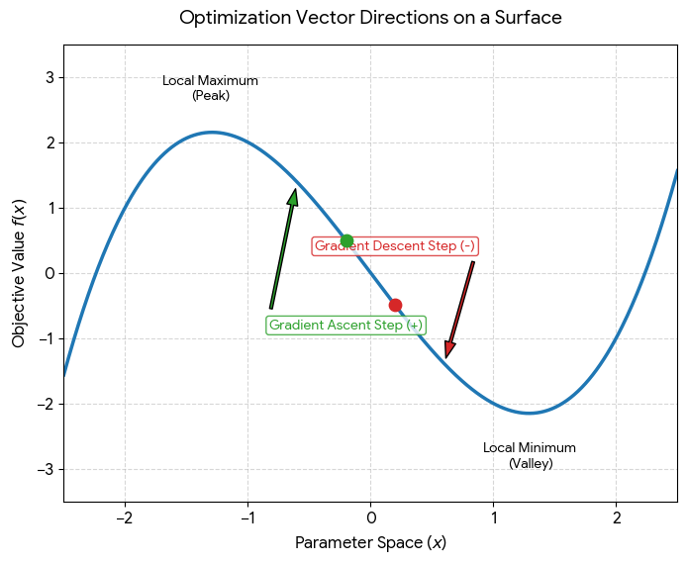
Gradient Descent and Ascent

Slide 42
Relationship among methods
You can think of them as analogous methods:
  Hill Climbing → move to a better neighboring state (maximize).
  Gradient Ascent → use gradients to maximize a function.
  Gradient Descent → use gradients to minimize a function.
Hill Climbing is a discrete, greedy search method that improves a solution by examining neighboring states,
while Gradient Descent is a continuous optimization method that uses derivatives to move toward the minimum of a mathematical function.
Hill Climbing does not require gradients; Gradient Descent does.
In fact, Hill Climbing ≈ Gradient Ascent without requiring derivatives.
Typical Applications
  Hill Climbing
  N-Queens problem
  Traveling Salesman Problem (heuristic version)
  Scheduling
  Game AI
  Gradient Descent
  Linear Regression
  Logistic Regression
  Neural Networks
  Deep Learning

Slide 43
Gradient Ascent vs Hill Climbing:
Nature of the Algorithm
  Hill Climbing
    A heuristic search algorithm used in AI and optimization.
    Works by evaluating neighboring states and moving to the one with the highest value.
    Does not require derivative information—it only compares values.
  Gradient Ascent
    A mathematical optimization algorithm.
    Uses the gradient (derivative) of the function to determine the direction of steepest increase.
    Requires the function to be differentiable.
Search Space
  Hill Climbing:
    Works on discrete or continuous spaces.
    Chooses the best neighbor based on evaluation.
    Often used in combinatorial optimization or state-space problems.
  Gradient Ascent:
    Primarily for continuous spaces.
    Moves in the direction of the gradient vector (steepest ascent).
    Step size controlled by learning rate.
    Common in machine learning (e.g., maximizing likelihood).

Slide 44
Summery: Hill Climbing vs. Gradient Descent
Both Hill Climbing and Gradient Descent are optimization techniques, but they are used in different contexts and work differently.
Feature | Hill Climbing | Gradient Descent
Purpose | Find a better neighboring state | Minimize a mathematical objective function
Search Type | Local search algorithm | Numerical optimization algorithm
Requires Gradient? | No | Yes
State Representation | Any state space | Continuous, differentiable functions
Move Selection | Chooses the best neighboring state | Moves in the direction of negative gradient
Typical Use | AI search problems, puzzles, planning | Machine learning, neural networks
Risk | Gets stuck in local maxima | Gets stuck in local minima or saddle points

Slide 45

Simulated annealing
A hill-climbing algorithm that never makes “downhill” moves toward states with lower value (or higher cost) is always vulnerable to getting stuck in a local maximum. In contrast, a purely random walk that moves to a successor state without concern for the value will eventually stumble upon the global maximum but will be extremely inefficient.
Therefore, it seems reasonable to try to combine hill climbing with a random walk in a way that yields both efficiency and completeness. Simulated annealing is such an algorithm.
In metallurgy, annealing is a technique involving heating & controlled cooling of a material to increase size of its crystals & reduce defects
Heat causes atoms to become unstuck from initial positions (local minima of internal energy) and wander randomly through states of higher energy
Slow cooling gives them more chances of finding configurations with lower internal energy than initial one.

Slide 46


Real annealing: Sword
The worker heats the metal, then slowly cools it as he hammers the blade into shape.
  If he cools the blade too quickly the metal will form patches of different composition;
  If the metal is cooled slowly while it is shaped, the constituent metals will form a uniform alloy.

Slide 47
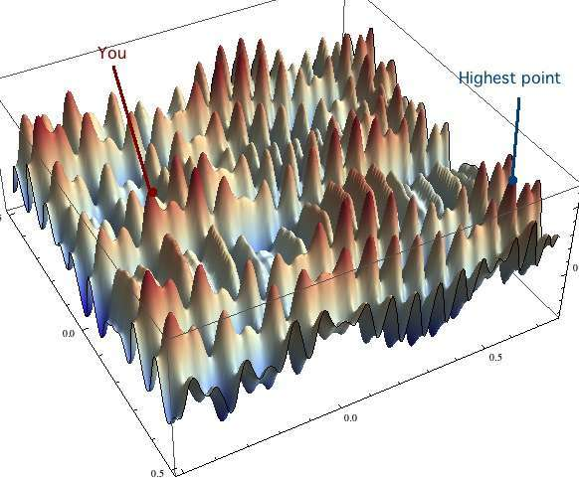
Simulated Annealing (SA) intuitions
Combines hill climbing (for efficiency) with random walk (for completeness)
Analogy: getting a ping-pong ball into the deepest depression in a bumpy surface
  Shake the surface to get the ball out of local minima
  Don’t shake too hard to dislodge it from global minimum
Simulated annealing:
  Start shaking hard (high temperature) and gradually reduce shaking intensity (lower temperature)
  Escape local minima by allowing some “bad” moves
  But gradually reduce their size and frequency
The simulated-annealing solution is to start by shaking hard (i.e., at a high temperature) and then gradually reduce the intensity of the shaking (i.e., lower the temperature).

Slide 48
Simulated Annealing
Cost
Best
SA can avoid becoming trapped at local minima
SA is a stochastic algorithm involving asymptotic convergence and allowing random movements in the searched neighborhood in order to escape local minima
States
From : CSC 361 - Dr. Yousef Al-Ohali

Slide 49
Simulated Annealing
Cost
Best
States

Slide 50
Simulated Annealing
Cost
Best
States

Slide 51
Simulated Annealing
Cost
Best
States

Slide 52
Simulated Annealing
Cost
Best
States

Slide 53
Simulated Annealing
Cost
Best
States

Slide 54
Simulated Annealing
Cost
Best
States

Slide 55
Simulated Annealing
Cost
Best
States

Slide 56
Simulated Annealing
Cost
Best
States

Slide 57
Simulated Annealing
Cost
Best
States

Slide 58
Simulated Annealing
Cost
Best
States

Slide 59
Simulated Annealing
Cost
Best
States

Slide 60
Simulated Annealing
Cost
Best
States

Slide 61
Simulated Annealing
Cost
Best
States

Slide 62
Simulated Annealing
Cost
Best
States

Slide 63
Simulated Annealing
Cost
Best
States

Slide 64
Simulated Annealing
Cost
Best
States

Slide 65
Simulated Annealing
Cost
Best
States

Slide 66
Simulated Annealing
Cost
Best
States

Slide 67
Simulated Annealing
Cost
Best
States

Slide 68
Simulated Annealing
Cost
Best
States

Slide 69
Simulated Annealing
Cost
Best
States

Slide 70
Simulated Annealing
Cost
Best
States

Slide 71
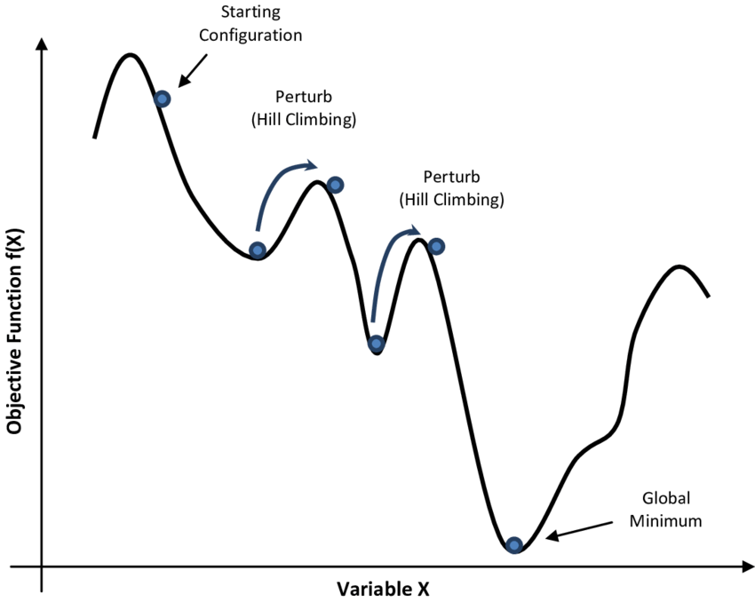
Simulated annealing (SA)
SA can avoid becoming trapped at local minima
SA is a stochastic algorithm involving asymptotic convergence and allowing random movements in the searched neighborhood in order to escape local minima
SA uses a control parameter T, which by analogy with the original application, is known as the system temperature
The higher the temperature, the higher probability of accepting a worse solution.
Typically, T decreases as the algorithm runs longer. Theoretically this algorithm always finds the global optimum but it can run very slow for some problems and in practice it would be a problem as to how to decide the rate at which to decrease T.
T starts out high and gradually decreases toward 0.

Slide 72
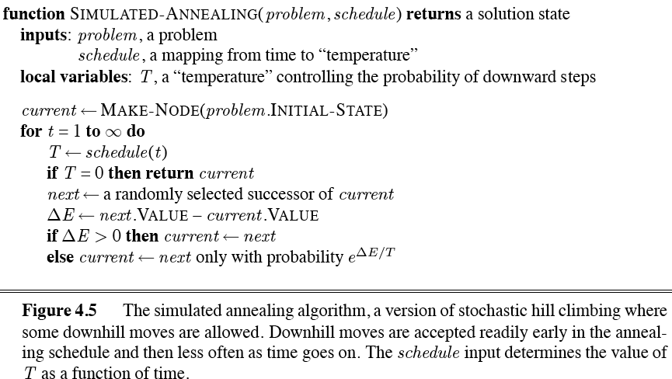
Simulated annealing algorithm

Slide 73
Simulated annealing
The overall structure of the simulated-annealing algorithm (Figure 4.5) is similar to hill climbing. Instead of picking the best move, however, it picks a random move.
If the move improves the situation, it is always accepted. Otherwise, the algorithm accepts the move with some probability less than 1.
The probability decreases exponentially with the “badness” of the move—the amount ΔE by which the evaluation is worsened.
A “bad” move from A to B is accepted with a probability
        -(f(B)-f(A)/T)
        e
The higher the temperature, the more likely it is that a bad move can be made
As T tends to zero, probability tends to zero, and SA becomes more like hill climbing
If T lowered slowly enough, SA is complete and admissible

Slide 74

Simulated annealing algorithm
function SIMULATED-ANNEALING(problem,schedule) returns a state
current ← problem.initial-state
for t = 1 to ∞ do
T ←schedule(t)
if T = 0 then return current
next ← a randomly selected successor of current
∆E ← next.value – current.value
if ∆E > 0 then current ← next
else current ← next only with probability e^{∆E/T}

Slide 75
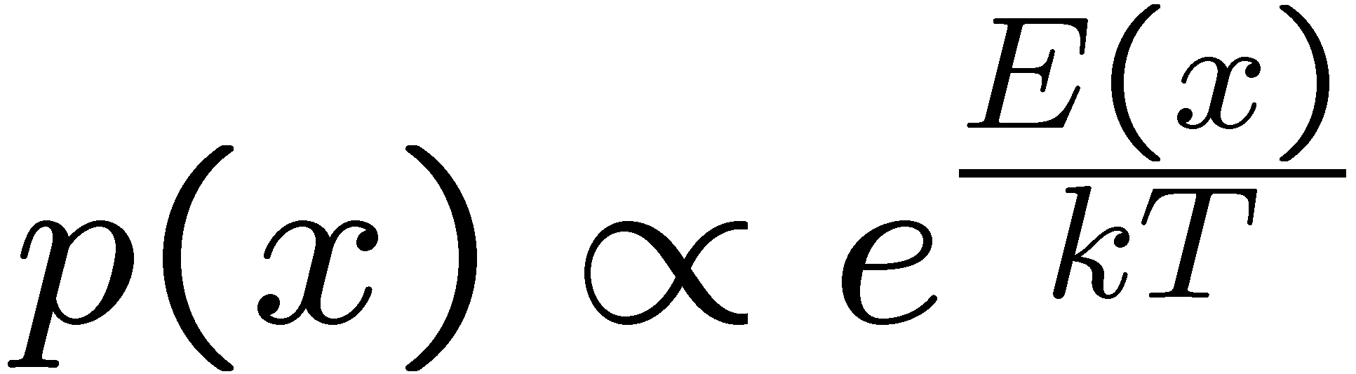
Simulated Annealing
Widely used in VLSI layout, airline scheduling, etc.
Often works very well in practice
  But usually VERY VERY slow
One can prove:
  If T decreases slowly enough, then simulated annealing search will find a global optimum with probability approaching 1
  Unfortunately this can take a VERY VERY long time
  Note: in any finite search space, random guessing also will find a global optimum with probability approaching 1
  So, ultimately this is a very weak claim
Theoretical guarantee (proof):
  Stationary distribution (Boltzmann): P(x) α e^{E(x)/T}
  If T decreased slowly enough, will converge to optimal state!
Proof sketch
  Consider two adjacent states x, y with E(y) > E(x) [high is good]
  Assume x→y and y→x and outdegrees D(x) = D(y) = D
  Let P(x), P(y) be the equilibrium occupancy probabilities at T
  Let P(x→y) be the probability that state x transitions to state y
Notes:
P(x)P(x->y) = P(y)P(y->x)
P(x)/D = P(y)exp((E(x)-E(y))/T)/D
P(x)/P(y) = exp(E(x)/T) / exp(E(y)/T)

Slide 76
Simulated Annealing
Is this convergence an interesting guarantee?
Sounds like magic, but reality is reality:
  The more downhill steps you need to escape a local optimum, the less likely you are to ever make them all in a row
  “Slowly enough” may mean exponentially slowly
  Random restart hill climbing also converges to optimal state…
Simulated annealing and its relatives are a key workhorse in VLSI layout and other optimal configuration problems.

Slide 77
Local beam search (LBS)
Or, K chosen randomly with
a bias towards good ones
Basic idea:
  K copies of a local search algorithm, initialized randomly
  For each iteration
    Generate ALL successors from K current states
    Choose best K of these to be the new current states
This is similar to k searches running in parallel!
LBS≠ running k random restarts in parallel instead of sequence.

Slide 78
Local beam search (LBS)
Idea:
  Unlike Hill Climbing, keep k states instead of just 1
Algorithm:
  Local Beam Search keeps track of k states rather than just one.
  It starts with k randomly generated states.
  At each step, all the successors of all the states are generated.
  If any one is a goal, the algorithm halts, otherwise it selects the k best successors from the complete list and repeats.

Slide 79
Local beam search
…
a1
b1
k1
Create k random initial states
…
Generate their children
…
a2
b2
k2
Select the k best children
…
Repeat …

Slide 80
Local Beam Search
Cost
States
From : CSC 361 - Dr. Yousef Al-Ohali

Slide 81
Local Beam Search

Slide 82
Local Beam Search

Slide 83
Local Beam Search

Slide 84
Local Beam Search

Slide 85
Local Beam Search

Slide 86
Local Beam Search

Slide 87
Local Beam Search

Slide 88
Local Beam Search

Slide 89
Local Beam Search

Slide 90
Local Beam Search

Slide 91
Local Beam Search

Slide 92
Local Beam Search

Slide 93
Local Beam Search

Slide 94
Local Beam Search

Slide 95
Local Beam Search

Slide 96
Tabu search
Tabu search is a meta-heuristic optimization technique, which owes its name to its memory structures, used to store recently evaluated candidate solutions.
  The candidates stored in these structures are not eligible for generation of further candidates and are thereby considered “Tabu” by the algorithm
  Key idea
    maintain the sequence of nodes already visited
      - tabu lists and tabu nodes
    Typically there are two kinds of tabu lists, a long term memory maintaining the history through all the exploration process as a whole and a short term memory to keep the most recently visited tabu movements.
    Select the best configurations that is not tabu,
    i.e., has not been visited before
Tabu search enhances the performance of local search by relaxing its basic rule.
  First, at each step worsening moves can be accepted if no improving move is available (like when the search is stuck at a strict local minimum).
  In addition, prohibitions (henceforth the term tabu) are introduced to discourage the search from coming back to previously-visited solutions.

Slide 97
Tabu Search: TS
Cost
States
From : CSC 361 - Dr. Yousef Al-Ohali

Slide 98
Tabu Search: TS
Best

Slide 99
Tabu Search: TS
Best

Slide 100
Tabu Search: TS
Best

Slide 101
Tabu Search: TS
Best

Slide 102
Tabu Search: TS
Best

Slide 103
Tabu Search: TS
Best

Slide 104
Tabu Search: TS
Best

Slide 105
Tabu Search: TS
Best

Slide 106
Tabu Search: TS
Best

Slide 107
Tabu Search: TS
Best

Slide 108
Tabu Search: TS
Best

Slide 109
Tabu Search: TS
Best

Slide 110
Tabu Search: TS
Best

Slide 111
Tabu Search: TS
Best

Slide 112
Tabu Search: TS
Best

Slide 113
Tabu Search: TS
Best

Slide 114
Tabu Search: TS
Best

Slide 115
Tabu Search: TS
Best

Slide 116
Tabu Search: TS
Best

Slide 117
Tabu Search: TS
Best

Slide 118
Tabu Search: TS
Best

Slide 119
Tabu Search: TS
Best

Slide 120
Advantages and Disadvantages of TS
Advantages and Disadvantages of TS
Advantages
  Can escape local optimums by picking non-improving solutions
  The Tabu List can be used to avoid cycles and reverting to old solutions
  Can be applied to both discrete and continuous solutions
Disadvantages
  Number of iterations can be very high
  There are a lot of tuneable parameters in this algorithm
  Key issue with tabu search
    expensive to maintain all the visited nodes (Short-term memory only keep a small set of recently visited nodes (tabu list)

Slide 121
Metaheuristic Optimization Algorithms
The word metaheuristic comes from:
  Meta = beyond, higher-level
  Heuristic = a rule-of-thumb or practical strategy for finding a good solution
So, a metaheuristic is a high-level strategy that guides lower-level heuristics to search for good solutions to optimization problems.
Metaheuristic optimization algorithms are high-level search strategies designed to find near-optimal solutions for complex optimization problems where exact methods are computationally expensive or infeasible. They guide the search process by balancing:
  Exploration: searching new regions of the solution space.
  Exploitation: improving currently promising solutions.
Metaheuristics do not guarantee the global optimum but often produce high-quality solutions within reasonable time.
Characteristics
Problem-independent (can be applied to many domains)
Suitable for large and complex search spaces
Can escape local optima
Usually stochastic (involve randomness)
Approximate rather than exact methods

Slide 122
Classification
Metaheuristics can be classified in several ways. These are the most common:
1. By source of inspiration
Evolutionary algorithms are based on natural selection and genetics.
Genetic Algorithm (GA)
Differential Evolution (DE)
Genetic Programming (GP)
Evolution Strategies (ES)
Swarm intelligence algorithms are based on the collective behavior of animals.
Particle Swarm Optimization (PSO)
Ant Colony Optimization (ACO)
Artificial Bee Colony (ABC)
Grey Wolf Optimizer (GWO)
Whale Optimization Algorithm (WOA)
Firefly Algorithm (FA)
Physics- and chemistry-based algorithms imitate physical laws or processes.
Simulated Annealing (SA)
Gravitational Search Algorithm (GSA)
Harmony Search (HS)
Chemical Reaction Optimization (CRO)
Human- and social-based algorithms imitate human behavior or social interaction.
Teaching–Learning-Based Optimization (TLBO)
Imperialist Competitive Algorithm (ICA)
Tabu Search (TS), which uses memory in a way that resembles how people remember
Bio-inspired algorithms that aren’t swarms are drawn from other biological processes.
Artificial Immune Systems (AIS)
Bacterial Foraging Optimization (BFO)

Slide 123
Classification
2. By number of solutions
Type | Description | Examples
Single-solution (trajectory-based) | Improves one solution step by step and follows a path through the search space. These lean toward exploitation. | SA, Tabu Search, Hill Climbing, Variable Neighborhood Search (VNS), Iterated Local Search (ILS), GRASP
Population-based | Evolves many solutions at the same time. These lean toward exploration. | Genetic Algorithm (GA) Differential Evolution (DE) Particle Swarm Optimization (PSO) Ant Colony Optimization (ACO) Artificial Bee Colony (ABC)
* Artificial Bee Colony (ABC) is a swarm intelligence and population-based metaheuristic optimization algorithm inspired by the foraging behavior of honey bee colonies. It was proposed by Derviş Karaboğa in 2005.

Slide 124
Classification
3. By other criteria
Memory usage: some algorithms keep a memory of past search, such as Tabu Search’s tabu list or ACO’s pheromone trails. Others are memoryless, such as Simulated Annealing.
Deterministic vs. stochastic: most metaheuristics are stochastic.
Objective function: static, or dynamic like Guided Local Search, which changes the objective during the search.
Neighborhood structure: a single neighborhood (most local search) or several neighborhoods (VNS).
Nature-inspired vs. non-nature-inspired: for example, GA and PSO are nature-inspired, while Tabu Search and ILS are not.
4. Hybrid metaheuristics
Hybrids combine two or more methods to use the strengths of each.
Memetic algorithms are a GA combined with local search.
Matheuristics combine a metaheuristic with exact mathematical programming methods.
Examples include GA with SA, or PSO with GA.

Slide 125
Evolutionary Computation (EC)
Evolutionary Computation (EC) is a branch of Artificial Intelligence and Computational Intelligence that develops optimization and search algorithms inspired by biological evolution.
EC optimization techniques that mimic the process of natural evolution to solve complex problems.
Key Concepts
  Population: A set of candidate solutions.
  Individual (Chromosome): A single candidate solution.
  Fitness Function: Measures the quality of a solution.
  Selection: Chooses better individuals to reproduce.
  Crossover (Recombination): Combines two parent solutions.
  Mutation: Randomly modifies a solution.
  Survival: Retains the best solutions for the next generation.
The basic idea is to evolve a population of candidate solutions over time using mechanisms similar to those found in nature:
  Selection (survival of the fittest)
  Crossover (recombination of parents)
  Mutation (random variation)
  Inheritance (passing traits to offspring)
The population gradually evolves toward better solutions.

Slide 126
Evolutionary algorithms
Evolutionary algorithms are based on concepts of biological evolution.
A ‘population’ of possible solutions to the problem is first created with each solution being scored using a ‘fitness function’ that indicates how good they are.
The population evolves over time and (hopefully) identifies better solutions.
Evolutionary algorithms can be seen as variants of stochastic beam search that are explicitly motivated by the metaphor of natural selection in biology: there is a population of individuals (states), in which the fittest (highest value) individuals produce offspring (successor states) that populate the next generation, a process called recombination. There are endless forms of evolutionary algorithms, varying in the following ways:
  The size of the population.
  The representation of each individual.
  The mixing number, which is the number of parents that come together to form offspring.
  The selection process for selecting the individuals who will become the parents of the next generation
  The recombination procedure. One common approach (assuming =2), is to randomly select a crossover point to split each of the parent strings, and recombine the parts to form two children.
  The mutation rate, which determines how often offspring have random mutations to their representation.
  The makeup of the next generation. This can be just the newly formed offspring, or it can include a few top-scoring parents from the previous generation (a practice called elitism)

Slide 127
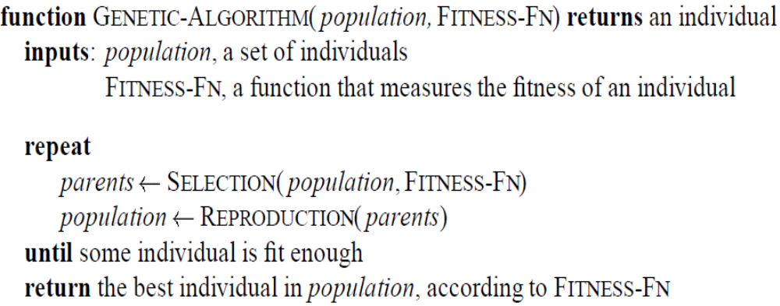
Genetic Algorithms
Each state is seen as an individual in a population.
A genetic algorithm applies selection and reproduction operators to an initial population
The aim is to generate individuals that are most successful, according to a given fitness function.
Select parents based on fitness, and “reproduce” to get the next generation (using “crossover” and mutations)
Replace the old generation with the new generation.
Variation operators used in Reproduction create the necessary diversity, facilitating novelty
Selection reduces diversity but pushes quality by increasing fitness

Slide 128
Genetic Algorithms
Before we can apply Genetic Algorithm to a problem, we need to answer:
    - How to represent an individual?
    - What is the fitness function?
    - How to select individuals?
    - How to reproduce individuals?

Slide 129
Representation of states (solutions)
Each state or individual is represented as a string over a finite alphabet. It is also called chromosome which Contains genes. Each character in the string is a gene.
genes
1001011111
Solution: 607
Encoding
Chromosome:
Binary String
Possible Encodings:
  Character strings 0101 · · · 1100
  Sequences of real numbers (43.2 -33.1 · · · 0.0 89.2)
  Tuples of elements (E11 E3 E7 · · · E1 E15)
  Lists of rules (R1 R2 R3 · · · R22 R23)
Choosing the right encoding of state configurations to strings is crucial.

Slide 130
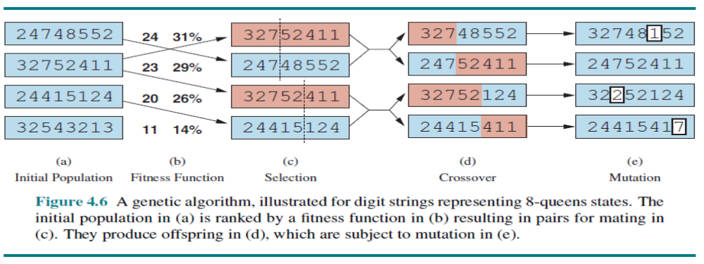
8-queens puzzle encoding
8-digit strings represents 8-queens states
Figure 4.6(a) shows a population of four 8-digit strings, each representing a state of the 8-queens puzzle: the c-th digit represents the row number of the queen in column c. In (b), each state is rated by the fitness function. Higher fitness values are better, so for the 8-queens problem we use the number of nonattacking pairs of queens, which has a value of 8*7/2=28.

Slide 131
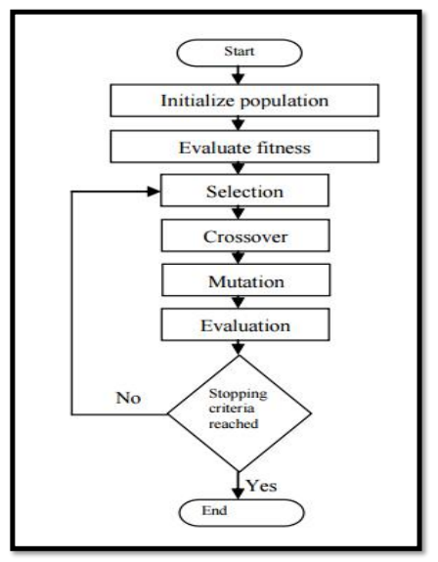
Fitness Function
Each state is rated by the evaluation function called fitness function. Fitness function should return higher values for better states:
  Fitness(X) should be greater than Fitness(Y) !!
  [Fitness(x) = 1/Cost(x)]
Cost
States
X
Y

Slide 132
Selection
Selection is the stage of a genetic algorithm in which individual genomes are chosen from a population for later breeding (using the crossover operator).
Methods of Selection (Genetic Algorithm)
  1.1 Roulette Wheel Selection
  1.2 Rank Selection
  1.3 Steady State Selection
  1.4 Tournament Selection
  1.5 Elitism Selection
  1.6 Boltzmann Selection

Slide 133
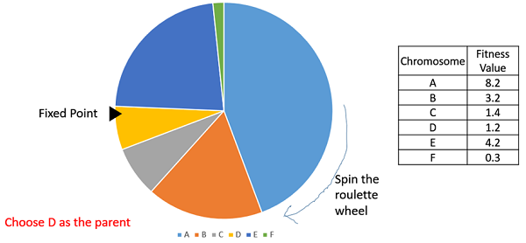
Roulette Wheel Selection
In the roulette wheel selection, the probability of choosing an individual for breeding of the next generation is proportional to its fitness, the better the fitness is, the higher chance for that individual to be chosen. Choosing individuals can be depicted as spinning a roulette that has as many pockets as there are individuals in the current generation, with sizes depending on their probability.
https://www.tutorialspoint.com/genetic_algorithms/genetic_algorithms_parent_selection.htm

Slide 134
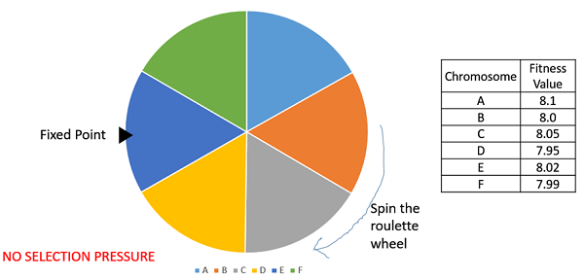
Rank Selection
Rank Selection also works with negative fitness values and is mostly used when the individuals in the population have very close fitness values (this happens usually at the end of the run). This leads to each individual having an almost equal share of the pie (like in case of fitness proportionate selection) and hence each individual no matter how fit relative to each other has an approximately same probability of getting selected as a parent. This in turn leads to a loss in the selection pressure towards fitter individuals, causing the GA to make poor parent selections in such situations.
https://www.tutorialspoint.com/genetic_algorithms/genetic_algorithms_parent_selection.htm

Slide 135
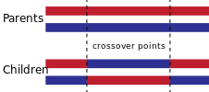
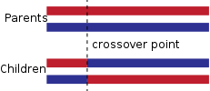
Cross-Over and Mutation
How to reproduce individuals?
  Crossover, also called recombination, is a genetic operator used to combine the genetic information of two parents to generate new offspring.
  The crossover of two parent strings produces offspring/children (new solutions) by swapping parts or genes of the chromosomes.
  Crossover has a higher probability, typically 0.8-0.95.
One-point crossover:
A point on both parents' chromosomes is picked randomly, and designated a 'crossover point'. Bits to the right of that point are swapped between the two parent chromosomes. This results in two offspring, each carrying some genetic information from both parents.
Two-point and k-point crossover:
In two-point crossover, two crossover points are picked randomly from the parent chromosomes. The bits in between the two points are swapped between the parent organisms.

Slide 136
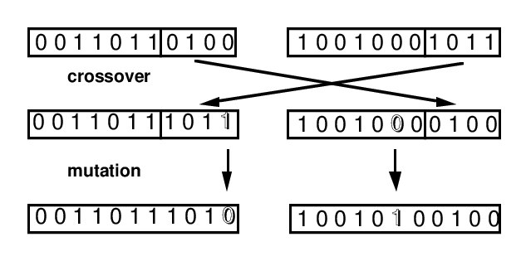
Cross-Over and Mutation
Mutation is a genetic operator used to maintain genetic diversity from one generation of a population of genetic algorithm chromosomes to the next. It is analogous to biological mutation.
Mutation is carried out by flipping some digits of a string, which generates new solutions. This mutation probability is typically low, from 0.001 to 0.05.
New solutions generated in each generation will be evaluated by their fitness that is linked to the objective function of the optimization problem.
The new solutions are selected according to their fitness—selection of the fittest. Sometimes, in order to make sure that the best solutions remain in the population, the best solutions are passed on to the next generation without much change. This is called elitism.
Order changing - two numbers are selected and exchanged : (1 2 3 4 5 6 8 9 7) => (1 8 3 4 5 6 2 9 7)
Adding a small number (for real value encoding) - to selected values is added (or subtracted) a small number:
(1.29 5.68 2.86 4.11 5.55) => (1.29 5.68 2.73 4.22 5.55)
Bit inversion - selected bits are inverted :
11001001 => 10001001
https://www.obitko.com/tutorials/genetic-algorithms/crossover-mutation.php

Slide 137
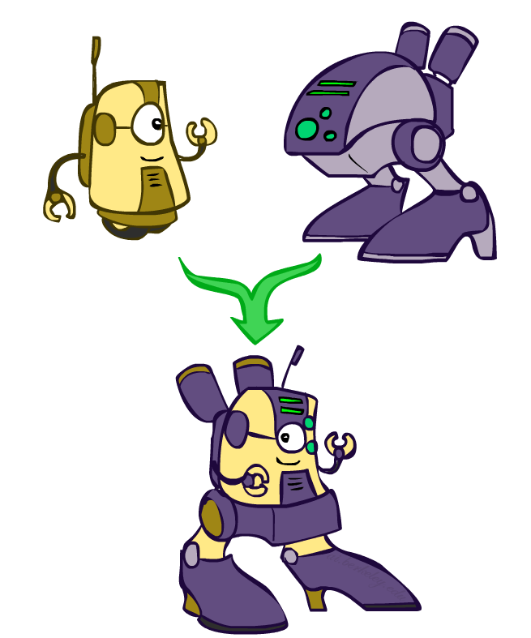
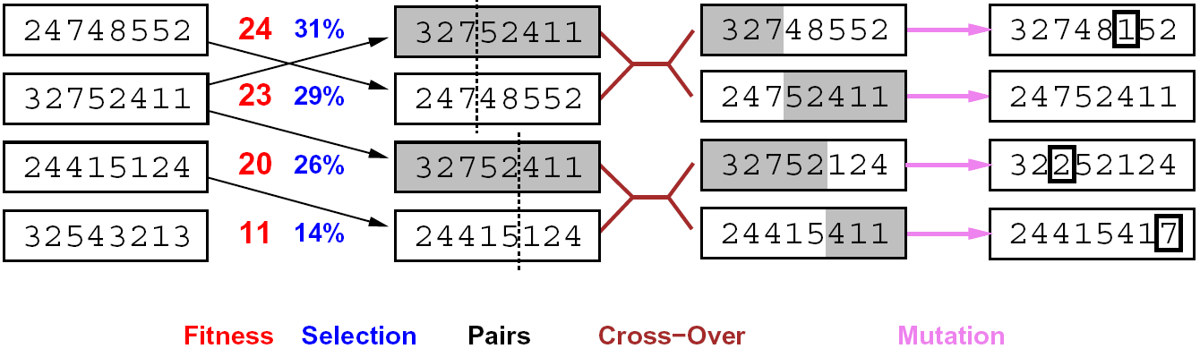
8-queens puzzle : selection
Genetic algorithms use a natural selection metaphor
  Resample K individuals at each step (selection) weighted by fitness function
  Combine by pairwise crossover operators, plus mutation to give variety
Fitness function: number of non-attacking pairs of queens (min = 0, max = 8 × 7/2 = 28)
The fitness values of the four states in (b) are 24, 23, 20, and 11.
  24/(24+23+20+11) = 31%
  23/(24+23+20+11) = 29% etc.
Higher fitness values are better.

Slide 138
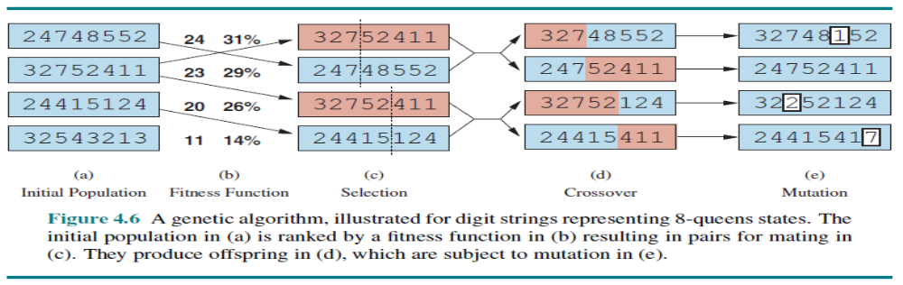
8-queens puzzle : crossover and mutation
The fitness values of the four states in (b) are 24, 23, 20, and 11. The fitness scores are then normalized to probabilities, and the resulting values are shown next to the fitness values in (b). In (c), two pairs of parents are selected, in accordance with the probabilities in (b). Notice that one individual is selected twice and one not at all. For each selected pair, a crossover point (dotted line) is chosen randomly. In (d), we cross over the parent strings at the crossover points, yielding new offspring.
Finally, in (e), each location in each string is subject to random mutation with a small independent probability. One digit was mutated in the first, third, and fourth offspring. In the 8-queens problem, this corresponds to choosing a queen at random and moving it to a random square in its column.

Slide 139
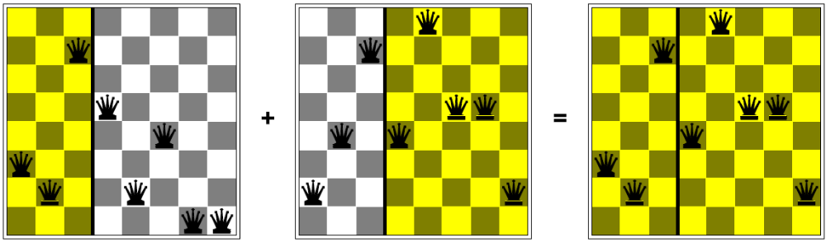
Example: N-Queens
Crossover helps only if substrings are meaningful components that can be reassembled into a new meaningful configuration.

Slide 140
Genetic Algorithms
Cost
States

Slide 141
Genetic Algorithms
Mutation
Cross-Over

Slide 142
Genetic Algorithms

Slide 143
Genetic Algorithms

Slide 144
Genetic Algorithms

Slide 145
Genetic Algorithms

Slide 146
Genetic Algorithms

Slide 147
Genetic Algorithms

Slide 148
Genetic Algorithms

Slide 149
Genetic Algorithms

Slide 150
Genetic Algorithms

Slide 151
Genetic Algorithms

Slide 152
Genetic Algorithms

Slide 153
Genetic Algorithms

Slide 154
Genetic Algorithms

Slide 155
Genetic Algorithms

Slide 156
Genetic Algorithms

Slide 157
Genetic Algorithms

Slide 158
Genetic Algorithms

Slide 159
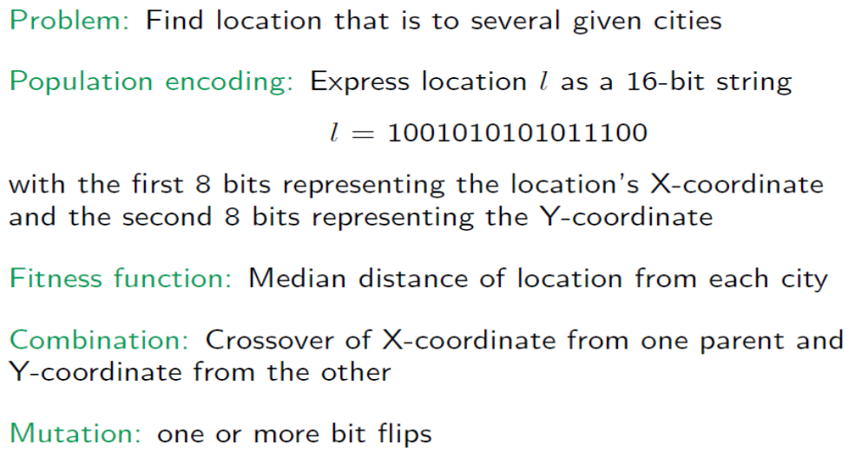
Problem Encoding
From: CS:4420

Slide 160
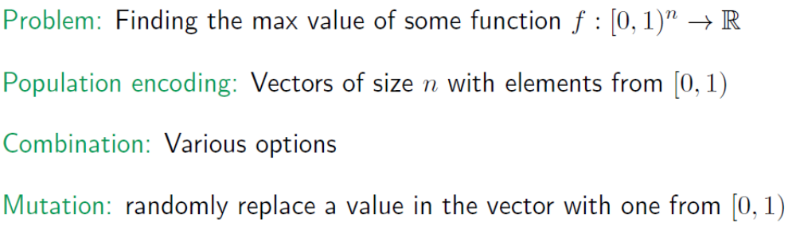
Problem Encoding
From: CS:4420

Slide 161


Recombination : Similar to crossover
From: CS:4420

Slide 162

GA for the Traveling Salesperson Problem
From: CS:4420

Slide 163

GA for the Traveling Salesperson Problem

Slide 164

GA for the Traveling Salesperson Problem

Slide 165

Local search in continuous spaces

Slide 166

Local Search in Continuous Spaces
There is a distinction between discrete and continuous environments. The most real-world environments are continuous. A continuous action space has an infinite branching factor, and thus can’t be handled by most of the algorithms we have covered so far (with the exception of first-choice hill climbing and simulated annealing).
Suppose we want to place three new airports anywhere in Romania, such that the sum of squared straight-line distances from each city on the map to its nearest airport is minimized. (See Figure 3.1 for the map of Romania.) The state space is then defined by the coordinates of the three airports:
(x1;y1), (x2;y2), and (x3;y3).
This is a six-dimensional space; we also say that states are defined by six variables.
The objective function f (x) = f (x1;y1;x2;y2;x3;y3) is relatively easy to compute for any particular state once we compute the closest cities. Let Ci be the set of cities whose closest airport (in the state x) is airport i. Then, we have

Slide 167

Example: Siting airports in Romania
Place 3 airports to minimize the sum of squared distances from each city to its nearest airport
Airport locations
x = (x₁,y₁), (x₂,y₂), (x₃,y₃)
City locations (x_{c},y_{c})
C_{a} = cities closest to airport a
Objective: minimize
f(x) = Σ_{a} Σ_{c∈Ca} (x_{a} - x_{c})² + (y_{a} - y_{c})²

Slide 168
Handling a continuous state/action space
One way to deal with a continuous state space is to discretize it. For example, instead of allowing the (xi;yi) locations to be any point in continuous two-dimensional space, we could limit them to fixed points on a rectangular grid with spacing of size δ (delta).
Discretize it!
  Define a grid with increment δ , use any of the discrete algorithms
Choose random perturbations to the state
  First-choice hill-climbing: keep trying until something improves the state
  Simulated annealing
Compute gradient of f(x) analytically

Slide 169
Finding extrema in continuous space
The gradient of the objective function is a vector ∇f(x) that gives the magnitude and direction of the steepest slope. For our problem, we have
Gradient vector: ∇f(x) = (∂f/∂x₁, ∂f/∂y₁, ∂f/∂x₂, …)^{T}
For the airports: f(x) = Σ_{a} Σ_{c∈Ca} (x_{a} - x_{c})² + (y_{a} - y_{c})²
In some cases, we can find a maximum by solving the equation ∇f(x) = 0
For example, with three airports, the expression for the gradient depends on what cities are closest to each airport in the current state. This means we can compute the gradient locally (but not globally); for example,
∂f/∂x₁ = Σ_{c∈C1} 2(x₁ - x_{c})
Given a locally correct expression for the gradient, we can perform steepest-ascent hill climbing by updating the current state according to the gradient descent formula:
x ← x - α∇f(x)
where α (alpha) is a small constant often called the step size.
There are huge range of algorithms for finding extrema using gradients.

Slide 170
Summary
Many configuration and optimization problems can be formulated as local search.
Local search methods keep small number of nodes in memory. They are suitable for problems where the solution is the goal state itself and not the path.
General families of algorithms:
  Hill-climbing, continuous optimization
  Simulated annealing (and other stochastic methods)
  Local beam search: multiple interaction searches
  Genetic algorithms: break and recombine states
Genetic algorithms are a kind of stochastic hill-climbing search in which a large population of states is maintained. New states are generated by mutation and by crossover which combines pairs of states from the population.
Many machine learning algorithms are local searches

