Slide 1


Artificial Intelligence
Constraint Satisfaction Problems
Many slides are adapted from CS 188 (http://ai.berkeley.edu), CS 322, CIS 521, CS 221, CS182, CS4420.
Notes:
Please retain proper attribution, including the reference to ai.berkeley.edu. Thanks!

Slide 2

Artificial Intelligence: A Modern Approach
Fourth Edition, Global Edition
Chapter 5
Constraint Satisfaction Problems
© 2022 Pearson Education Ltd.

Slide 3

What is Search For?
Assumptions about the world: a single agent, deterministic actions, fully observed state, discrete state space
1. Search/Planning: sequences of actions
  The path to the goal is the important thing
  Paths have various costs, depths
  Heuristics give problem-specific guidance
2. Local Search / Iterative Improvement
  Find a good or optimal state by repeatedly improving a current solution.
3. CSPs (Constraint Satisfaction Problems): assignments to variables
  The goal itself is important, not the path
  All paths at the same depth (for some formulations)
  CSPs are a specialized class of identification problems where we assign values to variables while respecting certain constraints

Slide 4

Constraint Satisfaction Problems

Slide 5
1. Classical Search / Planning
Question:
How do I get from the start state to the goal state?
Characteristics:
States are connected by actions.
The solution is a path.
Different paths may have different costs.
Typically uses a search tree or graph.
Example: Route Finding
Start: Istanbul
Goal: Ankara
Actions: drive between cities
Solution:
Istanbul → Bolu → Ankara
The sequence of actions is the solution.

Slide 6
2. Local Search / Iterative Improvement
Question:
What is a good solution state?
Characteristics:
Maintains only one (or a few) current states.
Moves to neighboring states.
Ignores the path used to reach the solution.
Suitable for enormous search spaces.
Example: 8-Queens
Start with a random placement:
  Q . . . . . . .
  . . . Q . . . .
  ...
Use hill climbing to reduce conflicts until none remain.
Only the final arrangement matters, not how it was found.

Slide 7
Classical Search/Planning Problems vs. Improvement Methods (Local Search)
Aspect | Classical Search / Planning | Improvement Methods (Local Search)
Goal | Find a path from an initial state to a goal state | Find a good or optimal solution state
Solution | Sequence of actions (path) | Final state/configuration
Path Important? | ✅ Yes | ❌ No
Memory Usage | Often high (stores frontier and explored states) | Very low (stores current state only)
Search Space Exploration | Systematic | Local, incremental improvement
Completeness | Often complete | Usually not complete
Optimality | Can guarantee optimal solutions (e.g., A*) | Usually no optimality guarantee
Suitable For | Planning, navigation, route finding | Large optimization problems
Evaluation | Goal test + path cost | Objective/fitness function
Typical Algorithms | BFS, DFS, Uniform Cost, A* | Hill Climbing, Simulated Annealing, Genetic Algorithms, Local Beam Search

Slide 8
3. Constraint Satisfaction Problems (CSPs)
3. Constraint Satisfaction Problems (CSPs)
Question:
What values should the variables take?
Characteristics:
Defined by:
  Variables
  Domains
  Constraints
Goal is to find an assignment satisfying all constraints.
Path is irrelevant.
Example: Different Colors
Variables
X, Y
Domains
X ∈ {Red, Blue}
Y ∈ {Red, Blue}
Constraint
X ≠ Y
Possible Assignments
X = Red, Y = Red ✗ Violates constraint
X = Red, Y = Blue ✓ Solution
X = Blue, Y = Red ✓ Solution
X = Blue, Y = Blue ✗ Violates constraint
CSP Components
Variables: X, Y
Domains: {Red, Blue}
Constraint: X ≠ Y
Solutions: (Red, Blue) and (Blue, Red)

Slide 9
Classical Search/Planning vs. Local Search (Iterative Improvement) vs. CSPs
Aspect | Classical Search / Planning | Local Search (Iterative Improvement) | CSPs (Constraint Satisfaction Problems)
Main Goal | Find a sequence of actions leading to a goal | Find a good or optimal state/configuration | Find an assignment that satisfies constraints
Output | A path (action sequence) | A final state/solution | A variable assignment
Path Important? | ✅ Yes | ❌ Usually no | ❌ No
State Representation | States connected by actions | Complete candidate solutions | Variables, domains, constraints
Search Strategy | Systematically explores a search tree/graph | Moves from one state to neighboring states | Assign values while enforcing constraints
Memory Usage | Often high (stores frontier/explored states) | Very low (stores current state only) | Moderate, depends on backtracking and propagation
Suitable For | Navigation, planning, game search | Large optimization problems | Scheduling, coloring, assignment problems
Evaluation | Goal test and path cost | Objective/fitness function | Constraint satisfaction
Can Handle Huge Spaces? | Limited | ✅ Yes | Often yes, using specialized techniques
Typical Algorithms | BFS, DFS, Uniform Cost, A* | Hill Climbing, Simulated Annealing, Genetic Algorithms | Backtracking, Forward Checking, AC-3, Min-Conflicts

Slide 10
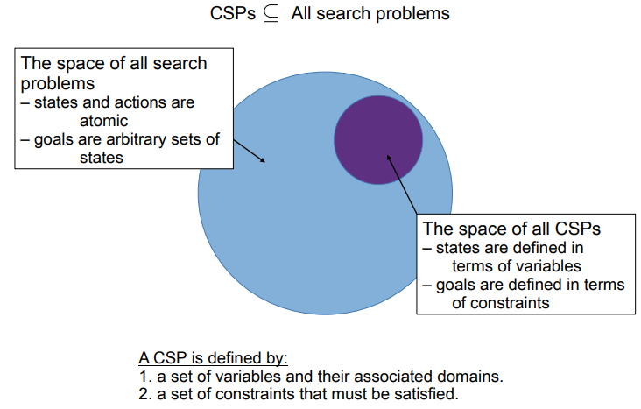
Constraint Satisfaction Problems
Constraint satisfaction problems (CSPs) are mathematical questions defined as a set of objects whose state must satisfy a number of constraints or limitations.

Slide 11
Defining Constraint Satisfaction Problems
A constraint satisfaction problem (CSP) consists of three components, X, D, and C:
X is a set of variables, {X₁ ….. X_{n}}.
D is a set of domains, {D₁, …. , D_{n}}, one for each variable
C is a set of constraints that specify allowable combination of values
CSPs deal with assignments of values to variables.
A complete assignment is one in which every variable is assigned a value.
A consistent assignment (partial or complete) does not violate any constraints.
A solution (also called model in CSP terminology) to a CSP is a consistent, complete assignment.
A partial assignment is one that leaves some variables unassigned.
A Partial solution is a partial assignment that is consistent.

Slide 12
Key Terms in CSPs
Complete Assignment
  Every variable in the problem has been assigned a value.
  If this assignment satisfies all constraints, it is considered a solution (model) to the CSP.
Partial Assignment
  Only some variables have been assigned values.
  Others remain unassigned.
Consistent Assignment
  An assignment (partial or complete) that does not violate any constraints.
  For example, if two variables must be different, assigning them the same value would be inconsistent.
Partial Solution
  A partial assignment that is consistent.
  It may not be a full solution yet, but it's on the right path.

Slide 13
Example CSP: Class Scheduling
Problem: Assign time slots to three university classes (Math, Physics, Chemistry) such that:
  No two classes are scheduled at the same time.
  The Physics professor is only available in the morning.
  Chemistry must be scheduled after Math.
Variables:
  Math
  Physics
  Chemistry
Domains:
  {Morning, Afternoon, Evening}
Constraints:
  All classes must be at different times.
  Physics must be in the Morning.
  Chemistry must be after Math (e.g., if Math is Morning, Chemistry can be Afternoon or Evening).
Partial Assignment:
Assign Physics = Morning. Math and Chemistry are still unassigned.
Partial Solution:
Physics = Morning is consistent with the constraints so far.
Complete Assignment:
Math = Afternoon,
Physics = Morning,
Chemistry = Evening.
Solution:
If this assignment satisfies all constraints
(no overlaps,
Chemistry after Math,
Physics in morning),
it’s a valid solution.

Slide 14

Constraint satisfaction problems (CSPs)
Standard search problem:
state is a “black box”—any old data structure that supports goal test, eval, successor
CSP:
state is defined by variables X_{i} with values from domain D_{i}
goal test is a set of constraints specifying
allowable combinations of values for subsets of variables
CSP specification can be considered as a simple example of a formal representation language
Allows useful general-purpose algorithms with more power than standard search algorithms
© 2022 Pearson Education Ltd.

Slide 15
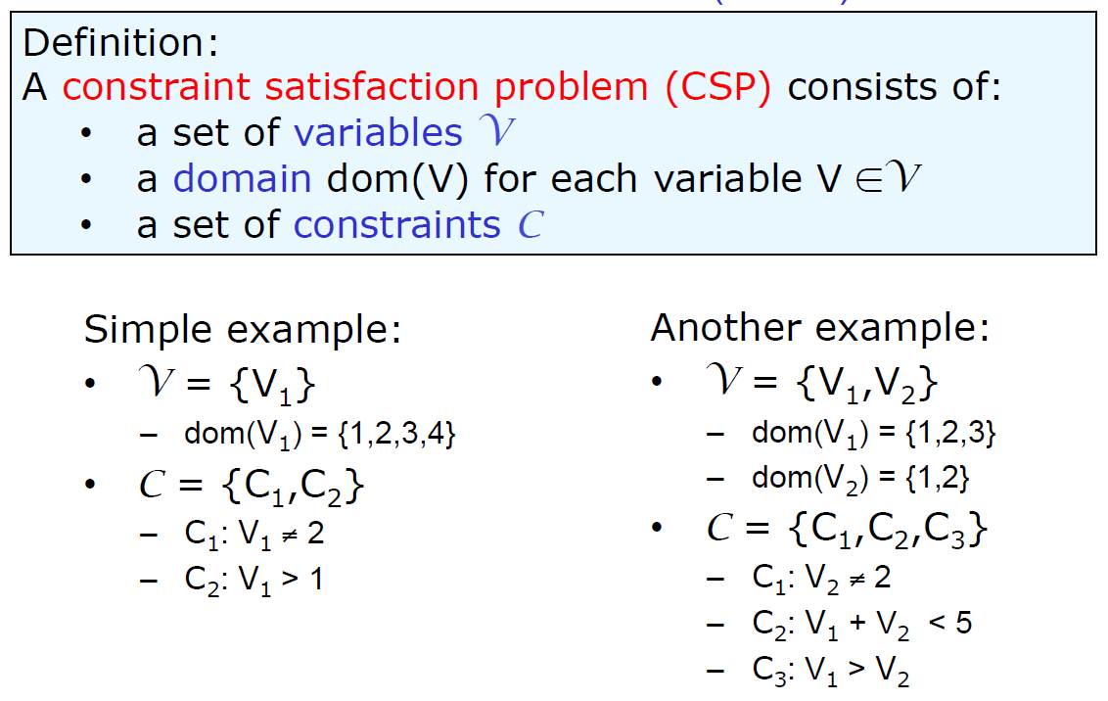
Constraint satisfaction problems (CSPs)
From: UBC CS 322 – CSP

Slide 16
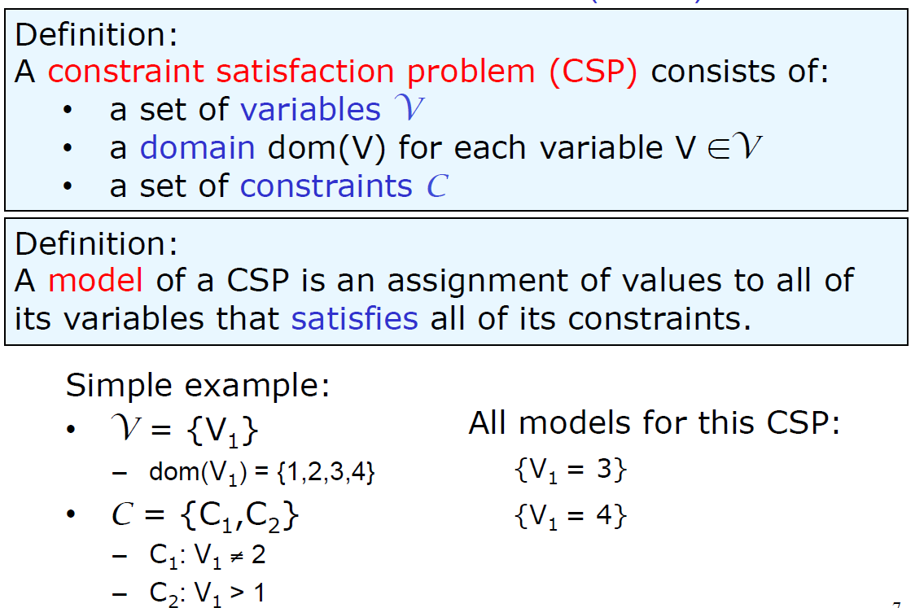
Constraint satisfaction problems (CSPs)

Slide 17
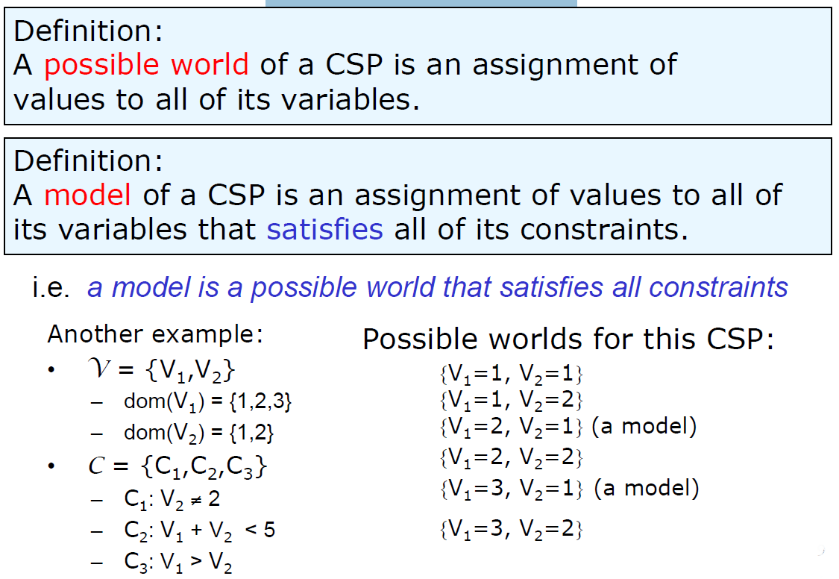
Possible Worlds

Slide 18

Varieties of CSPs and Constraints

Slide 19

Varieties of CSPs
Discrete Variables
  Finite domains
    Size d means O(d^{n}) complete assignments
    E.g., Boolean CSPs, including Boolean satisfiability (NP-complete)
  Infinite domains (integers, strings, etc.)
    E.g., job scheduling, variables are start/end times for each job
    CSPs with linear constraints are often efficiently solvable, while CSPs with general nonlinear constraints can become computationally very difficult, and some formulations are undecidable.
    Undecidable: There may be no algorithm that always determines whether a solution exists
Continuous variables
  E.g., start/end times for Hubble Telescope observations
  If all constraints are linear (equalities or inequalities involving only first-degree variables), the problem can be formulated as a Linear Programming (LP) problem. It can be solved efficiently.

Slide 20

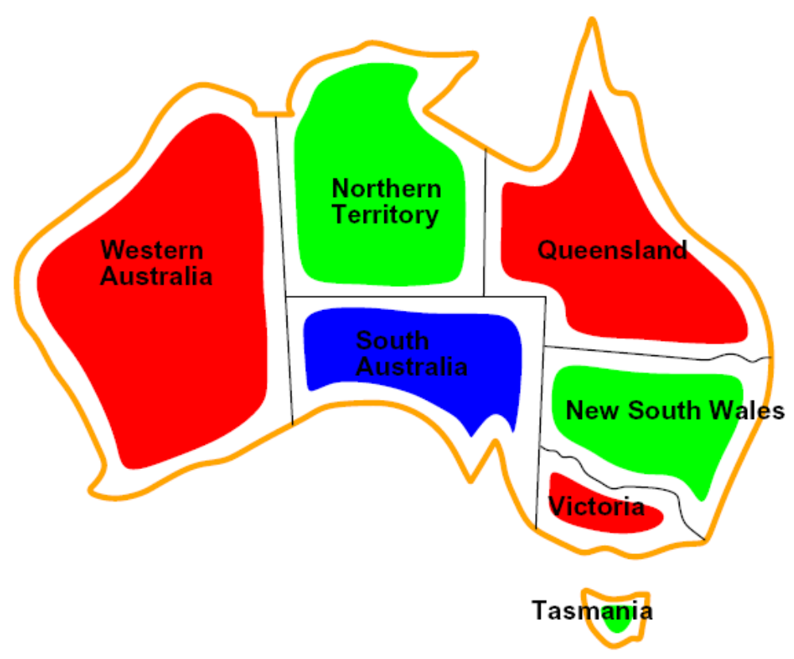

Varieties of Constraints
Varieties of Constraints
  Unary constraints involve a single variable (equivalent to reducing domains), e.g.:
  Binary constraints involve pairs of variables, e.g.:
  Higher-order constraints involve 3 or more variables:
  e.g., cryptarithmetic column constraints
Preferences (soft constraints):
  E.g., red is better than green
  Often representable by a cost for each variable assignment
  Gives constrained optimization problems
  (We’ll ignore these until we get to Bayes’ nets)
Map Coloring Problem: We are given the task of coloring each region either red, green, or blue in such a way that no two neighboring regions have the same color.

Slide 21
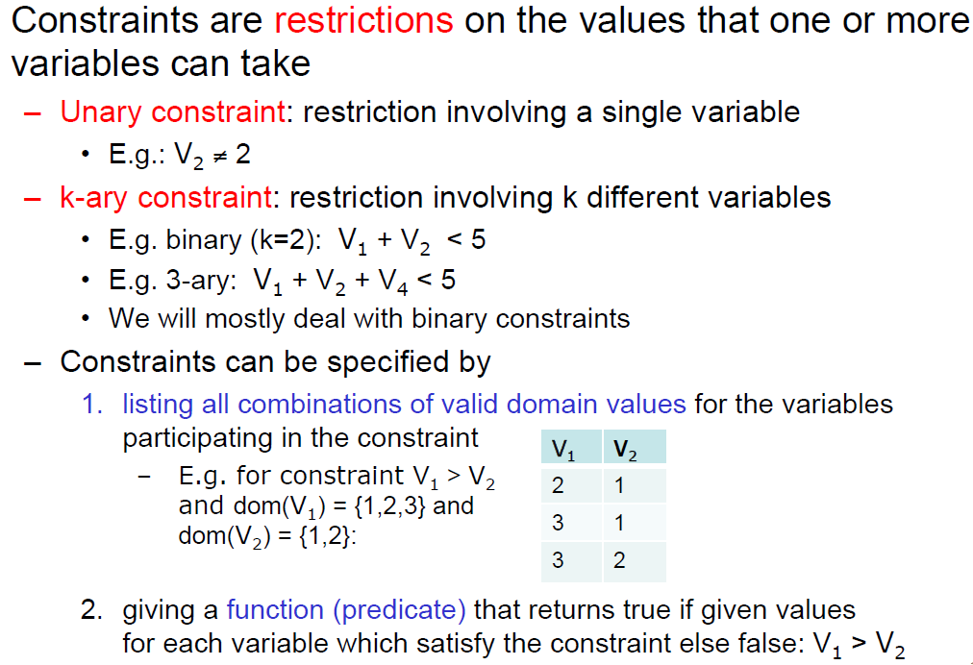
Constraints
From: UBC CS 322 – CSP

Slide 22
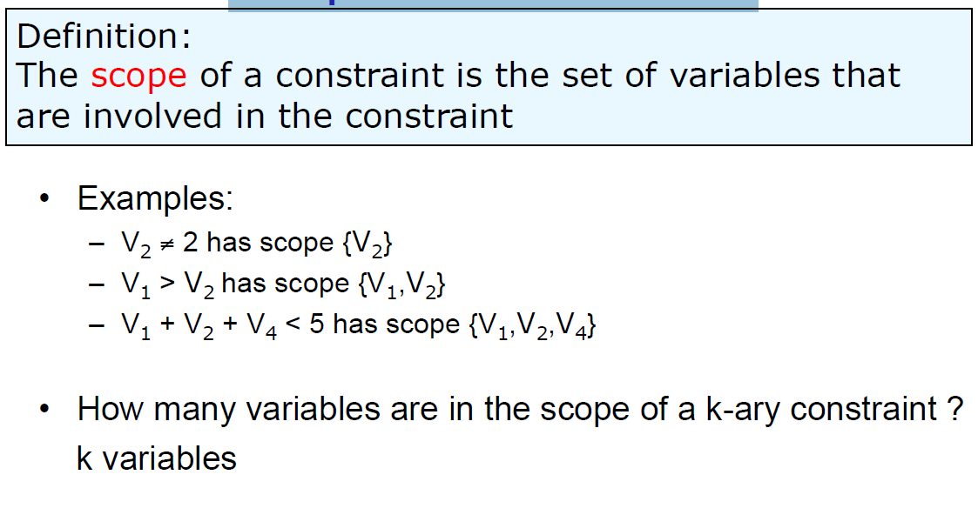
Scope of a constraint
From: UBC CS 322 – CSP

Slide 23
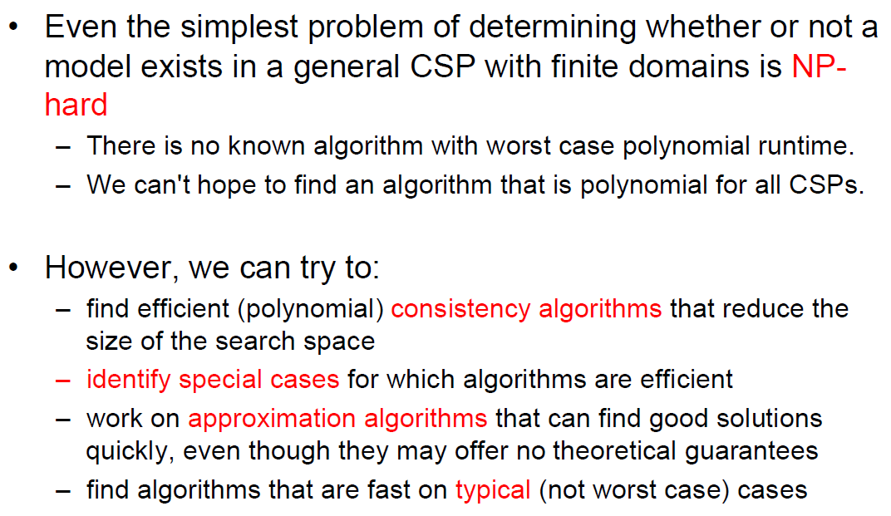
Solving Constraint Satisfaction Problems

Slide 24
CSP Examples
Example problem: Map coloring
We are looking at a map of Australia showing each of its states and territories
We are given the task of coloring each region either red, green, or blue in such a way that no two neighboring regions have the same color.
To formulate this as a CSP, we define the variables to be the regions:
X = {WA,NT,Q,NSW,V,SA,T}

Slide 25


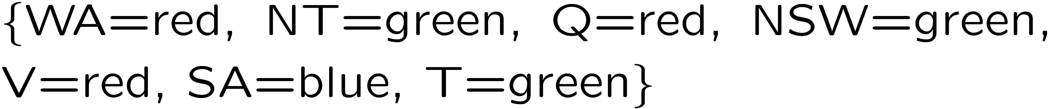
Example: Map Coloring
Variables:
Domains:
Constraints: adjacent regions must have different colors
Solutions are assignments satisfying all constraints, e.g.:
Implicit:
Explicit:

Slide 26
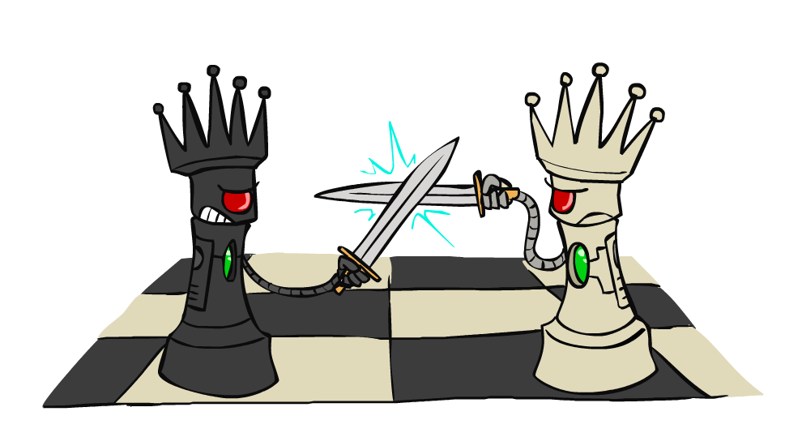
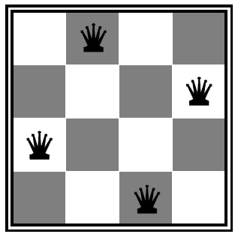
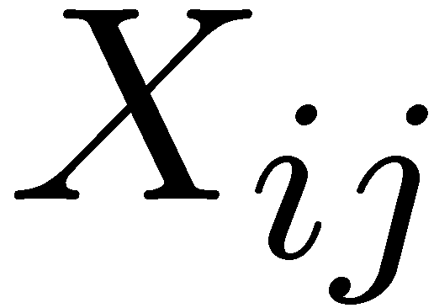

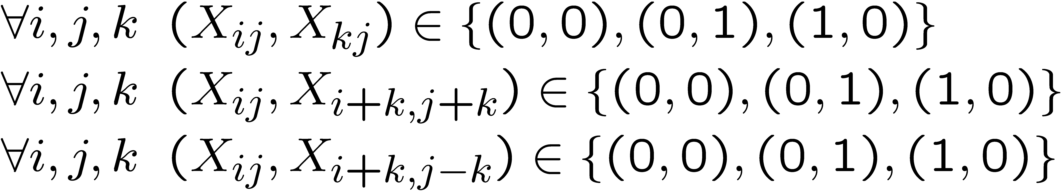
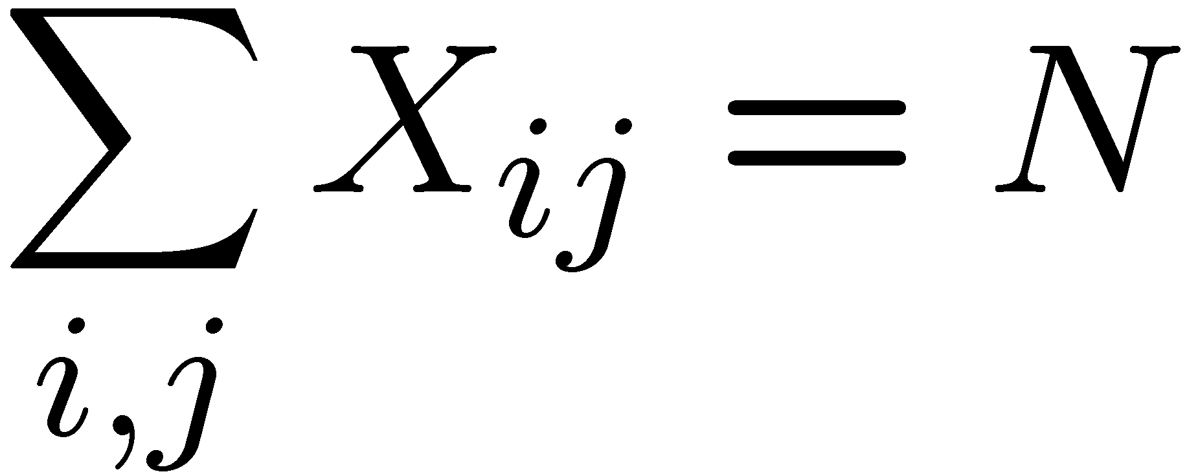
Example: N-Queens
Formulation 1:
  Variables:
  Domains:
  Constraints
Queens can not attack/threaten each other
Queens are not in the same row (No (1,1)),
Queens are not in the same columns
Queens are not in the same diagonals
Queens are not in the same oppsite diagonals

Slide 27







Example: N-Queens
Formulation 2:
  Variables:
  Domains:
  Constraints:
Each row will one queen.
Assign a column to each queen.
Implicit:
Explicit:

Slide 28
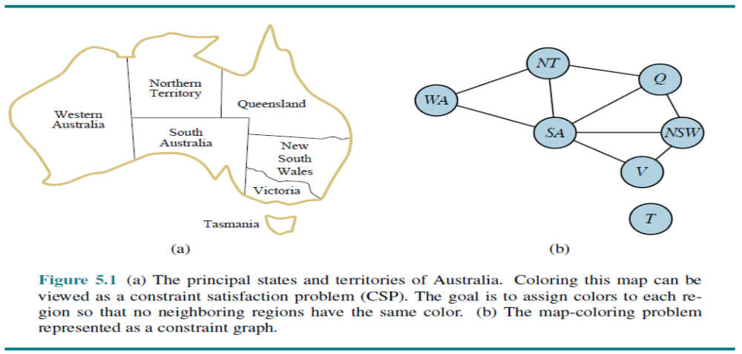
Constraint Graphs

Slide 29
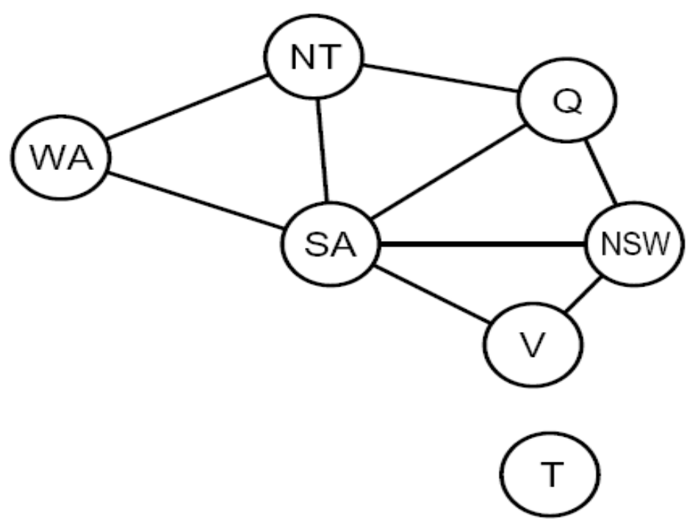
Constraint Graphs
Binary CSP: each constraint relates (at most) two variables
Binary constraint graph: nodes are variables, arcs show constraints
General-purpose CSP algorithms use the graph structure to speed up search. E.g., Tasmania is an independent subproblem!
[Demo: CSP applet (made available by aispace.org) -- n-queens]
Notes:
Demo:
Run constraint.jar or constraint.exe, load the 5 queens problem.
Demo is just showing the n-queens applet as illustration of constraint graph, but later in lecture we’ll interact with the applet.
aispace.org will have the latest version

Slide 30
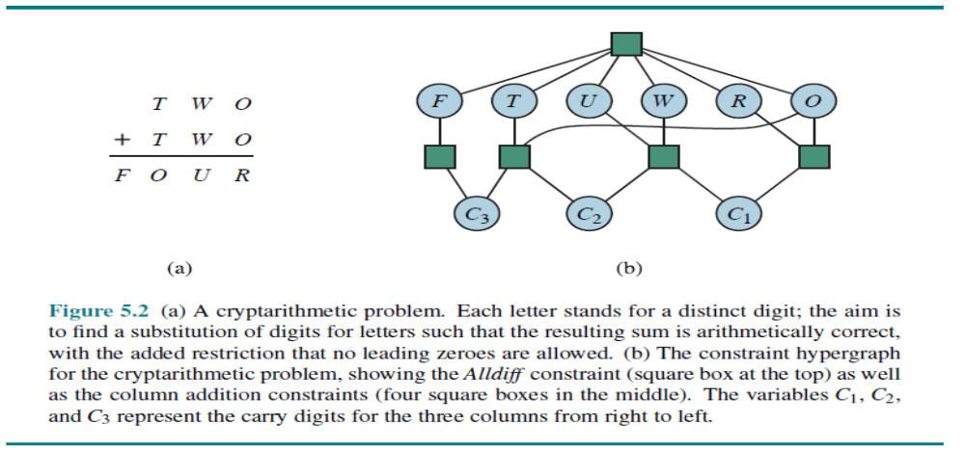
Example: cryptarithmetic puzzles

Slide 31

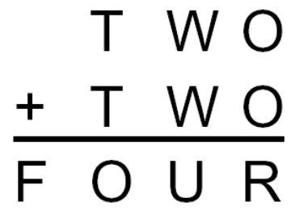
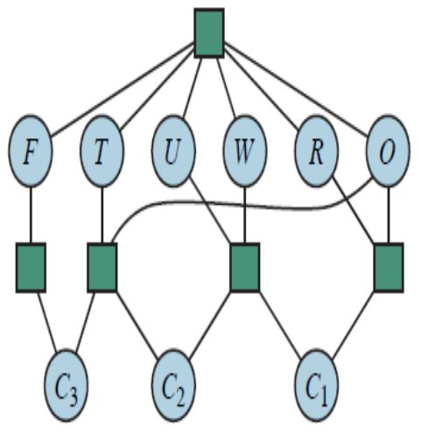
Example: Cryptarithmetic
Variables:
Domains:
Constraints:
C₃ C₂ C₁
F T U W R O C₁ C₂ C₃
- Each letter in a cryptarithmetic puzzle represents a different digit. For the case in Figure 5.2(a), this would be represented as the global constraint Alldiff (F;T;U;W;R;O).
- The addition constraints on the four columns of the puzzle can be written as the following n-ary constraints:
  O+O = R+10 C1
  C1+W +W =U +10 C2
  C2+T +T = O+10 C3
  C3 = F ;
where C1, C2, and C3 are auxiliary variables representing the digit carried over into the tens, hundreds, or thousands column.
Notes:
0=7, R=4, W=6, U=2, T=8, F=1; 867 + 867 = 1734

Slide 32
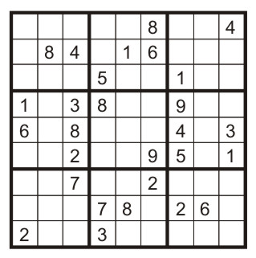
Example: Sudoku
The objective is to fill a 9×9 grid with digits so that each column, each row, and each of the nine 3×3 subgrids that compose the grid (also called "boxes", "blocks", or "regions") contains all of the digits from 1 to 9.
Variables:
  Each (open) square
Domains:
  {1,2,…,9}
Constraints:
9-way alldiff for each column
9-way alldiff for each row
9-way alldiff for each region
(or can have a bunch of pairwise inequality constraints)

Slide 33
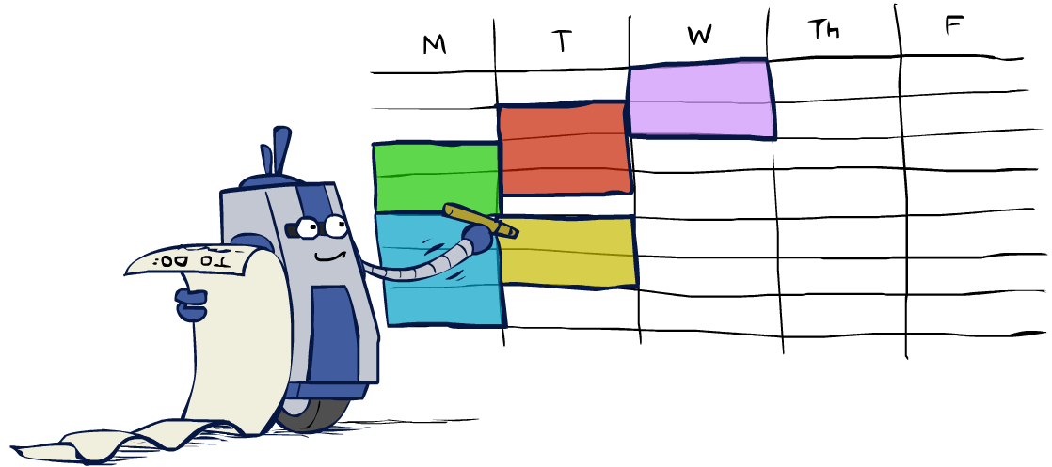
Real-World CSPs
Scheduling problems: e.g., when can we all meet?
Timetabling problems: e.g., which class is offered when and where?
Assignment problems: e.g., who teaches what class
Hardware configuration
Transportation scheduling
Factory scheduling
Circuit layout
Fault diagnosis
… lots more!
Many real-world problems involve real-valued variables…

Slide 34

Solving CSPs

Slide 35
Solving Constraint Satisfaction Problems (CSPs)
A CSP can be solved using generate-and-test paradigm (GT) that systematically generates each possible value assignment and then it tests to see if it satisfies all the constraints.
A more efficient method uses the backtracking paradigm (BT) that is the most common algorithm for performing systematic search. Backtracking incrementally attempts to extend a partial solution toward a complete solution, by repeatedly choosing a value for another variable.
Two methods:
  Generate & Test
  Graph search with backtracking paradigm (BT)

Slide 36
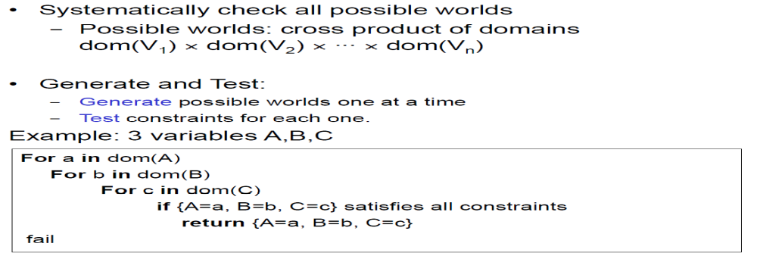
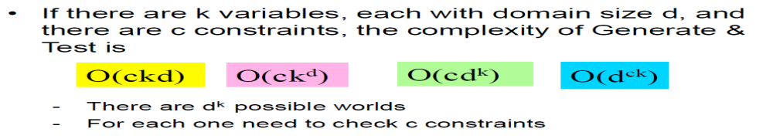
Generate and Test (GT) Algorithms
From: UBC CS 322 – CSP

Slide 37
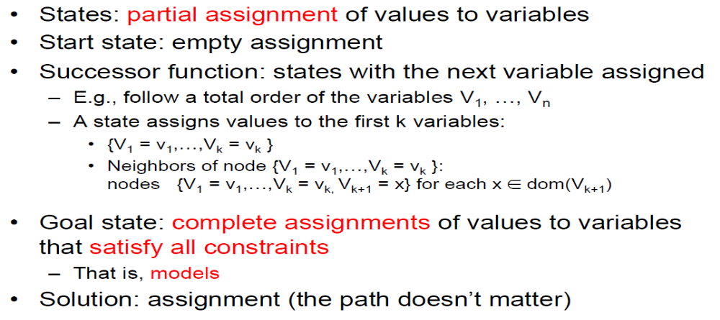
CSP as a Search Problem: one formulation
From: UBC CS 322 – CSP

Slide 38
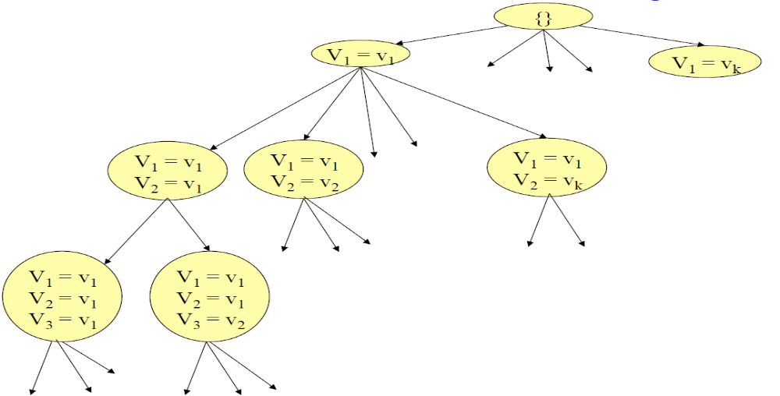
CSP as Graph Searching

Slide 39
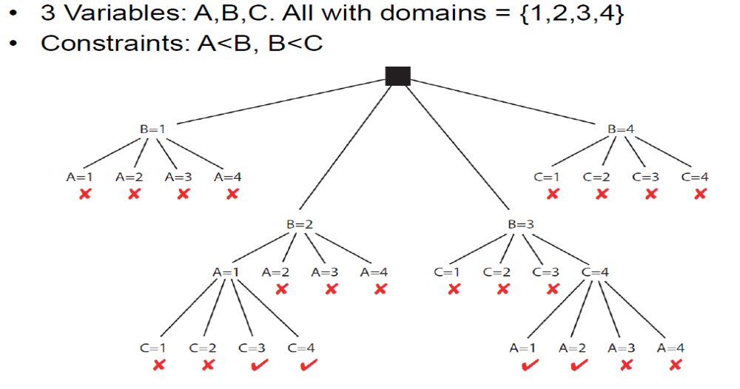
CSP as Graph Searching

Slide 40
Standard Search Formulation
Standard search formulation of CSPs
States defined by the values assigned so far (partial assignments)
  Initial state: the empty assignment, {}
  Successor function: assign a value to an unassigned variable
  Goal test: the current assignment is complete and satisfies all constraints
We’ll start with the straightforward, naïve approach, then improve it

Slide 41
Search Methods
What would BFS do?
What would DFS do?
What problems does naïve search have?
  For a CSP with n variables of domain size d we would end up with a search tree where all the complete assignments (and thus all the solutions) are leaf nodes at depth n.
  The number of leaves is d^{n}
[Demo: coloring -- dfs]
Notes:
Demo:
CS188 javascript demos -> source -> exercises -> csps -> CSPs demos -> CSPs demos.html
Settings:
Graph = Simple
Algorithm = Naïve Search
Ordering = None
Filtering = None

Slide 42
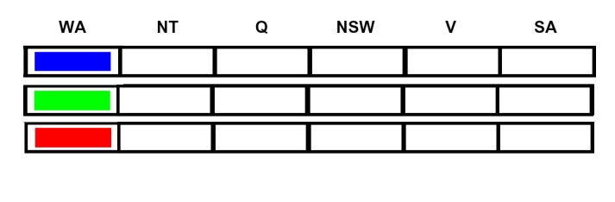
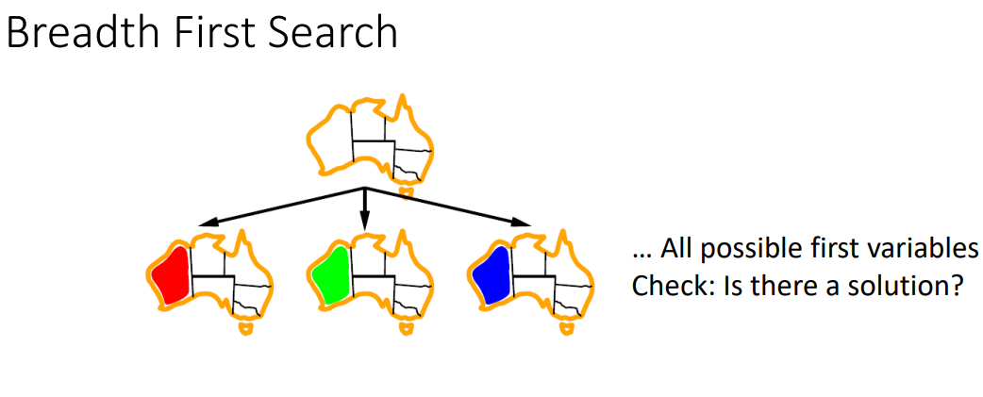
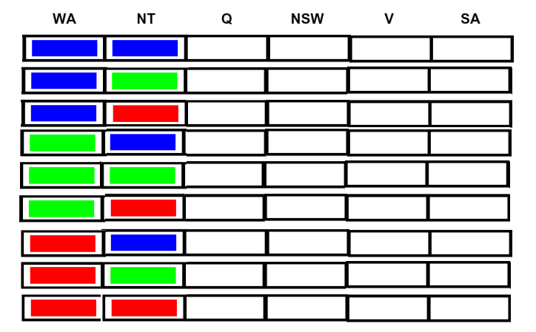
BFS
….
BFS will take a long time to find a solution.
DFS (Naive search) seems to be better choice

Slide 43

Video of Demo Coloring – DFS https://inst.eecs.berkeley.edu/~cs188/fa19/assets/demos/csp/csp_demos.html
A map coloring problem is a type of CSP where each state can be assigned a color from the set (red,green,blue)
The constraint involved says that no two neighbouring state is allowed to have the same color.

Slide 44
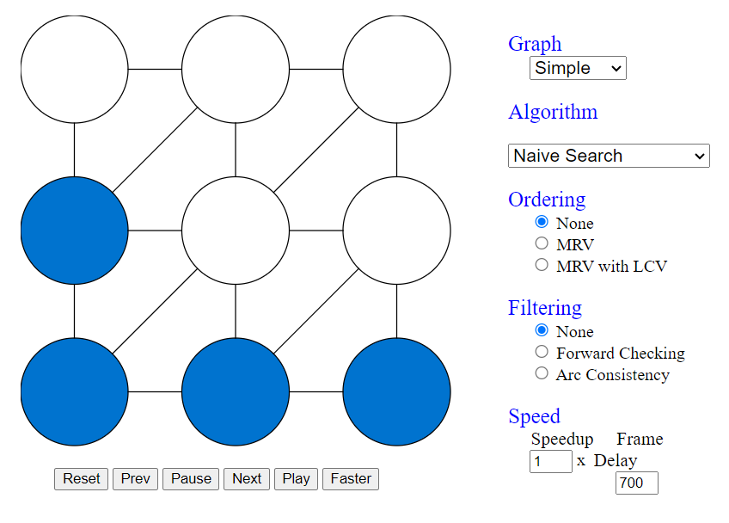
Demo Coloring – DFS https://www.cs.cmu.edu/~15281/demos/csp_backtracking/
A map coloring problem is a type of CSP where each state can be assigned a color from the set (red,green,blue)
The constraint involved says that no two neighbouring state is allowed to have the same color.
https://inst.eecs.berkeley.edu/~cs188/fa21/assets/demos/csp/csp_demos.html

Slide 45

Backtracking Search

Slide 46
Backtracking Search
Backtracking search is the basic uninformed algorithm for solving CSPs. It is essentially Depth-First Search (DFS) with two important improvements.
Idea 1: One variable at a time
  Variable assignments are commutative, so fix ordering
  I.e., [WA = red then NT = green] same as [NT = green then WA = red]
  Only need to consider assignments to a single variable at each step
Idea 2: Check constraints as you go
  I.e. consider only values which do not conflict with previous assignments
  Might have to do some computation to check the constraints
  “Incremental goal test”
Depth-first search with these two improvements
is called backtracking search (not the best name)
Can solve n-queens for n ≈ 25

Slide 47
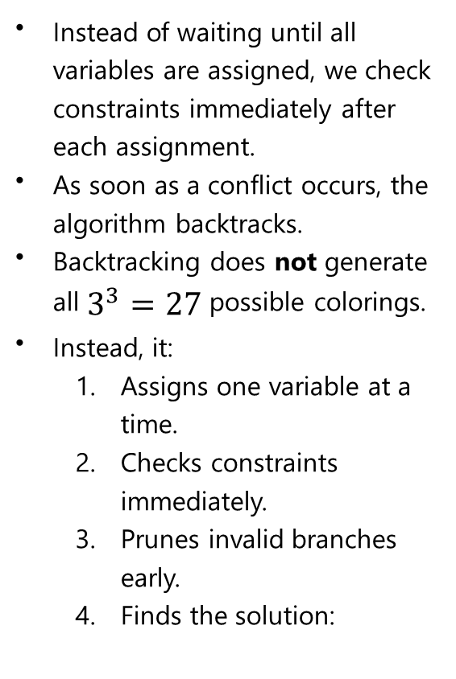
CSP Example: Graph Coloring
CSP
Variables: A, B, C
Domains: {Red, Green, Blue}
Constraints:
A ≠ B
A ≠ C
B ≠ C
Graph:
A ----- B
\ /
\ /
C
Instead of waiting until all variables are assigned, we check constraints immediately after each assignment.
As soon as a conflict occurs, the algorithm backtracks.
Backtracking does not generate all $3^{3}=27$possible colorings.
Instead, it:
  Assigns one variable at a time.
  Checks constraints immediately.
  Prunes invalid branches early.
  Finds the solution:
{}
|
A=Red
|
+-----------+-----------+
| |
B=Red ✗ B=Green
|
+-----------+-----------+
| | |
C=Red✗ C=Green✗ C=Blue✓

Slide 48
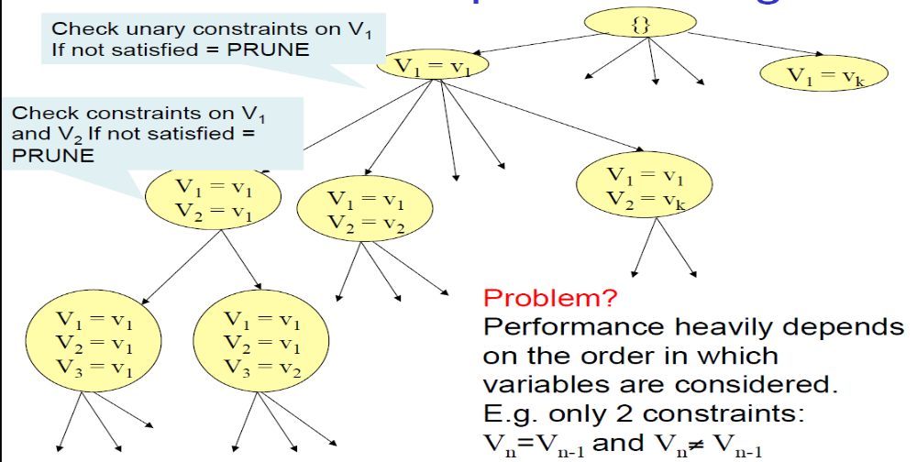
CSP as Graph Searching

Slide 49
Video of Demo Coloring – Backtracking https://www.cs.cmu.edu/~15281/demos/csp_backtracking/

Slide 50
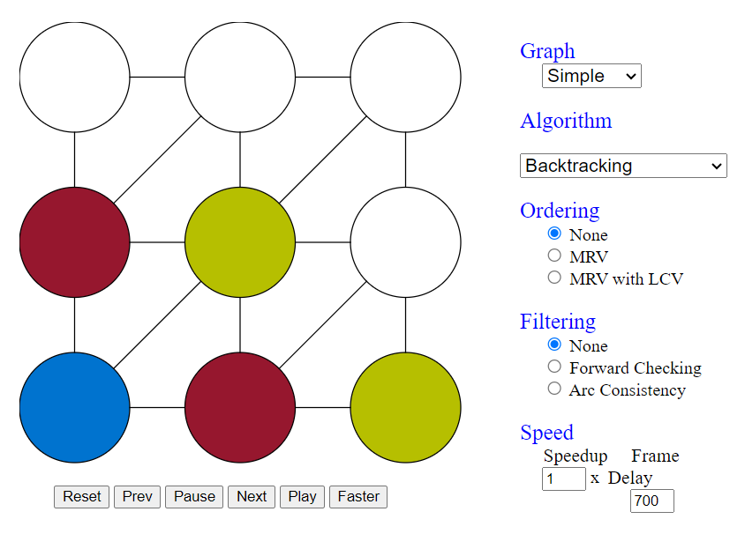
Demo Coloring – Backtracking
https://www.cs.cmu.edu/~15281/demos/csp_backtracking/

Slide 51

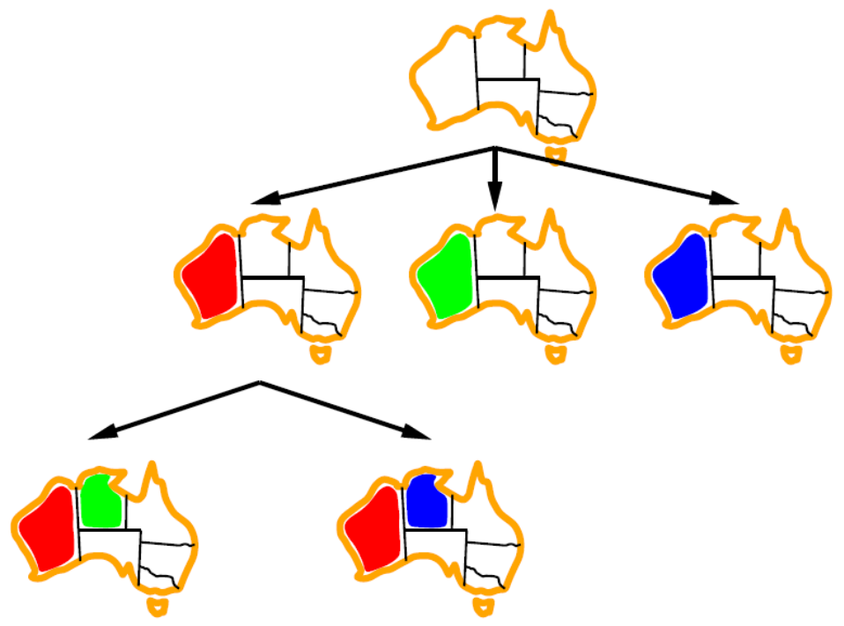
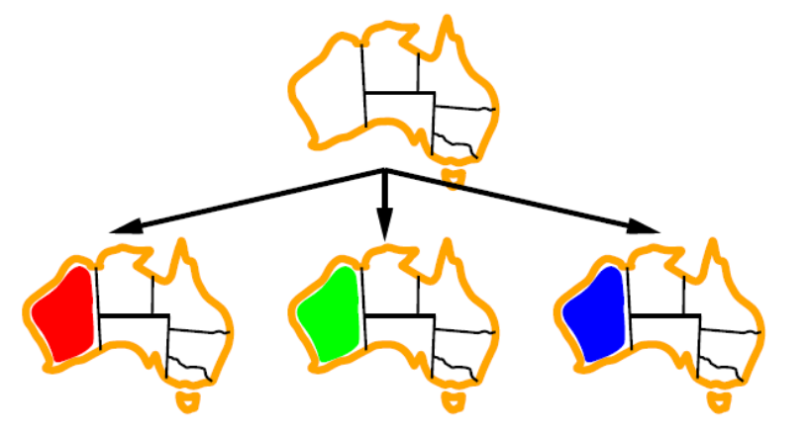
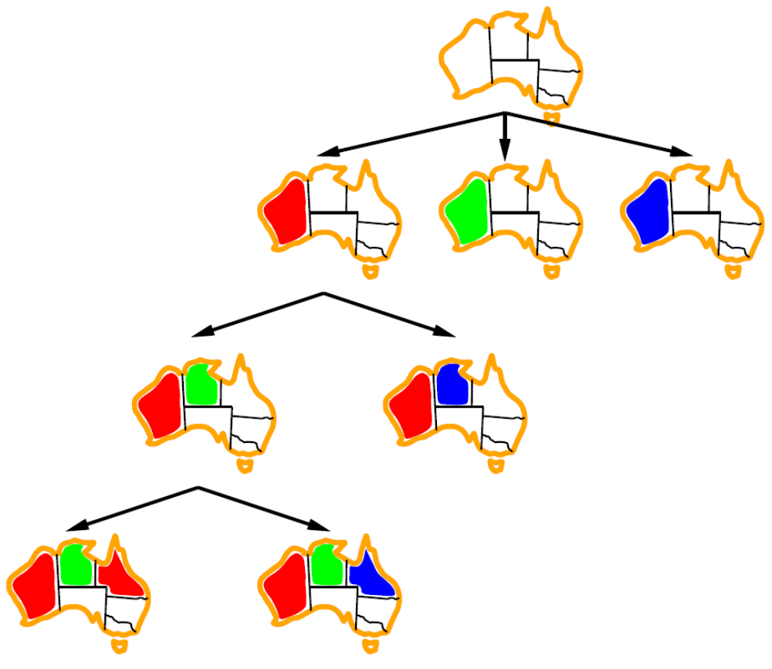
Backtracking Example

Slide 52
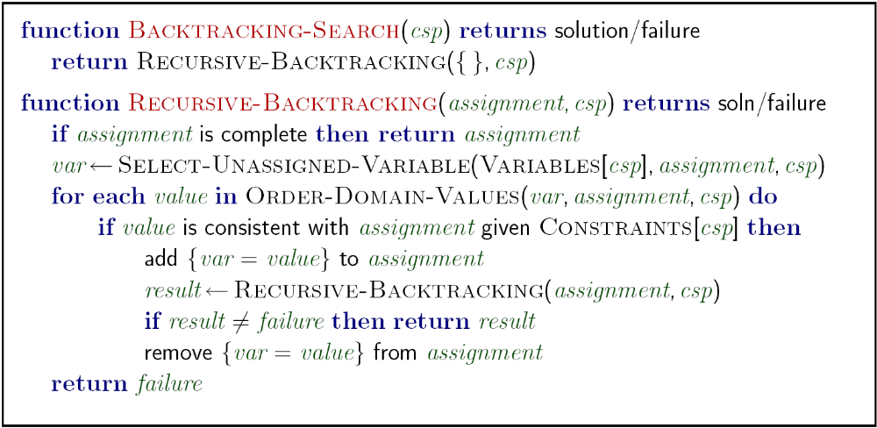
Backtracking Search
Backtracking = DFS + variable-ordering + fail-on-violation
https://inst.eecs.berkeley.edu/~cs188/fa19/assets/demos/csp/csp_demos.html
[Demo: coloring -- backtracking]
Notes:
Demo:
CS188 javascript demos -> source -> exercises -> csps -> CSPs demos -> CSPs demos.html
Settings:
Graph = Simple
Algorithm = Backtracking
Ordering = None
Filtering = None

Slide 53
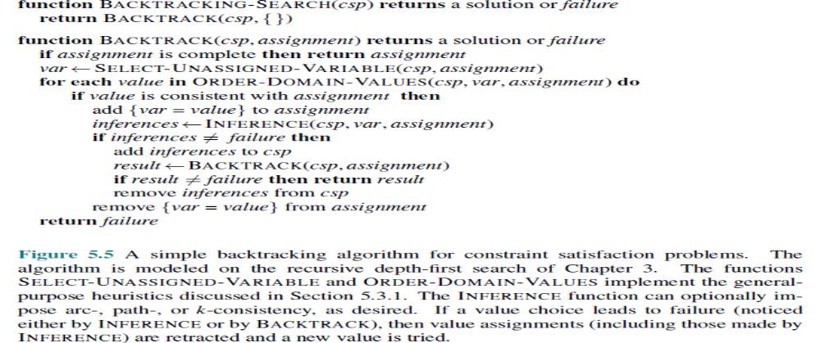
Backtracking Search

Slide 54

Improving Backtracking
General-purpose ideas give huge gains in speed.
Backtracking alone still isn’t very smart. The usual improvements are:
  Filtering: use forward checking or arc consistency (AC-3) to detect failure even earlier.
  Ordering: choose the next variable with MRV (minimum remaining values), and try the least-constraining value first.
  Structure: exploit tree-structured constraint graphs or cutset conditioning.

Slide 55

Filtering

Slide 56
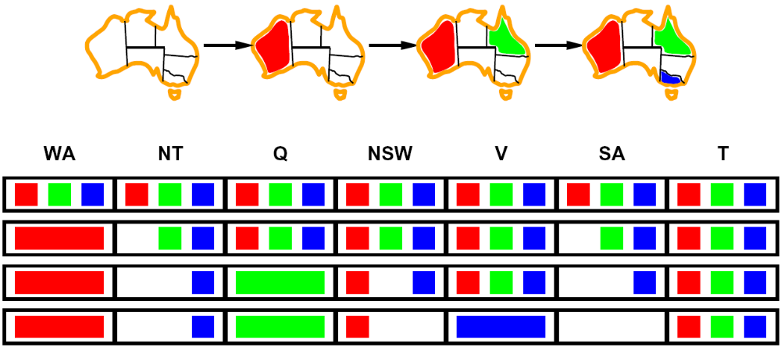
Filtering: Forward Checking
Filtering: Keep track of domains for unassigned variables and cross off bad options
Forward checking: Cross off values that violate a constraint when added to the existing assignment
WA
NT
Q
SA
NSW
V
[Demo: coloring -- forward checking]
Notes:
Demo:
CS188 javascript demos -> source -> exercises -> csps -> CSPs demos -> CSPs demos.html
Settings:
Graph = Simple
Algorithm = Backtracking
Ordering = None
Filtering = Forward Checking

Slide 57
Video of Demo Coloring – Backtracking with Forward Checking https://www.cs.cmu.edu/~15281/demos/csp_backtracking/

Slide 58
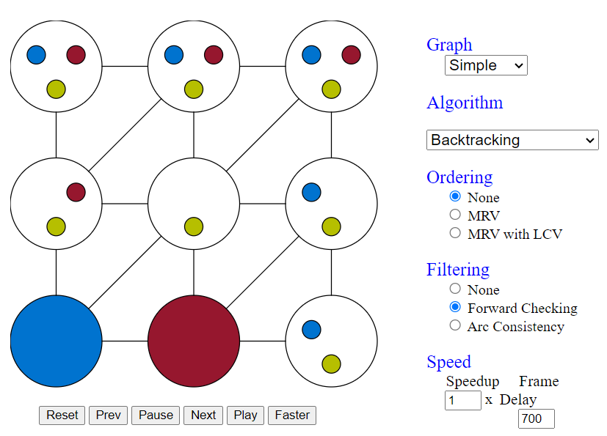
Backtracking with Forward Checking
https://www.cs.cmu.edu/~15281/demos/csp_backtracking/

Slide 59
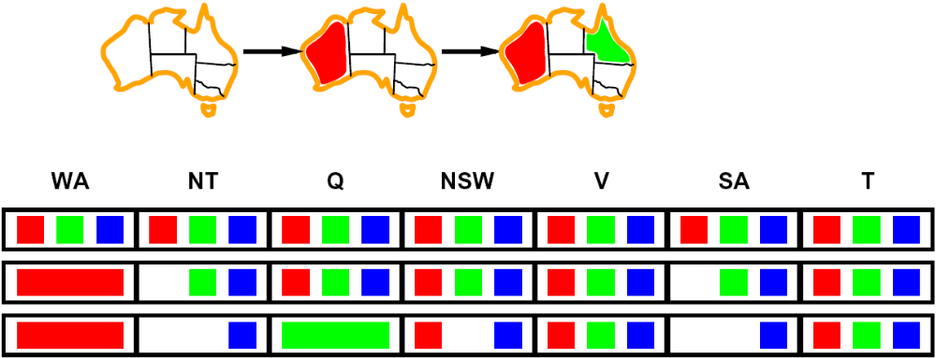
Filtering: Constraint Propagation
Forward checking propagates information from assigned to unassigned variables, but doesn't provide early detection for all failures:
NT and SA cannot both be blue!
Why didn’t we detect this yet?
Constraint propagation: reason from constraint to constraint
NT
Q
WA
SA
NSW
V

Slide 60
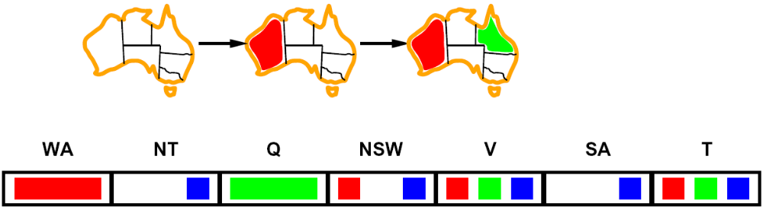

Consistency of A Single Arc
An arc X → Y is consistent iff for every x in the tail there is some y in the head which could be assigned without violating a constraint
Remove values in the domain of X
if there isn’t a corresponding legal Y
Forward checking: Enforcing consistency of arcs pointing to each new assignment
NT
Q
WA
SA
NSW
V
Delete from the tail!

Slide 61

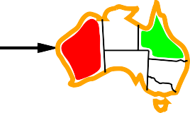
Arc consistency
Simplest form of propagation makes each arc consistent
X → Y is consistent iff
for every value x of X there is some allowed y
WA
NT
Q
NSW
V
SA
T
© 2022 Pearson Education Ltd.

Slide 62
Arc consistency
Simplest form of propagation makes each arc consistent
X → Y is consistent iff
for every value x of X there is some allowed y
WA
NT
Q
NSW
V
SA
T
If X loses a value, neighbors of X need to be rechecked
© 2022 Pearson Education Ltd.

Slide 63
Arc consistency
Simplest form of propagation makes each arc consistent
X → Y is consistent iff
for every value x of X there is some allowed y
WA
NT
Q
NSW
V
SA
T
If X loses a value, neighbors of X need to be rechecked
Arc consistency detects failure earlier than forward checking Can be run as a preprocessor or after each assignment
© 2022 Pearson Education Ltd.

Slide 64
Arc Consistency of an Entire CSP
A simple form of propagation makes sure all arcs are consistent:
Important: If X loses a value, neighbors of X need to be rechecked!
Arc consistency detects failure earlier than forward checking
Can be run as a preprocessor or after each assignment
What’s the downside of enforcing arc consistency?
NT
Q
WA
SA
NSW
V
Remember: Delete from the tail!

Slide 65
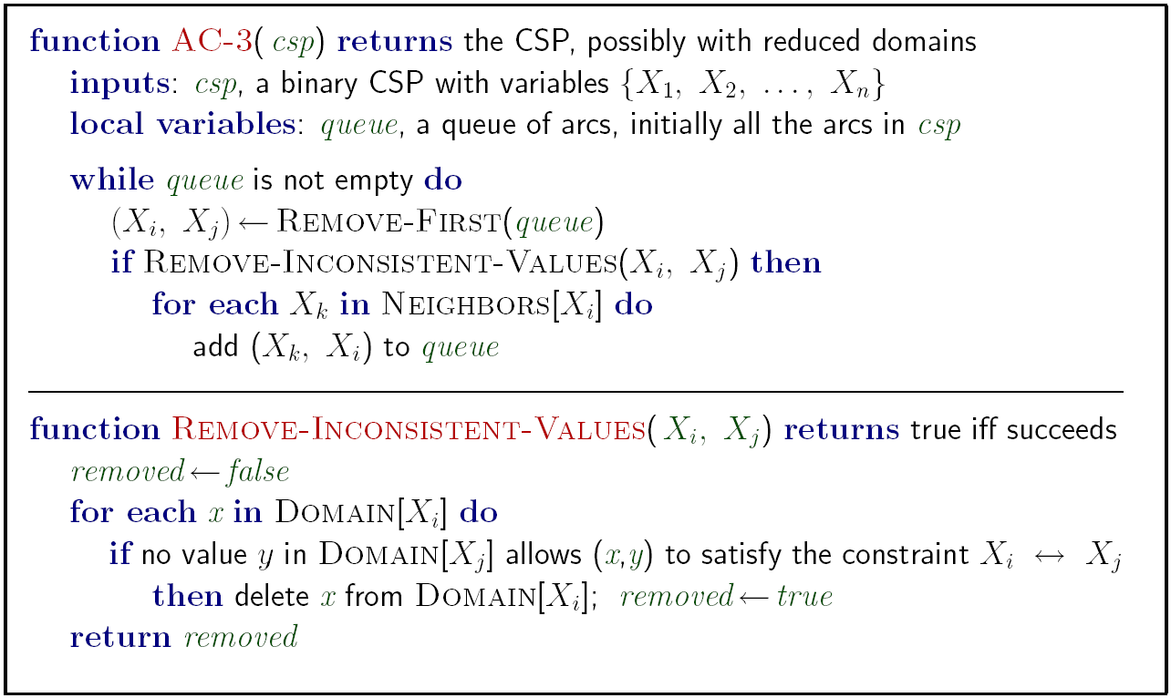
Enforcing Arc Consistency in a CSP
Runtime: O(n²d³), can be reduced to O(n²d²)
… but detecting all possible future problems is NP-hard – why?
[Demo: CSP applet (made available by aispace.org) -- n-queens]
Notes:
Auto-consistency (note initially nothing gets deleted/pruned since there are consistent options for all constraints for initial variable domains)
Flashes whenever something needs to be re-checked

Slide 66
Limitations of Arc Consistency
After enforcing arc consistency:
  Can have one solution left
  Can have multiple solutions left
  Can have no solutions left (and not know it)
Arc consistency still runs inside a backtracking search!
What went wrong here?
[Demo: coloring -- forward checking]
[Demo: coloring -- arc consistency]
Notes:
Demo:
CS188 javascript demos -> source -> exercises -> csps -> CSPs demos -> CSPs demos.html
Settings:
Graph = Complex
Algorithm = Backtracking
Ordering = None
Filtering = Forward Checking (first) / Arc Consistency (second)

Slide 67
Video of Demo Coloring – Backtracking with Forward Checking – Complex Graph

Slide 68
Video of Demo Coloring – Backtracking with Arc Consistency – Complex Graph

Slide 69
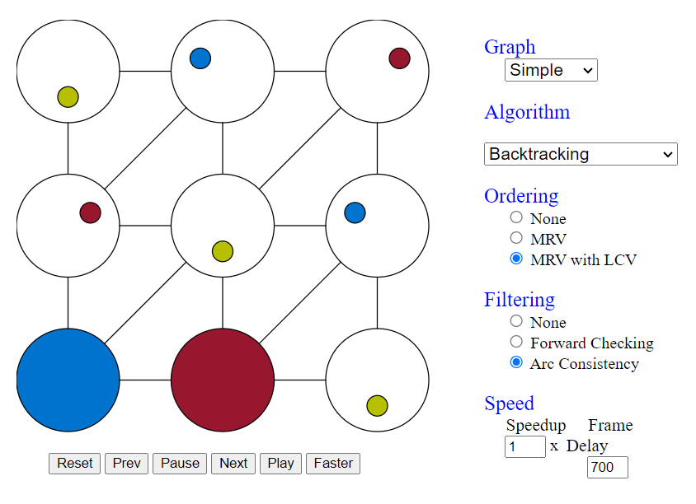
Backtracking with Arc Consistency
https://www.cs.cmu.edu/~15281/demos/csp_backtracking/

Slide 70

Ordering

Slide 71
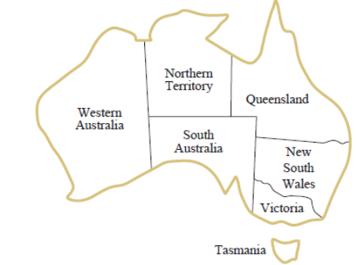

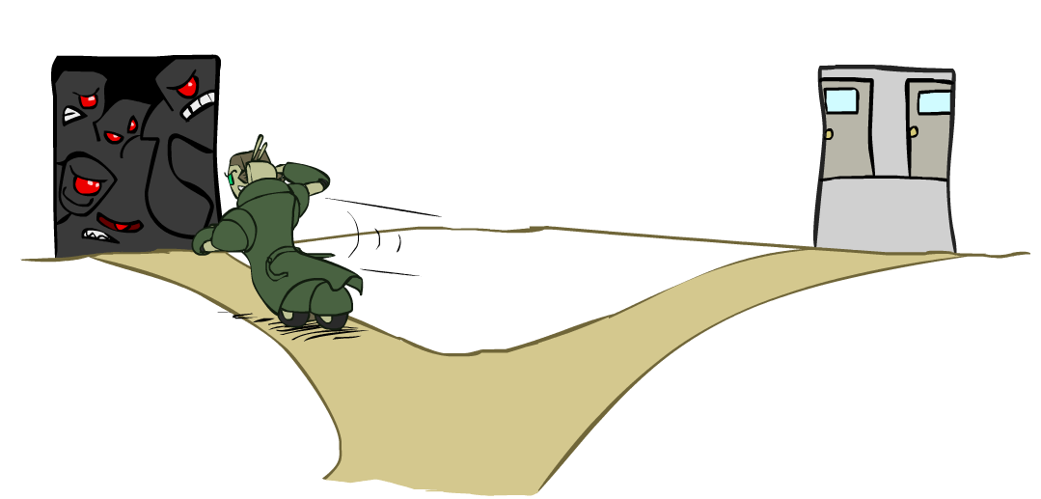
Ordering: Minimum Remaining Values
Variable Ordering: Minimum remaining values (MRV):
  Choose the variable with the fewest legal left values in its domain
  There is only one possible value for SA, so it makes sense to assign SA=blue next rather than assigning Q.
Why min rather than max?
Also called “most constrained variable”
“Fail-fast” ordering

Slide 72
Example: Australia Map Coloring
Example: Australia Map Coloring
Suppose after some assignments we have:
SA = {Blue}
Q = {Red, Green}
NSW = {Red, Blue}
The domains show the colors that are still legal.
SA has 1 possible value.
Q has 2 possible values.
NSW has 2 possible values.
MRV chooses SA first because it has the minimum remaining values.
SA = Blue
Why choose the minimum?
The goal is to find contradictions as early as possible.
Consider:
A = {1,2,3} B = {2} C = {1,2}
If we choose A first:
A
/ | \
1 2 3
Three branches must be explored.
If we choose B first:
B=2
There is only one possibility.
If this assignment later causes a conflict, we discover it immediately instead of exploring many unnecessary branches.
This is called the fail-fast principle.
B has only one choice.
A and C has more choices.
B is more constrained, so MRV selects B first.
Hence MRV is also known as the: Most Constrained Variable Heuristic

Slide 73
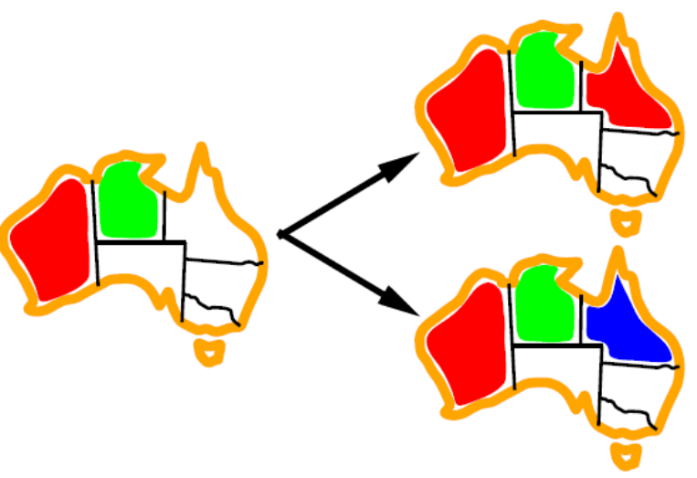
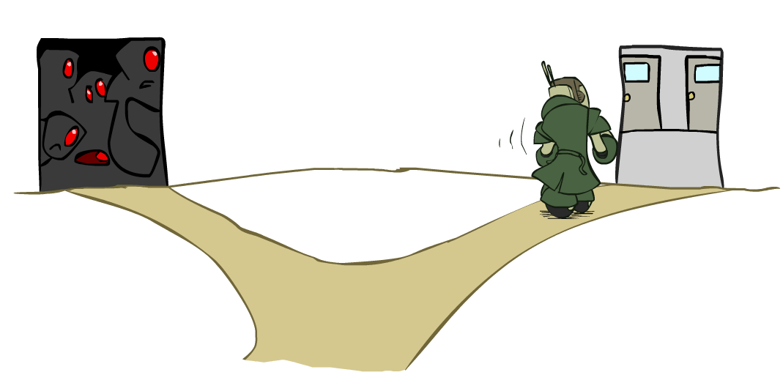
Ordering: Least Constraining Value
Value Ordering: Least Constraining Value
  Given a choice of variable, choose the least constraining value
  I.e., the one that rules out the fewest values in the remaining variables
  Note that it may take some computation to determine this! (E.g., rerunning filtering)
Combining these ordering ideas makes
1000 queens feasible
[Demo: coloring – backtracking + AC + ordering]
Notes:
Demo:
CS188 javascript demos -> source -> exercises -> csps -> CSPs demos -> CSPs demos.html
Settings:
Graph = Complex
Algorithm = Backtracking
Ordering = MRV
Filtering = Forward Checking
Solves already without any need for backtracking
Note: need a bigger problem to illustrate relevance of backtracking+AC+MRV+MCV

Slide 74
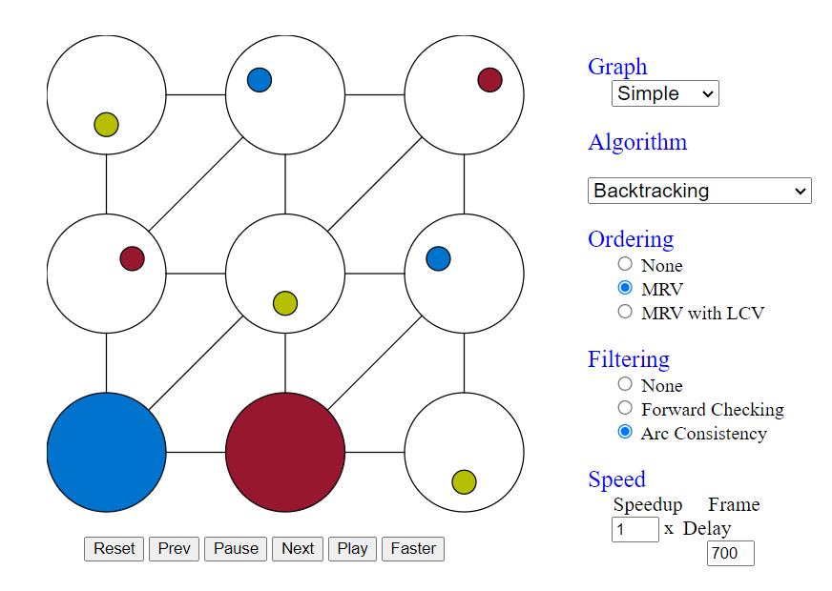
Demo: Backtracking + AC + Ordering
https://www.cs.cmu.edu/~15281/demos/csp_backtracking/

Slide 75

K-Consistency

Slide 76
K-Consistency
Stronger forms of propagation can be defined with the notion of k-consistency
Increasing degrees of consistency
  1-Consistency (Node Consistency): Each single node’s domain has a value which meets that node’s unary constraints
  2-Consistency (Arc Consistency): For each pair of nodes, any consistent assignment to one can be extended to the other
  K-Consistency: For each k nodes, any consistent assignment to k-1 can be extended to the k^{th} node.
Higher k --> more expensive to compute
In practice, determining the appropriate level of consistency checking is mostly an empirical science. Computing 2-consistency is common, and 3-consistency less common.
(You need to know the k=2 case: arc consistency)

Slide 77
Strong K-Consistency
Strong k-consistency: also k-1, k-2, … 1 consistent
Claim: strong n-consistency means we can solve without backtracking!
Why?
  Choose any assignment to any variable
  Choose a new variable
  By 2-consistency, there is a choice consistent with the first
  Choose a new variable
  By 3-consistency, there is a choice consistent with the first 2
  …
Lots of middle ground between arc consistency and n-consistency! (e.g. k=3, called path consistency)

Slide 78

Structure

Slide 79

Problem Structure
We examine ways in which the structure of the problem, as represented by the constraint graph, can be used to find solutions quickly. Most of the approaches here also apply to other problems besides CSPs, such as probabilistic reasoning.
The only way we can possibly hope to deal with the vast real world is to decompose it into subproblems. Looking again at the constraint graph for Australia (Figure 5.1(b), repeated as Figure 5.12(a)),
one fact stands out: Tasmania is not connected to the mainland. Intuitively, it is obvious that coloring Tasmania and coloring the mainland are independent subproblems
Independent subproblems are identifiable as connected components of constraint graph
Suppose a graph of n variables can be broken into subproblems of only c variables:
  Worst-case solution cost is O((n/c)(d^{c})), linear in n
  E.g., n = 80, d = 2, c =20
  2⁸⁰ = 4 billion years at 10 million nodes/sec
  (4)(2²⁰) = 0.4 seconds at 10 million nodes/sec

Slide 80

Tree-Structured CSPs
Theorem: if the constraint graph has no loops, the CSP can be solved in O(n d²) time where n is the number of tree nodes and d is the size of the largest domain.
  Compare to general CSPs, where worst-case time is O(d^{n})
This property also applies to probabilistic reasoning (later): an example of the relation between syntactic restrictions and the complexity of reasoning

Slide 81



Tree-Structured CSPs
Algorithm for tree-structured CSPs:
  To solve a tree-structured CSP, first pick any variable to be the root of the tree, and choose an ordering of the variables such that each variable appears after its parent in the tree. Such an ordering s called a topological sort.
  Remove backward: For i = n : 2, apply RemoveInconsistent(Parent(X_{i}),X_{i})
  Assign forward: For i = 1 : n, assign X_{i} consistently with Parent(X_{i})
Runtime: O(n d²) (why?)

Slide 82
Tree-Structured CSPs
Claim 1: After backward pass, all root-to-leaf arcs are consistent
Proof: Each X→Y was made consistent at one point and Y’s domain could not have been reduced thereafter (because Y’s children were processed before Y)
Claim 2: If root-to-leaf arcs are consistent, forward assignment will not backtrack
Proof: Induction on position
Why doesn’t this algorithm work with cycles in the constraint graph?
Note: we’ll see this basic idea again with Bayes’ nets

Slide 83

The TREE-CSP-SOLVER algorithm for solving tree-structured CSPs.

Slide 84

Improving Structure

Slide 85

Nearly Tree-Structured CSPs
Conditioning means:
Assign a value to a variable, then propagate the consequences by removing incompatible values from neighboring variables.
Example:
SA = Red
Then all neighbors of SA cannot be Blue:
WA ≠ Red
NT ≠ Red
Q ≠ Red
NSW ≠ Red
V ≠ Red
Their domains are pruned accordingly.
Conditioning: instantiate a variable, prune its neighbors' domains
Cutset conditioning: instantiate (in all ways) a set of variables such that the remaining constraint graph is a tree.
We can solve the remaining tree with the TREE-CSP-SOLVER
Without South Australia, the graph would become a tree
Cutset size c gives runtime O( (d^{c}) (n-c) d² ), very fast for small c

Slide 86
Cutset Conditioning
Choose a cutset
SA
Instantiate the cutset (all possible ways)
SA
SA
SA
Compute residual CSP for each assignment
Solve the residual CSPs (tree structured)
Many CSP algorithms are very efficient on trees, but general CSPs often contain cycles.
Break the cycles by fixing a few carefully chosen variables.

Slide 87

Cutset Quiz
Find the smallest cutset for the graph below.
Removing A eliminates all left-side cycles.
Removing B eliminates all right-side cycles.
After removing A and B, the remaining graph is a tree.

Slide 88

Tree Decomposition
Tree Decomposition: Group variables into bags and arrange bags as a tree.
The second way to reduce a constraint graph to a tree is based on constructing a tree decomposition of the constraint graph: a transformation of the original graph into a tree where each node in the tree consists of a set of variables, as in Figure 5.13. A tree decomposition must satisfy these three requirements:
  Every variable in the original problem appears in at least one of the tree nodes.
  If two variables are connected by a constraint in the original problem, they must appear together (along with the constraint) in at least one of the tree nodes.
  If a variable appears in two nodes in the tree, it must appear in every node along the path connecting those nodes.

Slide 89
Tree Decomposition*
Idea: create a tree-structured graph of mega-variables
Each mega-variable encodes part of the original CSP
Subproblems overlap to ensure consistent solutions
M1
M2
M3
M4
WA
≠
NT
NT
≠
Q
Q
≠
NSW
NSW
≠
V
≠
≠
≠
≠
≠
≠
≠
≠
SA
SA
SA
SA
Agree on shared vars
Agree on shared vars
Agree on shared vars
{(WA=r,SA=g,NT=b),
(WA=b,SA=r,NT=g),
…}
{(NT=r,SA=g,Q=b),
(NT=b,SA=g,Q=r),
…}
Agree: (M1,M2) ∈
{((WA=g,SA=g,NT=g), (NT=g,SA=g,Q=g)), …}
Once we have a tree-structured graph, we can apply TREE-CSP-SOLVER to get a solution in O(nd2) time, where n is the number of tree nodes and d is the size of the largest domain.

Slide 90

Iterative Improvement (Local Search)

Slide 91
Local Search for CSPs
Local search methods typically work with “complete” states, i.e., all variables assigned.
Local search algorithms turn out to be very effective in solving many CSPs. They use a complete-state formulation (as introduced in Section 4.1.1) where each state assigns a value to every variable, and the search changes the value of one variable at a time.
To apply to CSPs:
  Take an assignment with unsatisfied constraints
  Operators reassign variable values
  No fringe! Live on the edge.
We then randomly choose a conflicted variable, we’d like to change the value to something that brings us closer to a solution; the most obvious approach is to select the value that results in the minimum number of conflicts with other variables—the min-conflicts heuristic.
Algorithm: While not solved,
  Variable selection: randomly select any conflicted variable
  Value selection: min-conflicts heuristic:
    Choose a value that violates the fewest constraints
    I.e., hill climb with h(n) = total number of violated constraints
Min-conflicts is surprisingly effective for many CSPs, amazingly, on the n-queens problem.

Slide 92

8-queens problem

Slide 93

Example: 4-Queens
States: 4 queens in 4 columns (4⁴ = 256 states)
Operators: move queen in column
Goal test: no attacks
Evaluation: c(n) = number of attacks
  [Demo: n-queens – iterative improvement (L5D1)]
  [Demo: coloring – iterative improvement]
Notes:
L5D1 – python demos
Coloring – javascript demos

Slide 94
Video of Demo Iterative Improvement – n Queens

Slide 95

Video of Demo Iterative Improvement – Coloring
https://www.cs.cmu.edu/~15281/demos/csp_backtracking/

Slide 96


Performance of Min-Conflicts
Min-conflicts is surprisingly effective for many CSPs. Amazingly, on the n-queens problem, if you don’t count the initial placement of queens, the run time of min-conflicts is roughly independent of problem size.
Given random initial state, can solve n-queens in almost constant time for arbitrary n with high probability (e.g., n = 10,000,000)!
It solves even the million-queens problem in an average of 50 steps (after the initial assignment).
Min-conflicts also works well for hard problems.
For example, it has been used to schedule observations for the Hubble Space Telescope, reducing the time taken to schedule a week of observations from three weeks (!) to around 10 minutes.
The same appears to be true for any randomly-generated CSP except in a narrow range of the ratio.

Slide 97



The Ratio R
R measures how constrained the problem is.
Small R
Few constraints:
-Lots of solutions
-Easy
Example:
-100 variables
- 20 constraints
Many assignments work.
Large R
Too many constraints:
-Almost everything forbidden
-Often inconsistencies become obvious quickly.
Example:
-100 variables
-5000 constraints
Many values are immediately ruled out.
Before the Critical Ratio
-Few constraints
-Many solutions
-Easy
Min-Conflicts quickly finds one.
After the Critical Ratio
-Very constrained
-Often impossible
-Easy to detect failure
Still relatively easy.
Near the Critical Ratio
This is the hard region.
Why?
Because:
- Not many solutions
- Not obviously impossible
The solver must search extensively.
Most hard CSP benchmark instances occur around this point.

Slide 98

Summary: CSPs
CSPs are a special kind of search problem:
  States are partial assignments
  Goal test defined by constraints
Basic solution: backtracking search
Speed-ups:
  Ordering
  Filtering
  Structure
Iterative min-conflicts is often effective in practice
CSPLib: A problem library for constraints:
https://www.csplib.org/

