Slide 1
Chapter 4
Digital Design and Computer Architecture: ARM® Edition
Sarah L. Harris and David Money Harris

Slide 2
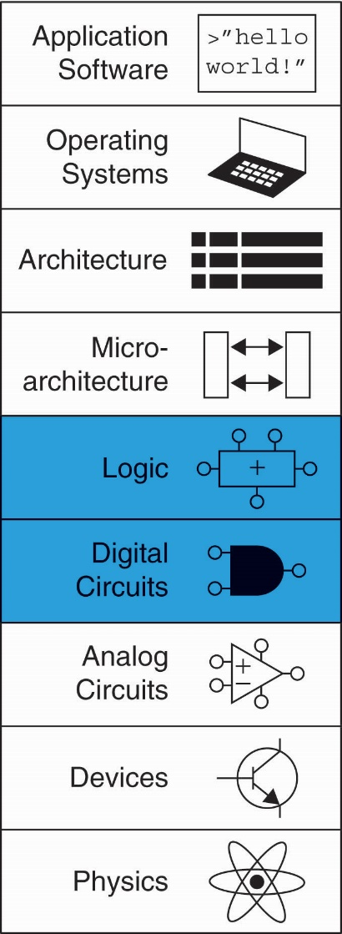
Chapter 4 :: Topics
Introduction
Combinational Logic
Structural Modeling
Sequential Logic
More Combinational Logic
Finite State Machines
Parameterized Modules
Testbenches

Slide 3
Introduction
Hardware description language (HDL):
  specifies logic function only
  Computer-aided design (CAD) tool produces or synthesizes the optimized gates
Most commercial designs built using HDLs
Two leading HDLs:
  SystemVerilog
    developed in 1984 by Gateway Design Automation
    IEEE standard (1364) in 1995
    Extended in 2005 (IEEE STD 1800-2009)
  VHDL 2008
    Developed in 1981 by the Department of Defense
    IEEE standard (1076) in 1987
    Updated in 2008 (IEEE STD 1076-2008)

Slide 5
HDL to Gates
Simulation
  Inputs applied to circuit
  Outputs checked for correctness
  Millions of dollars saved by debugging in simulation instead of hardware
  Example: correcting a mistake in a cutting-edge integrated circuit costs more than a million dollars and takes several months. Intel’s infamous FDIV (floating point division) bug in the Pentium processor forced the company to recall chips after they had shipped, at a total cost of $475 million.
  Logic simulation is essential to test a system before it is built.
Synthesis
  Transforms HDL code into a netlist describing the hardware (i.e., a list of gates and the wires connecting them)

Slide 6
HDL to Gates
Simulation
  Inputs applied to circuit
  Outputs checked for correctness
  Millions of dollars saved by debugging in simulation instead of hardware
Synthesis
  Transforms HDL code into a netlist describing the hardware (i.e., a list of gates and the wires connecting them)
IMPORTANT: When using an HDL, think of the hardware the HDL should produce

Slide 7
HDL
In our experience, the best way to learn an HDL is by example. HDLs have specific ways of describing various classes of logic; these ways are called idioms.
This chapter will teach you how to write the proper HDL idioms for each type of block and then how to put the blocks together to produce a working system.
When you need to describe a particular kind of hardware, look for a similar example and adapt it to your purpose.
We do not attempt to rigorously define all the syntax of the HDLs, because that is deathly boring and because it tends to encourage thinking of HDLs as programming languages, not shorthand for hardware.

Slide 8
SystemVerilog Modules
Two types of Modules:
  Behavioral: describe what a module does
  Structural: describe how it is built from simpler modules

Slide 9
Behavioral SystemVerilog
SystemVerilog:
module example(input logic a, b, c,
output logic y);
assign y = ~a & ~b & ~c | a & ~b & ~c | a & ~b & c;
endmodule

Slide 10
Behavioral SystemVerilog
SystemVerilog:
module example(input logic a, b, c,
output logic y);
assign y = ~a & ~b & ~c | a & ~b & ~c | a & ~b & c;
endmodule
module/endmodule: required to begin/end module
example: name of the module
Operators:
  ~: NOT
  &: AND
  |: OR

Slide 12
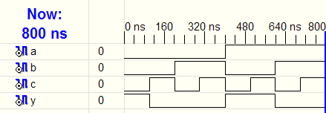
HDL Simulation
SystemVerilog:
module example(input logic a, b, c,
output logic y);
assign y = ~a & ~b & ~c | a & ~b & ~c | a & ~b & c;
endmodule

Slide 13
HDL Synthesis
SystemVerilog:
module example(input logic a, b, c,
output logic y);
assign y = ~a & ~b & ~c | a & ~b & ~c | a & ~b & c;
endmodule
Synthesis:

Slide 14
SystemVerilog Syntax
Case sensitive
  Example: reset and Reset are not the same signal.
No names that start with numbers
  Example: 2mux is an invalid name
Whitespace ignored
Comments:
  // single line comment
  /* multiline
  comment */

Slide 15
Structural Modeling - Hierarchy
module and3(input logic a, b, c,
output logic y);
assign y = a & b & c;
endmodule
module inv(input logic a,
output logic y);
assign y = ~a;
endmodule
module nand3(input logic a, b, c
output logic y);
logic n1; // internal signal
and3 andgate(a, b, c, n1); // instance of and3
inv inverter(n1, y); // instance of inv
endmodule

Slide 16
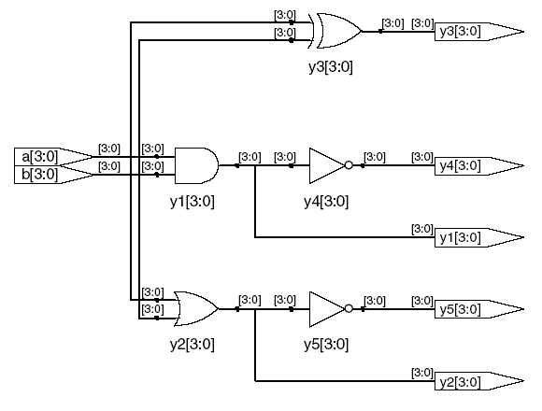
Bitwise Operators
module gates(input logic [3:0] a, b,
output logic [3:0] y1, y2, y3, y4, y5);
/* Five different two-input logic
gates acting on 4 bit busses */
assign y1 = a & b; // AND
assign y2 = a | b; // OR
assign y3 = a ^ b; // XOR
assign y4 = ~(a & b); // NAND
assign y5 = ~(a | b); // NOR
endmodule
// single line comment
/*…*/ multiline comment

Slide 20
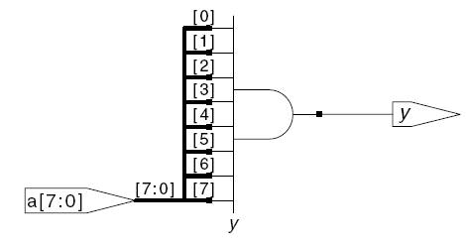
Reduction Operators
Reduction operators imply a multiple-input gate acting on a single bus.
module and8(input logic [7:0] a,
output logic y);
assign y = &a;
// &a is much easier to write than
// assign y = a[7] & a[6] & a[5] & a[4] &
// a[3] & a[2] & a[1] & a[0];
endmodule

Slide 22
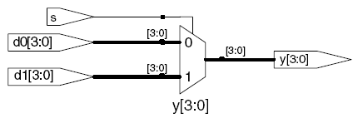
Conditional Assignment
Conditional assignments select the output from among alternatives based on an input called the condition.
module mux2(input logic [3:0] d0, d1,
input logic s,
output logic [3:0] y);
assign y = s ? d1 : d0;
endmodule
? : is also called a ternary operator because it
operates on 3 inputs: s, d1, and d0.

Slide 26
Internal Variables
module fulladder(input logic a, b, cin,
output logic s, cout);
logic p, g; // internal nodes
assign p = a ^ b;
assign g = a & b;
assign s = p ^ cin;
assign cout = g | (p & cin);
endmodule

Slide 28
Precedence
Highest
~ | NOT
*, /, % | mult, div, mod
+, - | add,sub
<<, >> | shift
<<<, >>> | arithmetic shift
<, <=, >, >= | comparison
==, != | equal, not equal
&, ~& | AND, NAND
^, ~^ | XOR, XNOR
|, ~| | OR, NOR
?: | ternary operator
Lowest

Slide 30
Numbers
Format: N'Bvalue
N = number of bits, B = base
N'B is optional but recommended (default is decimal)
Number | # Bits | Base | Decimal Equivalent | Stored
3'b101 | 3 | binary | 5 | 101
'b11 | unsized | binary | 3 | 00…0011
8'b11 | 8 | binary | 3 | 00000011
8'b1010_1011 | 8 | binary | 171 | 10101011
3'd6 | 3 | decimal | 6 | 110
6'o42 | 6 | octal | 34 | 100010
8'hAB | 8 | hexadecimal | 171 | 10101011
42 | Unsized | decimal | 42 | 00…0101010

Slide 33
Z: Floating Output
SystemVerilog:
module tristate(input logic [3:0] a,
input logic en,
output tri [3:0] y);
assign y = en ? a : 4'bz;
endmodule

Slide 36
Bit Manipulations: Example 1
assign y = {a[2:1], {3{b[0]}}, a[0], 6'b100_010};
// if y is a 12-bit signal, the above statement produces:
y = a[2] a[1] b[0] b[0] b[0] a[0] 1 0 0 0 1 0
// underscores (_) are used for formatting only to make
// it easier to read. SystemVerilog ignores them.
Often it is necessary to operate on a subset of a bus or to concatenate (join together) signals to form busses. These operations are collectively
known as bit swizzling. In HDL Example 4.12, y is given the 9-bit value c2c1d0d0d0c0101 using bit swizzling operations

Slide 37
Bit Manipulations: Example 2
SystemVerilog:
module mux2_8(input logic [7:0] d0, d1,
input logic s,
output logic [7:0] y);
mux2 lsbmux(d0[3:0], d1[3:0], s, y[3:0]);
mux2 msbmux(d0[7:4], d1[7:4], s, y[7:4]);
endmodule

Slide 40
Delays
module example(input logic a, b, c,
output logic y);
logic ab, bb, cb, n1, n2, n3;
assign #1 {ab, bb, cb} = ~{a, b, c};
assign #2 n1 = ab & bb & cb;
assign #2 n2 = a & bb & cb;
assign #2 n3 = a & bb & c;
assign #4 y = n1 | n2 | n3;
endmodule

Slide 41
Delays
module example(input logic a, b, c,
output logic y);
logic ab, bb, cb, n1, n2, n3;
assign #1 {ab, bb, cb} =
~{a, b, c};
assign #2 n1 = ab & bb & cb;
assign #2 n2 = a & bb & cb;
assign #2 n3 = a & bb & c;
assign #4 y = n1 | n2 | n3;
endmodule

Slide 42
Delays
1
module example(input logic a, b, c,
output logic y);
logic ab, bb, cb, n1, n2, n3;
assign #1 {ab, bb, cb} =
~{a, b, c};
assign #2 n1 = ab & bb & cb;
assign #2 n2 = a & bb & cb;
assign #2 n3 = a & bb & c;
assign #4 y = n1 | n2 | n3;
endmodule

Slide 43
Delays
2
module example(input logic a, b, c,
output logic y);
logic ab, bb, cb, n1, n2, n3;
assign #1 {ab, bb, cb} =
~{a, b, c};
assign #2 n1 = ab & bb & cb;
assign #2 n2 = a & bb & cb;
assign #2 n3 = a & bb & c;
assign #4 y = n1 | n2 | n3;
endmodule

Slide 44
Delays
module example(input logic a, b, c,
output logic y);
logic ab, bb, cb, n1, n2, n3;
assign #1 {ab, bb, cb} =
~{a, b, c};
assign #2 n1 = ab & bb & cb;
assign #2 n2 = a & bb & cb;
assign #2 n3 = a & bb & c;
assign #4 y = n1 | n2 | n3;
endmodule
2

Slide 45
Delays
module example(input logic a, b, c,
output logic y);
logic ab, bb, cb, n1, n2, n3;
assign #1 {ab, bb, cb} =
~{a, b, c};
assign #2 n1 = ab & bb & cb;
assign #2 n2 = a & bb & cb;
assign #2 n3 = a & bb & c;
assign #4 y = n1 | n2 | n3;
endmodule
4

Slide 46
STRUCTURAL MODELING
The previous section discussed behavioral modeling, describing a module in terms of the relationships between inputs and outputs.
This section examines structural modeling, describing a module in terms of how it is composed of simpler modules.
For example, HDL Example 4.14 shows how to assemble a 4:1 multiplexer from three 2:1 multiplexers

Slide 48
HDL Example 4.15 uses structural modeling to construct a 2:1 multiplexer from a pair of tristate buffers. Building logic out of tristates is not recommended, however.

Slide 49
HDL Example 4.16 shows how modules can access part of a bus. An 8-bit wide 2:1 multiplexer is built using two of the 4-bit 2:1 multiplexers already defined, operating on the low and high nibbles of the byte.
In general, complex systems are designed hierarchically. The overall system is described structurally by instantiating its major components. Each of these components is described structurally from its building blocks, and so forth recursively until the pieces are simple enough to describe behaviorally. It is good style to avoid (or at least to minimize) mixing structural and behavioral descriptions within a single module.

Slide 50
Sequential Logic
SystemVerilog uses idioms to describe latches, flip-flops and FSMs
HDL synthesizers recognize certain idioms and turn them into specific sequential circuits.
Other coding styles may simulate correctly but produce incorrect hardware

Slide 51
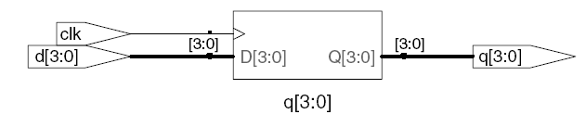
D Flip-Flop
The vast majority of modern commercial systems are built with registers
using positive edge-triggered D flip-flops. HDL Example 4.17 shows the
idiom for such flip-flops.
module flop(input logic clk,
input logic [3:0] d,
output logic [3:0] q);
always_ff @(posedge clk)
q <= d; // pronounced “q gets d”
endmodule

Slide 52
Always Statement
General Structure:
always @(sensitivity list)
statement;
Whenever the event in sensitivity list occurs, statement is executed
In SystemVerilog always statements and VHDL process statements, signals keep their old value until an event in the sensitivity list takes place that explicitly causes them to change. Hence, such code, with appropriate sensitivity lists, can be used to describe sequential circuits with memory. For example, the flip-flop includes only clk in the sensitive list. It remembers its old value of q until the next rising edge of the clk, even if d changes in the interim.
In contrast, SystemVerilog continuous assignment statements (assign) and VHDL concurrent assignment statements (<=) are reevaluated anytime any of the inputs on the right hand side changes. Therefore, such code necessarily describes combinational logic.

Slide 54
Resettable D Flip-Flop
When simulation begins or power is first applied to a circuit, the output of
a flop or register is unknown. This is indicated with x in SystemVerilog and
u in VHDL. Generally, it is good practice to use resettable registers so that
on powerup you can put your system in a known state. The reset may be
either asynchronous or synchronous. Recall that asynchronous reset
occurs immediately, whereas synchronous reset clears the output only on the next rising edge of the clock.
module flopr(input logic clk,
input logic reset,
input logic [3:0] d,
output logic [3:0] q);
// synchronous reset
always_ff @(posedge clk)
if (reset) q <= 4'b0;
else q <= d;
endmodule

Slide 55
Resettable D Flip-Flop
module flopr(input logic clk,
input logic reset,
input logic [3:0] d,
output logic [3:0] q);
// asynchronous reset
always_ff @(posedge clk, posedge reset)
if (reset) q <= 4'b0;
else q <= d;
endmodule

Slide 56
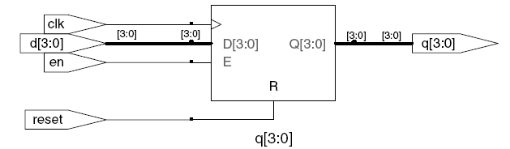
D Flip-Flop with Enable
module flopren(input logic clk,
input logic reset,
input logic en,
input logic [3:0] d,
output logic [3:0] q);
// enable and asynchronous reset
always_ff @(posedge clk, posedge reset)
if (reset) q <= 4'b0;
else if (en) q <= d;
endmodule
Enabled registers respond to the clock only when the enable is asserted.
HDL Example 4.19 shows an asynchronously resettable enabled register
that retains its old value if both reset and en are FALSE.

Slide 58
Latch
Recall from Section 3.2.2 that a D latch is transparent when the clock is HIGH, allowing data to flow from input to output. The latch becomes
opaque when the clock is LOW, retaining its old state. HDL Example 4.21 shows the idiom for a D latch.
module latch(input logic clk,
input logic [3:0] d,
output logic [3:0] q);
always_latch
if (clk) q <= d;
endmodule
Warning: We don’t use latches in this text. But you might write code that inadvertently implies a latch. Check synthesized hardware – if it has latches
in it, there’s an error.

Slide 60
In Section 4.2, we used assignment statements to describe combinational logic behaviorally. SystemVerilog always statements and VHDL process statements are used to describe sequential circuits, because they remember the old state when no new state is prescribed. However, always/process statements can also be used to describe combinational logic behaviorally if the sensitivity list is written to respond to changes in all of the inputs and the body prescribes the output value for every possible input combination. HDL Example 4.22 uses always/process statements to describe a bank of four inverters (see Figure 4.3 for the synthesized circuit).
HDLs support blocking and nonblocking assignments in an always/process statement. A group of blocking assignments are evaluated in the order in which they appear in the code, just as one would expect in a standard
programming language. A group of nonblocking assignments are evaluated concurrently; all of the statements are evaluated before any of the signals on the left hand sides are updated.

Slide 62
Other Behavioral Statements
Statements that must be inside always statements:
  if / else
  case, casez

Slide 63
Combinational Logic using always
// combinational logic using an always statement
module gates(input logic [3:0] a, b,
output logic [3:0] y1, y2, y3, y4, y5);
always_comb // need begin/end because there is
begin // more than one statement in always
y1 = a & b; // AND
y2 = a | b; // OR
y3 = a ^ b; // XOR
y4 = ~(a & b); // NAND
y5 = ~(a | b); // NOR
end
endmodule
This hardware could be described with assign statements using fewer lines of code, so it’s better to use assign statements in this case.

Slide 64
Combinational Logic using case
module sevenseg(input logic [3:0] data,
output logic [6:0] segments);
always_comb
case (data)
// abc_defg
0: segments = 7'b111_1110;
1: segments = 7'b011_0000;
2: segments = 7'b110_1101;
3: segments = 7'b111_1001;
4: segments = 7'b011_0011;
5: segments = 7'b101_1011;
6: segments = 7'b101_1111;
7: segments = 7'b111_0000;
8: segments = 7'b111_1111;
9: segments = 7'b111_0011;
default: segments = 7'b000_0000; // required
endcase
endmodule

Slide 65
Combinational Logic using case
case statement implies combinational logic only if all possible input combinations described
Remember to use default statement

Slide 66
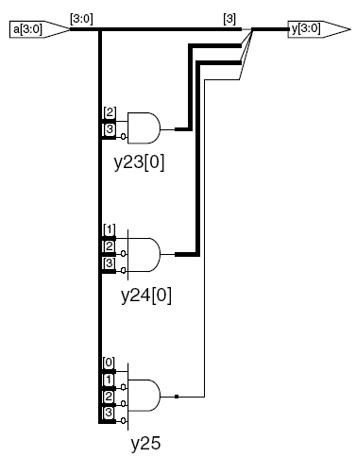
Combinational Logic using casez
module priority_casez(input logic [3:0] a,
output logic [3:0] y);
always_comb
casez(a)
4'b1???: y = 4'b1000; // ?=don’t care
4'b01??: y = 4'b0100;
4'b001?: y = 4'b0010;
4'b0001: y = 4'b0001;
default: y = 4'b0000;
endcase
endmodule
The casez statement acts like a case statement except that it also recognizes ? as don’t care.

Slide 67
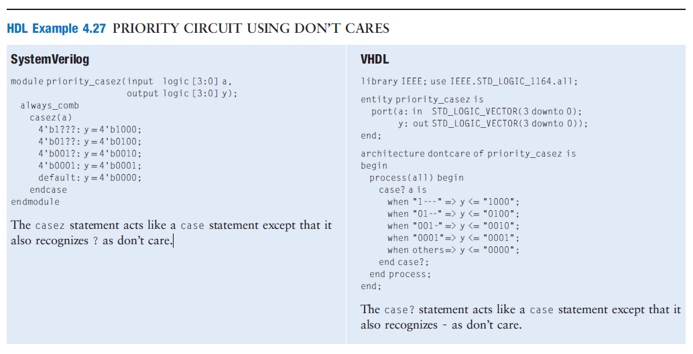

Slide 68
Blocking and Nonblocking Assignments
The guidelines on the next page explain when and how to use each type of assignment.
If these guidelines are not followed, it is possible to write code that appears
  to work in simulation
  but synthesizes to incorrect hardware.

Slide 69
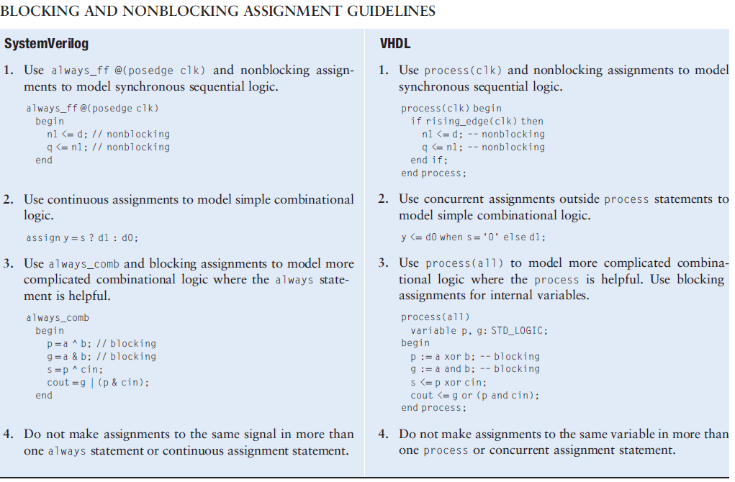

Slide 70
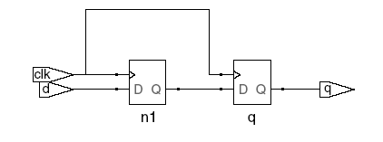

Blocking vs. Nonblocking Assignment
<= is nonblocking assignment
  Occurs simultaneously with others
= is blocking assignment
  Occurs in order it appears in file
// Good synchronizer using
// nonblocking assignments
module syncgood(input logic clk,
input logic d,
output logic q);
logic n1;
always_ff @(posedge clk)
begin
n1 <= d; // nonblocking
q <= n1; // nonblocking
end
endmodule
// Bad synchronizer using
// blocking assignments
module syncbad(input logic clk,
input logic d,
output logic q);
logic n1;
always_ff @(posedge clk)
begin
n1 = d; // blocking
q = n1; // blocking
end
endmodule

Slide 71
Rules for Signal Assignment
Synchronous sequential logic: use always_ff @(posedge clk)and nonblocking assignments (<=)
always_ff @ (posedge clk)
q <= d; // nonblocking
Simple combinational logic: use continuous assignments (assign…)
assign y = a & b;
More complicated combinational logic: use always_comb and blocking assignments (=)
Assign a signal in only one always statement or continuous assignment statement.

Slide 72
Finite State Machines (FSMs)
Recall that a finite state machine (FSM) consists of a state register and two blocks of combinational logic to compute the next state and the output given the current state and the input. HDL descriptions of state machines are correspondingly divided into three parts to model the state register, the next state logic, and the output logic.
Three blocks:
  next state logic
  state register
  output logic

Slide 73
Divide-by-3 Counter
A divide-by-N counter has one output and no inputs. The output Y is HIGH for
one clock cycle out of every N. In other words, the output divides the frequency
of the clock by N. The waveform and state transition diagram for a divide-by-3
counter is shown in Figure 3.28. Sketch circuit designs for such a counter using
binary and one-hot state encodings.

Slide 74
FSM Example: Divide by 3
The double circle indicates the reset state

Slide 78
FSM in SystemVerilog
module divideby3FSM (input logic clk,
input logic reset,
output logic q);
typedef enum logic [1:0] {S0, S1, S2} statetype;
statetype [1:0] state, nextstate;
// state register
always_ff @ (posedge clk, posedge reset)
if (reset) state <= S0;
else state <= nextstate;
// next state logic
always_comb
case (state)
S0: nextstate = S1;
S1: nextstate = S2;
S2: nextstate = S0;
default: nextstate = S0;
endcase
// output logic
assign q = (state == S0);
endmodule

Slide 81
Verilog

Slide 82
Parameterized Modules
So far all of our modules have had fixed-width inputs and outputs.
For example, we had to define separate modules for 4- and 8-bit wide 2:1 multiplexers.
HDLs permit variable bit widths using parameterized modules.
HDL Example 4.34 declares a parameterized 2:1 multiplexer with a default width of 8, then uses it to create 8- and 12-bit 4:1 multiplexers.

Slide 83
Parameterized Modules
2:1 mux:
module mux2
#(parameter width = 8) // name and default value
(input logic [width-1:0] d0, d1,
input logic s,
output logic [width-1:0] y);
assign y = s ? d1 : d0;
endmodule
Instance with 8-bit bus width (uses default):
mux2 myMux(d0, d1, s, out);
Instance with 12-bit bus width:
mux2 #(12) lowmux(d0, d1, s, out);

Slide 84
Testbenches
A testbench is an HDL module that is used to test another module, called the device under test (DUT).
The testbench contains statements to apply inputs to the DUT and, ideally, to check that the correct outputs are produced.
The input and desired output patterns are called test vectors.
It instantiates the DUT, then applies the inputs. Blocking assignments and delays are used to apply the inputs in the appropriate order.
The user must view the results of the simulation and verify by inspection that the correct outputs are produced.
Testbenches are simulated the same as other HDL modules. However, they are not synthesizeable.

Slide 85
Testbenches Types
Types:
  Simple
  Self-checking
  Self-checking with testvectors

Slide 86
Testbench Example
Write SystemVerilog code to implement the following function in hardware:
y = bc + ab
Name the module sillyfunction

Slide 87
Testbench Example
Write SystemVerilog code to implement the following function in hardware:
y = bc + ab
module sillyfunction(input logic a, b, c,
output logic y);
assign y = ~b & ~c | a & ~b;
endmodule

Slide 88
Simple Testbench
module testbench1();
logic a, b, c;
logic y;
// instantiate device under test
sillyfunction dut(a, b, c, y);
// apply inputs one at a time and wait 10 time units
initial begin
a = 0; b = 0; c = 0; #10;
c = 1; #10;
b = 1; c = 0; #10;
c = 1; #10;
a = 1; b = 0; c = 0; #10;
c = 1; #10;
b = 1; c = 0; #10;
c = 1; #10;
end
endmodule

Slide 89
Simple Testbenches
A simple testbench instantiates the DUT, then applies the inputs.
Blocking assignments and delays are used to apply the inputs in the appropriate order.
The user must view the results of the simulation and verify by inspection that the correct outputs are produced.

Slide 91
Self-checking Testbenches
Checking for correct outputs is tedious and error-prone. Moreover, determining the correct outputs is much easier when the design is fresh in your mind; if you make minor changes and need to retest weeks later, determining the correct outputs becomes a hassle.
A much better approach is to write a self-checking testbench.

Slide 92
Self-checking Testbench
module testbench2();
logic a, b, c;
logic y;
sillyfunction dut(a, b, c, y); // instantiate dut
initial begin // apply inputs, check results one at a time
a = 0; b = 0; c = 0; #10;
if (y !== 1) $display("000 failed.");
c = 1; #10;
if (y !== 0) $display("001 failed.");
b = 1; c = 0; #10;
if (y !== 0) $display("010 failed.");
c = 1; #10;
if (y !== 0) $display("011 failed.");
a = 1; b = 0; c = 0; #10;
if (y !== 1) $display("100 failed.");
c = 1; #10;
if (y !== 1) $display("101 failed.");
b = 1; c = 0; #10;
if (y !== 0) $display("110 failed.");
c = 1; #10;
if (y !== 0) $display("111 failed.");
end
endmodule
module sillyfunction(input logic a, b, c,
output logic y);
assign y = ~b & ~c | a & ~b;
endmodule

Slide 93
Testbench with Testvectors
Writing code for each test vector also becomes tedious, especially for modules that require a large number of vectors. An even better approach is to place the test vectors in a separate file.
The testbench simply reads the test vectors from the file, applies the input test vector to the DUT, waits, checks that the output values from the DUT match the output vector, and repeats until reaching the end of the test vectors file.
Testvector file: inputs and expected outputs
Testbench:
  Generate clock for assigning inputs, reading outputs
  Read testvectors file into array
  Assign inputs, expected outputs
  Compare outputs with expected outputs and report errors

Slide 94
Testbench with Testvectors
Testbench clock:
  assign inputs (on rising edge)
  compare outputs with expected outputs (on falling edge).
Testbench clock also used as clock for synchronous sequential circuits

Slide 95
Testvectors File
File: example.tv (a text file containing the inputs and expected output written in binary)
contains vectors of abc_y expected
000_1
001_0
010_0
011_0
100_1
101_1
110_0
111_0

Slide 96
1. Generate Clock
module testbench3();
logic clk, reset;
logic a, b, c, yexpected;
logic y;
logic [31:0] vectornum, errors; // bookkeeping variables
logic [3:0] testvectors[10000:0]; // array of testvectors
// instantiate device under test
sillyfunction dut(a, b, c, y);
// generate clock
always // no sensitivity list, so it always executes
begin
clk = 1; #5; clk = 0; #5;
end

Slide 97
2. Read Testvectors into Array
// at start of test, load vectors and pulse reset
initial
begin
$readmemb("example.tv", testvectors);
vectornum = 0; errors = 0;
reset = 1; #27; reset = 0;
end
// Note: $readmemh reads testvector files written in
// hexadecimal

Slide 98
3. Assign Inputs & Expected Outputs
// apply test vectors on rising edge of clk
always @(posedge clk)
begin
#1; {a, b, c, yexpected} = testvectors[vectornum];
end

Slide 99
4. Compare with Expected Outputs
// check results on falling edge of clk
always @(negedge clk)
if (~reset) begin // skip during reset
if (y !== yexpected) begin
$display("Error: inputs = %b", {a, b, c});
$display(" outputs = %b (%b expected)",y,yexpected);
errors = errors + 1;
end
// Note: to print in hexadecimal, use %h. For example,
// $display(“Error: inputs = %h”, {a, b, c});

Slide 100
4. Compare with Expected Outputs
// increment array index and read next testvector
vectornum = vectornum + 1;
if (testvectors[vectornum] === 4'bx) begin
$display("%d tests completed with %d errors",
vectornum, errors);
$finish;
end
end
endmodule
// === and !== can compare values that are 1, 0, x, or z.

Slide 103
Summary
Hardware description languages (HDLs) are extremely important tools for modern digital designers. Once you have learned SystemVerilog or VHDL, you will be able to specify digital systems much faster than if you had to draw the complete schematics.
The debug cycle is also often much faster, because modifications require code changes instead of tedious schematic rewiring. However, the debug cycle can be much longer using HDLs if you don’t have a good idea of the hardware your code implies.
HDLs are used for both simulation and synthesis. Logic simulation is a powerful way to test a system on a computer before it is turned into hardware. Simulators let you check the values of signals inside your system that might be impossible to measure on a physical piece of hardware.
Logic synthesis converts the HDL code into digital logic circuits.
The most important thing to remember when you are writing HDL code is that you are describing real hardware, not writing a computer program.
The most common beginner’s mistake is to write HDL code without
thinking about the hardware you intend to produce.

