Slide 1
Artificial Intelligence for
Medicine II
Spring 2025
Lecture 81: Unsupervised Learning
Clustering
(Many slides adapted from Bing Liu, Han, Kamber & Pei; Tan, Steinbach, Kumar and the web)

Slide 2
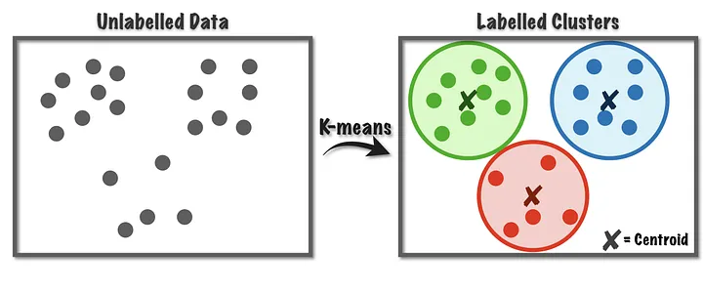
What is Cluster Analysis?
Cluster: a collection of data objects
  Similar to one another within the same cluster
  Dissimilar to the objects in other clusters
Cluster analysis
  Grouping a set of data objects into clusters
Clustering is unsupervised classification: no predefined classes
Typical applications
  As a stand-alone tool to get insight into data distribution
  As a preprocessing step for other algorithms

Slide 3
What is Cluster Analysis?
Given a set of objects, place them in groups such that the objects in a group are similar (or related) to one another and different from (or unrelated to) the objects in other groups
Inter-cluster distances are maximized
Intra-cluster distances are minimized

Slide 4
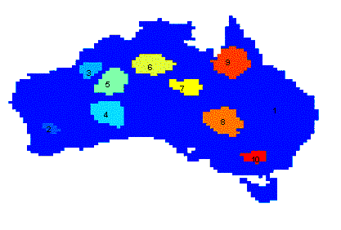
Applications of Cluster Analysis
Understanding
  Group related documents for browsing, group genes and proteins that have similar functionality, or group stocks with similar price fluctuations
Summarization
  Reduce the size of large data sets
Clustering precipitation in Australia

Slide 5
Clustering Problem Formally
Given
  a database D={t₁,t₂,…,t_{n}} of tuples and
  an integer value k,
the Clustering Problem is to define
  a mapping f:D → {1,..,k}
  where each t_{i} is assigned to one cluster K_{j}, 1<=j<=k.
A cluster, K_{j}, contains precisely those tuples mapped to it.
Unlike classification problem, clusters are not known a priori.

Slide 6
General Applications of Clustering
Pattern Recognition
Spatial Data Analysis
  create thematic maps in GIS by clustering feature spaces
  detect spatial clusters and explain them in spatial data mining
Image Processing
Economic Science (especially market research)
WWW
  Document classification
  Cluster Weblog data to discover groups of similar access patterns
Medicine
  Patient Stratification (Group patients with similar chatracteristics)
  Heathcare data analysis
  Medical Imaging (segmentation and detecting anomalies)

Slide 7
Examples of Clustering Applications
Marketing: Help marketers discover distinct groups in their customer bases, and then use this knowledge to develop targeted marketing programs
Land use: Identification of areas of similar land use in an earth observation database
Insurance: Identifying groups of motor insurance policy holders with a high average claim cost
City-planning: Identifying groups of houses according to their house type, value, and geographical location
Earth-quake studies: Observed earth quake epicenters should be clustered along continent faults

Slide 8
Clustering as a Preprocessing Tool (Utility)
Summarization:
  Preprocessing for regression, PCA, classification, and association analysis
Compression:
  Image processing: vector quantization
Finding K-nearest Neighbors
  Localizing search to one or a small number of clusters
Outlier detection
  Outliers are often viewed as those “far away” from any cluster

Slide 9
Clustering Issues
  The appropriate number of clusters for each data set.
  How to define similarity or the criterion used to group data together.
  Outlier handling is difficult. Should they be a part of an existing cluster, or another cluster?
  Dynamic database, how to update the clusters when there are changes in data.
  The semantic meaning of each cluster. (Contrast with classes in classification process, each has a definitive meaning.)
  Type of attributes that the clustering algorithm can handle.
  Scalability to large datasets.

Slide 10
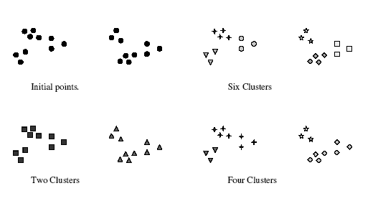
Notion of a cluster is ambigious

Slide 11
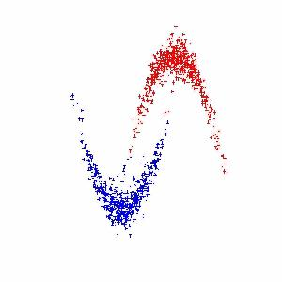
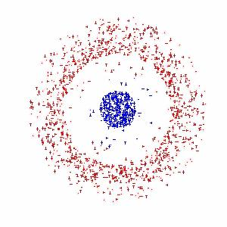
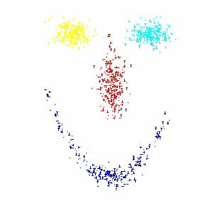
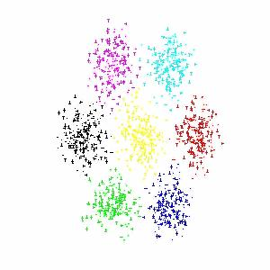
Different types of clusters
Cluster 1
Cluster 2
Cluster 1
Cluster 2
Cluster 1
Cluster 2
Cluster 1
Cluster 2
Cluster 3
Cluster 4

Slide 12
Quality: What Is Good Clustering?
A good clustering method will produce high quality clusters
  high intra-class similarity: cohesive within clusters
  low inter-class similarity: distinctive between clusters
The quality of a clustering method depends on
  the similarity measure used by the method
  its implementation, and
  Its ability to discover some or all of the hidden patterns

Slide 13
Requirements and Challenges
Scalability
  Clustering all the data instead of only on samples
Ability to deal with different types of attributes
  Numerical, binary, categorical, ordinal, linked, and mixture of these
Constraint-based clustering
    User may give inputs on constraints
    Use domain knowledge to determine input parameters
Interpretability and usability
Others
  Discovery of clusters with arbitrary shape
  Ability to deal with noisy data
  Incremental clustering and insensitivity to input order
  High dimensionality

Slide 14
Measure the Quality of Clustering
Dissimilarity/Similarity metric
  Similarity is expressed in terms of a distance function, typically metric: d(i, j)
  The definitions of distance functions are usually rather different for interval-scaled, boolean, categorical, ordinal ratio, and vector variables
  Weights should be associated with different variables based on applications and data semantics
Quality of clustering:
  There is usually a separate “quality” function that measures the “goodness” of a cluster.
  It is hard to define “similar enough” or “good enough”
    The answer is typically highly subjective

Slide 15
Similarity and Dissimilarity Metric
Similarity
- Numerical measure of how alike two data objects are.
- Is higher when objects are more alike.
- Often falls in the range [0,1]
• Dissimilarity
- Numerical measure of how different two data objects are.
- Is lower when objects are more alike.
- Minimum dissimilarity is often 0.
- Upper limit varies
• Proximity refers to a similarity or dissimilarity

Slide 16
Similarity and Dissimilarity Between Objects
Distances are normally used to measure the similarity or dissimilarity between two data objects
Some popular ones include: Minkowski distance:
  where i = (x_{i1}, x_{i2}, …, x_{ip}) and j = (x_{j1}, x_{j2}, …, x_{jp}) are two p-dimensional data objects, and q is a positive integer
If q = 1, d is Manhattan distance

Slide 17
Similarity and Dissimilarity Between Objects (Cont.)
If q = 2, d is Euclidean distance:
  Properties
    d(i,j) ≥ 0
    d(i,i) = 0
    d(i,j) = d(j,i)
    d(i,j) ≤ d(i,k) + d(k,j)
Also one can use weighted distance, parametric Pearson product moment correlation, or other disimilarity measures.

Slide 18
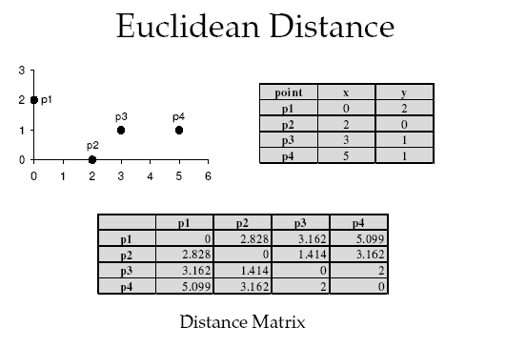
Euclidean Distance
Source : S. Ranka

Slide 19
Other Similarity and Dissimilarity Metrics Between Objects

Slide 20
Data Structures
Data matrix
  This represents n objects, such as persons, with p variables (also called measurements or attributes), such as age, height, gender, race, and so on.
  Called “two modes” : since rows and columns represent different entities
Proximity (Similarity/Dissimilarity) matrix
  Stores a collection of proximities that are available for all pairs of n objects. (n by n matrix)
  Called “one mode” : since it reprsents the same entity
  d(i,j) is the measured difference or dissimilarity between objects i and j.

Slide 21
Considerations for Cluster Analysis
Partitioning criteria
  Single level vs. hierarchical partitioning (often, multi-level hierarchical partitioning is desirable)
Separation of clusters
  Exclusive (e.g., one customer belongs to only one region) vs. non-exclusive (e.g., one document may belong to more than one class)
Similarity measure
  Distance-based (e.g., Euclidian, road network, vector) vs. connectivity-based (e.g., density or contiguity)
Clustering space
  Full space (often when low dimensional) vs. subspaces (often in high-dimensional clustering)

Slide 22
Types of Clusterings
A clustering is a set of clusters
Important distinction between hierarchical and partitional sets of clusters
  Partitional Clustering
    A division of data objects into non-overlapping subsets (clusters)
  Hierarchical clustering
    A set of nested clusters organized as a hierarchical tree

Slide 23
Partitional Clustering
Original Points
A Partitional Clustering

Slide 24
Hierarchical Clustering
Traditional Hierarchical Clustering
Traditional Dendrogram
Non-traditional Hierarchical Clustering
Non-traditional Dendrogram

Slide 25
Other Distinctions Between Sets of Clusters
Exclusive versus non-exclusive
  In non-exclusive clusterings, points may belong to multiple clusters.
    Can belong to multiple classes or could be ‘border’ points
  Fuzzy clustering (one type of non-exclusive)
    In fuzzy clustering, a point belongs to every cluster with some weight between 0 and 1
    Weights must sum to 1
    Probabilistic clustering has similar characteristics
Partial versus complete
  In some cases, we only want to cluster some of the data

Slide 26
Types of Clusters
Well-separated clusters
Prototype-based clusters
Contiguity-based clusters
Density-based clusters
Described by an Objective Function

Slide 27
Types of Clusters: Well-Separated
Well-Separated Clusters:
  A cluster is a set of points such that any point in a cluster is closer (or more similar) to every other point in the cluster than to any point not in the cluster.
3 well-separated clusters

Slide 28
Types of Clusters: Prototype-Based
Prototype-based
  A cluster is a set of objects such that an object in a cluster is closer (more similar) to the prototype or “center” of a cluster, than to the center of any other cluster
  The center of a cluster is often a centroid, the average of all the points in the cluster, or a medoid, the most “representative” point of a cluster
4 center-based clusters

Slide 29
Types of Clusters: Contiguity-Based
Contiguous Cluster (Nearest neighbor or Transitive)
  A cluster is a set of points such that a point in a cluster is closer (or more similar) to one or more other points in the cluster than to any point not in the cluster.
8 contiguous clusters

Slide 30
Types of Clusters: Density-Based
Density-based
  A cluster is a dense region of points, which is separated by low-density regions, from other regions of high density.
  Used when the clusters are irregular or intertwined, and when noise and outliers are present.
6 density-based clusters

Slide 31
Types of Clusters: Objective Function
Clusters Defined by an Objective Function
  Finds clusters that minimize or maximize an objective function.
  Enumerate all possible ways of dividing the points into clusters and evaluate the `goodness' of each potential set of clusters by using the given objective function. (NP Hard)
  Can have global or local objectives.
    Hierarchical clustering algorithms typically have local objectives
    Partitional algorithms typically have global objectives
  A variation of the global objective function approach is to fit the data to a parameterized model.
    Parameters for the model are determined from the data.
    Mixture models assume that the data is a ‘mixture' of a number of statistical distributions.

Slide 32
Characteristics of the Input Data Are Important
Type of proximity or density measure
  Central to clustering
  Depends on data and application
Data characteristics that affect proximity and/or density are
  Dimensionality
    Sparseness
  Attribute type
  Special relationships in the data
    For example, autocorrelation
  Distribution of the data
Noise and Outliers
  Often interfere with the operation of the clustering algorithm
Clusters of differing sizes, densities, and shapes

Slide 33
Clustering Algorithms
K-means and its variants (Partitional algorithms)
Hierarchical clustering
Density-based clustering

Slide 34
Partitioning Methods (or algorithms)
A partitioning method constructs k clusters. It classifies the data into k groups, which together satisfy the requirements of a partition.Each group must contain at least one object.
Each object must belong to exactly one group.
k <= n where k is the number of clusters with n objects.

Slide 35
Partitional algorithms
Partitional algorithms generate a single partition (or clustering) of the data.
Hierarchical clusterings are widely used in biological, social science where the representations in taxonomy style are preferred.
Partitional clusterings are frequently used in engineering, they offer more compact representation.
Partitional algorithms divide data into k clusters. The value of k may or may not be specified.
Criteria, such as squared error, are used to evaluate the goodness of each proposed clustering.
Partitioning method: Partitioning a database D of n objects into a set of k clusters, such that the sum of squared distances is minimized (where c_{i} is the centroid or medoid of cluster C_{i})
The choice of criterion function is problem dependent.

Slide 36
Partitional algorithms (cont.)
Achieving global optimility in partition-based algortihms require the exhaustive enumaretion of all posibile partitions
Evaluate every possible partition containing k clusters. Select the best partition according to the criterion function. (NP Hard)
The number of possible partitions is enormous, even when k, n are relatively small.
Let S(n,k) denote the number of partitions of n points into k clusters.
E.g. S(10,4) = 34105; S(19,4) = 11259666000.
Partition-based algortihms use heuristic methods such K-means, K-medoids, or a variation of them for clustering.

Slide 37
Partitioning Algorithms: Basic Concept
Partitioning method: Construct a partition of a database D of n objects into a set of k clusters
Given a k, find a partition of k clusters that optimizes the chosen partitioning criterion
  Global optimal: exhaustively enumerate all partitions
  Heuristic methods: k-means and k-medoids algorithms
  k-means (MacQueen’67): Each cluster is represented by the center of the cluster
  k-medoids or PAM (Partition around medoids) (Kaufman & Rousseeuw’87): Each cluster is represented by one of the objects in the cluster

Slide 38
Cluster Parameters
Some characteristic values of the clusters:
Centroid is the middle of the cluster. It is not necessary to be a data point. Let C_{K} denote centroid of cluster K.
Radius: square root of average distance from any point of the cluster to its centroid.
Diameter: square root of average mean squared distance between all pairs of points in the cluster
Medoid is an actual item that is located at the central of the cluster. Let M_{K} denote medoid of cluster K.

Slide 39
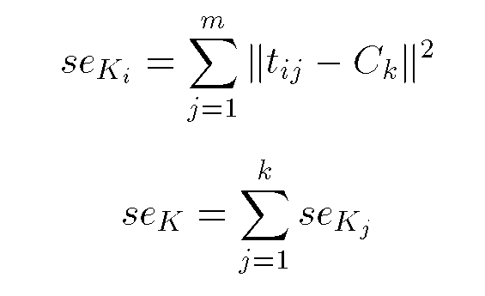
Cluster Parameters
The squared error for a cluster is the sum of the the squared
Euclidean distances between each element in the cluster
and the cluster centroid, C_{k}

Slide 40
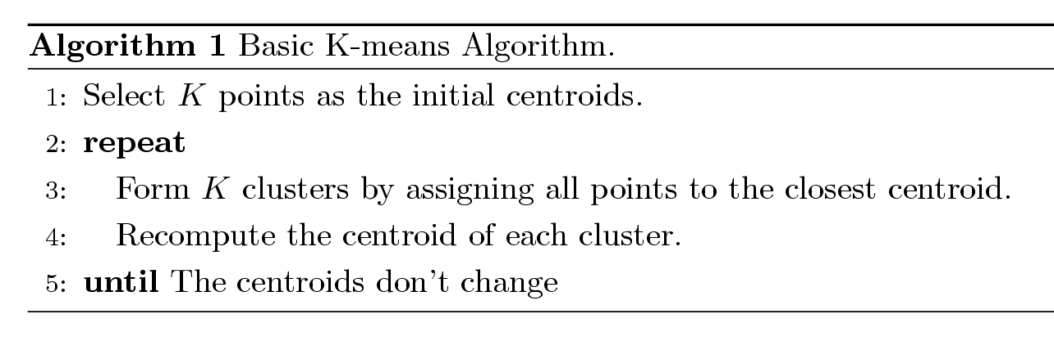
K-means Clustering
Partitional clustering approach
Number of clusters, K, must be specified
Each cluster is associated with a centroid (center point)
Each point is assigned to the cluster with the closest centroid
The basic algorithm is very simple

Slide 41
The K-Means Clustering Method in Detail
K-means clustering: First, pick a numeric attribute to cluster on. Then...
  Step 1: Start with K random cluster centers.
  Step 2: Assign each new example to the cluster with the closest center (i.e. closest mean). After all examples have been assigned, calculate the new center (i.e. mean) for each cluster.
  Step 3: Repeat Step 2 until there is convergence. The algorithm may stop when:
    only a small number of examples are assigned to different clusters, or
    a fixed number of iterations have been executed,
    The centroids don’t change or
    the difference between successive squared errors is below a certain threshold (so called ‘minimum-squared-error clustering)’. The ‘squared error’ is the Euclidian distance between each element in the cluster and the cluster center.

Slide 42
The K-Means Clustering Method
10
10
9
9
8
8
7
7
6
6
5
5
4
Assign each objects to most similar center
Update the cluster means
4
3
3
2
2
1
1
0
0
0
1
2
3
4
5
6
7
8
9
10
0
1
2
3
4
5
6
7
8
9
10
reassign
reassign
K=2
Arbitrarily choose K object as initial cluster center
Update the cluster means

Slide 43
K-Means Example
Given: {2,4,10,12,3,20,30,11,25}, k=2
Randomly assign means: m₁=3,m₂=4
K₁={2,3}, K₂={4,10,12,20,30,11,25}, m₁=2.5,m₂=16
K₁={2,3,4},K₂={10,12,20,30,11,25}, m₁=3,m₂=18
K₁={2,3,4,10},K₂={12,20,30,11,25}, m₁=4.75,m₂=19.6
K₁={2,3,4,10,11,12},K₂={20,30,25}, m₁=7,m₂=25
Stop as the clusters with these means are the same.

Slide 44
Example of K-means Clustering

Slide 45
Example of K-means Clustering

Slide 46
K-means Clustering – Details
Simple iterative algorithm.
  Choose initial centroids;
  repeat {assign each point to a nearest centroid; re-compute cluster centroids}
  until centroids stop changing.
Initial centroids are often chosen randomly.
  Clusters produced can vary from one run to another
The centroid is (typically) the mean of the points in the cluster, but other definitions are possible.
K-means will converge for common proximity measures with appropriately defined centroid.
Most of the convergence happens in the first few iterations.
  Often the stopping condition is changed to ‘Until relatively few points change clusters’
Complexity is O( n * K * I * d )
  n = number of points, K = number of clusters,
  I = number of iterations, d = number of attributes

Slide 47
K-means Objective Function
A common objective function (used with Euclidean distance measure) is Sum of Squared Error (SSE)
  For each point, the error is the distance to the nearest cluster center
  To get SSE, we square these errors and sum them.
  x is a data point in cluster C_{i} and m_{i} is the centroid (mean) for cluster C_{i}
  SSE improves in each iteration of K-means until it reaches a local or global minima.

Slide 48
K-Means Clustering Problems
Because k-means clustering techniques decide the number of clusters in advance, they are sensitive to outliers.
Selection of initial centroids
K-means works well for spherical clusters in small data sets, but poorly for complex-shaped clusters in large data sets.
From the diagram below, you can see that, for this particular data set, using 3-means is better than using 2-means because the latter is excessively influenced by the outlier and fails to split the clusters well.
Note that hierarchical, demographic, and neural clustering algorithms do not suffer from this drawback as they do not require you to specify in advance how many clusters to create.
Attribute B
3-means cluster
2-means cluster
Attribute A
Source: Adapted from Dunham

Slide 49
Two different K-means Clusterings
Original Points
Optimal Clustering
Sub-optimal Clustering

Slide 50
Importance of Choosing Initial Centroids …

Slide 51
Importance of Choosing Initial Centroids …

Slide 52
Solutions to Initial Centroids Problem
Multiple runs
  Helps, but probability is not on your side
Use some strategy to select the k initial centroids and then select among these initial centroids
  Select most widely separated
    K-means++ is a robust way of doing this selection
  Use hierarchical clustering to determine initial centroids
Bisecting K-means
  Not as susceptible to initialization issues

Slide 53
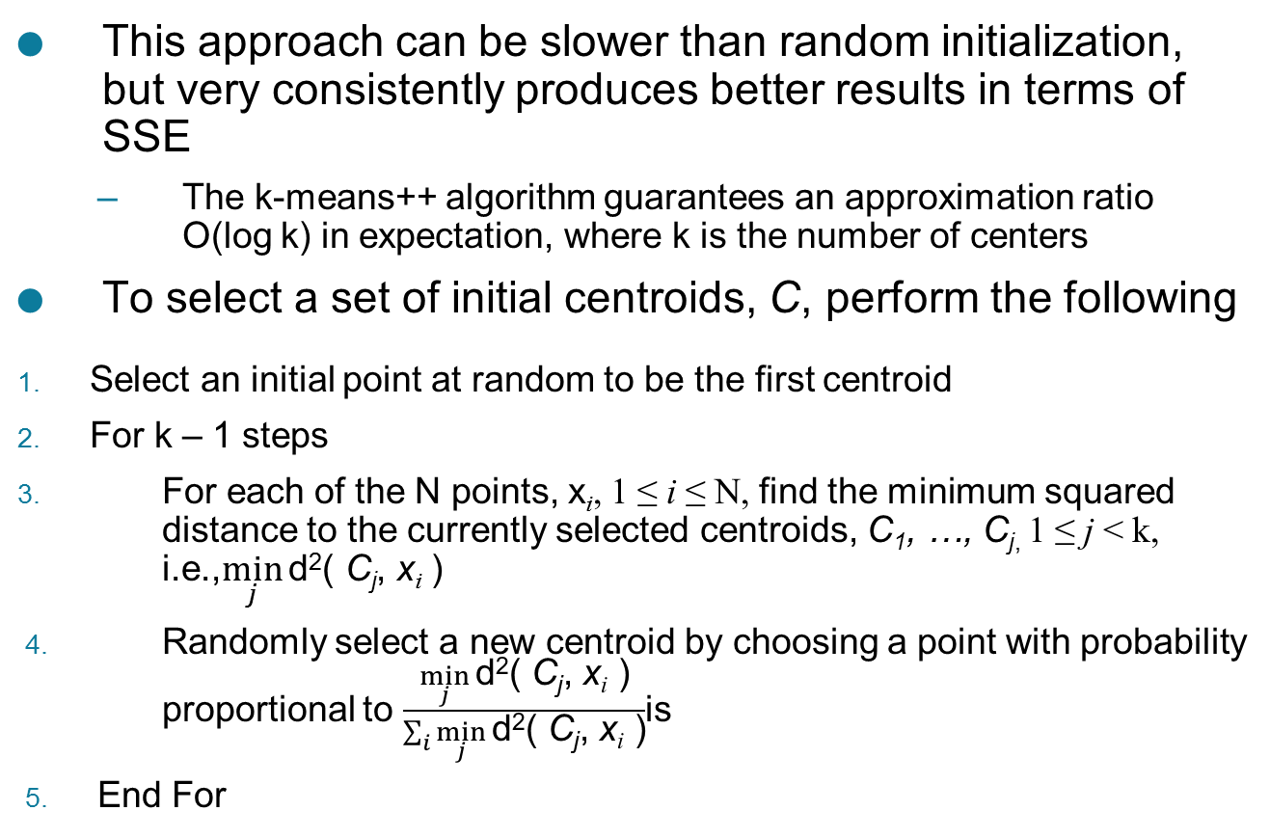
K-means++
This approach can be slower than random initialization, but very consistently produces better results in terms of SSE
  The k-means++ algorithm guarantees an approximation ratio
  O(log k) in expectation, where k is the number of centers
To select a set of initial centroids, C, perform the following
Select an initial point at random to be the first centroid
For k – 1 steps
For each of the N points, x_{i}, 1 ≤ i ≤ N, find the minimum squared
distance to the currently selected centroids, C₁, …, C_{j,} 1 ≤ j < k,
i.e.,$\min_{j}{\text{d}\text{2}\text{( }\text{C}\text{j}\text{, }\text{x}\text{i}\text{ )}}$
Randomly select a new centroid by choosing a point with probability
proportional to $\frac{\min_{j}{\text{d}\text{2}\text{( }\text{C}\text{j}\text{, }\text{x}\text{i}\text{ )}}}{\sum_{i}{\min_{j}{\text{d}\text{2}\text{( }\text{C}\text{j}\text{, }\text{x}\text{i}\text{ )}}}}$is
End For

Slide 54
Other Variations of the K-Means Method
A few variants of the k-means which differ in
  Selection of the initial k means
  Dissimilarity calculations
  Strategies to calculate cluster means
Handling categorical data: k-modes (Huang’98)
  Replacing means of clusters with modes
  Using new dissimilarity measures to deal with categorical objects
  Using a frequency-based method to update modes of clusters
  A mixture of categorical and numerical data: k-prototype method
K-Medoids (Partitioning Around Medoids) Clustering Method
Bisecting K-Means
CLARA (Kaufmann & Rousseeuw, 1990)
CLARANS (Ng & Han, 1994): Randomized sampling
Focusing + spatial data structure (Ester et al., 1995)

Slide 55
K-Medoids (Partitioning Around Medoids) Clustering Method
The k-means algorithm is sensitive to outliers !
  Since an object with an extremely large value may substantially distort the distribution of the data
K-Medoids: Instead of taking the mean value of the object in a cluster as a reference point, medoids can be used, which is the most centrally located object in a cluster
10
10
9
9
8
8
7
7
6
6
5
5
4
4
3
3
2
2
1
1
0
0
1
2
3
4
5
6
7
8
9
10
0
0
1
2
3
4
5
6
7
8
9
10

Slide 56
Bisecting K-means
Bisecting K-means algorithm
  Variant of K-means that can produce a partitional or a hierarchical clustering
CLUTO: http://glaros.dtc.umn.edu/gkhome/cluto/cluto/overview

Slide 57
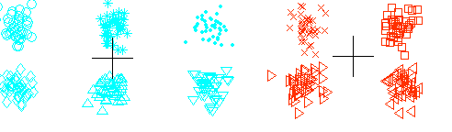
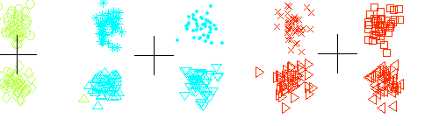
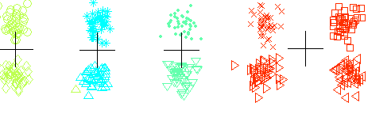
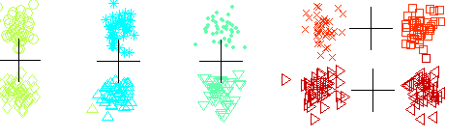
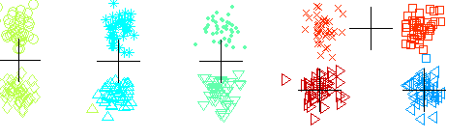
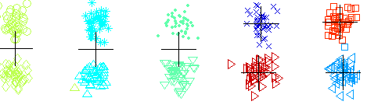
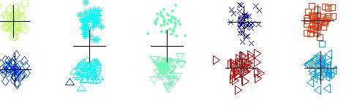
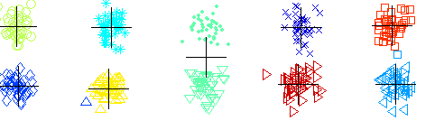
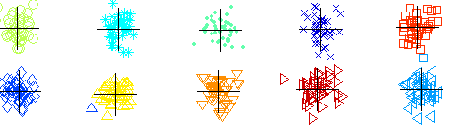
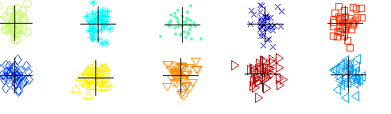
Bisecting K-means Example
Initial Cluster: Start with all data points in one cluster.
Bisecting: Split the cluster into two sub-clusters using k-means (k=2).
Selection: Choose the cluster with the highest variance or largest size for further splitting.
Repeat: Continue bisecting until the desired number of clusters is reached.
In medicine, In medicine, bisecting k-means has been applied to tasks like brain tumor detection using MRI images

Slide 58
Limitations of K-means
K-means has problems when clusters are of differing
  Sizes
  Densities
  Non-globular shapes
K-means has problems when the data contains outliers.
  One possible solution is to remove outliers before clustering

