Slide 1
Artificial Intelligence for
Medicine II
Spring 2025
Lecture 91: Unsupervised Learning
Other Clustering Methods
(Many slides adapted from Bing Liu, Han, Kamber & Pei; Tan, Steinbach, Kumar and the web)

Slide 2
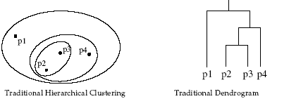
Hierarchical Clustering
Produces a set of nested clusters organized as a
hierarchical tree.
Can be visualized as a dendrogram
– Tree like diagram
– Records the sequences of merges or splits

Slide 3
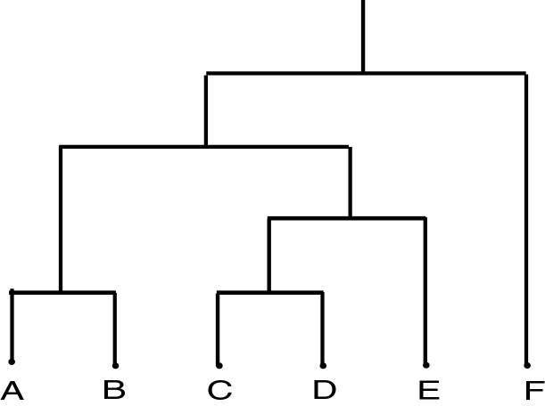
Dendrograms
Dendrogram: a tree data structure which illustrates hierarchical clustering techniques.
Each level shows clusters for that level.
  Leaf – individual clusters
  Root – one cluster
A cluster at level i is the union of its children clusters at level i+1.
each level is typically associated with a distance threshold: sub-clusters of the clusters at that level were combined because they had a distance between them of less than the distance threshold.

Slide 4
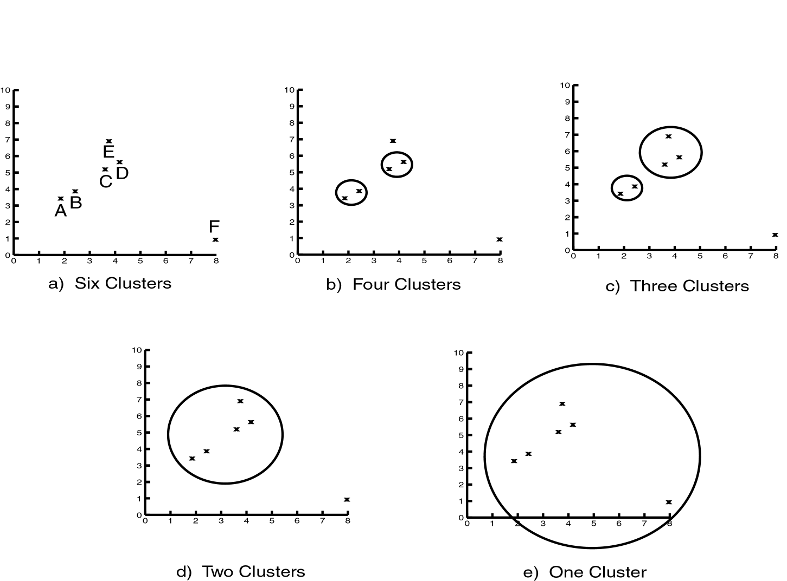
Dendrograms

Slide 5
How to Define Inter-Cluster Distance
p1
p2
p3
p4
p5
. . .
p1
Similarity?
p2
p3
p4
p5
MIN
MAX
Distance Between Centroids
Other methods
.
.
.
Proximity Matrix

Slide 6
Inter-cluster distance (similarity) metrics
Many hierarchical clustering algorithms require that the distance (or inter-cluster similarity) between clusters to be determined.
Let K_{i}, K_{j} be two clusters, i ∈ K_{i} and j ∈ K_{j,,}, there is a variety of distance metrics to calculate the distance between clusters
  Single link: Smallest distance between two points, one in K_{i} and the other in K_{j} : dist(K_{i},K_{j}) = min(dist(i, j)).
  Complete link: Largest distance between two points, one in K_{i} and the other in K_{j} : dist(K_{i},K_{j}) = max(dist(i, j)).
  Average link: Average distance between two points, one in K_{i} and the other in K_{j} : dist(K_{i},K_{j}) = avg(dist(i, j)).
  Centroid: Distance between the centroid: dist(K_{i},K_{j}) = dist(C_{Ki},C_{Kj}).
  Medoid: Distance between the medoids: dist(K_{i},K_{j}) = dist(M_{Ki},M_{Kj}).

Slide 7
Inter-cluster distance metrics (cont.)
  Single link: Calculate the smallest distance between an element in one cluster and an element in the other cluster.
  Complete link (Farthest neighbor): Calculate the largest distance between an element in one cluster and an element in the other cluster.
  Average link: Calculate the average distance between each element in one cluster and all elements in the other cluster.
  Centroid: Calculate the distance between cluster centroids.
  Medoid: Calculate the distance between cluster medoids.
single link
complete link
centroid
medoid

Slide 8
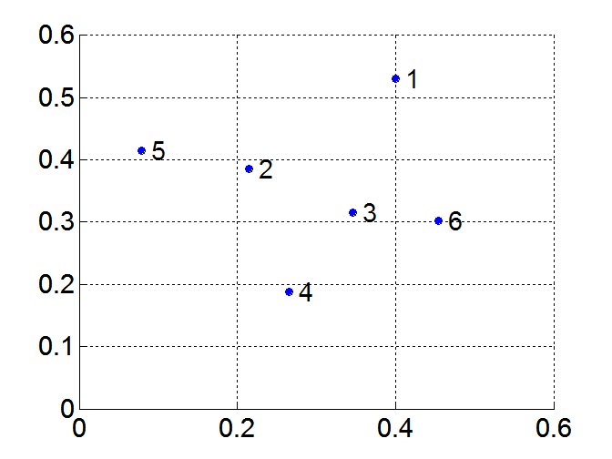
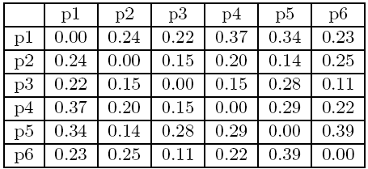
MIN or Single Link
Proximity of two clusters is based on the two closest points in the different clusters
  Determined by one pair of points, i.e., by one link in the proximity graph
Example:
Distance Matrix:

Slide 9
Hierarchical Clustering: MIN
5
1
3
5
2
1
2
3
6
4
4
Nested Clusters
Dendrogram

Slide 10
MAX or Complete Linkage
Proximity of two clusters is based on the two most distant points in the different clusters
  Determined by all pairs of points in the two clusters
Distance Matrix:

Slide 11
Hierarchical Clustering: MAX
4
1
2
5
5
2
3
6
3
1
4
Nested Clusters
Dendrogram

Slide 12
Hierarchical Clustering
Two main types of algorithms:
– Agglomerative (bottom-up merging)
  • Start with the points as individual clusters
  • Merge clusters until only one is left
– Divisive (top-down splitting)
• Start with all the points as one cluster
• Split clusters until only singleton clusters remain
– Agglomerative is more popular
• Traditional hierarchical algorithms use a similarity or distance matrix, and merge or split one cluster at a time

Slide 13
Agglomerative Clustering (Bottom-Up Merging)
Bottom-up merging techniques are called agglomerative as they agglomerate (merge) smaller clusters into bigger ones.
Typically, clusters are merged if the distance metric between the two clusters is less than a certain threshold.
The threshold increases at each stage of merging.
A variety of distance metrics can be used to calculate the distance (inter-cluster similarity) between clusters

Slide 14
Agglomerative Clustering (Bottom-Up Merging)
The sequence of graphs below show how a bottom-up merging techniques may proceed. Each example starts off in its own cluster. At each stage, we use the distance threshold to decide which clusters to merge, until eventually we have only one super-cluster. (We may also stop at some other termination condition - e.g. we may stop when we have less than a certain number of super-clusters.)
Stage 1: 5 clusters
Stage 2: 3 clusters
Stage 3: 1 cluster
Merge
Merge
Stage 3: Cluster 1
Stage 2: Cluster 1
Stage 2: Cluster 2
Stage 2:
Cluster 3
Stage 1:
Cluster 1
Stage 1:
Cluster 2
Stage 1:
Cluster 3
Stage 1:
Cluster 4
Stage 1:
Cluster 5
A
B
C
D
E
Source: Alan Abrahams

Slide 15
Divisive Clustering (Top-down Splitting)
The sequence of graphs below show how a top-down splitting techniques may proceed. We start off with one super-cluster. At each stage, we decide where to split, until eventually we have reasonable sub-clusters.
Stage 1: 1 cluster
Stage 2: 2 clusters
Split
Stage 3: 3 clusters
Split
Stage 1: Cluster 1
Stage 2: Cluster 1
Stage 2: Cluster 2
Stage 3:
Cluster 1
Stage 3:
Cluster 2
Stage 3:
Cluster 3
A
B
C
D
E
Source: Alan Abrahams
15

Slide 16
Agglomerative Algorithms
Agglomerative algorithms start with each inidividual item in its own cluster and iterative merge clusters until all items belong in on cluster.
Key operation is the computation of the proximity of two clusters.
Different approaches to defining the distance between clusters distinguishes the different algorithms.
  Single link
  Complete link (Farthest neighbor)
  Average link
  Centroid
  Medoid

Slide 17
Agglomerative Algorithms
In the algorithm given on the next slide:
  d: the threshold distance
  k: the number of clusters
  K: the set of clusters
The procedure NewClusters determine how to form the next level clusters from the previous level. This is where the different types of agglomerative algorithms differ.
Different approaches to defining the distance between clusters results in the different algorithms.
  Single link
  Complete link (Farthest neighbor)
  Average link
  Centroid
  Medoid

Slide 18
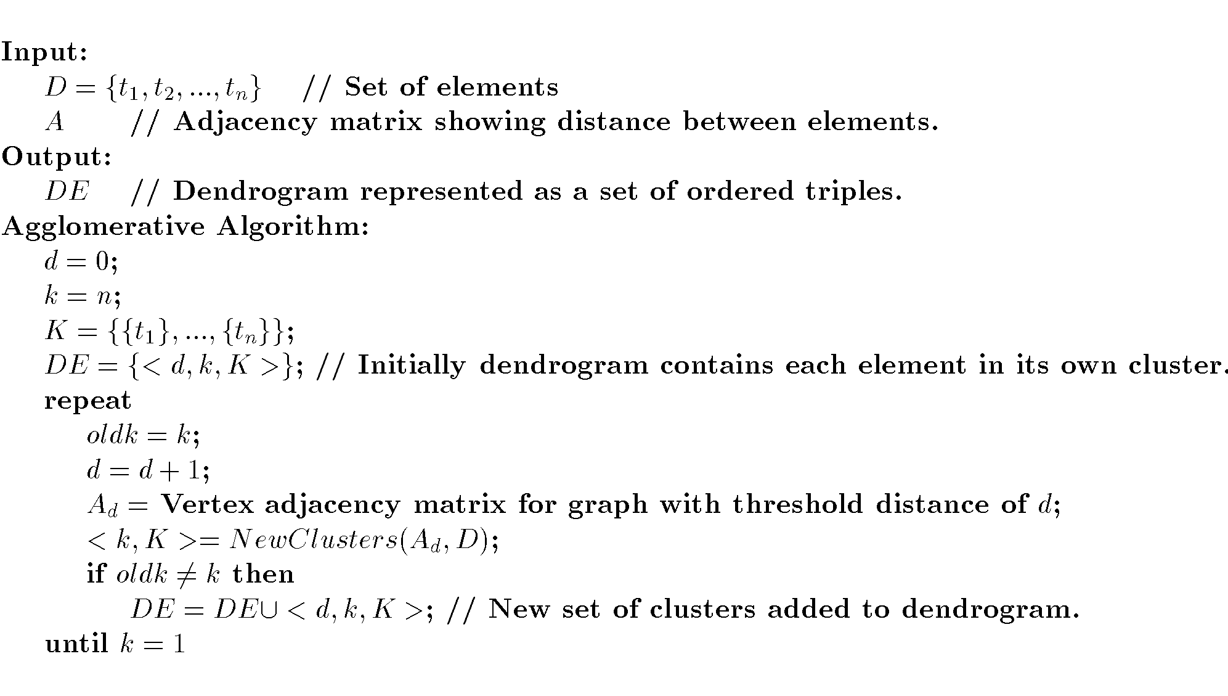
Agglomerative Algorithm

Slide 19
Basic agglomerative algorithms
Agglomerative algorithm using complete-link (max) technique
  Merged if the maximum distance is less than or equal to the distance threshold.
  Clusters found using the complete link tend to be more compact than the single link tehnique
  Tends to break large clusters.
  Less susceptible to noise and outliers.
Agglomerative algorithm using average-link technique
  Merged if the average distance is less than or equal to the distance threshold
  Compromise between Single and Complete Link.
  Need to use average connectivity for scalability since total connectivity favors large clusters.
  Less susceptible to noise and outliers.

Slide 20
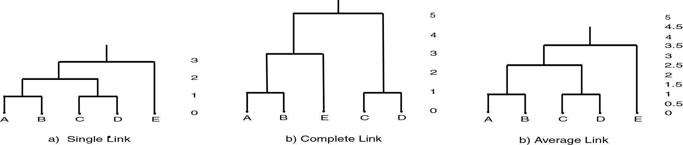
Agglomerative Clustering

Slide 21
Density-Based Clustering Methods
Clustering based on density (local cluster criterion), such as density-connected points
Major features:
  Discover clusters of arbitrary shape
  Handle noise
  One scan
  Need density parameters as termination condition
Several interesting studies:
  DBSCAN: Ester, et al. (KDD’96)
  OPTICS: Ankerst, et al (SIGMOD’99).
  DENCLUE: Hinneburg & D. Keim (KDD’98)
  CLIQUE: Agrawal, et al. (SIGMOD’98)

Slide 22
DBSCAN
DBSCAN is a density-based algorithm.
  Density = number of points within a specified radius (Eps)
  A point is a core point if it has at least a specified number of points (MinPts) within Eps
      These are points that are at the interior of a cluster
      Counts the point itself
  A border point is not a core point, but is in the neighborhood of a core point
  A noise point is any point that is not a core point or a border point

Slide 23
DBSCAN: Density Based Spatial Clustering of Applications with Noise
Relies on a density-based notion of cluster: A cluster is defined as a maximal set of density-connected points
Discovers clusters of arbitrary shape in spatial databases with noise
Outlier
Border
Eps = 1cm
MinPts = 5
Core

Slide 24
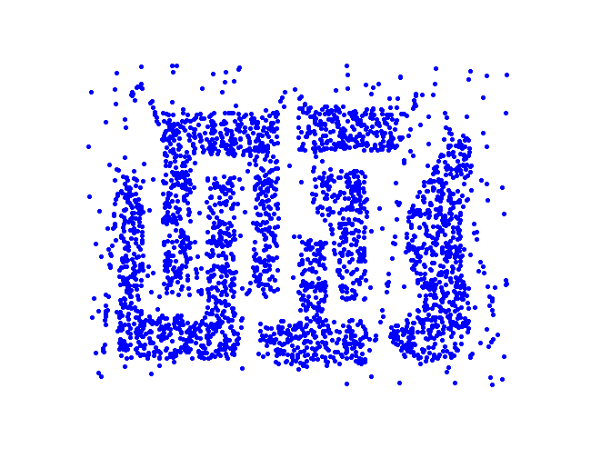
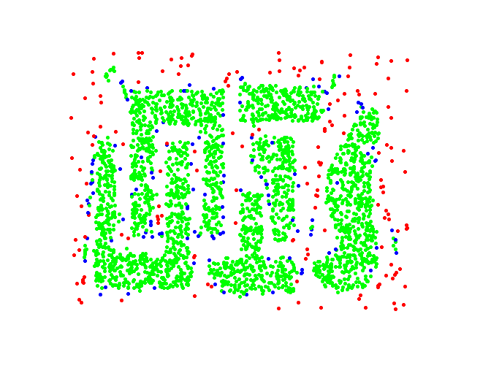
DBSCAN: Core, Border and Noise Points
Original Points
Point types: core, border and noise
Eps = 10, MinPts = 4

Slide 25
DBSCAN Algorithm
Form clusters using core points, and assign border points to one of its neighboring clusters
1: Label all points as core, border, or noise points.
2: Eliminate noise points.
3: Put an edge between all core points within a distance Eps of each other.
4: Make each group of connected core points into a separate cluster.
5: Assign each border point to one of the clusters of its associated core points

Slide 26
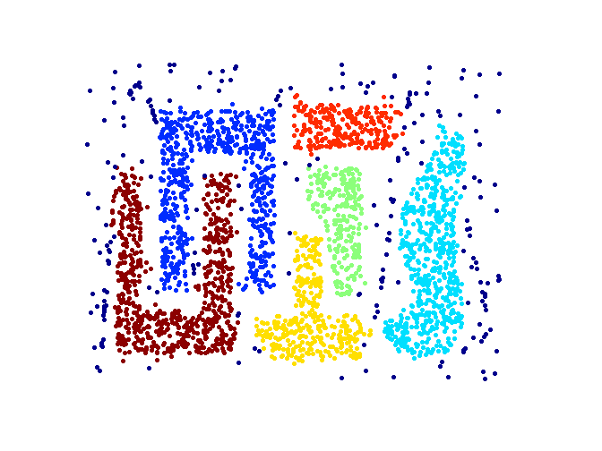
When DBSCAN Works Well
Original Points
Clusters (dark blue points indicate noise)
Can handle clusters of different shapes and sizes
Resistant to noise

Slide 27
Cluster Validity
For supervised classification we have a variety of measures to evaluate how good our model is
  Accuracy, precision, recall
For cluster analysis, the analogous question is how to evaluate the “goodness” of the resulting clusters?
But “clusters are in the eye of the beholder”!
  In practice the clusters we find are defined by the clustering algorithm
Then why do we want to evaluate them?
  To avoid finding patterns in noise
  To compare clustering algorithms
  To compare two sets of clusters
  To compare two clusters

Slide 28
Clusters found in Random Data
Random Points
DBSCAN
K-means
Complete Link

Slide 29
Measures of Cluster Validity
Numerical measures that are applied to judge various aspects of cluster validity, are classified into the following two types.
  Supervised: Used to measure the extent to which cluster labels match externally supplied class labels.
    Entropy
    Often called external indices because they use information external to the data
  Unsupervised: Used to measure the goodness of a clustering structure without respect to external information.
    Sum of Squared Error (SSE)
    Often called internal indices because they only use information in the data
You can use supervised or unsupervised measures to compare clusters or clusterings

Slide 30
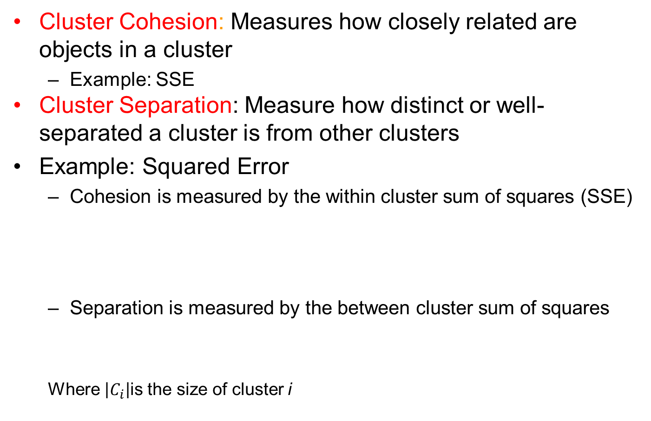
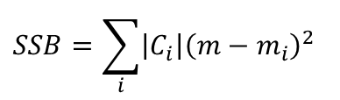
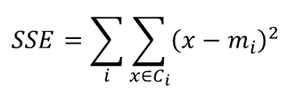
Unsupervised Measures: Cohesion and Separation
Cluster Cohesion: Measures how closely related are objects in a cluster
  Example: SSE
Cluster Separation: Measure how distinct or well-separated a cluster is from other clusters
Example: Squared Error
  Cohesion is measured by the within cluster sum of squares (SSE)
  Separation is measured by the between cluster sum of squares
  Where $\left|C_{i}\right|$is the size of cluster i
$$SSE=\sum_{i}{\sum_{x∈C_{i}}{{\left(x−m_{i}\right)}^{2}}}$$
$$SSB=\sum_{i}{\left|C_{i}\right|{\left(m−m_{i}\right)}^{2}}$$

Slide 31



Unsupervised Measures: Cohesion and Separation
Example: SSE
  SSB + SSE = constant
m
×
×
×
1
m₁
2
3
4
m₂
5
K=1 cluster:
$$SSE={\left(1−3\right)}^{2}+{\left(2−3\right)}^{2}+{\left(4−3\right)}^{2}+{\left(5−3\right)}^{2}=10$$
$$SSB=4×{\left(3−3\right)}^{2}=0$$
$$Total=10+0=10$$
K=2 clusters:
$$SSE={\left(1−1.5\right)}^{2}+{\left(2−1.5\right)}^{2}+{\left(4−4.5\right)}^{2}+{\left(5−4.5\right)}^{2}=1$$
$$SSB=2 ×{\left(3−1.5\right)}^{2}+2×{\left(4.5−3\right)}^{2}=9$$
$$Total=1+9=10$$

Slide 32
Unsupervised Measures: Cohesion and Separation
A proximity graph-based approach can also be used for cohesion and separation.
  Cluster cohesion is the sum of the weight of all links within a cluster.
  Cluster separation is the sum of the weights between nodes in the cluster and nodes outside the cluster.
cohesion
separation

Slide 33
Unsupervised Measures: Silhouette Coefficient
Silhouette coefficient combines ideas of both cohesion and separation, but for individual points, as well as clusters and clusterings.
For an individual point, i
  Calculate a = average distance of i to the points in its cluster
  Calculate b = min (average distance of i to points in another cluster)
  The silhouette coefficient for a point is then given by
  s = (b – a) / max(a,b)
  Value can vary between -1 and 1
  Typically ranges between 0 and 1.
  The closer to 1 the better.
Can calculate the average silhouette coefficient for a cluster or a clustering

Slide 34
Measuring Cluster Validity Via Correlation
Two matrices
  Proximity Matrix
  Ideal Similarity Matrix
    One row and one column for each data point
    An entry is 1 if the associated pair of points belong to the same cluster
    An entry is 0 if the associated pair of points belongs to different clusters
Compute the correlation between the two matrices
  Since the matrices are symmetric, only the correlation between
  n(n-1) / 2 entries needs to be calculated.
High magnitude of correlation indicates that points that belong to the same cluster are close to each other.
  Correlation may be positive or negative depending on whether the similarity matrix is a similarity or dissimilarity matrix
Not a good measure for some density or contiguity based clusters.

Slide 35
Measuring Cluster Validity Via Correlation
Correlation of ideal similarity and proximity matrices for the K-means clusterings of the following well-clustered data set.
Corr = 0.9235

Slide 36
Measuring Cluster Validity Via Correlation
Correlation of ideal similarity and proximity matrices for the K-means clusterings of the following random data set.
K-means
Corr = 0.5810

Slide 37
Judging clustering quality visually using a similarity matrix
A similarity matrix represents pairwise similarities between data points.
- Visualizing the Matrix
  The matrix is typically displayed as a heatmap, where colors indicate similarity levels.
  Well-defined clusters appear as blocks along the diagonal, showing high intra-cluster similarity.
  If clusters are poorly separated, the heatmap may show blurred boundaries or scattered similarities.
- Interpretation
  Clear diagonal blocks → Strong clustering structure.
  Scattered similarities → Overlapping or weak clusters.
  Uniform color → No meaningful clustering.
- Applications
  Used in hierarchical clustering to validate dendrogram structures.
  Helps assess spectral clustering, where similarity matrices drive the clustering process.
  Useful in medical imaging and bioinformatics for pattern recognition.

Slide 38
Judging a Clustering Visually by its Similarity Matrix
Order the similarity matrix with respect to cluster labels and inspect visually.

Slide 39
Judging a Clustering Visually by its Similarity Matrix
Clusters in random data are not so crisp
DBSCAN

Slide 40
Judging a Clustering Visually by its Similarity Matrix
DBSCAN

Slide 41
Determining the Correct Number of Clusters Using SSE curve
The Sum of Squared Errors (SSE) curve, often called the Elbow Method, is a popular technique for determining the optimal number of clusters in K-Means clustering.
Here's how it works:
1. Compute SSE for Different Cluster Counts
  SSE measures the total squared distance between each data point and its assigned cluster centroid.
  As the number of clusters (K) increases, SSE decreases because clusters become more refined.
2. Plot the SSE Curve
  The SSE values are plotted against different values of K.
  The curve typically shows a sharp drop initially, then levels off.
3. Identify the "Elbow" Point
  The elbow is where the SSE curve bends, indicating the optimal number of clusters.
  Beyond this point, adding more clusters does not significantly reduce SSE, meaning additional clusters may not provide meaningful separation.

Slide 42
Determining the Correct Number of Clusters
SSE is good for comparing two clusterings or two clusters
SSE can also be used to estimate the number of clusters

Slide 43
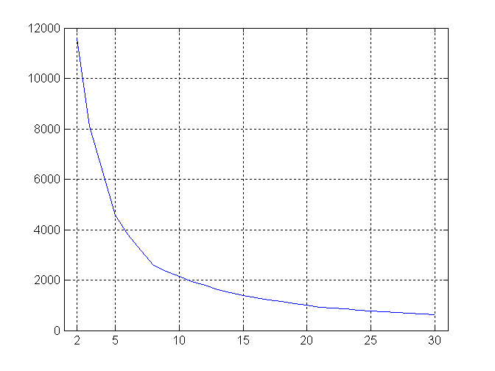
Determining the Correct Number of Clusters
SSE curve for a more complicated data set
SSE of clusters found using K-means

Slide 44
Assessing the Significance of Cluster Validity Measures
Need a framework to interpret any measure.
  For example, if our measure of evaluation has the value, 10, is that good, fair, or poor?
Statistics provide a framework for cluster validity
  The more “atypical” a clustering result is, the more likely it represents valid structure in the data
  Compare the value of an index obtained from the given data with those resulting from random data.
    Compute the evaluation index (e.g., Silhouette Score, Davies-Bouldin Index) for both.
Try to judge how likely it is that our observed value was achieved by random chance.
If the index value from the real data is significantly different from those obtained from random data, it suggests that the clustering captures real structure.

Slide 45
Statistical Framework for SSE
Example
  Compare SSE of three cohesive clusters against three clusters in random data
  Histogram shows SSE of three clusters in 500 sets of random data points of size 100 distributed over the range 0.2 – 0.8 for x and y values
SSE = 0.005
- The lowest SSE shown in histogram is 0.0173. For the three clusters, the SSE is 0.0050. We could therefore conservatively claim that there is less than a 1% chance that a clustering such as that of these three clusters could occur by chance.

Slide 46
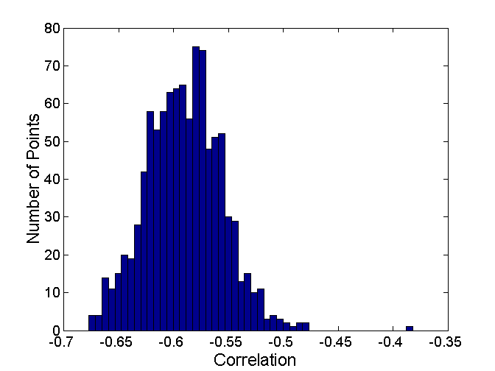
Statistical Framework for Correlation
Correlation of ideal similarity and proximity matrices for the K-means clusterings of the following two data sets.
Histogram of correlation for 500 random data sets of size 100 with x and y values of points between 0.2 and 0.8.
Corr = -0.9235
Corr = -0.5810
Correlation is negative because it is calculated between a distance matrix and the ideal similarity matrix. Higher magnitude is better.

Slide 47
Final Comment on Cluster Validity
“The validation of clustering structures is the most difficult and frustrating part of cluster analysis.
Without a strong effort in this direction, cluster analysis will remain a black art accessible only to those true believers who have experience and great courage.”
  Algorithms for Clustering Data, Jain and Dubes
H. Xiong and Z. Li. Clustering Validation Measures. In C. C. Aggarwal and C. K. Reddy, editors, Data Clustering: Algorithms and Applications, pages 571–605. Chapman & Hall/CRC, 2013.

