Slide 1
Artificial Intelligence for
Medicine II
Spring 2025
Lecture 10: Anomaly Detection
(Many slides adapted from Bing Liu, Han, Kamber & Pei; Tan, Steinbach, Kumar and the web)

Slide 2
Anomaly Detection
In anomaly detection, the goal is to find objects that do not conform to normal patterns or behavior.
Often, anomalous objects are known as outliers, since, on a scatter plot of the data, they lie far away from other data points.
Anomaly detection is also known as deviation detection, because anomalous objects have attribute values that deviate significantly from the expected or typical attribute values, or as exception mining.
Applications:
  Fraud Detection
  Intrusion Detection
  Ecosystem Disturbances
  Medicine and Public Health
    For a particular patient, unusual symptoms or test results, such as an anomalous MRI scan, may indicate potential health problems.

Slide 3
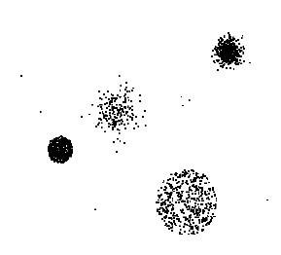
Anomaly/Outlier Detection
What are anomalies/outliers?
  The set of data points that are
  considerably different than the
  remainder of the data
Natural implication is that
anomalies are relatively rare
  One in a thousand occurs often if you have lots of data
  Context is important, e.g., freezing temps in July
Can be important or a nuisance
  Unusually high blood pressure
  200 pound, 2 year old

Slide 4
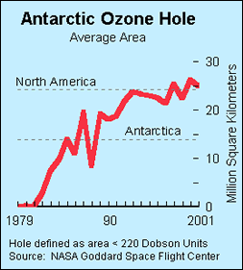
Importance of Anomaly Detection
Ozone Depletion History
In 1985 three researchers (Farman, Gardinar and Shanklin) were puzzled by data gathered by the British Antarctic Survey showing that ozone levels for Antarctica had dropped 10% below normal levels
Why did the Nimbus 7 satellite, which had instruments aboard for recording ozone levels, not record similarly low ozone concentrations?
  The ozone concentrations recorded by the satellite were so low they were being treated as outliers by a computer program and discarded!
  Since the Antarctic ozone depletion was far beyond anticipated values, the system ignored the most critical data.
Source:
http://www.epa.gov/ozone/science/hole/size.html

Slide 5
Causes of Anomalies
Data from different classes
  Measuring the weights of oranges, but a few grapefruit are mixed in
Natural variation
  Unusually tall people
Data errors
  200 pound 2 year old

Slide 6
Distinction Between Noise and Anomalies
Noise doesn’t necessarily produce unusual values or objects
Noise is not interesting
Noise and anomalies are related but distinct concepts

Slide 7
Model-based vs Model-free
Model-based Approaches
    Build models that can be used to identify whether a test instance is anomalous or not.
    Build a model of the normal class and identify anomalies that do not fit this model.
    Model can be parametric or non-parametric
    Anomalies are those points that don’t fit well
    Anomalies are those points that distort the model
Model-free Approaches
    Anomalies are identified directly from the data without building a model
Often the underlying assumption is that the most of the points in the data are normal

Slide 8
General Issues: Label vs Score
Some anomaly detection techniques provide only a binary categorization
Other approaches measure the degree to which an object is an anomaly
  This allows objects to be ranked
  Scores can also have associated meaning (e.g., statistical significance)

Slide 9
Anomaly Detection Techniques
Statistical Approaches
Proximity-based
  Anomalies are points far away from other points
Clustering-based
  Points far away from cluster centers are outliers
  Small clusters are outliers
Reconstruction Based

Slide 10
Statistical Approaches
Probabilistic definition of an outlier: An outlier is an object that has a low probability with respect to a probability distribution model of the data.
Usually assume a parametric model describing the distribution of the data (e.g., normal distribution)
Apply a statistical test that depends on
  Data distribution
  Parameters of distribution (e.g., mean, variance)
  Number of expected outliers (confidence limit)
Issues
  Identifying the distribution of a data set
    Heavy tailed distribution
  Number of attributes
  Is the data a mixture of distributions?

Slide 11
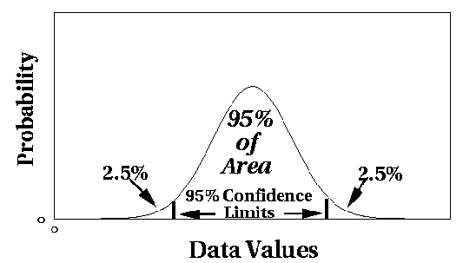
Normal Distributions
One-dimensional Gaussian
The Gaussian distribution has two parameters, μ and σ, which are the mean and standard deviation, respectively, and is
represented using the notation
N(μ,σ).
Two-dimensional Gaussian

Slide 12
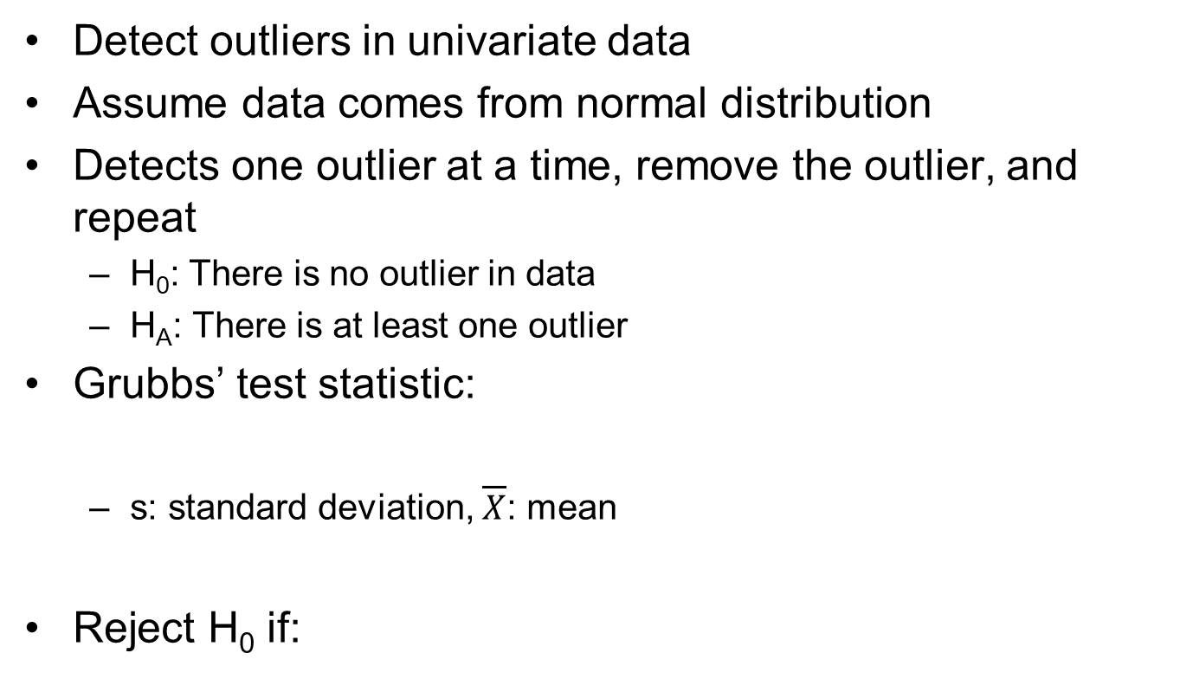
Grubbs’ Test
Detect outliers in univariate data
Assume data comes from normal distribution
Detects one outlier at a time, remove the outlier, and repeat
  H₀: There is no outlier in data
  H_{A}: There is at least one outlier
Grubbs’ test statistic:
  s: standard deviation, $\overline{X}$: mean
Reject H₀ if:

Slide 13
Statistically-based – Likelihood Approach
Assume the data set D contains samples from a mixture of two probability distributions:
  M (majority distribution)
  A (anomalous distribution)
General Approach:
  Initially, assume all the data points belong to M
  Let L_{t}(D) be the log likelihood of D at time t
  For each point x_{t} that belongs to M, move it to A
    Let L_{t+1} (D) be the new log likelihood.
    Compute the difference, Δ = L_{t}(D) – L_{t+1} (D)
    If Δ > c (some threshold), then x_{t} is declared as an anomaly and moved permanently from M to A

Slide 14
Statistically-based – Likelihood Approach
Data distribution, D = (1 – λ) M + λ A
where λ is a number between 0 and 1 that gives the expected fraction of outliers.
M is a probability distribution estimated from data
  Can be based on any modeling method (naïve Bayes, maximum entropy, etc.)
A is initially assumed to be uniform distribution
The likelihood and log likelihood of the entire data set D at time t:

Slide 15
Strengths/Weaknesses of Statistical Approaches
Firm mathematical foundation
Can be very efficient
Good results if distribution is known
In many cases, data distribution may not be known
For high dimensional data, it may be difficult to estimate the true distribution
Anomalies can distort the parameters of the distribution

Slide 16
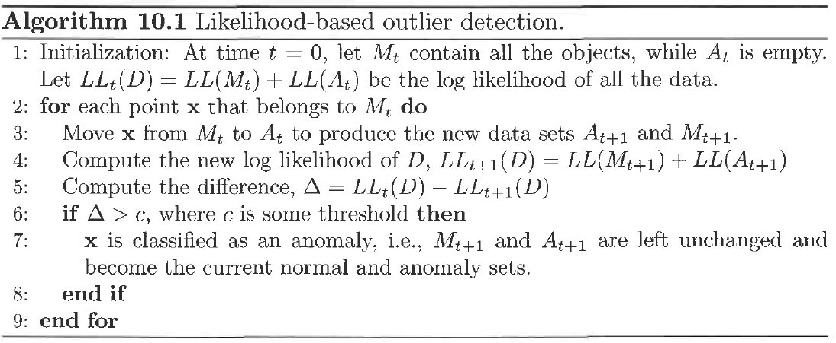
Likelihood-based outlier detection

Slide 17
Distance-Based Approaches
The outlier score of an object is the distance to its kth nearest neighbor
The next figures show a set of two-dimensional points.
The shading of each point indicates its outlier score using a value of k.
The outlier score can be highly sensitive to the value of k. If k is too small, e.g., 1, then a small number of nearby outliers can cause a low outlier score.

Slide 18
One Nearest Neighbor - One Outlier
Outlier Score

Slide 19
One Nearest Neighbor - Two Outliers
Outlier Score

Slide 20
Five Nearest Neighbors - Small Cluster
Outlier Score

Slide 21
Five Nearest Neighbors - Differing Density
Outlier Score

Slide 22
Strengths/Weaknesses of Distance-Based Approaches
Simple
Expensive – O(n²)
Sensitive to parameters
Sensitive to variations in density
Distance becomes less meaningful in high-dimensional space

Slide 23
Density-Based Approaches
Density-based Outlier: The outlier score of an object is the inverse of the density around the object.
  Can be defined in terms of the k nearest neighbors
  One definition: Inverse of distance to kth neighbor
  Another definition: Inverse of the average distance to k neighbors
  DBSCAN definition
If there are regions of different density, this approach can have problems

Slide 24
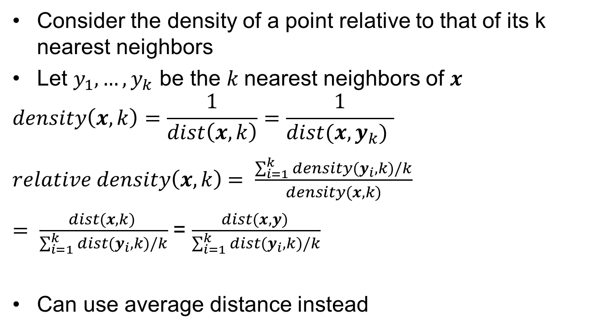
Relative Density
Consider the density of a point relative to that of its k nearest neighbors
Let $y_{1},…, y_{k}$ be the $k$nearest neighbors of $x$
$$density\left(x,k\right)=\frac{1}{dist\left(x,k\right)}=\frac{1}{dist(x,y_{k}) }$$
$relative density\left(x,k\right)$ $= \frac{\sum_{i=1}^{k}{density(y_{i},k)/k}}{density(x,k)}$
$= \frac{dist(x,k) }{\sum_{i=1}^{k}{dist(y_{i},k)/k}}$= $\frac{dist(x,y) }{\sum_{i=1}^{k}{dist(y_{i},k)/k}}$
Can use average distance instead

Slide 25
Relative Density Outlier Scores
Outlier Score

Slide 26
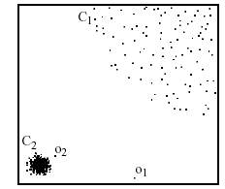
Relative Density-based: LOF approach
For each point, compute the density of its local neighborhood
Compute local outlier factor (LOF) of a sample p as the average of the ratios of the density of sample p and the density of its nearest neighbors
Outliers are points with largest LOF value
In the NN approach, p₂ is not considered as outlier, while LOF approach find both p₁ and p₂ as outliers
p₂
×
p₁
×

Slide 27
Strengths/Weaknesses of Density-Based Approaches
Simple
Expensive – O(n²)
Sensitive to parameters
Density becomes less meaningful in high-dimensional space

Slide 28
Clustering-Based Approaches
Cluster analysis finds groups of strongly related objects, while anomaly detection finds objects that are not strongly related to other objects
An object is a cluster-based outlier if it does not strongly belong to any cluster
  For prototype-based clusters, an object is an outlier if it is not close enough to a cluster center
    Outliers can impact the clustering produced
  For density-based clusters, an object is an outlier if its density is too low
    Can’t distinguish between noise and outliers
  For graph-based clusters, an object is an outlier if it is not well connected

Slide 29
Distance of Points from Closest Centroids
Outlier Score

Slide 30
Relative Distance of Points from Closest Centroid
Outlier Score

Slide 31
Strengths/Weaknesses of Clustering-Based Approaches
Simple
Many clustering techniques can be used
Can be difficult to decide on a clustering technique
Can be difficult to decide on number of clusters
Outliers can distort the clusters

Slide 32
Reconstruction-Based Approaches
Based on assumptions there are patterns in the distribution of the normal class that can be captured using lower-dimensional representations
Reduce data to lower dimensional data
  E.g. Use Principal Components Analysis (PCA) or Auto-encoders
Measure the reconstruction error for each object
  The difference between original and reduced dimensionality version

Slide 33
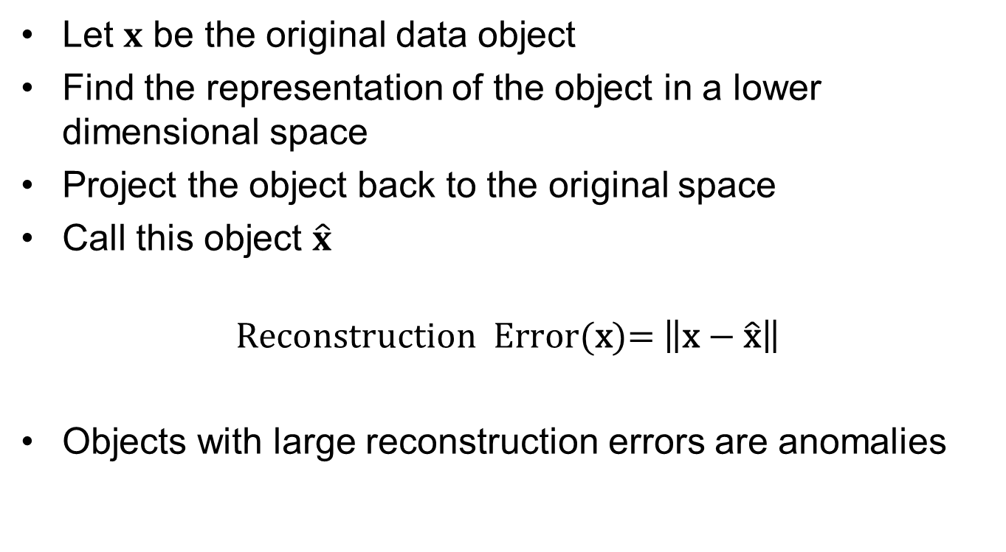
Reconstruction Error
Let $x$ be the original data object
Find the representation of the object in a lower dimensional space
Project the object back to the original space
Call this object $\hat{x}$
$$\text{Reconstruction} \text{Error}\text{(}\text{x}\text{)= }\left\|\text{x}\text{ − }\hat{\text{x}}\right\|$$
Objects with large reconstruction errors are anomalies

Slide 34
Reconstruction of two-dimensional data
The black squares are anomalous instances. The solid black line shows the first principal component learned from this data, which
corresponds to the direction of maximum variance of normal instances

Slide 35
Strengths and Weaknesses
Does not require assumptions about distribution of normal class
Can use many dimensionality reduction approaches
The reconstruction error is computed in the original space
  This can be a problem if dimensionality is high

Slide 36
Basic Architecture of an Autoencoder
An autoencoder is a multi-layer neural network.
The number of input and output neurons is equal to the number of original attributes.
An Autoencoder involves two basic steps, encoding and decoding.
During encoding, a data instance x is transformed to a low dimensional representation y, using a number of nonlinear transformations in the encoding layers.
The autoencoder scheme provides a powerful approach for learning complex and nonlinear representations of the normal class.
In order to learn an autoencoder from an input data set comprising primarily of normal instances, we can use the backpropagation techniques introduced in the context of artificial neural networks.

Slide 37
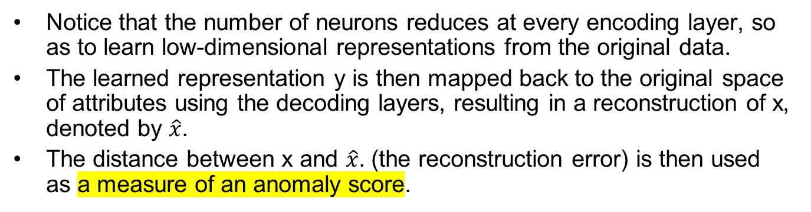
Basic Architecture of an Autoencoder
Notice that the number of neurons reduces at every encoding layer, so as to learn low-dimensional representations from the original data.
The learned representation y is then mapped back to the original space of attributes using the decoding layers, resulting in a reconstruction of x, denoted by $\hat{x}$.
The distance between x and $\hat{x}$. (the reconstruction error) is then used as a measure of an anomaly score.

Slide 38
One Class SVM
One-class classification approaches learn a decision boundary in the attribute space that encloses all normal objects on one side of the boundary.
One-class SVM uses an SVM approach to classify normal objects
It only uses training instances from the normal class to learn its decision boundary.

Slide 39
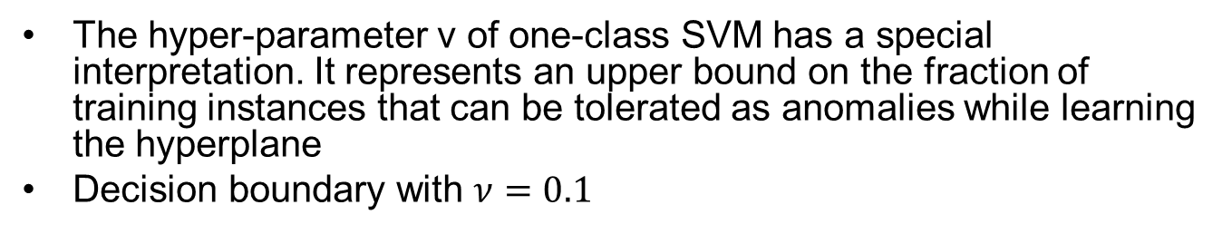
Finding Outliers with a One-Class SVM
The hyper-parameter ν of one-class SVM has a special interpretation. It represents an upper bound on the fraction of training instances that can be tolerated as anomalies while learning the hyperplane
Decision boundary with $ν=0.1$

Slide 40
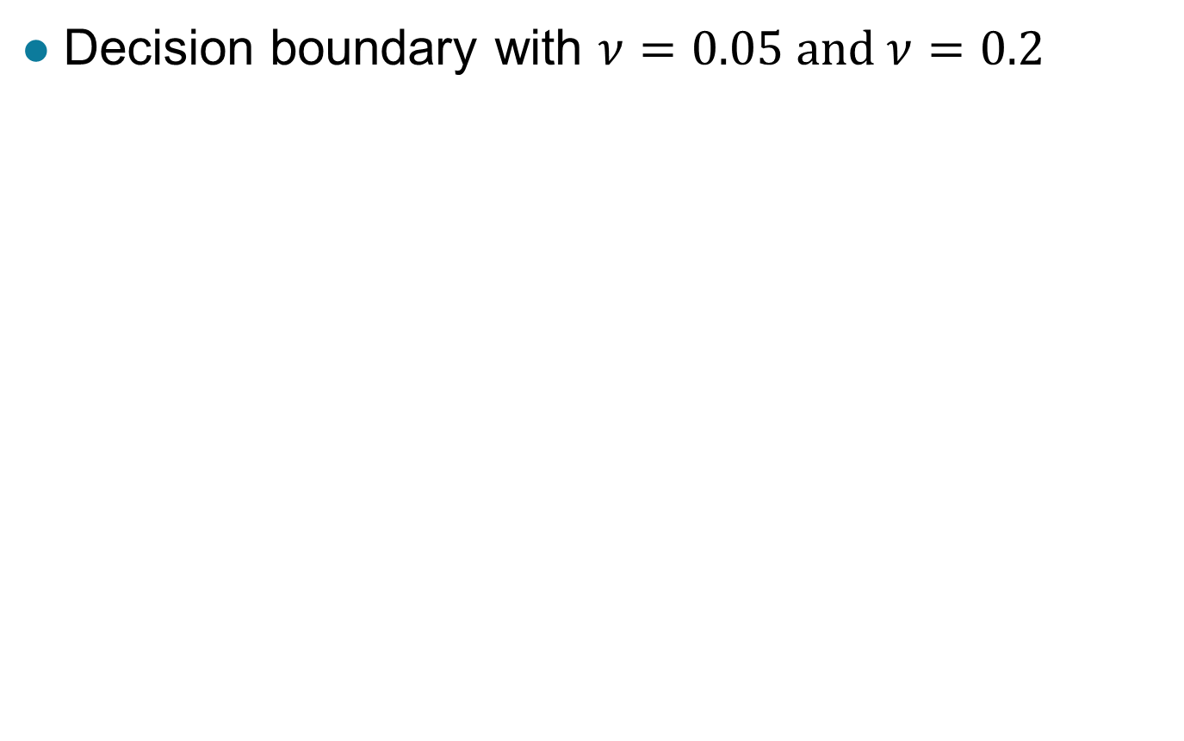
Finding Outliers with a One-Class SVM
Decision boundary with $ν=0.05 \text{and} ν=0.2$

Slide 41
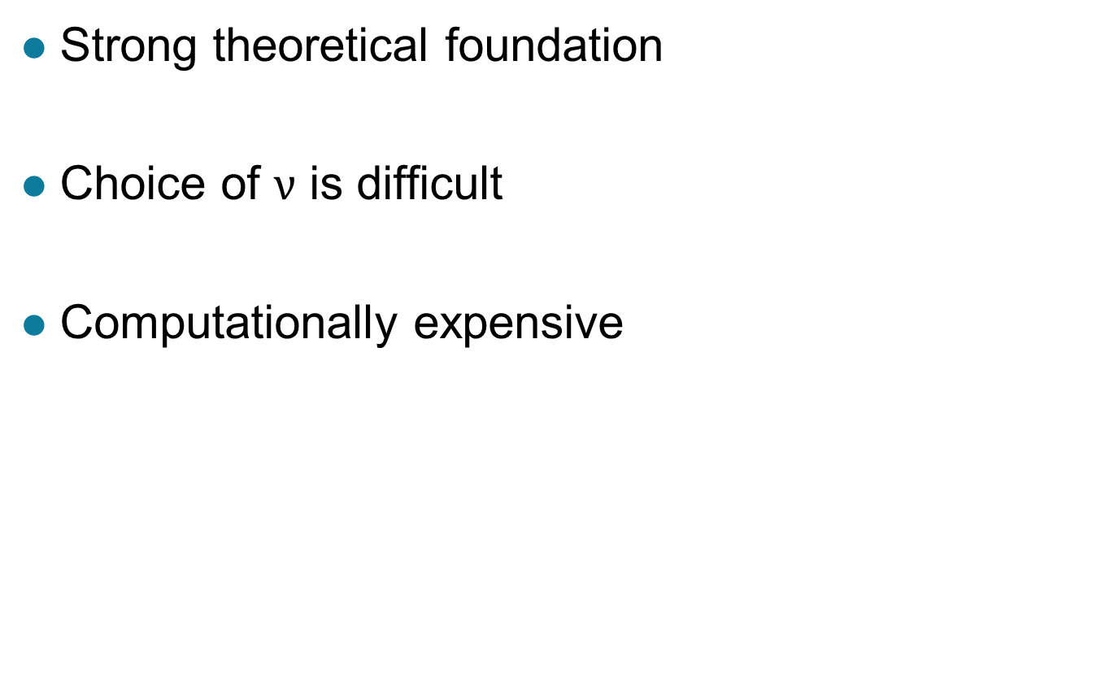
Strengths and Weaknesses
Strong theoretical foundation
Choice of $ν$ is difficult
Computationally expensive

Slide 42
Information Theoretic Approaches
The focus of information theoretic approaches is to quantify the amount of information required for encoding them. If the normal class shows some structure or pattern, we can expect to encode it using a small number of bits.
Anomalies can then be identified as instances that introduce irregularities in the data, which increase the overall information content of the data set.
There are a number of approaches for quantifying the information content (also referred to as complexity) of a data set like:
  Entropy measure
  Kolmogorov complexity

Slide 43
Information Theoretic Approaches
Let us denote the information content of a data set D as Info(D). Consider computing the anomaly score of a data instance x in D.
If we remove x from D, we can measure the information content of the remaining data as Info(D \ x).
Key idea is to measure how much information decreases when you delete an observation
This happens because anomalies are expected to be surprising, and thus, their elimination should result in a substantial reduction in the information content. We can thus use as a measure of anomaly score.
Anomalies should show higher gain
Normal points should have less gain

Slide 44
Information Theoretic Example
Survey of height and weight for 100 participants. The weight and height information of 100 participants, which has an entropy of 2.08.
We can see that there is a pattern in the height and weight distribution of normal participants, since most participants that have a high value of weight also have a high value of height and vice-versa. However, there are 5 participants that have a high weight value but low height value, which is quite unusual.
By eliminating these 5 instances, the entropy of the resulting data set becomes 1.89, resulting in a gain of
2.08 − 1.89 = 0.19

Slide 45
Strengths and Weaknesses
Solid theoretical foundation
Theoretically applicable to all kinds of data
Difficult and computationally expensive to implement in practice

Slide 46
Evaluation of Anomaly Detection
When class labels are available to distinguish between anomalies and normal data, then the effectiveness of an anomaly detection scheme can be evaluated by using measures of classification performance.
Then use standard evaluation approaches for rare class such as precision, recall, or false positive rate
  FPR is also know as false alarm rate
For unsupervised anomaly detection use measures provided by the anomaly method
  E.g. reconstruction error or gain
Can also look at histograms of anomaly scores.

Slide 47
Distribution of Anomaly Scores
By looking at the distribution of the scores via a histogram or density plot, we can assess whether the approach we are using generates scores that behave in a reasonable manner.
The histogram of the average KNN dist shows a bimodal distribution.
The key point is that the distribution of anomaly scores should look similar to that of the LOF scores in this example.
There may be one or more secondary peaks in the distribution as one moves to the right, but these secondary peaks should only contain a relatively small fraction of the points, and not a large fraction of the points as with the average KNN dist approach.

