Slide 1
Artificial Intelligence for
Medicine II
Spring 2025
Lecture 111: Machine Learning Overview
(Many slides adapted from mostly Alex Vakanski, D. Jurafsky, Bing Liu, Han, Kamber & Pei; Tan, Steinbach, Kumar and the web)

Slide 2
Machine Learning Basics
Machine Learning Basics
Artificial Intelligence is a scientific field concerned with the development of algorithms that allow computers to learn without being explicitly programmed
Machine Learning is a branch of Artificial Intelligence, which focuses on methods that learn from data and make predictions on unseen data
Labeled Data
Machine Learning algorithm
Training
Prediction
Labeled Data
Learned model
Prediction
Picture from: Ismini Lourentzou – Introduction to Deep Learning

Slide 3

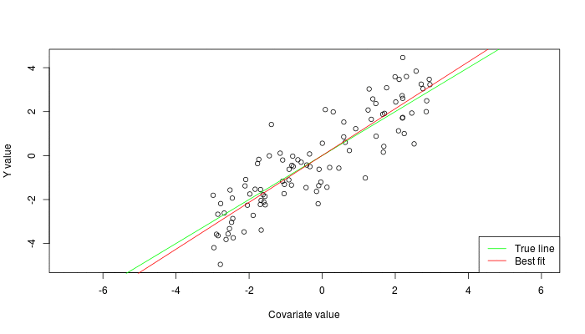
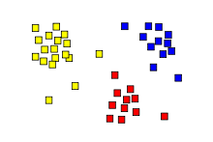
Machine Learning Types
Machine Learning Basics
Supervised: learning with labeled data
  Example: email classification, image classification
  Example: regression for predicting real-valued outputs
Unsupervised: discover patterns in unlabeled data
  Example: cluster similar data points
Reinforcement learning: learn to act based on feedback/reward
  Example: learn to play Go
class A
class B
Classification
Regression
Clustering
Slide credit: Ismini Lourentzou – Introduction to Deep Learning

Slide 4
Supervised Learning
Machine Learning Basics
Supervised learning categories and techniques
  Numerical classifier functions
    Linear classifier, perceptron, logistic regression, support vector machines (SVM), neural networks
  Parametric (probabilistic) functions
    Naïve Bayes, Gaussian discriminant analysis (GDA), hidden Markov models (HMM), probabilistic graphical models
  Non-parametric (instance-based) functions
    k-nearest neighbors, kernel regression, kernel density estimation, local regression
  Symbolic functions
    Decision trees, classification and regression trees (CART)
  Aggregation (ensemble) learning
    Bagging, boosting (Adaboost), random forest
Slide credit: Y-Fan Chang – An Overview of Machine Learning

Slide 5
Unsupervised Learning
Machine Learning Basics
Unsupervised learning categories and techniques
  Clustering
    k-means clustering
    Mean-shift clustering
    Spectral clustering
  Density estimation
    Gaussian mixture model (GMM)
    Graphical models
  Dimensionality reduction
    Principal component analysis (PCA)
    Factor analysis
Slide credit: Y-Fan Chang – An Overview of Machine Learning

Slide 6
Nearest Neighbor Classifier
Machine Learning Basics
Nearest Neighbor – for each test data point, assign the class label of the nearest training data point
  Adopt a distance function to find the nearest neighbor
    Calculate the distance to each data point in the training set, and assign the class of the nearest data point (minimum distance)
  It does not require learning a set of weights
Test example
Training examples from class 2
Training examples from class 1
Picture from: James Hays – Machine Learning Overview

Slide 7
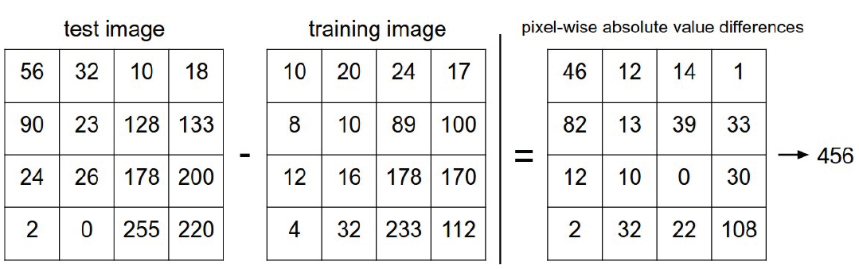


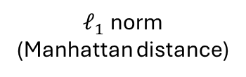
Nearest Neighbor Classifier
Machine Learning Basics
For image classification, the distance between all pixels is calculated (e.g., using $ℓ_{1}$ norm, or $ℓ_{2}$ norm)
  Accuracy on CIFAR-10: 38.6%
Disadvantages:
  The classifier must remember all training data and store it for future comparisons with the test data
  Classifying a test image is expensive since it requires a comparison to all training images
$ℓ_{1}$ norm
(Manhattan distance)
Picture from: https://cs231n.github.io/classification/

Slide 8
k-Nearest Neighbors Classifier
Machine Learning Basics
k-Nearest Neighbors approach considers multiple neighboring data points to classify a test data point
  E.g., 3-nearest neighbors
    The test example in the figure is the + mark
    The class of the test example is obtained by voting (based on the distance to the 3 closest points)
x2
x
x
x
o
x
x
x
x
+
o
x
o
o
x
o
+
o
o
o
o
x1
Picture from: James Hays – Machine Learning Overview

Slide 9
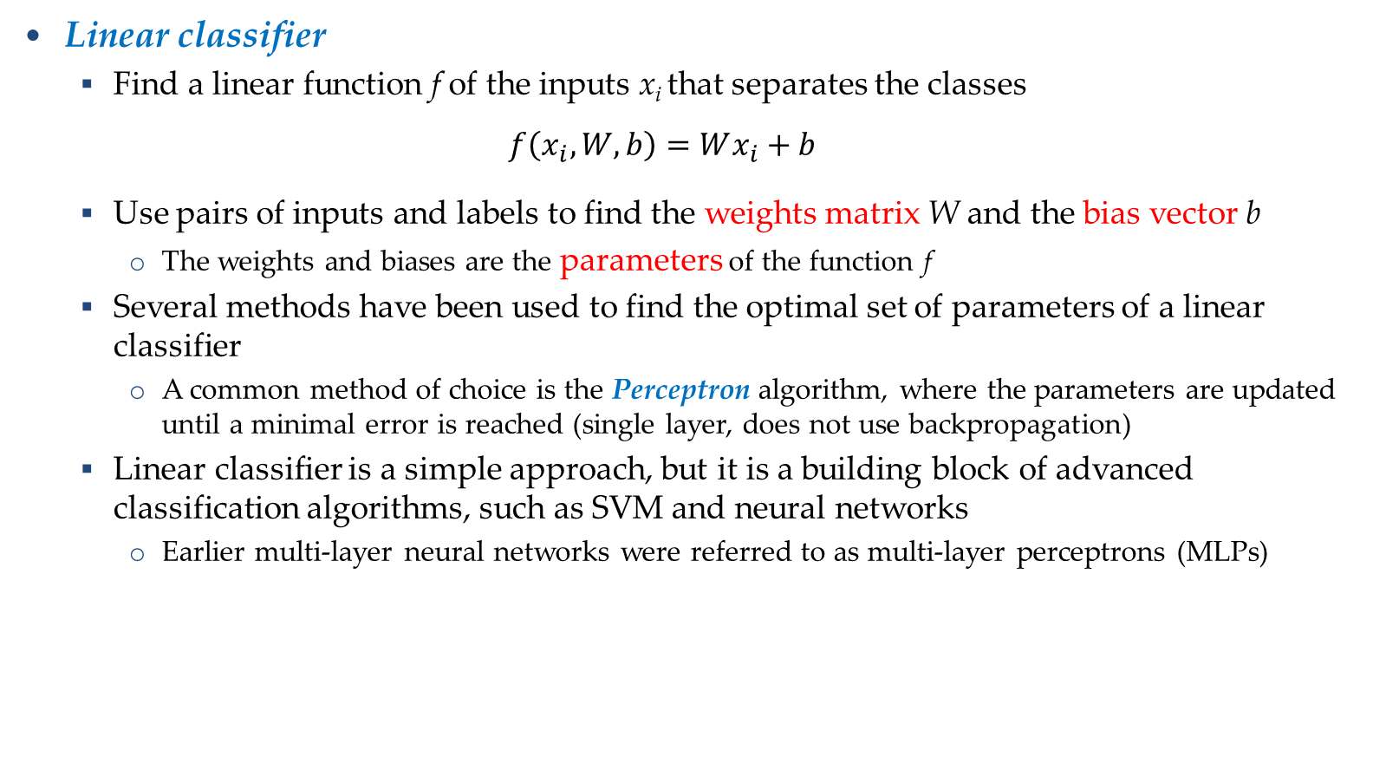
Linear Classifier
Machine Learning Basics
Linear classifier
  Find a linear function f of the inputs x_{i} that separates the classes
  $$f\left(x_{i},W,b\right)=Wx_{i}+b$$
  Use pairs of inputs and labels to find the weights matrix W and the bias vector b
    The weights and biases are the parameters of the function f
  Several methods have been used to find the optimal set of parameters of a linear classifier
    A common method of choice is the Perceptron algorithm, where the parameters are updated until a minimal error is reached (single layer, does not use backpropagation)
  Linear classifier is a simple approach, but it is a building block of advanced classification algorithms, such as SVM and neural networks
    Earlier multi-layer neural networks were referred to as multi-layer perceptrons (MLPs)

Slide 10
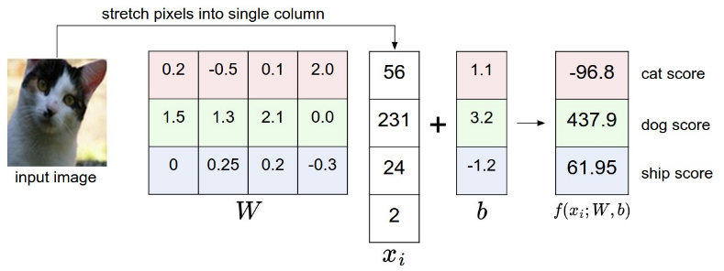
Linear Classifier
Machine Learning Basics
The decision boundary is linear
  A straight line in 2D, a flat plane in 3D, a hyperplane in 3D and higher dimensional space
Example: classify an input image
  The selected parameters in this example are not good, because the predicted cat score is low
Picture from: https://cs231n.github.io/classification/

Slide 11
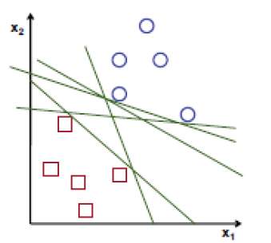
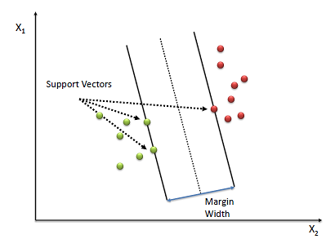

Support Vector Machines
Machine Learning Basics
Support vector machines (SVM)
  How to find the best decision boundary?
    All lines in the figure correctly separate the 2 classes
    The line that is farthest from all training examples will have better generalization capabilities
  SVM solves an optimization problem:
    First, identify a decision boundary that correctly classifies the examples
    Next, increase the geometric margin between the boundary and all examples
  The data points that define the maximum margin width are called support vectors
  Find W and b by solving:

Slide 12
Linear vs Non-linear Techniques
Linear vs Non-linear Techniques
Linear classification techniques
  Linear classifier
  Perceptron
  Logistic regression
  Linear SVM
  Naïve Bayes
Non-linear classification techniques
  k-nearest neighbors
  Non-linear SVM
  Neural networks
  Decision trees
  Random forest

Slide 13
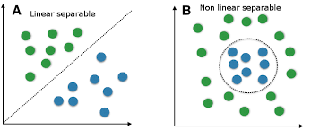


Linear vs Non-linear Techniques
Linear vs Non-linear Techniques
For some tasks, input data can be linearly separable, and linear classifiers can be suitably applied
For other tasks, linear classifiers may have difficulties to produce adequate decision boundaries
Picture from: Y-Fan Chang – An Overview of Machine Learning

Slide 14

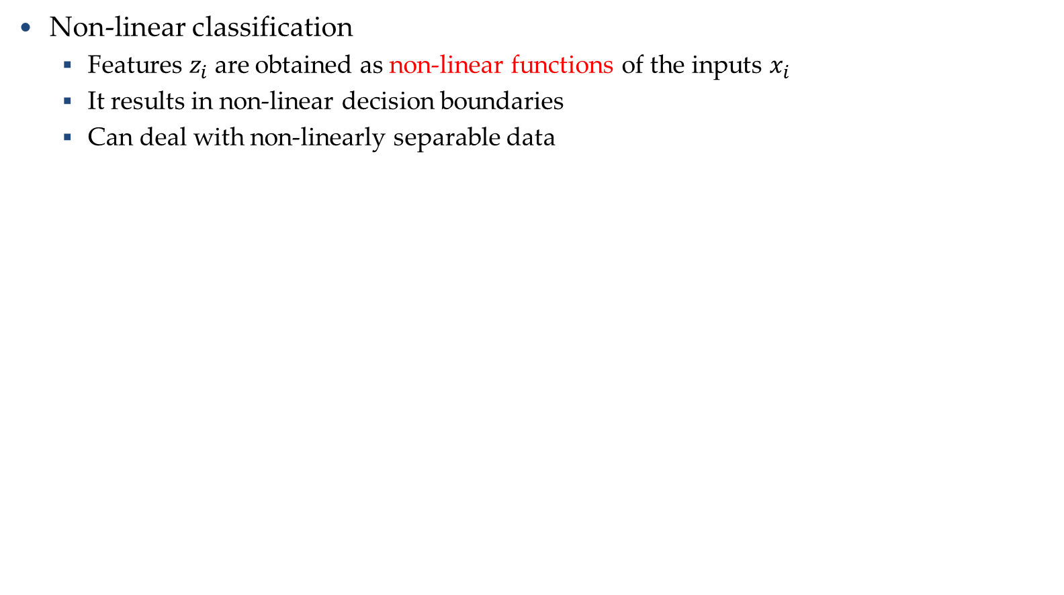


Non-linear Techniques
Linear vs Non-linear Techniques
Non-linear classification
  Features $z_{i}$are obtained as non-linear functions of the inputs $x_{i}$
  It results in non-linear decision boundaries
  Can deal with non-linearly separable data
Inputs: $x_{i}=\left[\begin{matrix}x_{n1} & x_{n2}\end{matrix}\right]$
Features: $z_{i}=\left[\begin{matrix}x_{n1} & x_{n2} & \begin{matrix}x_{n1}∙x_{n2} & x_{n1}^{2} & x_{n2}^{2}\end{matrix}\end{matrix}\right]$
Outputs: $f\left(x_{i}, W, b\right)=Wz_{i}+b$
Picture from: Y-Fan Chang – An Overview of Machine Learning

Slide 15

Non-linear Support Vector Machines
Linear vs Non-linear Techniques
Non-linear SVM
  The original input space is mapped to a higher-dimensional feature space where the training set is linearly separable
  Define a non-linear kernel function to calculate a non-linear decision boundary in the original feature space
$$Φ:x ↦φ\left(x\right)$$
Picture from: James Hays – Machine Learning Overview

Slide 16
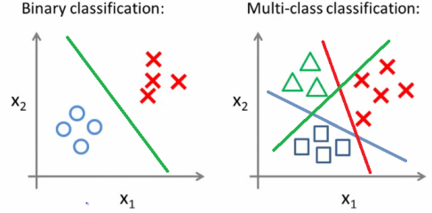
Binary vs Multi-class Classification
Binary vs Multi-class Classification
A classification problem with only 2 classes is referred to as binary classification
  The output labels are 0 or 1
  E.g., benign or malignant tumor, spam or no-spam email
A problem with 3 or more classes is referred to as multi-class classification

Slide 17
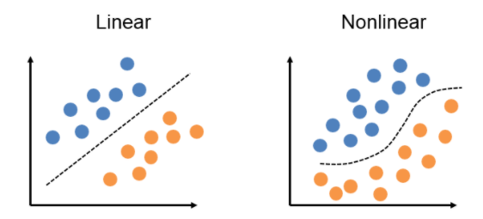
Binary vs Multi-class Classification
Binary vs Multi-class Classification
Both the binary and multi-class classification problems can be linearly or non-linearly separated
  Figure: linearly and non-linearly separated data for binary classification problem

Slide 18
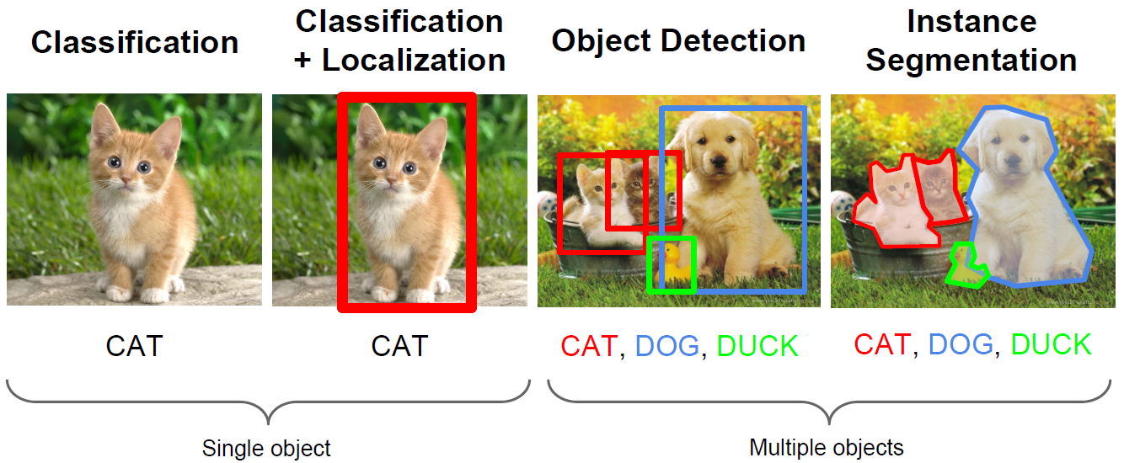
Computer Vision Tasks
Machine Learning Basics
Computer vision has been the primary area of interest for ML
The tasks include: classification, localization, object detection, instance segmentation
Picture from: Fie-Fei Li, Andrej Karpathy, Justin Johnson – Understanding and Visualizing CNNs

Slide 19
No-Free-Lunch Theorem
Machine Learning Basics
Wolpert (2002) - The Supervised Learning No-Free-Lunch Theorems
The derived classification models for supervised learning are simplifications of the reality
  The simplifications are based on certain assumptions
  The assumptions fail in some situations
    E.g., due to inability to perfectly estimate ML model parameters from limited data
In summary, No-Free-Lunch Theorem states:
  No single classifier works the best for all possible problems
  Since we need to make assumptions to generalize

