Slide 1
Artificial Intelligence for
Medicine II
Spring 2025
Lecture 112: NNs and Deep Learning
(Many slides adapted from mostly Alex Vakanski, D. Jurafsky, Bing Liu, Han, Kamber & Pei; Tan, Steinbach, Kumar and the web)

Slide 2
Lecture Outline
ML vs. Deep Learning
Introduction to NNs (Neural Networks)
NN architectures
  Convolutional NNs
  Recurrent NNs
  Encoder-Decoder NNs
  Transformers

Slide 3
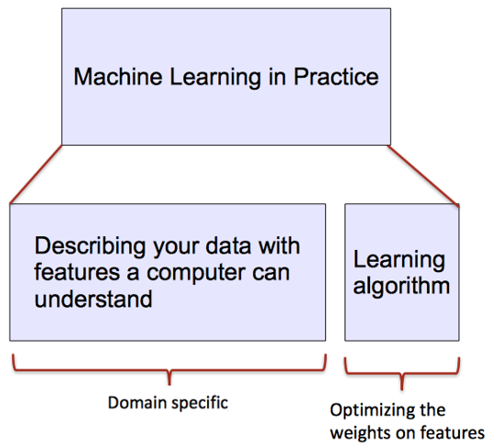
ML vs. Deep Learning
Introduction to Deep Learning
Conventional machine learning methods rely on human-designed feature representations
  ML becomes just optimizing weights to best make a final prediction
Picture from: Ismini Lourentzou – Introduction to Deep Learning

Slide 4
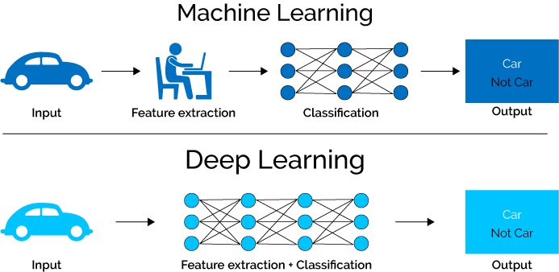
ML vs. Deep Learning
Introduction to Deep Learning
Deep learning (DL) is a machine learning subfield that uses multiple layers for learning data representations
  DL is exceptionally effective at learning patterns
Picture from: https://www.xenonstack.com/blog/static/public/uploads/media/machine-learning-vs-deep-learning.png

Slide 5




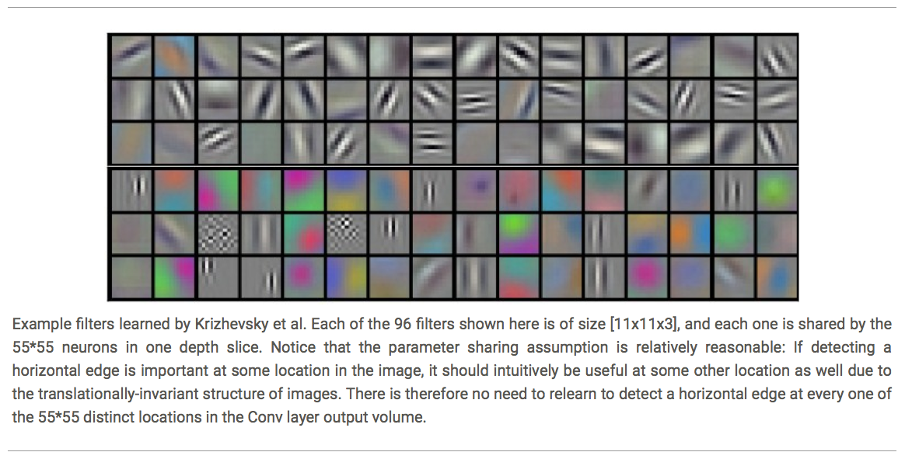














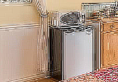

ML vs. Deep Learning
Introduction to Deep Learning
DL applies a multi-layer process for learning rich hierarchical features (i.e., data representations)
  Input image pixels → Edges → Textures → Parts → Objects
Low-Level Features
Mid-Level Features
High-Level Features
Trainable Classifier
Output
Slide credit: Param Vir Singh – Deep Learning

Slide 6
Why is DL Useful?
Introduction to Deep Learning
DL provides a flexible, learnable framework for representing visual, text, linguistic information
  Can learn in supervised and unsupervised manner
DL represents an effective end-to-end learning system
Requires large amounts of training data
Since about 2010, DL has outperformed other ML techniques
  First in vision and speech, then NLP, and other applications

Slide 7
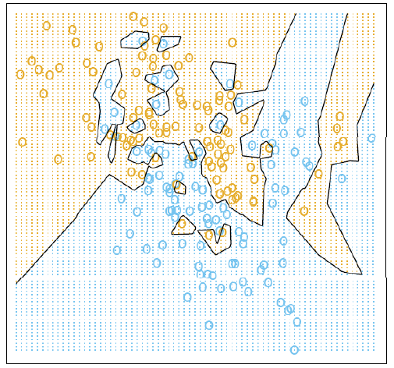
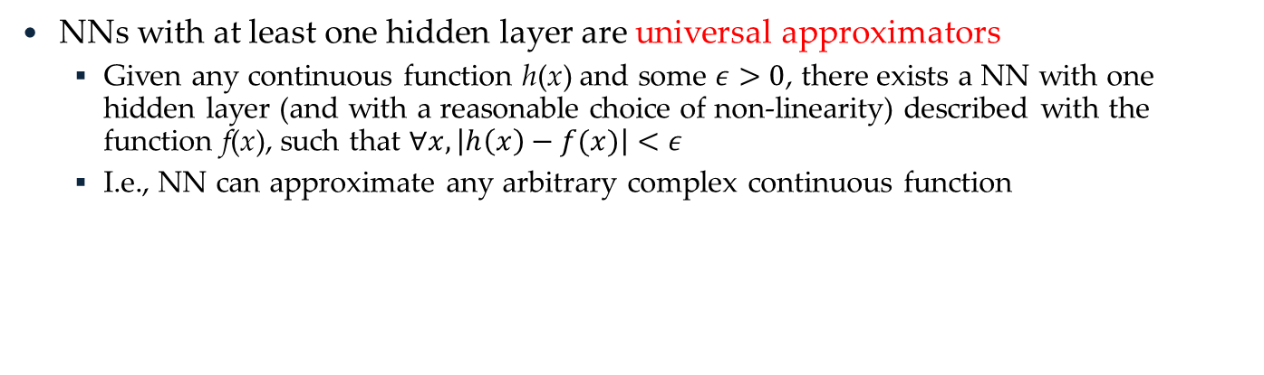
Representational Power
Introduction to Deep Learning
NNs with at least one hidden layer are universal approximators
  Given any continuous function h(x) and some $ε>0$, there exists a NN with one hidden layer (and with a reasonable choice of non-linearity) described with the function f(x), such that $∀x, \left|h\left(x\right)−f(x)\right|<ε$
  I.e., NN can approximate any arbitrary complex continuous function
NNs use nonlinear mapping of the inputs x to the outputs f(x) to compute complex decision boundaries
But then, why use deeper NNs?
  The fact that deep NNs work better is an empirical observation
  Mathematically, deep NNs have the same representational power as a one-layer NN

Slide 8
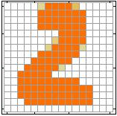
Introduction to Neural Networks
Introduction to Neural Networks
Handwritten digit recognition (MNIST dataset)
  The intensity of each pixel is considered an input element
  Output is the class of the digit
Input
Output
y₁
is 1
0.1
y₂
is 2
0.7
The image is “2”
……
……
……
y₁₀
0.2
is 0
16 x 16 = 256
Ink → 1
No ink → 0
Each dimension represents the confidence of a digit
Slide credit: Hung-yi Lee – Deep Learning Tutorial

Slide 9


Introduction to Neural Networks
Introduction to Neural Networks
Handwritten digit recognition
y₁
Machine
y₂
……
“2”
……
$$f:R^{256}→R^{10}$$
y₁₀
The function $f$ is represented by a neural network
Slide credit: Hung-yi Lee – Deep Learning Tutorial

Slide 10

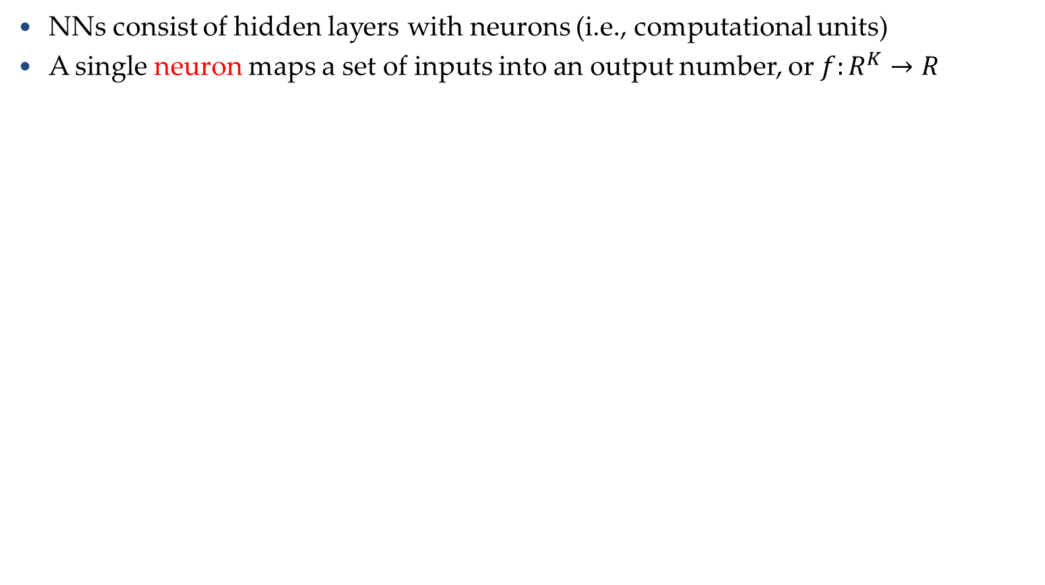
Elements of Neural Networks
Introduction to Neural Networks
NNs consist of hidden layers with neurons (i.e., computational units)
A single neuron maps a set of inputs into an output number, or $f:R^{K}→R$
$$a=σ\left(z\right)$$
…
…
output
Activation function
weights
input
bias
Slide credit: Hung-yi Lee – Deep Learning Tutorial

Slide 11
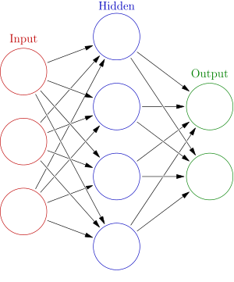




Elements of Neural Networks
Introduction to Neural Networks
A NN with one hidden layer and one output layer
Weights
Biases
$$hidden layer h=σ(W_{1}x+b_{1})$$
$$output layer y=σ(W_{2}h+b_{2})$$
Activation functions
4 + 2 = 6 neurons (not counting inputs)
[3 × 4] + [4 × 2] = 20 weights
4 + 2 = 6 biases
26 learnable parameters
$$y$$
$$x$$
$$h$$
Slide credit: Ismini Lourentzou – Introduction to Deep Learning

Slide 12
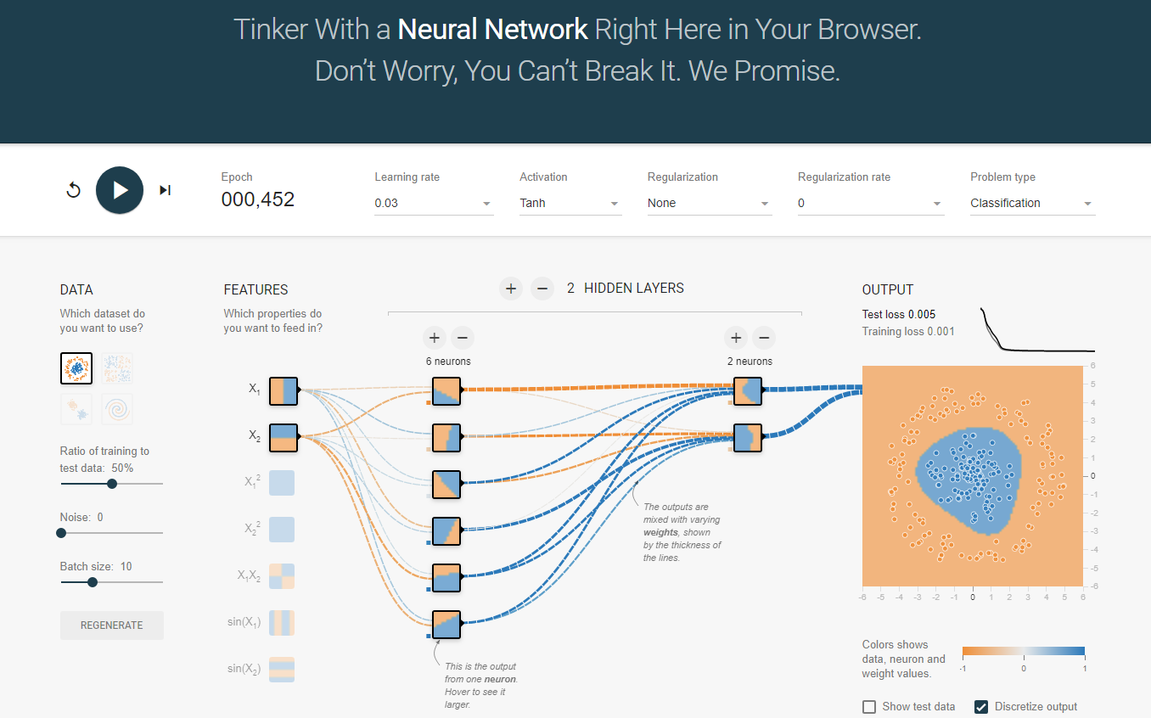
Elements of Neural Networks
Introduction to Neural Networks
A neural network playground link

Slide 13
Elements of Neural Networks
Introduction to Neural Networks
Deep NNs have many hidden layers
  Fully-connected (dense) layers (a.k.a. Multi-Layer Perceptron or MLP)
  Each neuron is connected to all neurons in the succeeding layer
Input
Layer 1
Layer 2
Layer L
Output
……
y₁
……
y₂
……
……
……
……
……
……
y_{M}
Input Layer
Output Layer
Hidden Layers
Slide credit: Hung-yi Lee – Deep Learning Tutorial

Slide 14
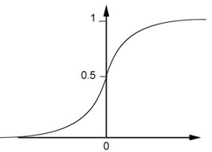


Elements of Neural Networks
Introduction to Neural Networks
A simple network, toy example
$$\left(1∙1\right)+\left(−1\right)∙\left(−2\right)+1=4$$
0.98
Sigmoid Function
1
4
1
-2
1
-1
-2
0.12
-1
1
0
1 $∙ \left(−1\right)+\left(−1\right)∙1+0=$-2
Slide credit: Hung-yi Lee – Deep Learning Tutorial

Slide 15

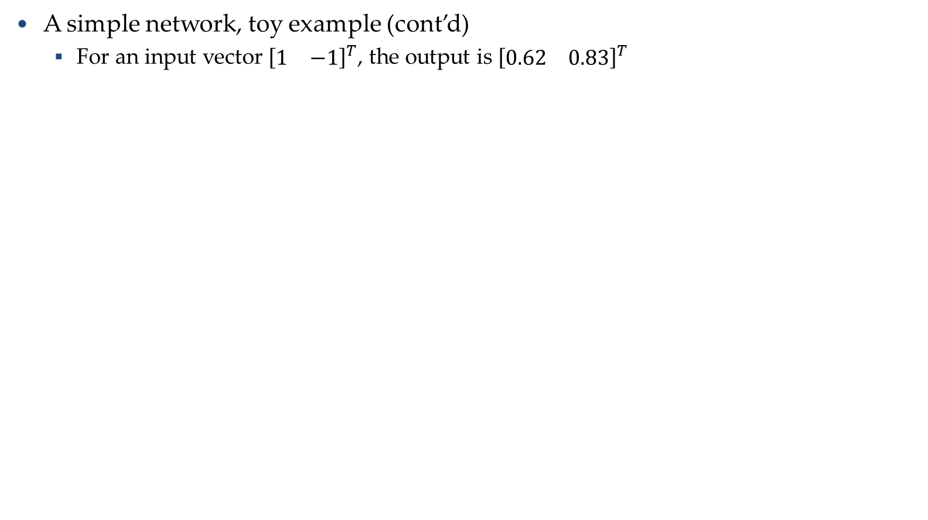
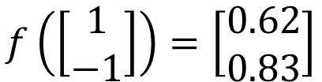
Elements of Neural Networks
Introduction to Neural Networks
A simple network, toy example (cont’d)
  For an input vector ${[\begin{matrix}1 & −1\end{matrix}]}^{T}$, the output is ${[\begin{matrix}0.62 & 0.83\end{matrix}]}^{T}$
1
4
0.98
2
0.86
3
0.62
1
-2
-1
-1
1
0
-2
-1
-2
0.12
-2
0.11
-1
0.83
-1
1
-1
4
0
0
2
$$f\left(\left[\begin{matrix}1 \\ −1\end{matrix}\right]\right)=\left[\begin{matrix}0.62 \\ 0.83\end{matrix}\right]$$
$$f:R^{2}→R^{2}$$
Slide credit: Hung-yi Lee – Deep Learning Tutorial

Slide 16







Matrix Operation
Introduction to Neural Networks
Matrix operations are helpful when working with multidimensional inputs and outputs
1
4
0.98
1
W
x
b
a
+
-2
$σ\left( \right) =$
1
-1
-2
0.12
$$\left[\begin{matrix}1 & −2 \\ −1 & 1\end{matrix}\right]$$
$$\left[\begin{matrix}1 \\ −1\end{matrix}\right]$$
$$\left[\begin{matrix}1 \\ 0\end{matrix}\right]$$
$$=$$
$$\left[\begin{matrix}0.98 \\ 0.12\end{matrix}\right]$$
$$σ\left( \right)$$
$$+$$
-1
1
0
$$\left[\begin{matrix}4 \\ −2\end{matrix}\right]$$
Slide credit: Hung-yi Lee – Deep Learning Tutorial

Slide 17

Matrix Operation
Introduction to Neural Networks
Multilayer NN, matrix calculations for the first layer
  Input vector x, weights matrix W¹, bias vector b¹, output vector a¹
……
y₁
W¹
y₂
……
……
b¹
……
……
……
……
x
a¹
……
y_{M}
a¹
W¹
x
b¹
+
$=σ\left( \right)$
Slide credit: Hung-yi Lee – Deep Learning Tutorial

Slide 18



Matrix Operation
Introduction to Neural Networks
Multilayer NN, matrix calculations for all layers
……
y₁
W¹
W²
W^{L}
y₂
……
b¹
b²
b^{L}
……
……
……
……
……
x
a¹
a²
y
……
y_{M}
W¹
x
b¹
+
$$σ\left( \right)$$
W²
a¹
b²
+
$$σ\left( \right)$$
W^{L}
b^{L}
a^{L-1}
+
$$σ\left( \right)$$
Slide credit: Hung-yi Lee – Deep Learning Tutorial

Slide 19

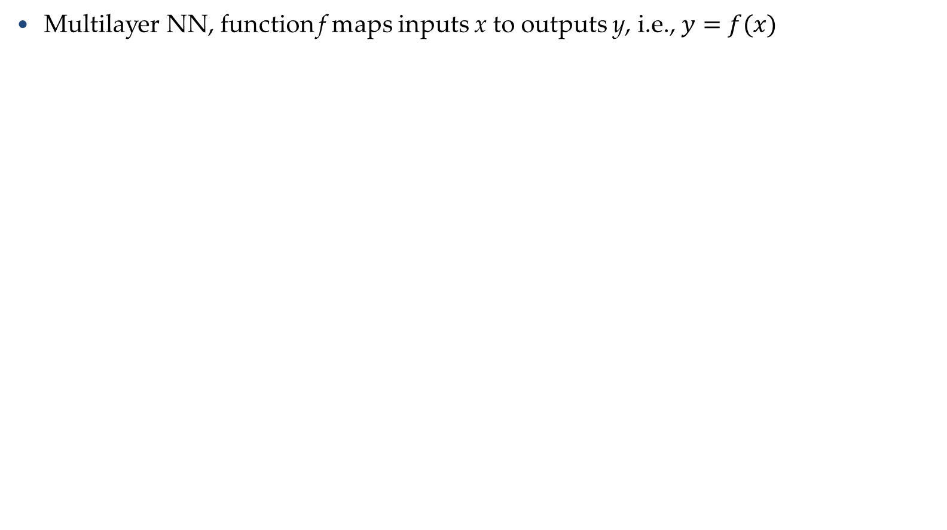

Matrix Operation
Introduction to Neural Networks
Multilayer NN, function f maps inputs x to outputs y, i.e., $y=f(x)$
……
y₁
W¹
W²
W^{L}
y₂
……
b¹
b²
b^{L}
……
……
……
……
……
x
a¹
a²
y
……
y_{M}
y
x
W^{L}
…
W²
W¹
x
b¹
b²
…
b^{L}
$$=f\left( \right)$$
+
+
$$=σ\left( \right)$$
$$σ\left( \right)$$
+
$$σ\left( \right)$$
Slide credit: Hung-yi Lee – Deep Learning Tutorial

Slide 20
Softmax Layer
Introduction to Neural Networks
In multi-class classification tasks, the output layer is typically a softmax layer
  I.e., it employs a softmax activation function
  If a layer with a sigmoid activation function is used as the output layer instead, the predictions by the NN may not be easy to interpret
    Note that an output layer with sigmoid activations can still be used for binary classification
A Layer with Sigmoid Activations
3
0.95
1
0.73
-3
0.05
Slide credit: Hung-yi Lee – Deep Learning Tutorial

Slide 21
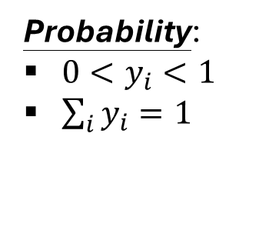
Softmax Layer
Introduction to Neural Networks
The softmax layer applies softmax activations to output a probability value in the range [0, 1]
  The values z inputted to the softmax layer are referred to as logits
Probability:
$0<y_{i}<1$
$\sum_{i}{y_{i}=1}$
A Softmax Layer
3
20
0.88
1
2.7
0.12
-3
0.05
≈0
Slide credit: Hung-yi Lee – Deep Learning Tutorial

Slide 22
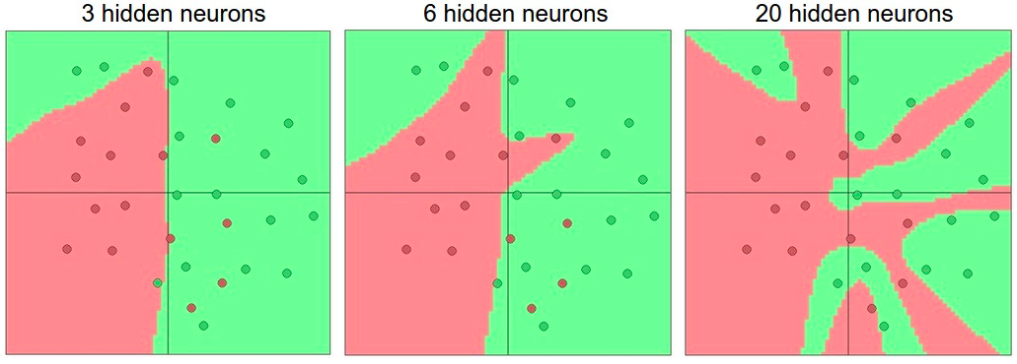
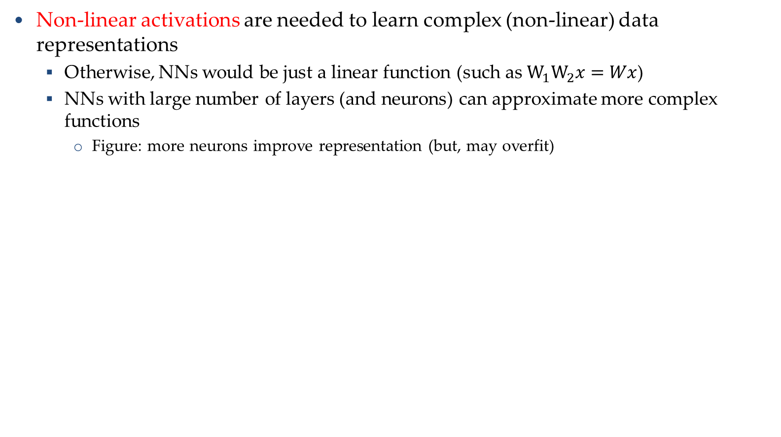
Activation Functions
Introduction to Neural Networks
Non-linear activations are needed to learn complex (non-linear) data representations
  Otherwise, NNs would be just a linear function (such as $W_{1}W_{2}x=Wx$)
  NNs with large number of layers (and neurons) can approximate more complex functions
    Figure: more neurons improve representation (but, may overfit)
Picture from: http://cs231n.github.io/assets/nn1/layer_sizes.jpeg

Slide 23
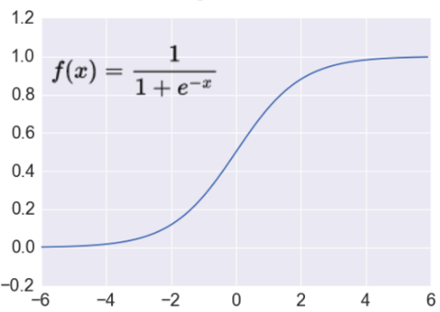



Activation: Sigmoid
Introduction to Neural Networks
Sigmoid function σ: takes a real-valued number and “squashes” it into the range between 0 and 1
  The output can be interpreted as the firing rate of a biological neuron
    Not firing = 0; Fully firing = 1
  When the neuron’s activation are 0 or 1, sigmoid neurons saturate
    Gradients at these regions are almost zero (almost no signal will flow)
  Sigmoid activations are less common in modern NNs
$$f\left(x\right)$$
$$ℝ^{n}→\left[0,1\right]$$
$$x$$
Slide credit: Ismini Lourentzou – Introduction to Deep Learning

Slide 24
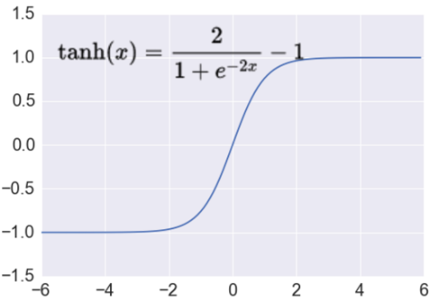




Activation: Tanh
Introduction to Neural Networks
Tanh function: takes a real-valued number and “squashes” it into range between -1 and 1
  Like sigmoid, tanh neurons saturate
  Unlike sigmoid, the output is zero-centered
    It is therefore preferred than sigmoid
  Tanh is a scaled sigmoid: $tanh⁡(x)=2∙σ(2x)−1$
$$f\left(x\right)$$
$$ℝ^{n}→\left[−1,1\right]$$
$$x$$
Slide credit: Ismini Lourentzou – Introduction to Deep Learning

Slide 25
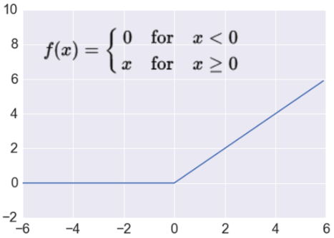
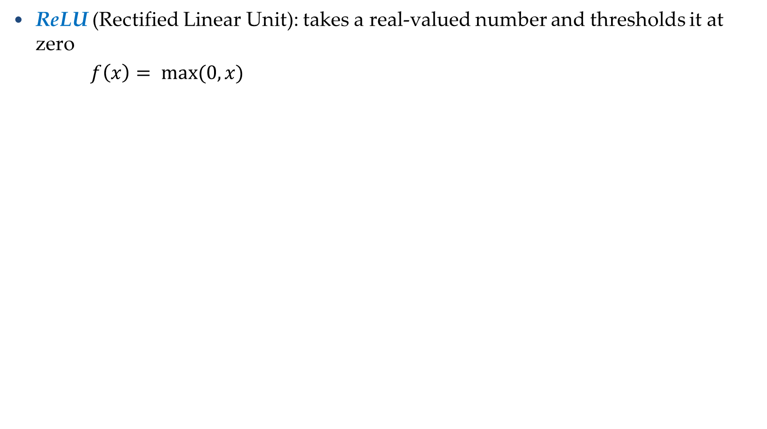



Activation: ReLU
Introduction to Neural Networks
ReLU (Rectified Linear Unit): takes a real-valued number and thresholds it at zero
$f\left(x\right)= max(0,x)$
$$ℝ^{n}→ℝ_{+}^{n}$$
  Most modern deep NNs use ReLU activations
  ReLU is fast to compute
    Compared to sigmoid, tanh
    Simply threshold a matrix at zero
  Accelerates the convergence of gradient descent
    Due to linear, non-saturating form
  Prevents the gradient vanishing problem
$$f\left(x\right)$$
$$x$$

Slide 26
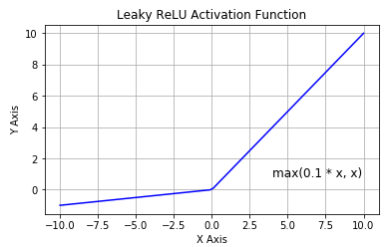


Activation: Leaky ReLU
Introduction to Neural Networks
The problem of ReLU activations: they can “die”
  ReLU could cause weights to update in a way that the gradients can become zero and the neuron will not activate again on any data
  E.g., when a large learning rate is used
Leaky ReLU activation function is a variant of ReLU
  Instead of the function being 0 when $x<0$, a leaky ReLU has a small negative slope (e.g., α = 0.01, or similar)
  This resolves the dying ReLU problem
  Most current works still use ReLU
    With a proper setting of the learning rate, the problem of dying ReLU can be avoided
$$f\left(x\right)=\left\{\begin{matrix}\begin{matrix}αx & for x<0 \end{matrix} \\ \begin{matrix}x & for x≫0\end{matrix}\end{matrix}\right.$$

Slide 27
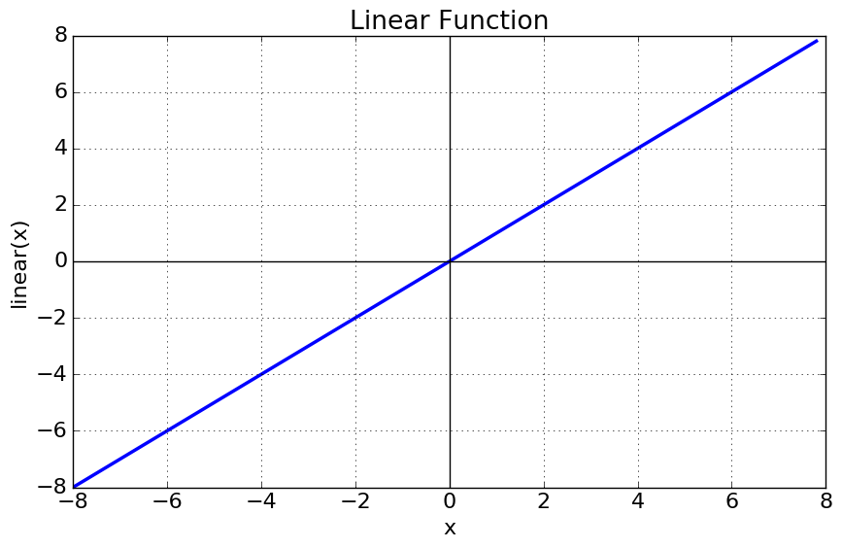


Activation: Linear Function
Introduction to Neural Networks
Linear function means that the output signal is proportional to the input signal to the neuron
$$ℝ^{n}→ℝ^{n}$$
  If the value of the constant c is 1, it is also called identity activation function
  This activation type is used in regression problems
    E.g., the last layer can have linear activation function, in order to output a real number (and not a class membership)
$$f\left(x\right)=cx$$

Slide 28
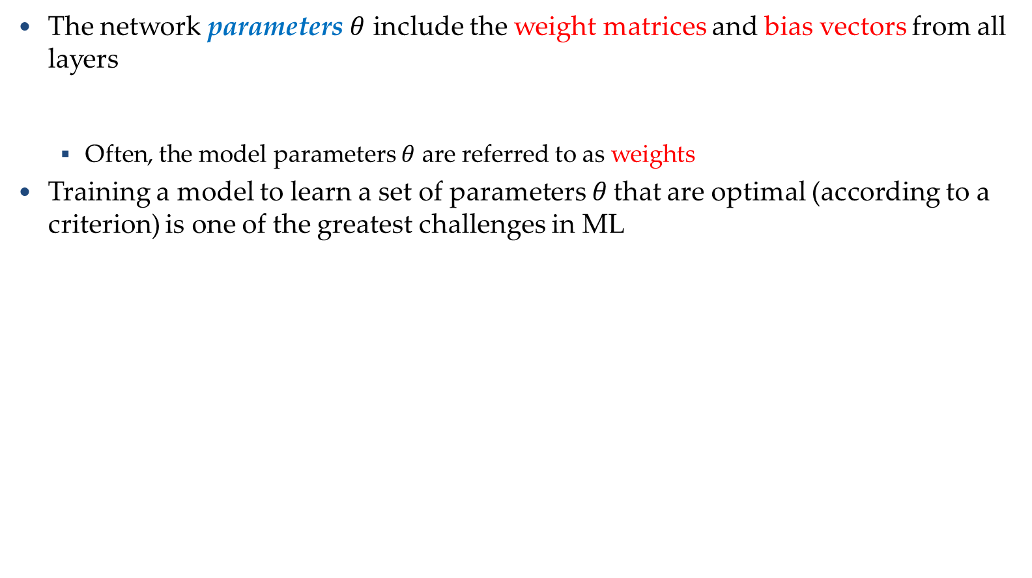
Training NNs
Training Neural Networks
The network parameters $θ$ include the weight matrices and bias vectors from all layers
  Often, the model parameters $θ$ are referred to as weights
Training a model to learn a set of parameters$θ$ that are optimal (according to a criterion) is one of the greatest challenges in ML
$$θ=\left\{W^{1},b^{1},W^{2},b^{2},⋯W^{L},b^{L}\right\}$$
……
y₁
is 1
0.1
……
y₂
0.7
is 2
……
Softmax
……
……
……
y₁₀
is 0
0.2
16 x 16 = 256
Slide credit: Hung-yi Lee – Deep Learning Tutorial

Slide 29
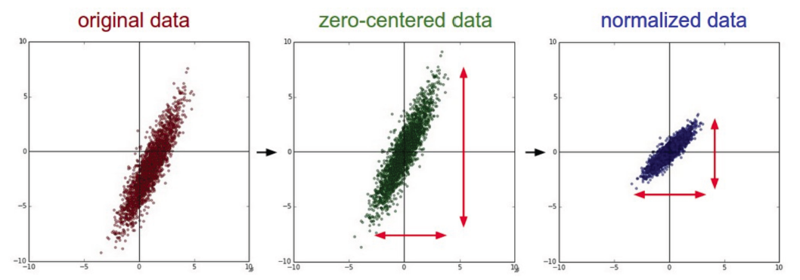
Training NNs
Training Neural Networks
Data preprocessing - helps convergence during training
  Mean subtraction, to obtain zero-centered data
    Subtract the mean for each individual data dimension (feature)
  Normalization
    Divide each feature by its standard deviation
      To obtain standard deviation of 1 for each data dimension (feature)
    Or, scale the data within the range [0,1] or [-1, 1]
      E.g., image pixel intensities are divided by 255 to be scaled in the [0,1] range
Picture from: https://cs231n.github.io/neural-networks-2/

Slide 30




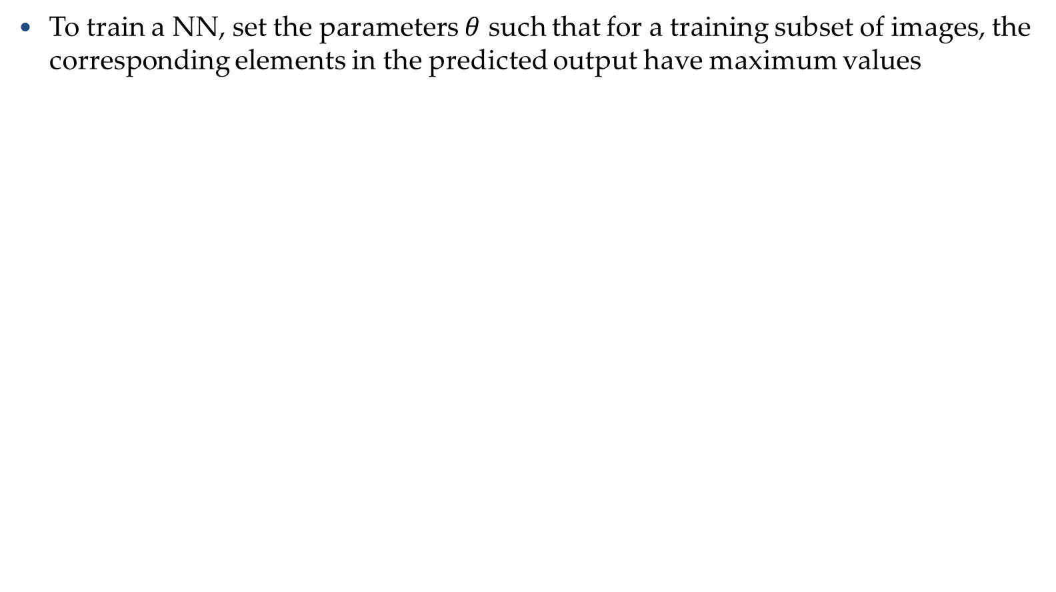
Training NNs
Training Neural Networks
To train a NN, set the parameters $θ$ such that for a training subset of images, the corresponding elements in the predicted output have maximum values
Input:
y₁ has the maximum value
Input:
y₂ has the maximum value
.
.
.
Input:
y₉ has the maximum value
Input:
y₁₀ has the maximum value
Slide credit: Hung-yi Lee – Deep Learning Tutorial

Slide 31

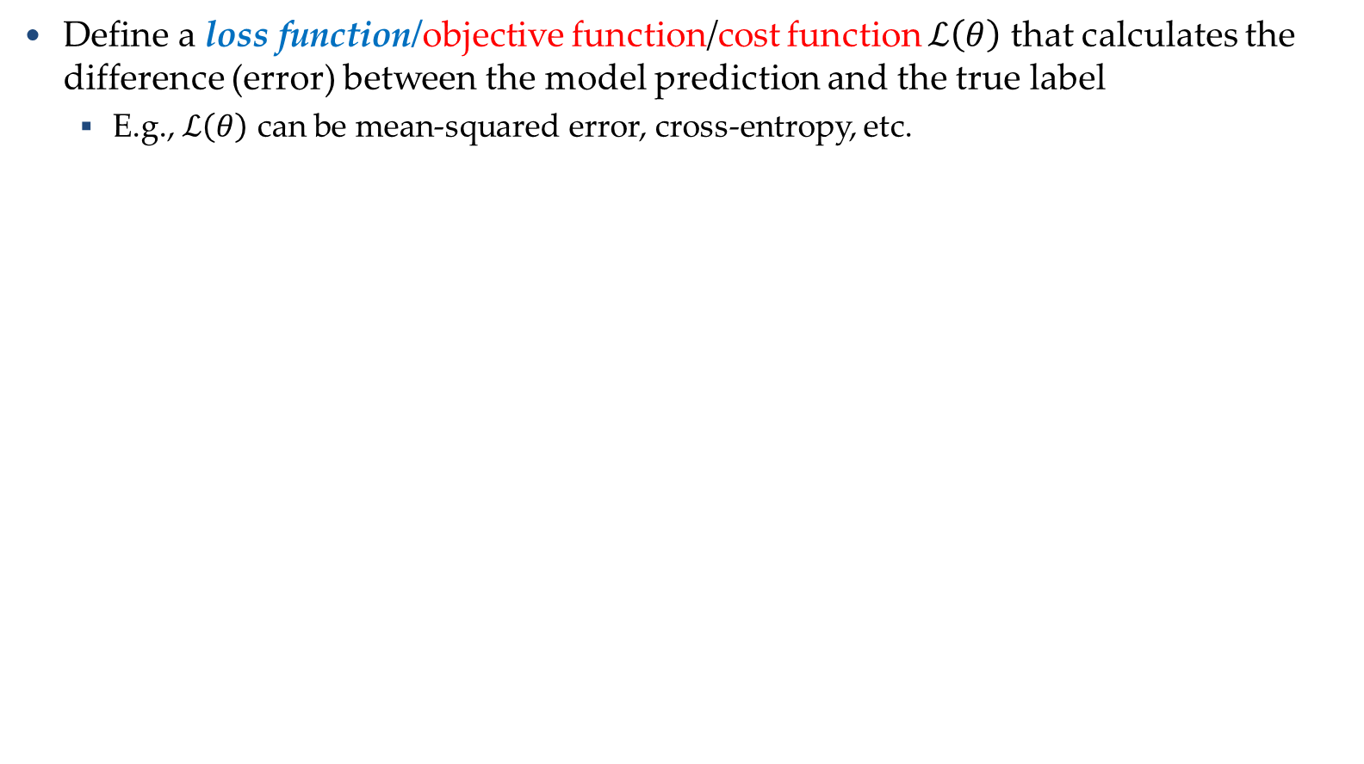

Training NNs
Training Neural Networks
Define a loss function/objective function/cost function $ℒ\left(θ\right)$ that calculates the difference (error) between the model prediction and the true label
  E.g., $ℒ\left(θ\right)$ can be mean-squared error, cross-entropy, etc.
……
y₁
1
0.2
……
y₂
0
0.3
……
……
……
……
Cost
……
……
……
y₁₀
$$ℒ(θ)$$
0
0.5
True label “1”
Slide credit: Hung-yi Lee – Deep Learning Tutorial

Slide 32






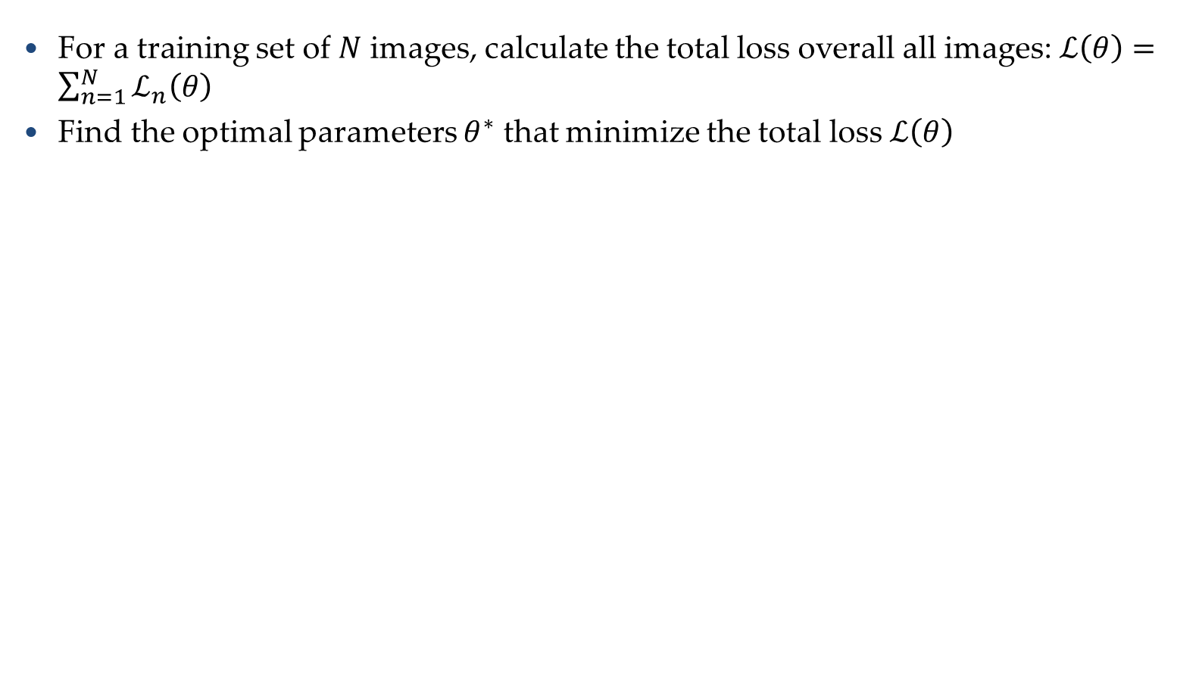




Training NNs
Training Neural Networks
For a training set of $N$ images, calculate the total loss overall all images: $ℒ\left(θ\right)=\sum_{n=1}^{N}{ℒ_{n}\left(θ\right)}$
Find the optimal parameters $θ^{∗}$ that minimize the total loss $ℒ\left(θ\right)$
$$ℒ_{1}\left(θ\right)$$
x¹
NN
y¹
$${\hat{y}}^{1}$$
NN
$$ℒ_{2}\left(θ\right)$$
x²
$${\hat{y}}^{2}$$
y²
NN
$$ℒ_{3}\left(θ\right)$$
x³
$${\hat{y}}^{3}$$
y³
……
……
……
……
NN
$$ℒ_{n}\left(θ\right)$$
x^{N}
$${\hat{y}}^{N}$$
y^{N}
Slide credit: Hung-yi Lee – Deep Learning Tutorial

Slide 33

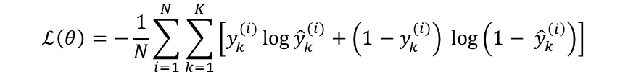
Loss Functions
Training Neural Networks
Classification tasks
Training
examples
Pairs of 𝑁 inputs $x_{i}$ and ground-truth class labels $y_{i}$
Output
Layer
Softmax Activations
[maps to a probability distribution]
Loss function
$$ℒ\left(θ\right)=−\frac{1}{N}\sum_{i=1}^{N}{\sum_{k=1}^{K}{\left[y_{k}^{(i)}\log{{\hat{y}}_{k}^{(i)}+\left(1−y_{k}^{(i)}\right) }\log\left(1− {\hat{y}}_{k}^{\left(i\right)}\right)\right]}}$$
Cross-entropy
Ground-truth class labels $y_{i}$ and model predicted class labels ${\hat{y}}_{i}$
Slide credit: Ismini Lourentzou – Introduction to Deep Learning

Slide 34
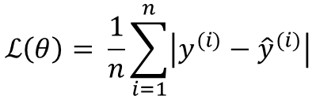
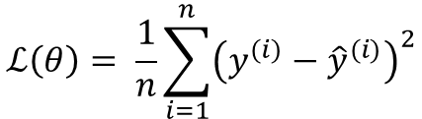
Loss Functions
Training Neural Networks
Regression tasks
Training
examples
Pairs of 𝑁 inputs $x_{i}$ and ground-truth output values$y_{i}$
Output
Layer
Linear (Identity) or Sigmoid Activation
$$ℒ\left(θ\right)= \frac{1}{n}\sum_{i=1}^{n}{{\left(y^{(i)}−{\hat{y}}^{(i)}\right)}^{2}}$$
Mean Squared Error
Loss function
$$ℒ\left(θ\right)= \frac{1}{n}\sum_{i=1}^{n}{\left|y^{(i)}−{\hat{y}}^{(i)}\right|}$$
Mean Absolute Error
Slide credit: Ismini Lourentzou – Introduction to Deep Learning

Slide 35
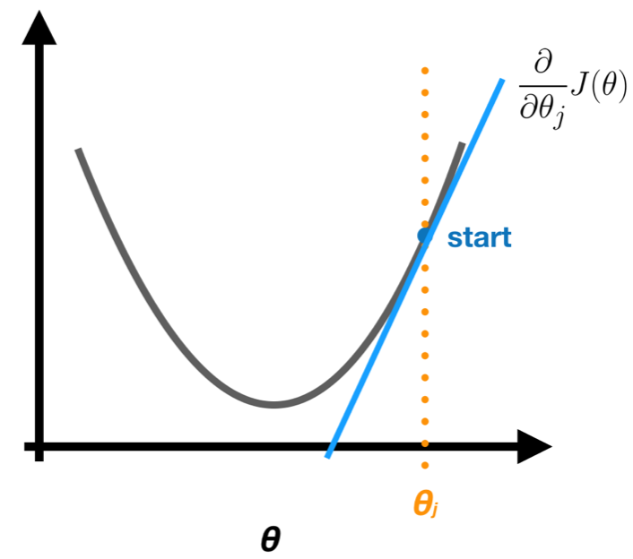
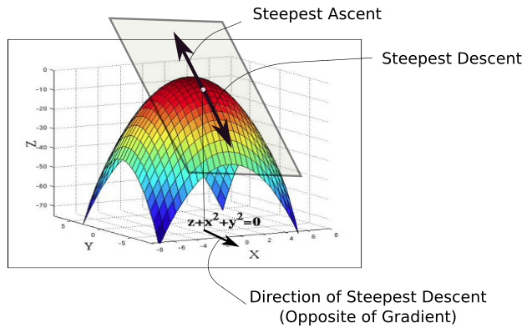
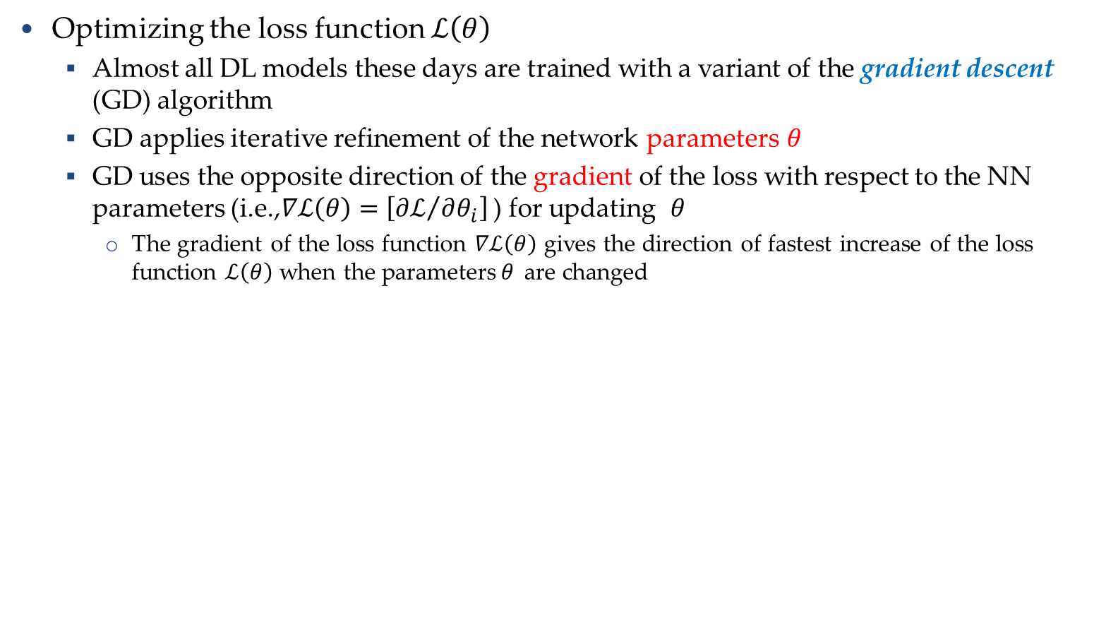



Training NNs
Training Neural Networks
Optimizing the loss function $ℒ\left(θ\right)$
  Almost all DL models these days are trained with a variant of the gradient descent (GD) algorithm
  GD applies iterative refinement of the network parameters$θ$
  GD uses the opposite direction of the gradient of the loss with respect to the NN parameters (i.e.,$∇ℒ\left(θ\right)=\left[{∂ℒ}/{∂θ_{i}}\right]$ ) for updating $θ$
    The gradient of the loss function $∇ℒ\left(θ\right)$ gives the direction of fastest increase of the loss function $ℒ\left(θ\right)$ when the parameters$θ$ are changed
$$ℒ\left(θ\right)$$
$$\frac{∂ℒ}{∂θ_{i}}$$
$$θ_{i}$$

Slide 36
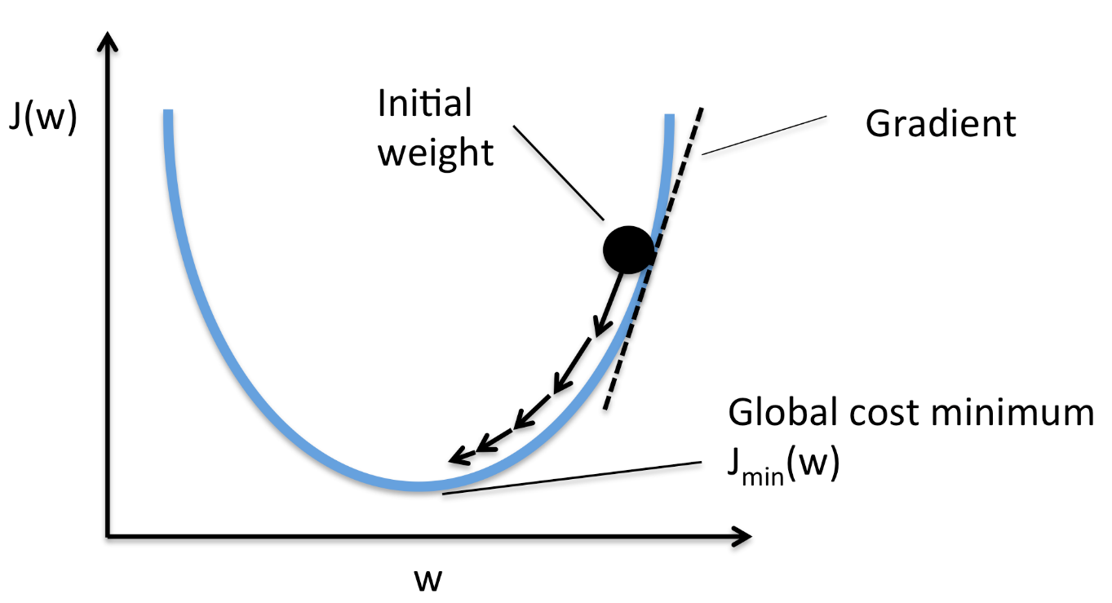


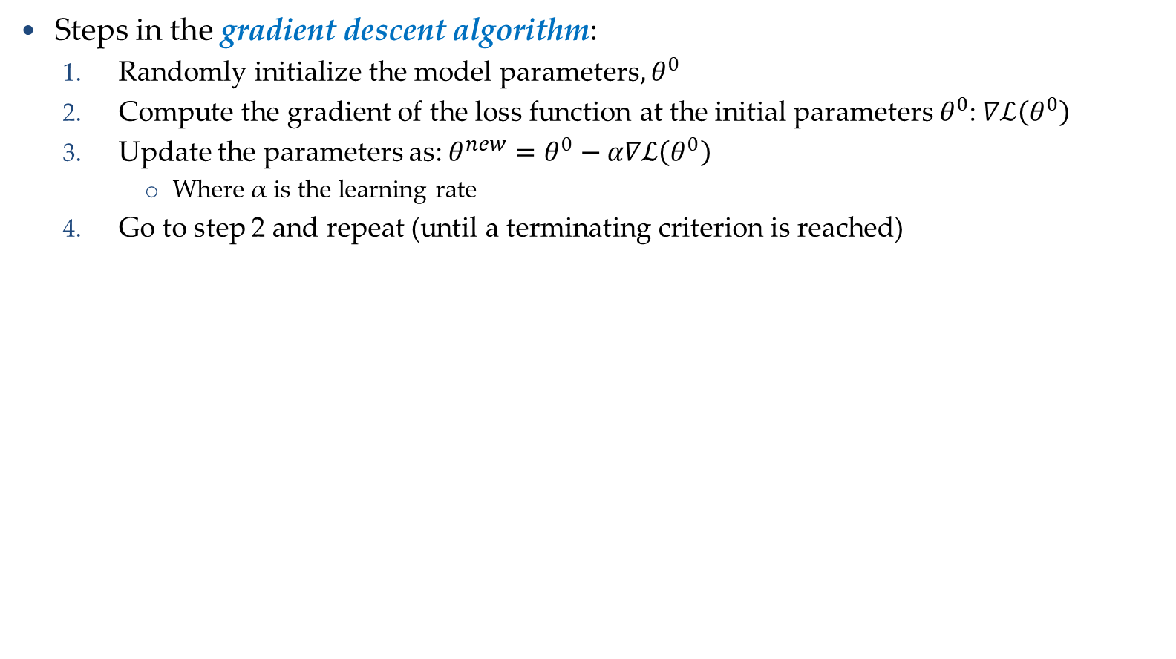
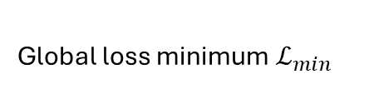



Gradient Descent Algorithm
Training Neural Networks
Steps in the gradient descent algorithm:
  Randomly initialize the model parameters$,θ^{0}$
  Compute the gradient of the loss function at the initial parameters $θ^{0}$: $∇ℒ\left(θ^{0}\right)$
  Update the parameters as: $θ^{new}=θ^{0}−α∇ℒ\left(θ^{0}\right)$
    Where α is the learning rate
  Go to step 2 and repeat (until a terminating criterion is reached)
Loss $ℒ$
Initial
parameters $θ^{0}$
Gradient $∇ℒ=\frac{∂ℒ}{∂θ}$
Parameter update:${ θ}^{new}=θ−α∇ℒ\left(θ^{0}\right)$
Global loss minimum $ℒ_{min}$
Parameters $θ$

Slide 37
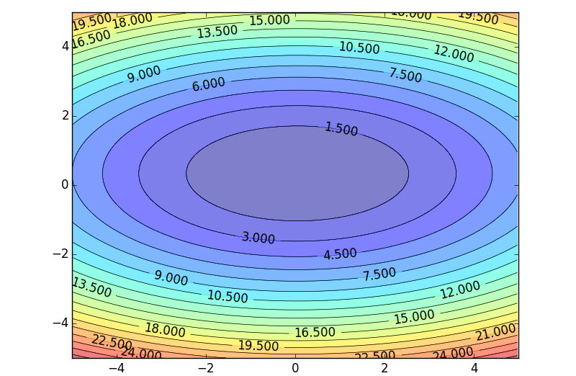

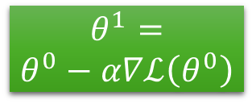

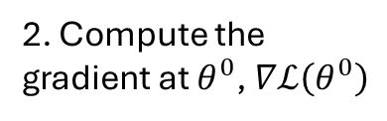


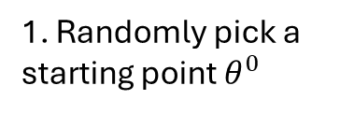

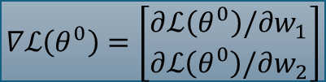



Gradient Descent Algorithm
Training Neural Networks
Example: a NN with only 2 parameters $w_{1}$ and $w_{2}$, i.e., $θ=\left\{w_{1},w_{2}\right\}$
  The different colors represent the values of the loss (minimum loss$θ^{∗}$ is ≈ 1.3)
1. Randomly pick a starting point $θ^{0}$
2. Compute the gradient at $θ^{0}$, $∇ℒ\left(θ^{0}\right)$
$$θ^{∗}$$
$$w_{2}$$
3. Times the learning rate $η$, and update $θ,$
$$θ^{new}=θ^{0}−α∇ℒ\left(θ^{0}\right)$$
$$θ^{1}$$
$$θ^{1}=$$
$$θ^{0}−α∇ℒ\left(θ^{0}\right)$$
$$−∇ℒ\left(θ^{0}\right)$$
4. Go to step 2, repeat
$$θ^{0}$$
$$∇ℒ\left(θ^{0}\right)=\left[\begin{matrix}∂ℒ\left(θ^{0}\right)/∂w_{1} \\ ∂ℒ\left(θ^{0}\right)/∂w_{2}\end{matrix}\right]$$
$$w_{1}$$
Slide credit: Hung-yi Lee – Deep Learning Tutorial

Slide 38






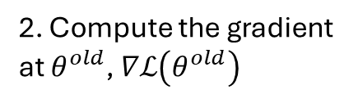


Gradient Descent Algorithm
Training Neural Networks
Example (contd.)
Eventually, we would reach a minimum …..
2. Compute the gradient at $θ^{old}$, $∇ℒ\left(θ^{old}\right)$
$$θ^{2}$$
$$θ^{1}−α∇ℒ\left(θ^{1}\right)$$
3. Times the learning rate $η$, and update $θ,$
$$θ^{new}=θ^{old}−α∇ℒ\left(θ^{old}\right)$$
$$w_{2}$$
$$θ^{2}−α∇ℒ\left(θ^{2}\right)$$
$$θ^{1}$$
4. Go to step 2, repeat
$$θ^{0}$$
$$w_{1}$$
Slide credit: Hung-yi Lee – Deep Learning Tutorial

Slide 39
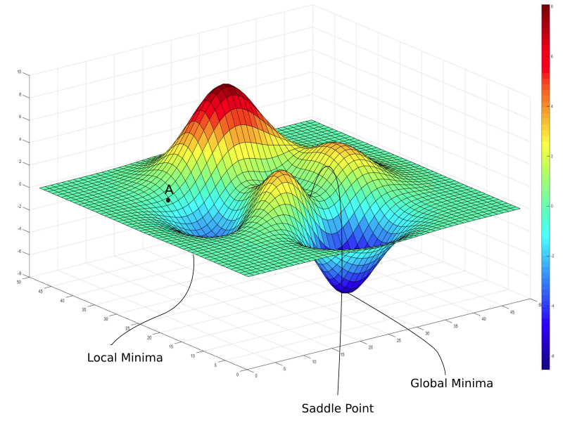



Gradient Descent Algorithm
Training Neural Networks
Gradient descent algorithm stops when a local minimum of the loss surface is reached
  GD does not guarantee reaching a global minimum
  However, empirical evidence suggests that GD works well for NNs
$ℒ\left(θ\right)$
$$θ$$
Picture from: https://blog.paperspace.com/intro-to-optimization-in-deep-learning-gradient-descent/

Slide 40






Gradient Descent Algorithm
Training Neural Networks
For most tasks, the loss surface $ℒ\left(θ\right)$ is highly complex (and non-convex)
Random initialization in NNs results in different initial parameters $θ^{0}$ every time the NN is trained
  Gradient descent may reach different minima at every run
  Therefore, NN will produce different predicted outputs
In addition, currently we don’t have algorithms that guarantee reaching a global minimum for an arbitrary loss function
$$ℒ$$
$$w_{1}$$
$$w_{2}$$
Slide credit: Hung-yi Lee – Deep Learning Tutorial

Slide 41

Backpropagation
Training Neural Networks
Modern NNs employ the backpropagation method for calculating the gradients of the loss function $∇ℒ\left(θ\right)={∂ℒ}/{∂θ_{i}}$
  Backpropagation is short for “backward propagation”
For training NNs, forward propagation (forward pass) refers to passing the inputs $x$ through the hidden layers to obtain the model outputs (predictions) $y$
  The loss $ℒ\left(y,\hat{y}\right)$ function is then calculated
  Backpropagation traverses the network in reverse order, from the outputs $y$ backward toward the inputs $x$ to calculate the gradients of the loss$∇ℒ\left(θ\right)$
  The chain rule is used for calculating the partial derivatives of the loss function with respect to the parameters$θ$ in the different layers in the network
Each update of the model parameters $θ$ during training takes one forward and one backward pass (e.g., of a batch of inputs)
Automatic calculation of the gradients (automatic differentiation) is available in all current deep learning libraries
  It significantly simplifies the implementation of deep learning algorithms, since it obviates deriving the partial derivatives of the loss function by hand

Slide 42

Mini-batch Gradient Descent
Training Neural Networks
It is wasteful to compute the loss over the entire training dataset to perform a single parameter update for large datasets
  E.g., ImageNet has 14M images
  Therefore, GD (a.k.a. vanilla GD) is almost always replaced with mini-batch GD
Mini-batch gradient descent
  Approach:
    Compute the loss $ℒ\left(θ\right)$ on a mini-batch of images, update the parameters $θ$, and repeat until all images are used
    At the next epoch, shuffle the training data, and repeat the above process
  Mini-batch GD results in much faster training
  Typical mini-batch size: 32 to 256 images
  It works because the gradient from a mini-batch is a good approximation of the gradient from the entire training set

Slide 43

Stochastic Gradient Descent
Training Neural Networks
Stochastic gradient descent
  SGD uses mini-batches that consist of a single input example
    E.g., one image mini-batch
  Although this method is very fast, it may cause significant fluctuations in the loss function
    Therefore, it is less commonly used, and mini-batch GD is preferred
  In most DL libraries, SGD typically means a mini-batch GD (with an option to add momentum)

Slide 44





Problems with Gradient Descent
Training Neural Networks
Besides the local minima problem, the GD algorithm can be very slow at plateaus, and it can get stuck at saddle points
cost $ℒ\left(θ\right)$
Very slow at the plateau
Stuck at a saddle point
Stuck at a local minimum
$$∇ℒ\left(θ\right)≈0$$
$$∇ℒ\left(θ\right)=0$$
$$∇ℒ\left(θ\right)=0$$
$$θ$$
Slide credit: Hung-yi Lee – Deep Learning Tutorial

Slide 45


Gradient Descent with Momentum
Training Neural Networks
Gradient descent with momentum uses the momentum of the gradient for parameter optimization
cost $ℒ\left(θ\right)$
Movement = Negative of Gradient + Momentum
Negative of Gradient
Momentum
Real Movement
$$θ$$
Gradient = 0
Slide credit: Hung-yi Lee – Deep Learning Tutorial

Slide 46

Gradient Descent with Momentum
Training Neural Networks
Parameters update in GD with momentum at iteration $t$: $θ^{t}=θ^{t−1}−V^{t}$
    Where: $V^{t}$= $βV^{t−1}+α∇ℒ\left(θ^{t−1}\right)$
    I.e., $θ^{t}=θ^{t−1}−α∇ℒ\left(θ^{t−1}\right)−βV^{t−1}$
Compare to vanilla GD: $θ^{t}=θ^{t−1}−α∇ℒ\left(θ^{t−1}\right)$
  Where $θ^{t−1}$ are the parameters from the previous iteration $t−1$
The term $V^{t}$ is called momentum
  This term accumulates the gradients from the past several steps, i.e.,
    $V^{t}$= $βV^{t−1}+α∇ℒ\left(θ^{t−1}\right)$
    $$=β\left(βV^{t−2}+α∇ℒ\left(θ^{t−2}\right)\right)+α∇ℒ\left(θ^{t−1}\right)$$
    $$=β^{2}V^{t−2}+βα∇ℒ\left(θ^{t−2}\right)+α∇ℒ\left(θ^{t−1}\right)$$
    $$=β^{3}V^{t−3}+β^{2}α∇ℒ\left(θ^{t−3}\right)+βα∇ℒ\left(θ^{t−2}\right)+α∇ℒ\left(θ^{t−1}\right)$$
  This term is analogous to a momentum of a heavy ball rolling down the hill
The parameter$β$ is referred to as a coefficient of momentum
  A typical value of the parameter $β$ is 0.9
This method updates the parameters $θ$ in the direction of the weighted average of the past gradients

Slide 47


Nesterov Accelerated Momentum
Training Neural Networks
Gradient descent with Nesterov accelerated momentum
  Parameter update: $θ^{t}=θ^{t−1}−V^{t}$
    Where: $V^{t}$= $βV^{t−1}+α∇ℒ\left(θ^{t−1}+βV^{t−1}\right)$
  The term $θ^{t−1}+βV^{t−1}$ allows to predict the position of the parameters in the next step (i.e., $θ^{t} ≈θ^{t−1}+βV^{t−1}$)
  The gradient is calculated with respect to the approximate future position of the parameters in the next iteration, $θ^{t}$, calculated at iteration $t−1$
GD with momentum
GD with Nesterov momentum
Picture from: https://towardsdatascience.com/learning-parameters-part-2-a190bef2d12

Slide 48

Adam
Training Neural Networks
Adaptive Moment Estimation (Adam)
  Adam combines insights from the momentum optimizers that accumulate the values of past gradients, and it also introduces new terms based on the second moment of the gradient
    Similar to GD with momentum, Adam computes a weighted average of past gradients (first moment of the gradient), i.e., $V^{t}$= $β_{1}V^{t−1}+\left(1−β_{1}\right)∇ℒ\left(θ^{t−1}\right)$
    Adam also computes a weighted average of past squared gradients (second moment of the gradient), , i.e., $U^{t}$= $β_{2}U^{t−1}+\left(1−β_{2}\right){\left(∇ℒ\left(θ^{t−1}\right)\right)}^{2}$
  The parameter update is:$θ^{t}=θ^{t−1}−α\frac{{\hat{V}}^{t}}{\sqrt{{\hat{U}}^{t}}+ε}$
    Where: ${\hat{V}}^{t}=\frac{V^{t}}{1−β_{1}}$ and ${\hat{U}}^{t}=\frac{U^{t}}{1−β_{2}}$
    The proposed default values are $β_{1}$ = 0.9, $β_{2}$ = 0.999, and $ε={10}^{−8}$
Other commonly used optimization methods include:
  Adagrad, Adadelta, RMSprop, Nadam, etc.
  Most commonly used optimizers nowadays are Adam and SGD with momentum

Slide 49


Learning Rate
Training Neural Networks
Learning rate
  The gradient tells us the direction in which the loss has the steepest rate of increase, but it does not tell us how far along the opposite direction we should step
  Choosing the learning rate (also called the step size) is one of the most important hyper-parameter settings for NN training
LR too small
LR too large

Slide 50

Learning Rate
Training Neural Networks
Training loss for different learning rates
  High learning rate: the loss increases or plateaus too quickly
  Low learning rate: the loss decreases too slowly (takes many epochs to reach a solution)
Picture from: https://cs231n.github.io/neural-networks-3/

Slide 51



Learning Rate Scheduling
Training Neural Networks
Learning rate scheduling is applied to change the values of the learning rate during the training
  Annealing is reducing the learning rate over time (a.k.a. learning rate decay)
    Approach 1: reduce the learning rate by some factor every few epochs
      Typical values: reduce the learning rate by a half every 5 epochs, or divide by 10 every 20 epochs
    Approach 2: exponential or cosine decay gradually reduce the learning rate over time
    Approach 3: reduce the learning rate by a constant (e.g., by half) whenever the validation loss stops improving
      In TensorFlow: tf.keras.callbacks.ReduceLROnPleateau()
        Monitor: validation loss, factor: 0.1 (i.e., divide by 10), patience: 10 (how many epochs to wait before applying it), Minimum learning rate: 1e-6 (when to stop)
  Warmup is gradually increasing the learning rate initially, and afterward let it cool down until the end of the training
Exponential decay
Cosine decay
Warmup

Slide 52
Vanishing Gradient Problem
Training Neural Networks
In some cases, during training, the gradients can become either very small (vanishing gradients) of very large (exploding gradients)
  They result in very small or very large update of the parameters
  Solutions: change learning rate, ReLU activations, regularization, LSTM units in RNNs
……
y₁
……
y₂
……
……
……
……
……
……
y_{M}
Small gradients, learns very slow
Slide credit: Hung-yi Lee – Deep Learning Tutorial

Slide 53

Generalization
Generalization
Underfitting
  The model is too “simple” to represent all the relevant class characteristics
  E.g., model with too few parameters
  Produces high error on the training set and high error on the validation set
Overfitting
  The model is too “complex” and fits irrelevant characteristics (noise) in the data
  E.g., model with too many parameters
  Produces low error on the training error and high error on the validation set

Slide 54


Overfitting
Generalization
Overfitting – a model with high capacity fits the noise in the data instead of the underlying relationship
The model may fit the training data very well, but fails to generalize to new examples (test or validation data)
Picture from: http://cs231n.github.io/assets/nn1/layer_sizes.jpeg

Slide 55

Regularization: Weight Decay
Regularization
$ℓ_{2}$ weight decay
  A regularization term that penalizes large weights is added to the loss function
  $$ℒ_{reg}\left(θ\right)= ℒ\left(θ\right)+λ\sum_{k}{θ_{k}^{2}}$$
  For every weight in the network, we add the regularization term to the loss value
    During gradient descent parameter update, every weight is decayed linearly toward zero
  The weight decay coefficient $λ$determines how dominant the regularization is during the gradient computation
Data loss
Regularization loss

Slide 56


Regularization: Weight Decay
Regularization
Effect of the decay coefficient $λ$
  Large weight decay coefficient → penalty for weights with large values

Slide 57

Regularization: Weight Decay
Regularization
$ℓ_{1}$ weight decay
  The regularization term is based on the $ℓ_{1}$ norm of the weights
  $ℒ_{reg}\left(θ\right)= ℒ\left(θ\right)+λ\sum_{k}{\left|θ_{k}\right|}$
  $ℓ_{1}$ weight decay is less common with NN
    Often performs worse than $ℓ_{2}$ weight decay
  It is also possible to combine $ℓ_{1}$ and $ℓ_{2}$ regularization
    Called elastic net regularization
  $ℒ_{reg}\left(θ\right)= ℒ\left(θ\right)+λ_{1}\sum_{k}{\left|θ_{k}\right|+λ_{2}\sum_{k}{θ_{k}^{2}}}$

Slide 58

Regularization: Dropout
Regularization
Dropout
  Randomly drop units (along with their connections) during training
  Each unit is retained with a fixed dropout rate p, independent of other units
  The hyper-parameter p needs to be chosen (tuned)
    Often, between 20% and 50% of the units are dropped
Slide credit: Hung-yi Lee – Deep Learning Tutorial

Slide 59
Regularization: Dropout
Regularization
Dropout is a kind of ensemble learning
  Using one mini-batch to train one network with a slightly different architecture
minibatch
1
minibatch
2
minibatch
3
minibatch
n
……
Slide credit: Hung-yi Lee – Deep Learning Tutorial

Slide 60

Regularization: Early Stopping
Regularization
Early-stopping
  During model training, use a validation set
    E.g., validation/train ratio of about 25% to 75%
  Stop when the validation accuracy (or loss) has not improved after n epochs
    The parameter n is called patience
Stop training
validation

Slide 61

Batch Normalization
Regularization
Batch normalization layers act similar to the data preprocessing steps mentioned earlier
  They calculate the mean μ and variance σ of a batch of input data, and normalize the data x to a zero mean and unit variance
  I.e., $\hat{x}=\frac{x−μ}{σ}$
BatchNorm layers alleviate the problems of proper initialization of the parameters and hyper-parameters
  Result in faster convergence training, allow larger learning rates
  Reduce the internal covariate shift
BatchNorm layers are inserted immediately after convolutional layers or fully-connected layers, and before activation layers
  They are very common with convolutional NNs

Slide 62

Hyper-parameter Tuning
Hyper-parameter Tuning
Training NNs can involve setting many hyper-parameters
The most common hyper-parameters include:
  Number of layers, and number of neurons per layer
  Initial learning rate
  Learning rate decay schedule (e.g., decay constant)
  Optimizer type
Other hyper-parameters may include:
  Regularization parameters ($ℓ_{2}$ penalty, dropout rate)
  Batch size
  Activation functions
  Loss function
Hyper-parameter tuning can be time-consuming for larger NNs

Slide 63

Hyper-parameter Tuning
Hyper-parameter Tuning
Grid search
  Check all values in a range with a step value
Random search
  Randomly sample values for the parameter
  Often preferred to grid search
Bayesian hyper-parameter optimization
  Is an active area of research

Slide 64
k-Fold Cross-Validation
k-Fold Cross-Validation
Using k-fold cross-validation for hyper-parameter tuning is common when the size of the training data is small
  It also leads to a better and less noisy estimate of the model performance by averaging the results across several folds
E.g., 5-fold cross-validation (see the figure on the next slide)
  Split the train data into 5 equal folds
  First use folds 2-5 for training and fold 1 for validation
  Repeat by using fold 2 for validation, then fold 3, fold 4, and fold 5
  Average the results over the 5 runs (for reporting purposes)
  Once the best hyper-parameters are determined, evaluate the model on the test data

Slide 65

k-Fold Cross-Validation
k-Fold Cross-Validation
Illustration of a 5-fold cross-validation
Picture from: https://scikit-learn.org/stable/modules/cross_validation.html

Slide 66
Ensemble Learning
Ensemble Learning
Ensemble learning is training multiple classifiers separately and combining their predictions
  Ensemble learning often outperforms individual classifiers
  Better results obtained with higher model variety in the ensemble
  Bagging (bootstrap aggregating)
    Randomly draw subsets from the training set (i.e., bootstrap samples)
    Train separate classifiers on each subset of the training set
    Perform classification based on the average vote of all classifiers
  Boosting
    Train a classifier, and apply weights on the training set (apply higher weights on misclassified examples, focus on “hard examples”)
    Train new classifier, reweight training set according to prediction error
    Repeat
    Perform classification based on weighted vote of the classifiers

Slide 67

Deep vs Shallow Networks
Deep vs Shallow Networks
Deeper networks perform better than shallow networks
  But only up to some limit: after a certain number of layers, the performance of deeper networks plateaus
output
Shallow NN
Deep
NN
……
……
input
Slide credit: Hung-yi Lee – Deep Learning Tutorial

Slide 68



Convolutional Neural Networks (CNNs)
Convolutional Neural Networks
Convolutional neural networks (CNNs) were primarily designed for image data
CNNs use a convolutional operator for extracting data features
  Allows parameter sharing
  Efficient to train
  Have less parameters than NNs with fully-connected layers
CNNs are robust to spatial translations of objects in images
A convolutional filter slides (i.e., convolves) across the image
Convolutional
3x3 filter
Input matrix
Picture from: http://deeplearning.stanford.edu/wiki/index.php/Feature_extraction_using_convolution

Slide 69


Convolutional Neural Networks (CNNs)
Convolutional Neural Networks
When the convolutional filters are scanned over the image, they capture useful features
  E.g., edge detection by convolutions
0 1 0
1 -4 1
0 1 0
Filter
Input Image
Convoluted Image
Slide credit: Param Vir Singh – Deep Learning

Slide 70
Convolutional Neural Networks (CNNs)
Convolutional Neural Networks
In CNNs, hidden units in a layer are only connected to a small region of the layer before it (called local receptive field)
  The depth of each feature map corresponds to the number of convolutional filters used at each layer
w1 | w2
w3 | w4
w5 | w6
w7 | w8
Filter 1
Filter 2
Input Image
Layer 1 Feature Map
Layer 2 Feature Map
Slide credit: Param Vir Singh – Deep Learning

Slide 71
Convolutional Neural Networks (CNNs)
Convolutional Neural Networks
Max pooling: reports the maximum output within a rectangular neighborhood
Average pooling: reports the average output of a rectangular neighborhood
Pooling layers reduce the spatial size of the feature maps
  Reduce the number of parameters, prevent overfitting
MaxPool with a 2×2 filter with stride of 2
1 | 3 | 5 | 3
4 | 2 | 3 | 1
3 | 1 | 1 | 3
0 | 1 | 0 | 4
4 | 5
3 | 4
Output Matrix
Input Matrix
Slide credit: Param Vir Singh – Deep Learning

Slide 72

Convolutional Neural Networks (CNNs)
Convolutional Neural Networks
Feature extraction architecture
  After 2 convolutional layers, a max-pooling layer reduces the size of the feature maps (typically by 2)
  A fully convolutional and a softmax layers are added last to perform classification
Living Room
Bedroom
64
64
128
128
256
256
256
512
512
512
512
512
512
Kitchen
Bathroom
Conv layer
Max Pool
Outdoor
Fully Connected Layer
Slide credit: Param Vir Singh – Deep Learning

Slide 73


Residual CNNs
Convolutional Neural Networks
Residual networks (ResNets)
  Introduce “identity” skip connections
    Layer inputs are propagated and added to the layer output
    Mitigate the problem of vanishing gradients during training
    Allow training very deep NN (with over 1,000 layers)
  Several ResNet variants exist: 18, 34, 50, 101, 152, and 200 layers
  Are used as base models of other state-of-the-art NNs
    Other similar models: ResNeXT, DenseNet

Slide 74
Recurrent Neural Networks (RNNs)
Recurrent Neural Networks
Recurrent NNs are used for modeling sequential data and data with varying length of inputs and outputs
  Videos, text, speech, DNA sequences, human skeletal data
RNNs introduce recurrent connections between the neurons
  This allows processing sequential data one element at a time by selectively passing information across a sequence
  Memory of the previous inputs is stored in the model’s internal state and affect the model predictions
  Can capture correlations in sequential data
RNNs use backpropagation-through-time for training
RNNs are more sensitive to the vanishing gradient problem than CNNs

Slide 75














Recurrent Neural Networks (RNNs)
Recurrent Neural Networks
RNN use same set of weights $w_{h}$ and $w_{x}$ across all time steps
  A sequence of hidden states $\left\{h_{o},{h_{o}h}_{2},h_{3}, …\right\}$is learned, which represents the memory of the network
  The hidden state at step t, $h\left(t\right)$, is calculated based on the previous hidden state $h\left(t−1\right)$ and the input at the current step $x\left(t\right)$, i.e.,$h\left(t\right)=f_{h}\left(w_{h}∗h\left(t−1\right)+w_{x}∗x\left(t\right)\right)$
  The function $f_{h}\left(∙\right)$ is a nonlinear activation function, e.g., ReLU or tanh
RNN shown rolled over time
HIDDEN STATES SEQUENCE: ${h_{o},h}_{1},h_{2},h_{3}, ….$
OUTPUT
$$w_{h}$$
$$w_{h}$$
$$w_{h}$$
$$w_{y}$$
h0
$f_{h}$(·)
h1
$f_{h}$(·)
h2
$f_{h}$(·)
h3
$f_{y}$(·)
$$w_{x}$$
$$w_{x}$$
$$w_{x}$$
x1
x2
x3
INPUT SEQUENCE: $x_{1},x_{2},x_{3}, ….$
Slide credit: Param Vir Singh – Deep Learning

Slide 76


Recurrent Neural Networks (RNNs)
Recurrent Neural Networks
RNNs can have one of many inputs and one of many outputs
RNN
Application
Input
Output
Image Captioning
A person riding a motorbike on dirt road
Sentiment Analysis
Awesome movie. Highly recommended.
Positive
Machine Translation
Happy Diwali
शुभ दीपावली
Slide credit: Param Vir SIngh– Deep Learning

Slide 77




Bidirectional RNNs
Recurrent Neural Networks
Bidirectional RNNs incorporate both forward and backward passes through sequential data
  The output may not only depend on the previous elements in the sequence, but also on future elements in the sequence
  It resembles two RNNs stacked on top of each other
$${\overset{⃑}{h}}_{t}= σ({\overset{⃑}{W}}^{(hh)}{\overset{⃑}{h}}_{t−1}+{\overset{⃑}{W}}^{(hx)}x_{t})$$
$${\overset{⃖}{h}}_{t}= σ({\overset{⃖}{W}}^{(hh)}{\overset{⃖}{h}}_{t+1}+{\overset{⃖}{W}}^{(hx)}x_{t})$$
$$y_{t}=f\left( \left[{\overset{⃑}{h}}_{t}{;\overset{⃖}{h}}_{t}\right] \right)$$
Outputs both past and future elements
Slide credit: Param Vir Singh – Deep Learning

Slide 78
LSTM Networks
Recurrent Neural Networks
Long Short-Term Memory (LSTM) networks are a variant of RNNs
LSTM mitigates the vanishing/exploding gradient problem
  Solution: a Memory Cell, updated at each step in the sequence
Three gates control the flow of information to and from the Memory Cell
  Input Gate: protects the current step from irrelevant inputs
  Output Gate: prevents current step from passing irrelevant information to later steps
  Forget Gate: limits information passed from one cell to the next
Most modern RNN models use either LSTM units or other more advanced types of recurrent units (e.g., GRU units)

Slide 79


LSTM Networks
Recurrent Neural Networks
LSTM cell
  Input gate, output gate, forget gate, memory cell
  LSTM can learn long-term correlations within data sequences

Slide 80
The Encoder-Decoder Model with RNNs
We introduce a new model, the encoder-decoder model, which is used when we are taking an input sequence and translating it to an output sequence x that is of a different length than the input, and doesn’t align with it in a word-to-word way.
Encoder-decoder models are used especially for tasks like machine translation, where the input sequence and output sequence can have different lengths and the mapping between a token in the input and a token in the output can be very indirect (in some languages the verb appears at the beginning of the sentence; in other languages at the end.)
Encoder-decoder networks, sometimes called sequence-to-sequence networks, are models capable of generating contextually appropriate, arbitrary length, output sequences given an input sequence. Encoder-decoder networks have been applied to a very wide range of applications including summarization, question answering, and dialogue, but they are particularly popular for machine translation.

Slide 81

Demo: Chat-bot
Notes:
Will you build a wall?

Slide 82


Sequence-to-sequence
Auto-encoder
Input acoustic features
x₁
x₂
x₃
x₄
The RNN encoder and decoder are jointly trained.
y₁
y₂
y₃
y₄
RNN Encoder
RNN Decoder
x₁
x₂
x₃
x₄
acoustic features
audio segment

Slide 83
The encoder-decoder architecture
The key idea underlying these networks is the use of an encoder network that takes an input sequence and creates a contextualized representation of it, often called the context. This representation is then passed to a decoder which generates a task specific output sequence. Fig. 9.16 illustrates the architecture.

Slide 84
A translation model using an encoder-decoder

Slide 85
A translation model using an encoder-decoder
To translate a source text, we run it through the network performing forward inference to generate hidden states until we get to the end of the source.
Then we begin autoregressive generation, asking for a word in the context of the hidden layer from the end of the source input as well as the end-of-sentence marker.
Subsequent words are conditioned on the previous hidden state and the embedding for the last word generated.

Slide 86

A translation model using an encoder-decoder
The entire purpose of the encoder is to generate a contextualized representation of the input. This representation is embodied in the final hidden state of the encoder, $h_{n}^{e}.$This representation, also called c for context, is then passed to the decoder.
The decoder network on the right takes this state and uses it to initialize the first hidden state of the decoder. That is, the first decoder RNN cell uses c as its prior hidden state $h_{0}^{d}.$
The decoder autoregressively generates a sequence of outputs, an element at a time, until an end-of-sequence marker is generated. Each hidden state is conditioned on the previous hidden state and the output generated in the previous state.

Slide 87
Training the Encoder-Decoder Model
Encoder-decoder architectures are trained end-to-end, just as with the RNN language models of Chapter 9.
Each training example is a tuple of paired strings, a source and a target. Concatenated with a separator token, these source-target pairs can now serve as training data.
For MT, the training data typically consists of sets of sentences and their translations. These can be drawn from standard datasets of aligned sentence pairs.

Slide 88

Training the Encoder-Decoder Model
The network is given the source text and then starting with the separator token is trained autoregressively to predict the next word, as shown in Fig. 9.20.
The decoder during inference uses its own estimated output. Thus the decoder will tend to deviate more and more from the gold target sentence as it keeps generating teacher forcing more tokens.
In training, therefore, it is more common to use teacher forcing in the decoder.
Teacher forcing means that we force the system to use the gold target token from training as the next input xt+1, rather than allowing it to rely on the (possibly erroneous) decoder output ${\hat{y}}_{t}$. This speeds up training.

Slide 89
Training the Encoder-Decoder Model

Slide 90
Attention
For many applications, it helps to add “attention” to RNNs.
Allows network to learn to attend to different parts of the input at different time steps, shifting its attention to focus on different aspects during its processing.
Used in image captioning to focus on different parts of an image when generating different parts of the output sentence.
In MT, allows focusing attention on different parts of the source sentence when generating different parts of the translation.

Slide 91

Attention for Image Captioning
(Xu, et al. 2015)

Slide 92
Attention
The simplicity of the encoder-decoder model is its clean separation of the encoder— which builds a representation of the source text—from the decoder, which uses this context to generate a target text.
In the model as we’ve described it so far, this context vector is h_{n}, the hidden state of the last (nth) time step of the source text.
This final hidden state is thus acting as a bottleneck: it must represent absolutely everything about the meaning of the source text, since the only thing the decoder knows about the source text is what’s in this context vector (Fig. 9.21).
Information at the beginning of the sentence, especially for long sentences, may not be equally well represented in the context vector.

Slide 93
Attention definition
A mechanism for helping compute the embedding for a token by selectively attending to and integrating information from surrounding tokens (at the previous layer).
More formally: a method for doing a weighted sum of vectors.
Notes:
D

Slide 94
Attention Mechanism

Slide 95



Multihead Attention
The different words in a sentence can relate to each other in many different ways simultaneously. For example, distinct syntactic, semantic, and discourse relationships can hold between verbs and their arguments in a sentence.
It would be difficult for a single transformer block to learn to capture all of the different kinds of parallel relations among its inputs.
Transformers address this issue with multihead self-attention layers.
These are sets of self-attention layers, called heads, that reside in parallel layers at the same depth in a model, each with its own set of parameters.
Given these distinct sets of parameters, each head can learn different aspects of the relationships that exist among inputs at the same level of abstraction.

Slide 96


Multihead Attention
HEAD 1: As we are encoding the word "it" in encoder #5 (the top encoder in the stack), part of the attention mechanism was focusing on "The Animal", and baked a part of its representation into the encoding of "it".
HEAD 2: As we encode the word "it", one attention head is focusing most on "the animal", while another is focusing on "tired" -- in a sense, the model's representation of the word "it" bakes in some of the representation of both "animal" and "tired".

Slide 97
Transformers
Transformers map sequences of input vectors (x1….,xn) to sequences of output vectors (y1,…,yn) of the same length.
Transformers are made up of stacks of transformer blocks, each of which is a multilayer network made by combining simple linear layers, feedforward networks, and self-attention layers, the key innovation of transformers.
Self-attention allows a network to directly extract and use information from arbitrarily large contexts without the need to pass it through intermediate recurrent connections as in RNNs.

Slide 98
Summary

Slide 99
Transformers as Language Models
We’ve seen all the major components of transformers, let’s examine how to deploy them as language models via self-supervised learning.
Given a training corpus of plain text we’ll in a sequence y_{t} , using cross-entropy loss. train the model autoregressively to predict the next token (Recall from Section 9.3.3 that using a language model to incrementally generate words by repeatedly sampling the next word conditioned on our previous choices is called autoregressive generation or causal LM generation.)
Fig. 10.7 illustrates the general training approach. At each step, given all the preceding words, the final transformer layer produces an output distribution over the entire vocabulary. During training, the probability assigned to the correct word is used to calculate the cross-entropy loss for each item in the sequence

Slide 100

Explosion of Pre-trained LMs

Slide 101
References
Hung-yi Lee – Deep Learning Tutorial
Ismini Lourentzou – Introduction to Deep Learning
CS231n Convolutional Neural Networks for Visual Recognition (Stanford CS course) (link)
James Hays, Brown – Machine Learning Overview
Param Vir Singh, Shunyuan Zhang, Nikhil Malik – Deep Learning
Sebastian Ruder – An Overview of Gradient Descent Optimization Algorithms (link)

