Slide 1
Artificial Intelligence for
Medicine II
Spring 2025
Lecture 12:
Large Language Models (LLMs)
and
LLMs in Medicine
(Many slides adapted from mostly Alex Vakanski, D. Jurafsky, Bing Liu, Han, Kamber & Pei; Tan, Steinbach, Kumar and the web)

Slide 2
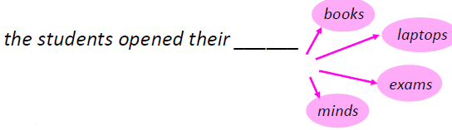
Language Modeling
Language Modeling is the task of predicting what word comes next or the probability of a sentence.
Goal:
  compute the probability of a sentence or sequence of words:
P(W) = P(w₁,w₂,w₃,w₄,w₅…w_{n})
  compute probability of an upcoming word:
  P(w₅|w₁,w₂,w₃,w₄)
A system that does this is called a Language Model (LM).

Slide 3
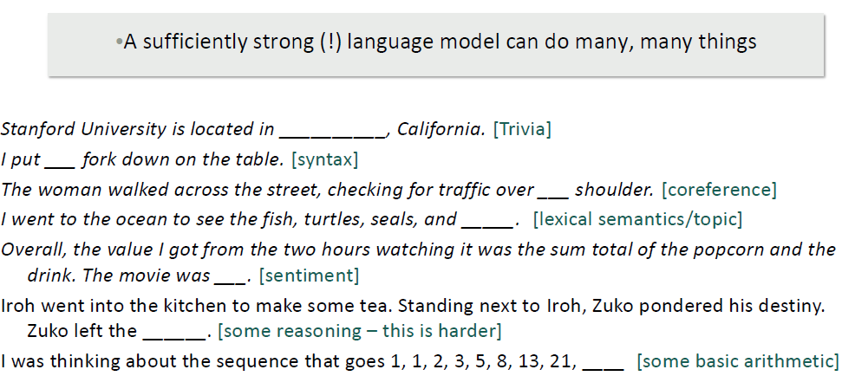
What can you do with next-word prediction?
Source: CS224N

Slide 4
Why word prediction?
It's how large language models (LLMs) work!
LLMs are trained to predict words
Left-to-right (autoregressive) LMs learn to predict next word
LLMs generate text by predicting words
  By predicting the next word over and over again

Slide 5
Applications
Language Modeling is a subcomponent of many NLP tasks, especially those involving generating text or estimating the probability of text:
  Predictive typing
  Speech recognition
  Handwriting recognition
  Spelling/grammar correction
  Authorship identification
  Machine translation
  Summarization
  Dialogue
  etc.
Many tasks in NLP has been rebuilt upon Language Modeling.
ChatGPT is an LM!

Slide 6
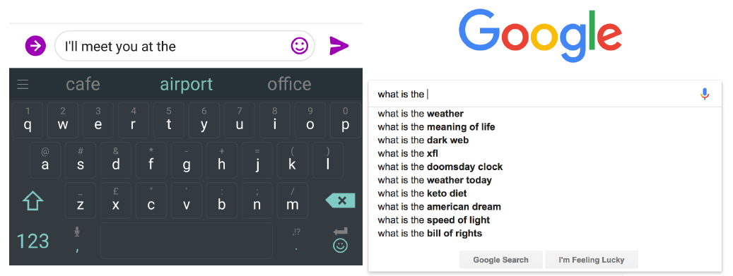
We use Language Models every day!

Slide 7
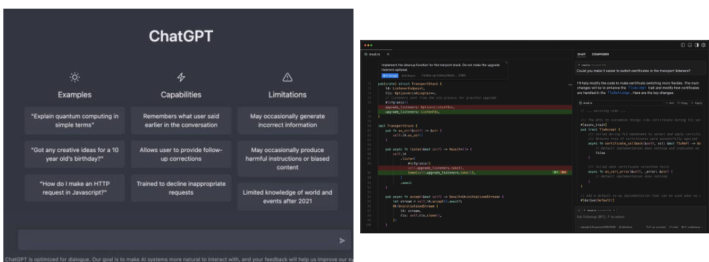
We use Language Models every day!

Slide 8
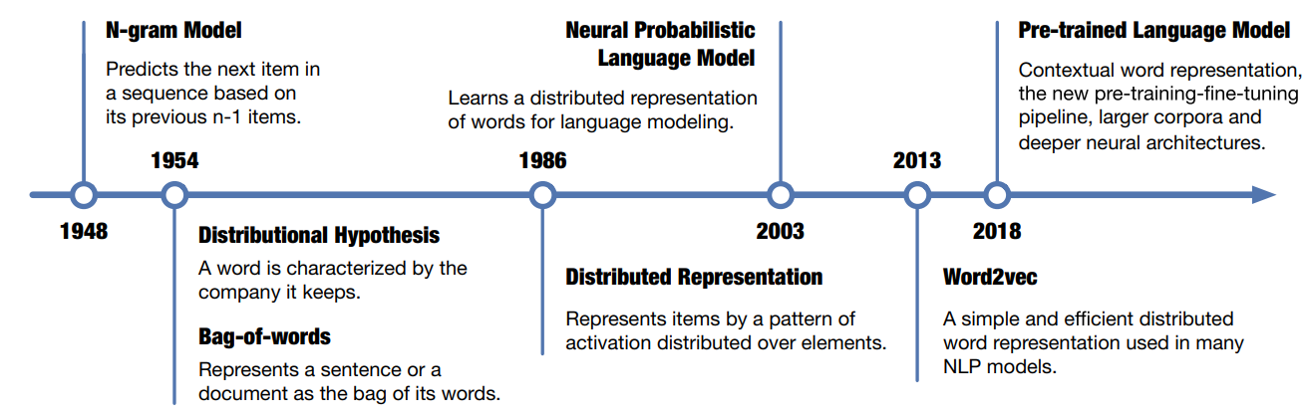
Developments in Representation Learning and LMs
With the growing computing power and large-scale text data, distributed representation trained with neural networks and large corpora has become the mainstream.
Source: Liu et al., Representation Learning for Natural Language Processing, Springer, 2020

Slide 9
n-gram Language Models
Question: How to learn a Language Model?
Answer (pre- Deep Learning): learn an n-gram Language Model!
The simplest model that assigns probabilities to sentences and sequences of words, the n-gram Language Model.
An n-gram is a sequence of n consecutive words:
  unigrams: “the”, “students”, “opened”, ”their”
  bigrams: “the students”, “students opened”, “opened their”
  trigrams: “the students opened”, “students opened their”
  four-grams: “the students opened their”
How to estimate probabilities?
  Idea: Collect statistics about how frequent different n-grams are and use these to predict next word.

Slide 10

An example for bi-gram
<s> I am Sam </s>
<s> Sam I am </s>
<s> I do not like green eggs and ham </s>

Slide 11
n-gram LM with Shakespeare Corpus
Shakespeare Corpus contains the complete works, plays, sonnets, and poems of Shakespeare.
N=884,647 tokens, V=29,066
The next slide shows random sentences generated from unigram, bigram, trigram, and 4-gram models trained on Shakespeare’s works.
The longer the context on which we train the model, the more coherent the sentences. In the unigram sentences, there is no coherent relation between words or any sentence-final punctuation.
The trigram and 4-gram sentences are beginning to look a lot like Shakespeare.
Indeed, a careful investigation of the 4-gram sentences shows that they look a little too much like Shakespeare.
The words “It cannot be but so” are directly from King John.

Slide 12
Approximating Shakespeare
Notes:
This figure shows some random sentences generated from unigram, bigram, trigram, and 4- gram models trained on the works of William Shakespeare.
The longer the context, the more coherent the sentences. In these unigram sentences, there's no coherent relation between words. The bigram sentences have some local word-to-word coherence, and sensible punctuation. The 3 and 4-gram sentences are beginning to look a lot like Shakespeare. In fact, they look a little too much like Shakespeare. The words It cannot be but so are directly from King John.

Slide 13
Language Models: History
Probabilistic n-gram models of text generation [Jelinek+ 1980’s, …]
  Applications: Speech Recognition, Machine Translation
Statistical or shallow neural LMs (late 90’s – mid 00’s) [Bengio+ 2001, …]
Recurrent neural nets (2010s)
Pre-training deep neural language models (2017’s onward):
  Many models based on: Self-Attention

Slide 14
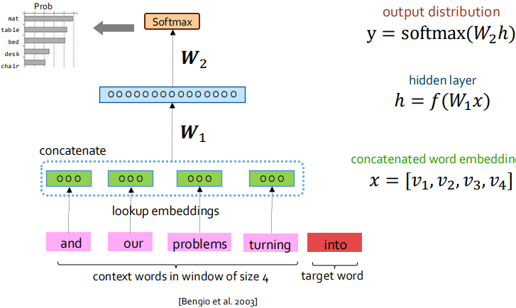
Neural Network (NN)- Language Model
Improvements over n-gram LM:
Tackles the sparsity problem
Model size is O(n) not O(exp(n)) — n being the window size.
Remaining problems:
Fixed window is too small
Enlarging window enlarges 𝑾 — Window can never be large enough!
It’s not deep enough to capture nuanced contextual meanings
https://self-supervised.cs.jhu.edu/sp2025/files/slides/07.mlp-language-modeling.pdf

Slide 15
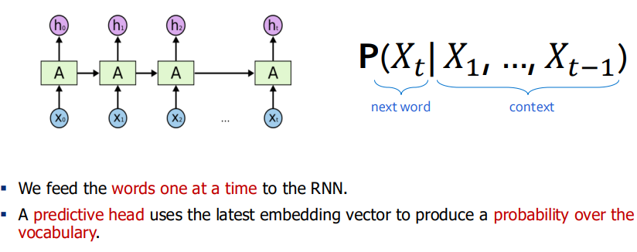
Recurrent Neural Network(RNN) Language Models

Slide 16
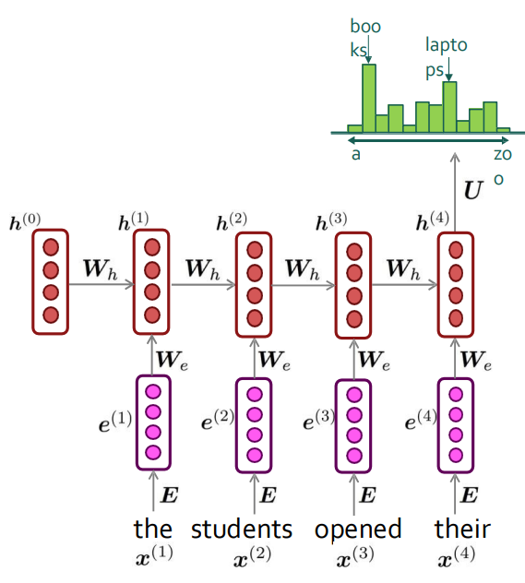
RNNs: Weaknesses
Recurrent computation is slow and difficult to parallelize.
  self-attention mechanism, better at representing long sequences and also parallelizable.
While RNNs in theory can represent long sequences, they quickly forget portions of the input.
Hard to learn long-distance dependencies
https://self-supervised.cs.jhu.edu/sp2025/files/slides/08-9.recurrent-nets.pdf

Slide 17
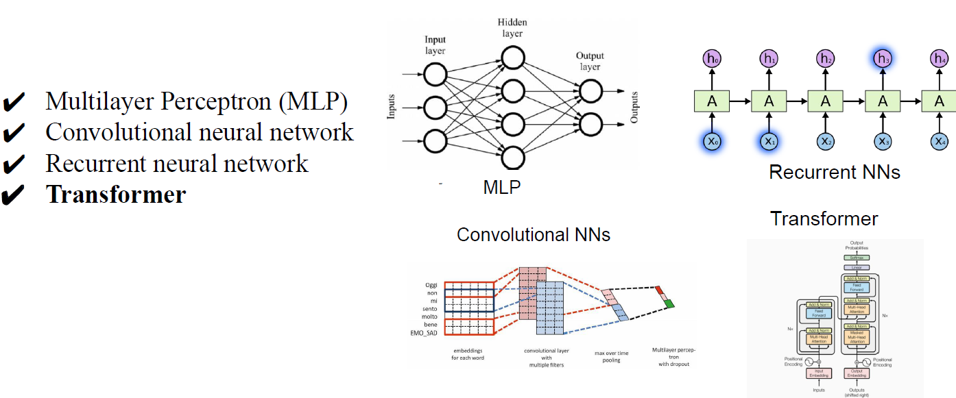
Which neural networks should be used for LLM?
Source: CSC6203

Slide 18
Which neural networks should be used for LLM?
MLP
  +: Strongest inductive bias: if all words are concatenated
  +: Weakest inductive bias: if all words are averaged
  - : The interaction at the token-level is too weak
CNN & RNN
+: The interaction at the token-level is slightly better.
CNN: Bringing the global token-level interaction to the window-level
- : Make simplifications, its global dependencies are limited
RNN: An ideal method for processing token sequences
- : Its recursive nature has the problem of disaster forgetting.
Transformer
  +: Achieve global dependence at the token-level by decoupling token-level interaction and feature-level abstraction into two components, in SAN and FNN.
Source: CSC6203

Slide 19
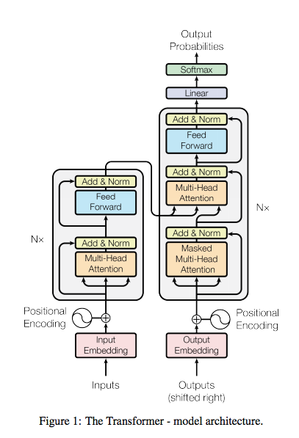
Transformers
Transformers map sequences of input vectors (x1….,xn) to sequences of output vectors (y1,…,yn) of the same length.
Transformers are made up of stacks of transformer blocks, each of which is a multilayer network made by combining simple linear layers, feedforward networks, and attention layers, the key innovation of transformers.
Self-attention allows a network to directly extract and use information from arbitrarily large contexts without the need to pass it through intermediate recurrent connections as in RNNs.

Slide 20
Transformers as Language Models
Fig. 10.7 illustrates the general training approach. At each step, given all the preceding words, the final transformer layer produces an output distribution over the entire vocabulary. During training, the probability assigned to the correct word is used to calculate the cross-entropy loss for each item in the sequence

Slide 21
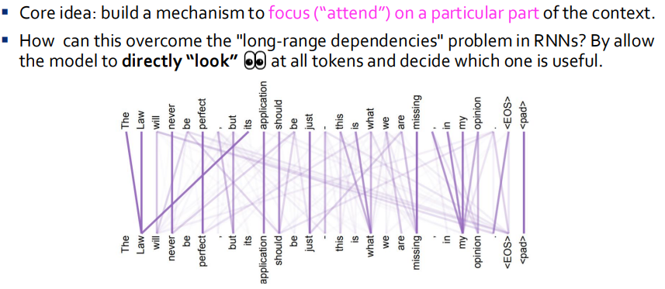
Attention
The attention mechanism enables the Transformer to handle long-range dependencies more effectively than traditional RNNs or CNNs. It allows the model to understand the context of each word in a sentence by considering its relationships with all other words, leading to better performance on various NLP tasks
https://self-supervised.cs.jhu.edu/sp2025/files/slides/10-11.transformers.pdf

Slide 22
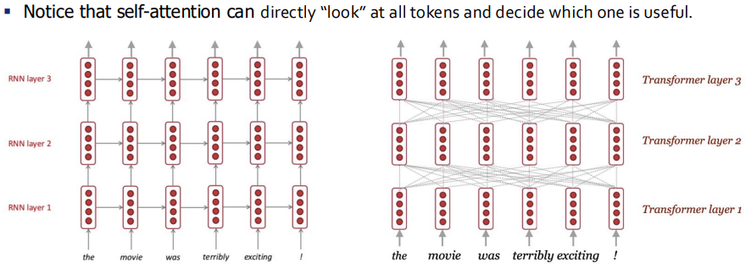
RNN vs Transformer
https://self-supervised.cs.jhu.edu/sp2025/files/slides/10-11.transformers.pdf

Slide 23
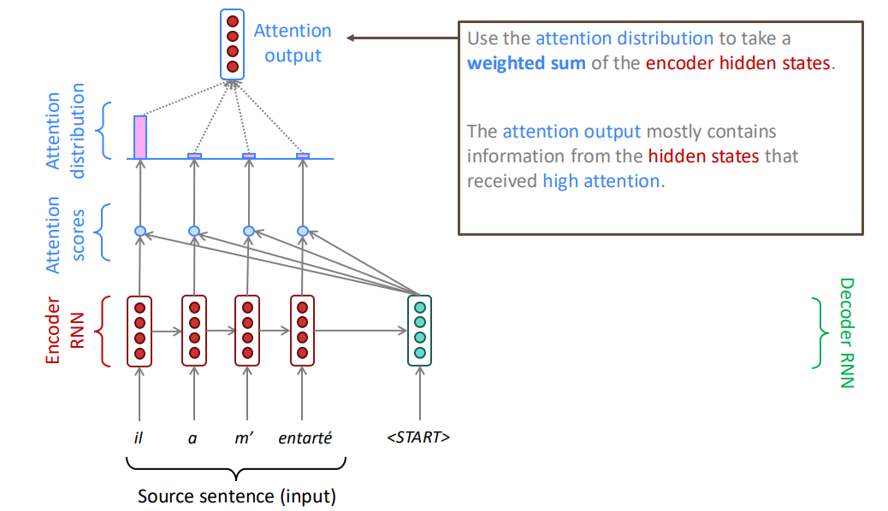
Transformers for Neural Machine Translation (NMT)
Sequence-to-sequence with attention
https://web.stanford.edu/class/cs224n/slides_w25/cs224n-2025-lecture06-fancy-rnn.pdf

Slide 24
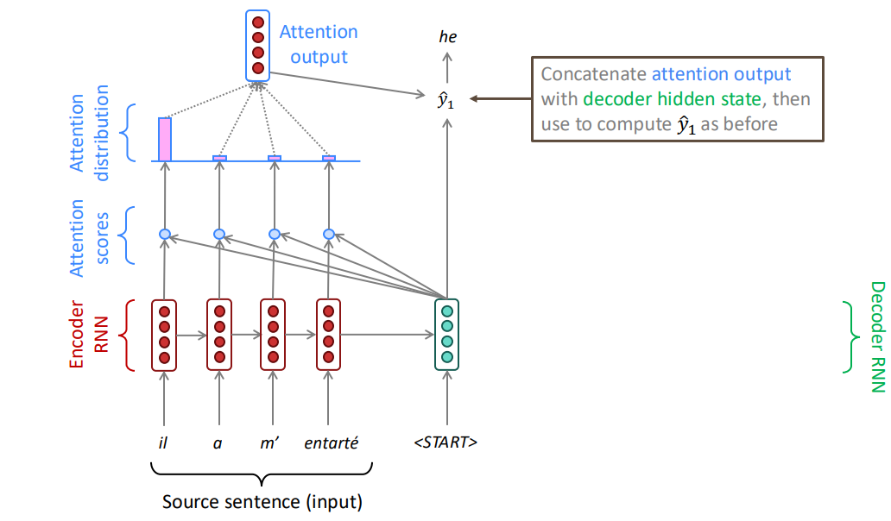
Sequence-to-sequence with attention
https://web.stanford.edu/class/cs224n/slides_w25/cs224n-2025-lecture06-fancy-rnn.pdf

Slide 25
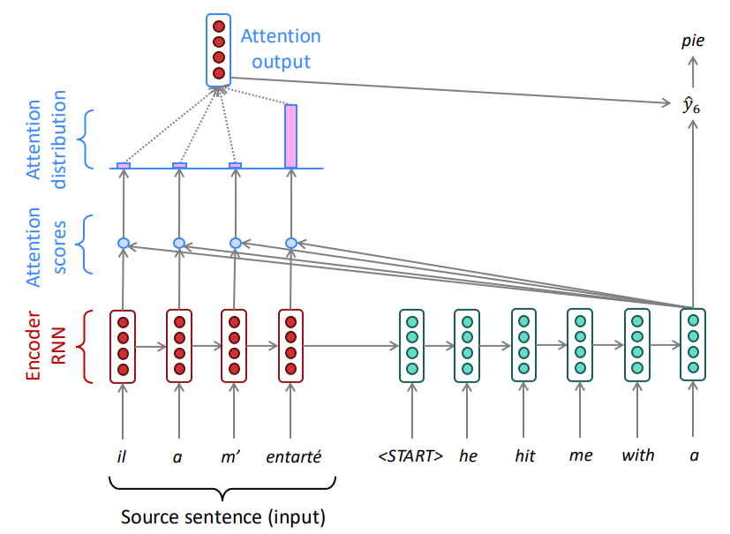
Sequence-to-sequence with attention
https://web.stanford.edu/class/cs224n/slides_w25/cs224n-2025-lecture06-fancy-rnn.pdf

Slide 26
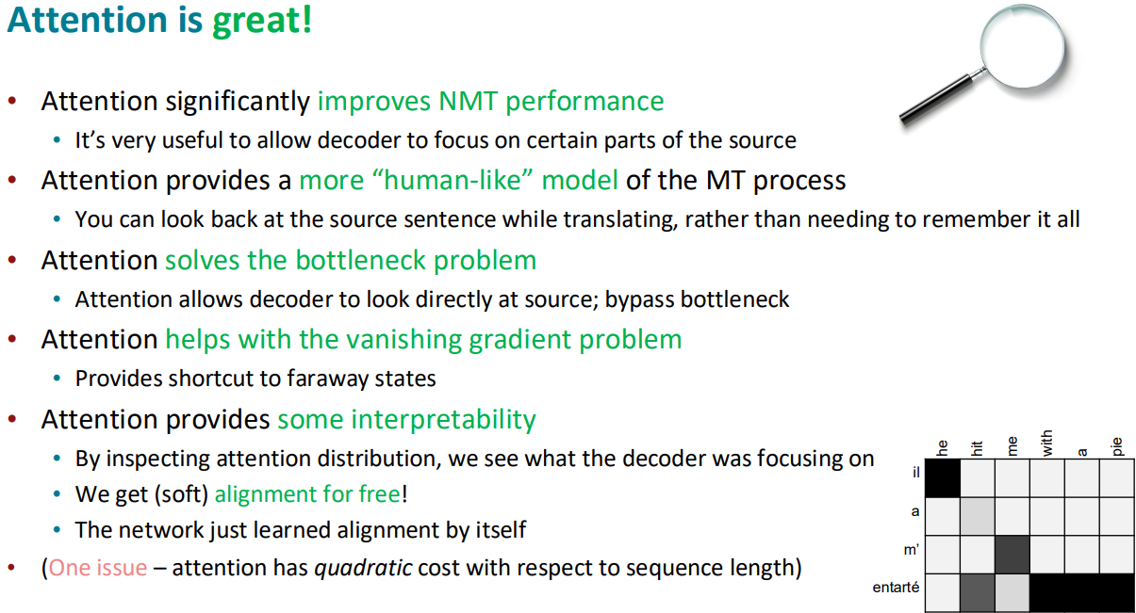
Attention is parallelizable, and solves bottleneck issues
https://web.stanford.edu/class/cs224n/slides_w25/cs224n-2025-lecture06-fancy-rnn.pdf

Slide 27



Multihead Attention
The different words in a sentence can relate to each other in many different ways simultaneously. For example, distinct syntactic, semantic, and discourse relationships can hold between verbs and their arguments in a sentence.
It would be difficult for a single transformer block to learn to capture all of the different kinds of parallel relations among its inputs.
Transformers address this issue with multihead self-attention layers.
These are sets of self-attention layers, called heads, that reside in parallel layers at the same depth in a model, each with its own set of parameters.
Given these distinct sets of parameters, each head can learn different aspects of the relationships that exist among inputs at the same level of abstraction.

Slide 28
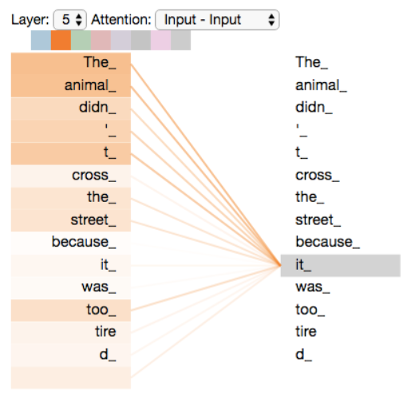
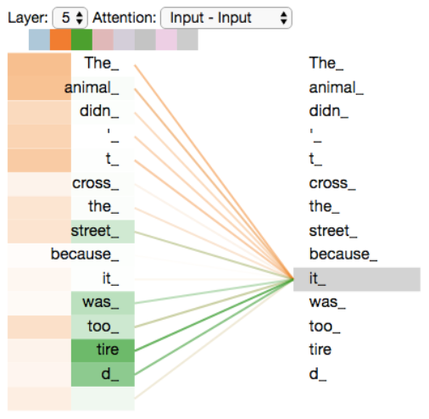
Multihead Attention
HEAD 1: As we are encoding the word "it" in encoder #5 (the top encoder in the stack), part of the attention mechanism was focusing on "The Animal", and baked a part of its representation into the encoding of "it".
HEAD 2: As we encode the word "it", one attention head is focusing most on "the animal", while another is focusing on "tired" -- in a sense, the model's representation of the word "it" bakes in some of the representation of both "animal" and "tired".

Slide 29
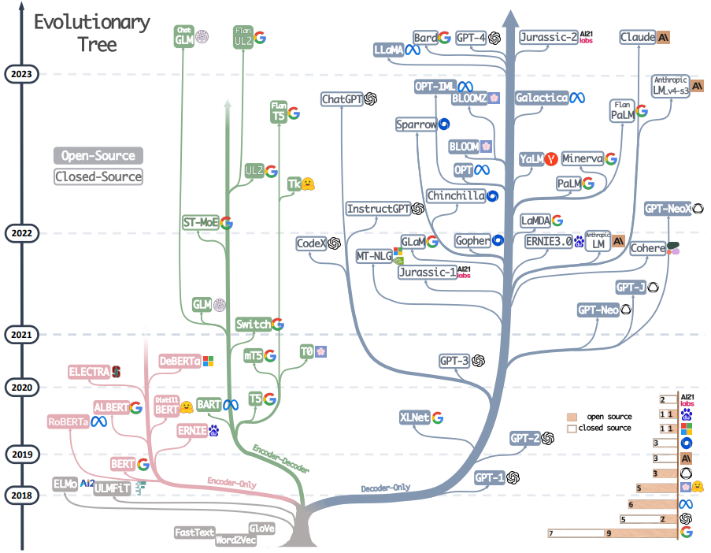
After Transformers
Yang et al. Harnessing the Power of LLMs in Practice: A Survey on ChatGPT and Beyond, 2023
The evolutionary tree of modern LLMs traces the development of language models in recent years and highlights some of the most well-known models

Slide 30
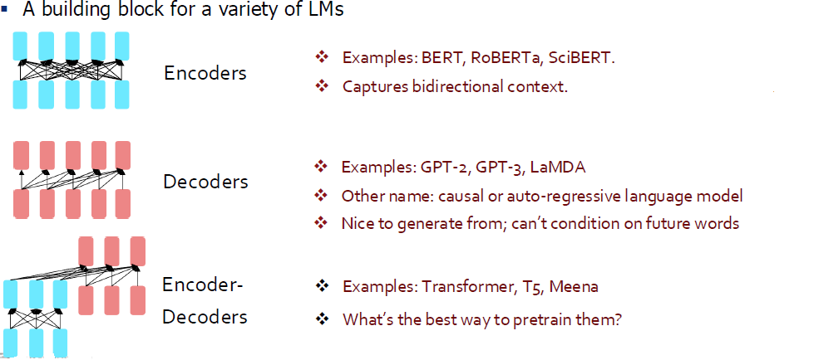
Impact of Transformers

Slide 31
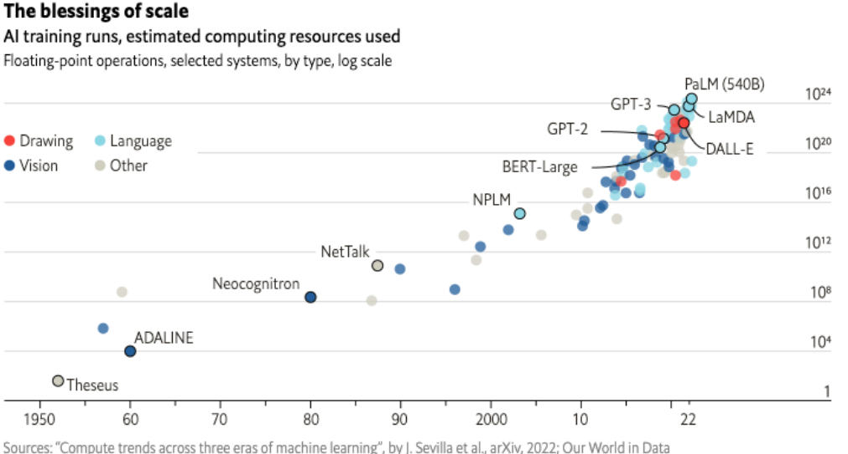
Larger and larger models

Slide 32
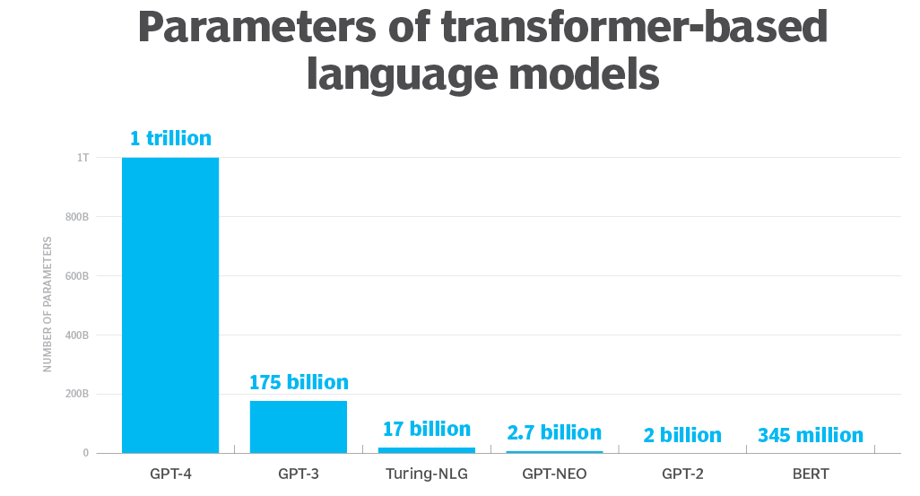
Larger and larger models
https://www.techtarget.com/whatis/definition/large-language-model-LLM#:~:text=While%20there%20isn't%20a,one%20billion%20or%20more%20parameters

Slide 33
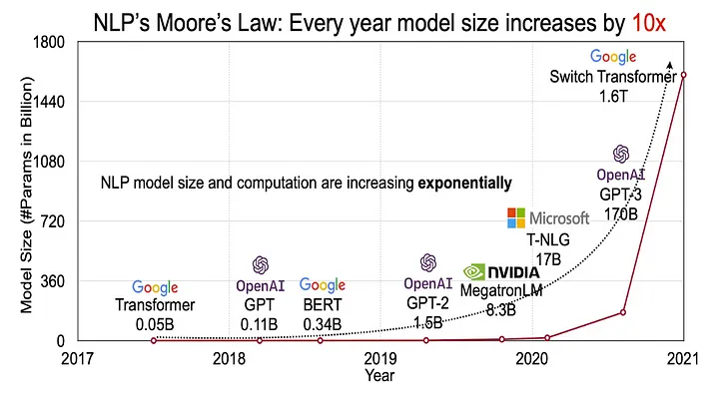
Larger and larger models
Moore’s law for the number of transistors on a chip. You can observe the exponential increase in the model size from the below graph. According to Moore’s Law, the model size is increasing by a factor of 10 year-on-year.

Slide 34
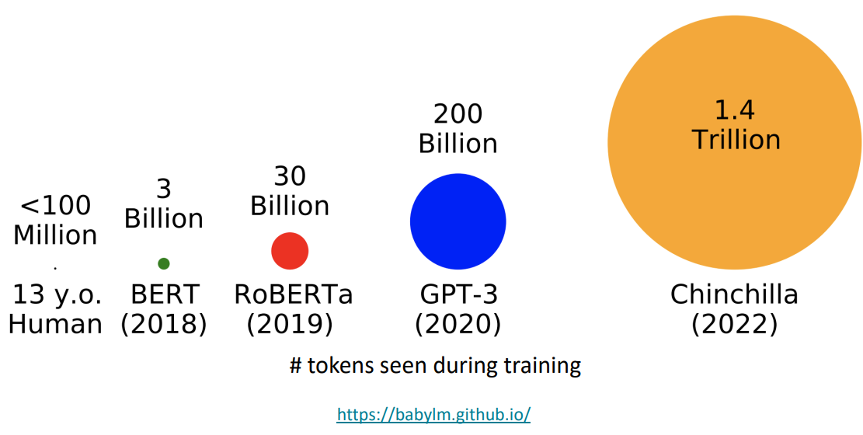
Trained on more and more data

Slide 35
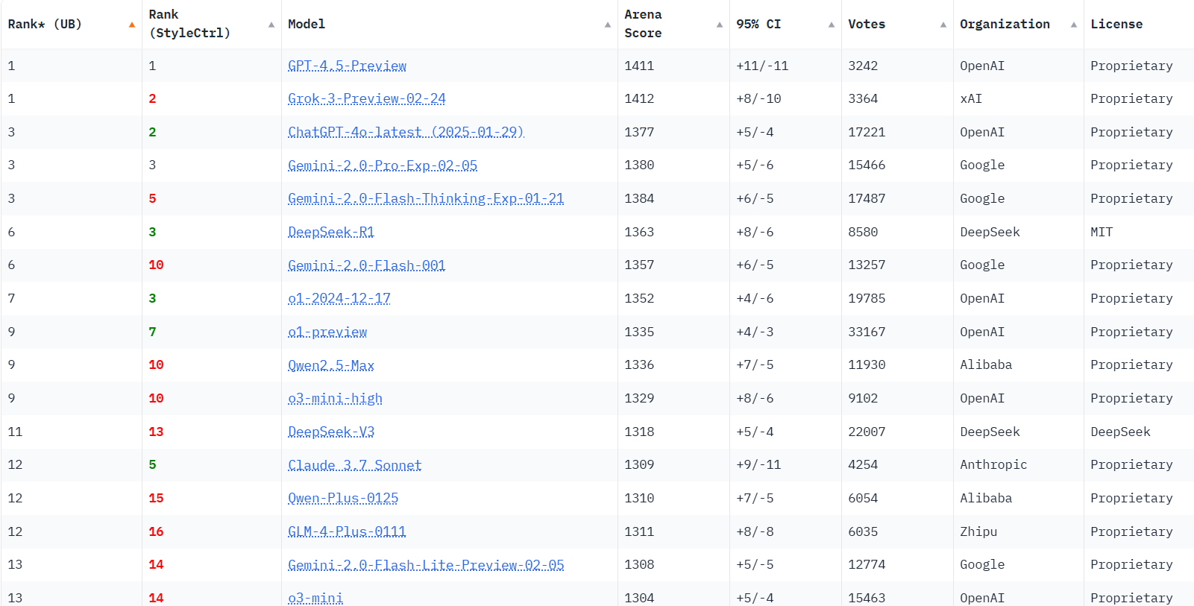
Chatbot Arena LLM Leaderboard

Slide 36
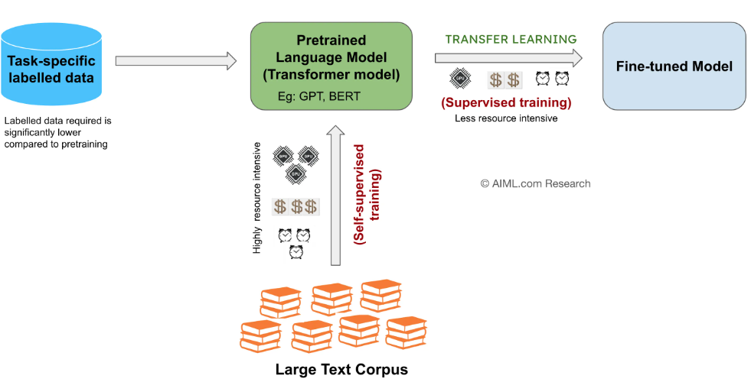
Pretraining and Finetuning
https://aiml.com/what-do-you-mean-by-pretraining-finetuning-and-transfer-learning-in-the-context-of-machine-learning-or-language-modeling/

Slide 37
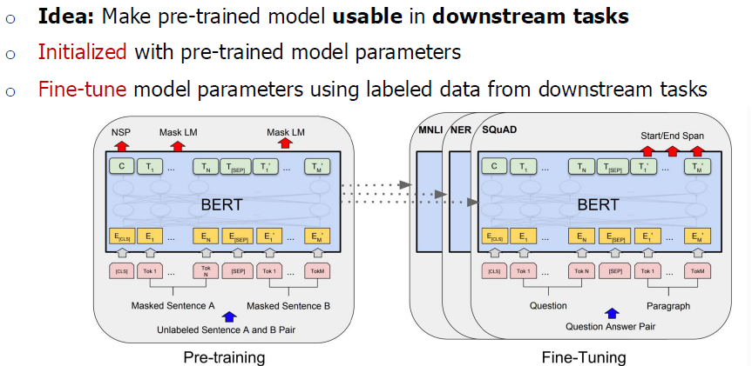
Pretrain once, finetune many times for different tasks

Slide 38
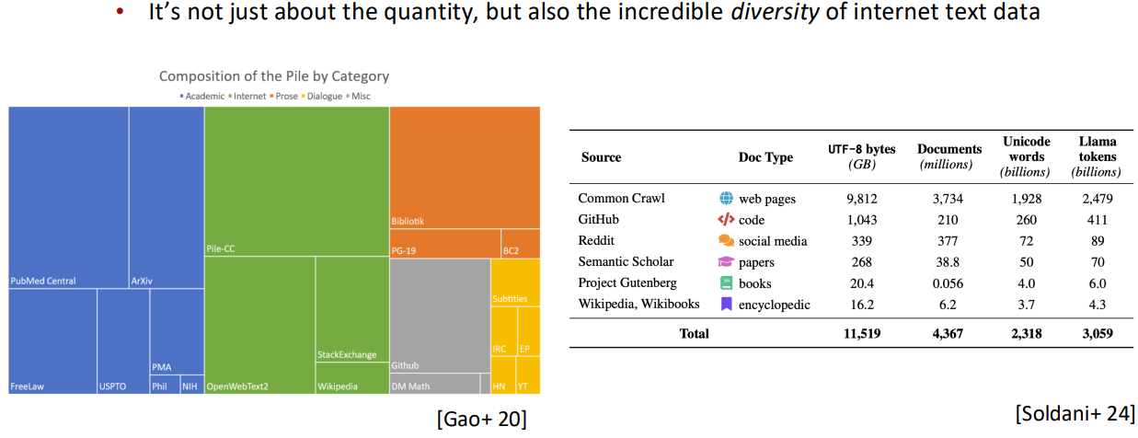
Pretraining can be massively diverse
https://web.stanford.edu/class/cs224n/slides_w25/cs224n-2025-lecture09-pretraining.pdf

Slide 39
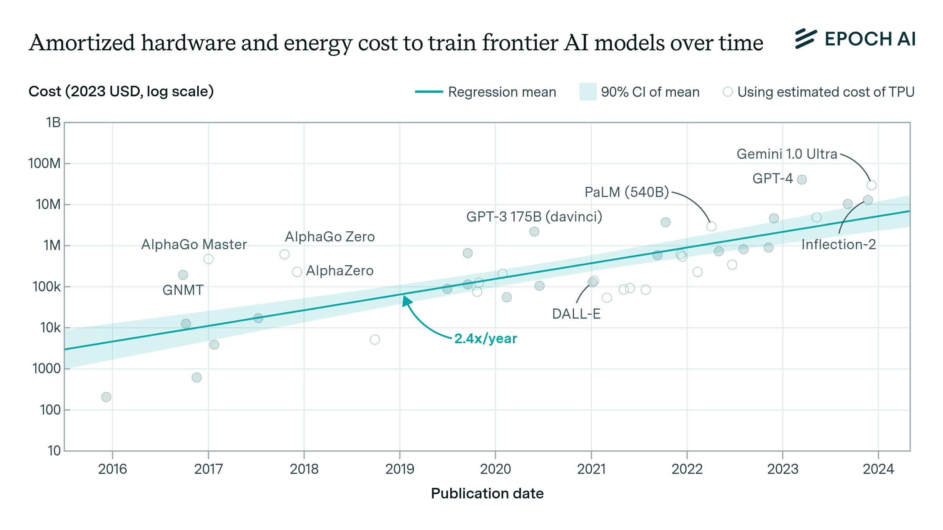
Hardware and Energy Cost
The cost of training frontier AI models has grown by a factor of 2 to 3x per year for the past eight years, suggesting that the largest models will cost over a billion dollars by 2027.
https://epoch.ai/blog/how-much-does-it-cost-to-train-frontier-ai-models

Slide 40
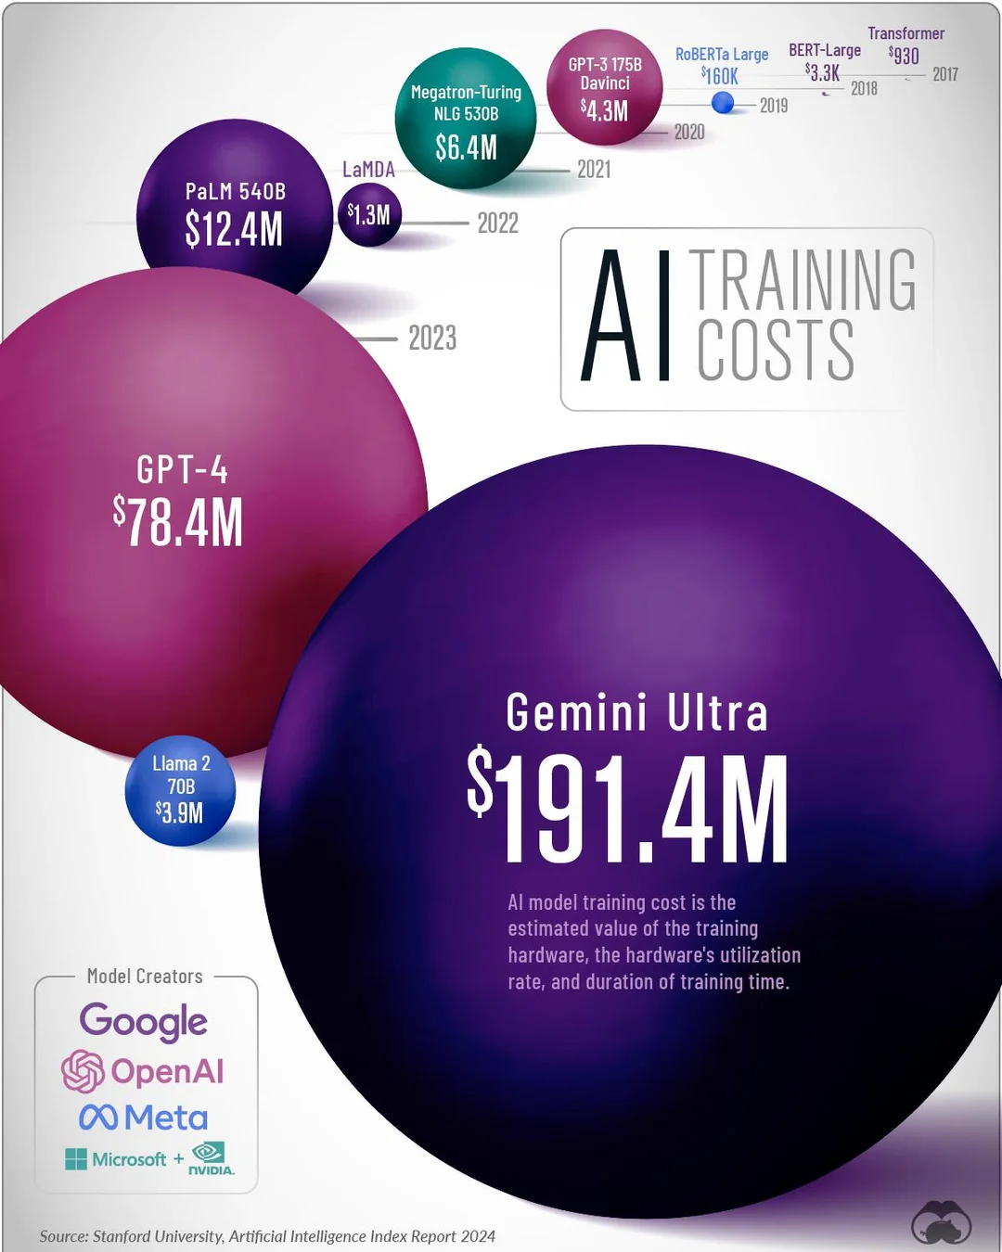
Training Costs
https://www.reddit.com/r/Infographics/comments/1d44tzb/the_training_cost_of_ai_models_over_time/

Slide 41
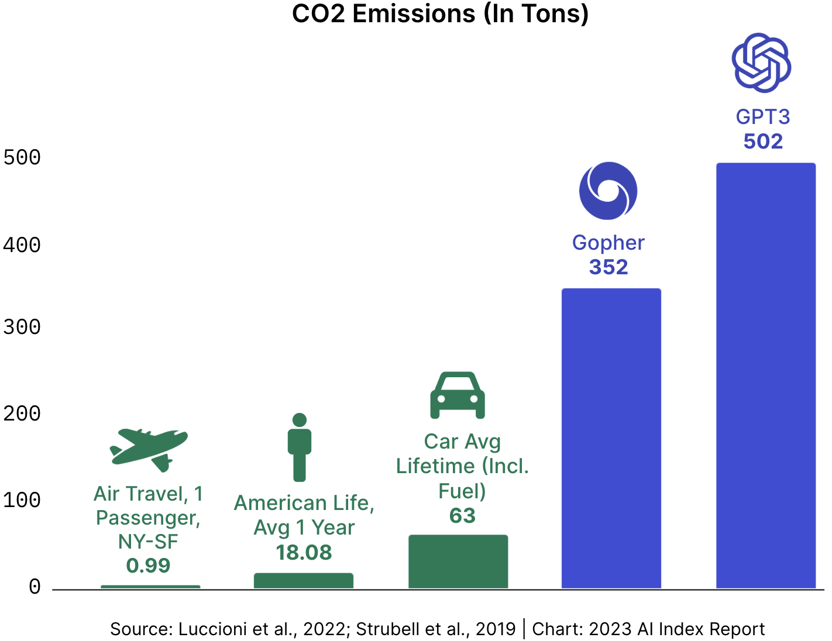
CO2 Emmisions
Training a model, especially a large one, requires a large amount of data. This becomes very costly in terms of time and compute resources. It even translates to environmental impact, as can be seen in the following graph.
Training AI models are carbon intensive, and data center construction is accelerating rapidly
Training LLMs like GPT3 produces about 500 metric tons of CO2, equivalent to taking 500 flights from NY to SF.
https://www.austinledzian.com/project/cairn

Slide 42
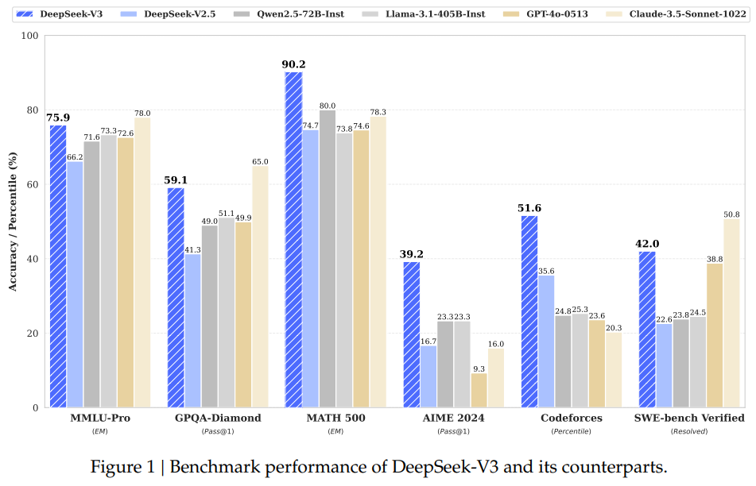
DeepSeek-V3

Slide 43
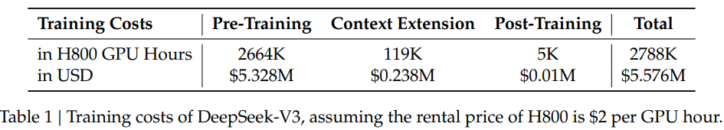
DeepSeek-V3 Technical Report
we scale up our models and introduce DeepSeek-V3, a large Mixture-of-Experts (MoE) model with 671B parameters, of which 37B are activated for each token.
During pre-training, we train DeepSeek-V3 on 14.8T high-quality and diverse tokens.
During the pre-training stage, training DeepSeek-V3 on each trillion tokens requires only 180K H800 GPU hours, i.e., 3.7 days on our cluster with 2048 H800 GPUs.
Consequently, our pretraining stage is completed in less than two months (3.7*14.8 = 54.76 days)
Assuming the rental price of the H800 GPU is $2 per GPU hour, our total training costs amount to only $5.576M.

Slide 44
DeepSeek $6M Cost Of Training Is Misleading
The $5-6M cost of training is misleading. It comes from the claim that 2048 H800 cards were used for *one* training, which at market prices is upwards of $5-6M.
Developing such a model, however, requires running this training, or some variation of it, many times, and also many other experiments
That makes the cost to be many times above that, not to mention data collection and other things, a process which can be very expensive
Also, 2048 H800 cost between $50-100M.
https://therecursive.com/martin-vechev-of-insait-deepseek-6m-cost-of-training-is-misleading/

Slide 45
AI Arms Race
Demis Hassabis, Google’s artificial intelligence (AI) chief:
  In an interview with Bloomberg Television, Hassabis, who leads Google’s DeepMind, called the idea that the Chinese startup spent so little to develop an AI system that rivals American tech giants “exaggerated and a little bit misleading.”
  His comments come at a time when, as PYMNTS wrote last week, the “AI arms race is getting pricey,” with Google, Meta Microsoft and Amazon planning to collectively spend at least $320 billion on capital expenditures in 2025, the bulk of it for AI.
  Meta’s budget for capital expenditures could reach as high as $65 billion,
  while Google has set aside $75 billion, primarily for data centers, servers and networking infrastructure.
  Amazon projects it will spend $100 billion,
  while Microsoft is booking $80 billion to construct data centers, train AI models and launch AI and cloud-based applications.
https://www.pymnts.com/artificial-intelligence-2/2025/google-ai-head-reports-of-deepseeks-low-costs-are-misleading/

Slide 46
LLMs
in
Medicine/Healthcare

Slide 47
What Are Medical LLMs?
Specialized large language models trained on medical data to assist in healthcare tasks.
Key Features:
  Understand and generate human-like text.
  Trained on medical literature, clinical notes, and health records.
  Designed for tasks like diagnosis support, patient interaction, and research.
Examples:
  BioGPT (Microsoft)
  Med-PaLM / Med-PaLM 2 (Google)
  ClinicalBERT
  GatorTron

Slide 48
How Are Medical LLMs Built?
Base Models: GPT, BERT, LLaMA, etc.
Training Process:
  Base Models are Pre-trained on general text (e.g., books, websites)
  Domain Adaptation:
    Fine-tuned on medical datasets (e.g., PubMed, EHRs).
    Instruction Tuning: Using QA pairs or curated prompts
Key Technologies:
  Natural Language Processing (NLP).
  Transformer architectures (e.g., BERT, GPT).
Data Sources:
  Peer-reviewed journals, clinical trial data, patient records.
  Anonymized and ethically sourced to ensure privacy.

Slide 49
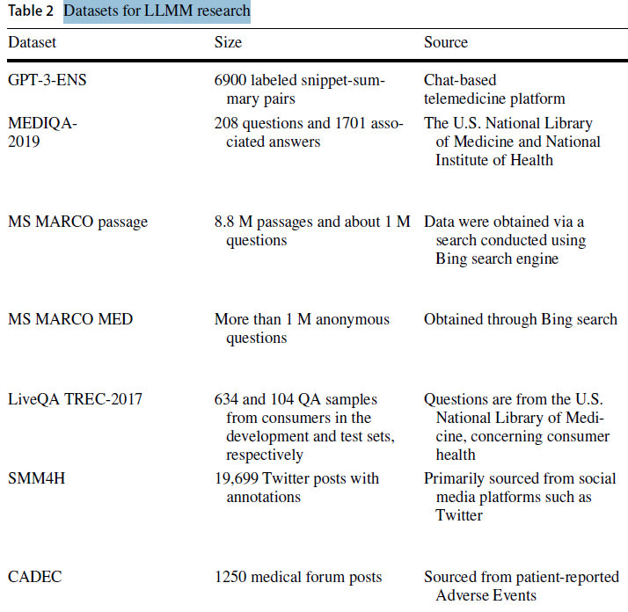
Datasets for LLMs in Medicine Research
There are many datasets: See
Artificial Intelligence Review (2024) 57:299 https://doi.org/10.1007/s10462-024-10921-0

Slide 50
Why Medical LLMs Matter
Healthcare Challenges:
  Growing demand for personalized care.
  Overburdened healthcare systems.
  Need for faster, evidence-based decision-making.
LLM Solutions:
  Automate repetitive tasks (e.g., medical record summarization).
  Enhance diagnostic accuracy.
  Improve patient communication and education.

Slide 51
Applications of Medical LLMs
Clinical Decision Support:
  Assist doctors in diagnosing rare diseases.
  Suggest treatment plans based on patient data and medical guidelines.
Medical Research:
  Summarize research papers and identify trends.
  Accelerate drug discovery through data analysis.
Patient Interaction:
  Power chatbots for triage and patient queries.
  Translate medical jargon into patient-friendly language.
Administrative Efficiency:
  Automate clinical documentation and coding.
  Streamline insurance claims and billing.

Slide 52
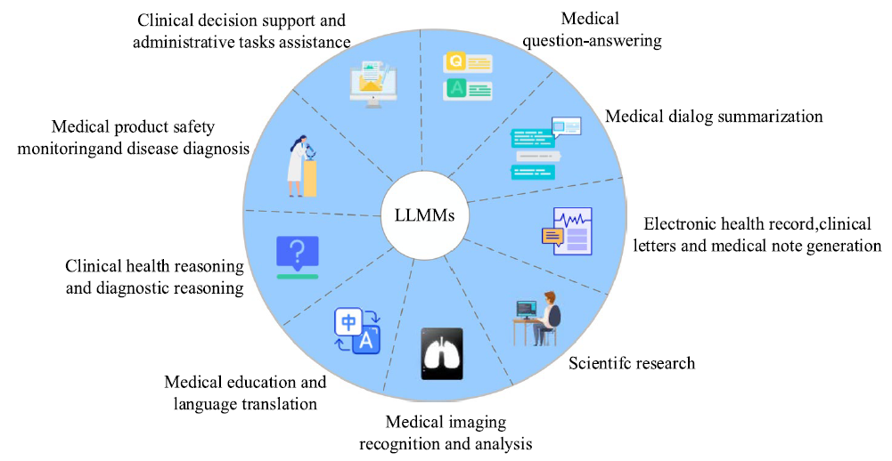
Applications of Medical LLMs
Artificial Intelligence Review (2024) 57:299 https://doi.org/10.1007/s10462-024-10921-0

Slide 53
Evaluation Metrics
Accuracy (e.g., USMLE performance)
Factuality / Faithfulness
Clinical Utility
Human-in-the-loop testing

Slide 54
Case Studies
Med-PaLM (Google):
  Achieved high accuracy on medical question-answering benchmarks (e.g., MedQA).
  Used for clinical decision support and patient education.
GatorTron (University of Florida):
  Trained on 90 billion words of clinical text.
  Improves prediction of hospital readmissions and diagnoses.
Chatbot Example:
  AI-driven triage systems in hospitals reduce wait times by 20-30%.

Slide 55
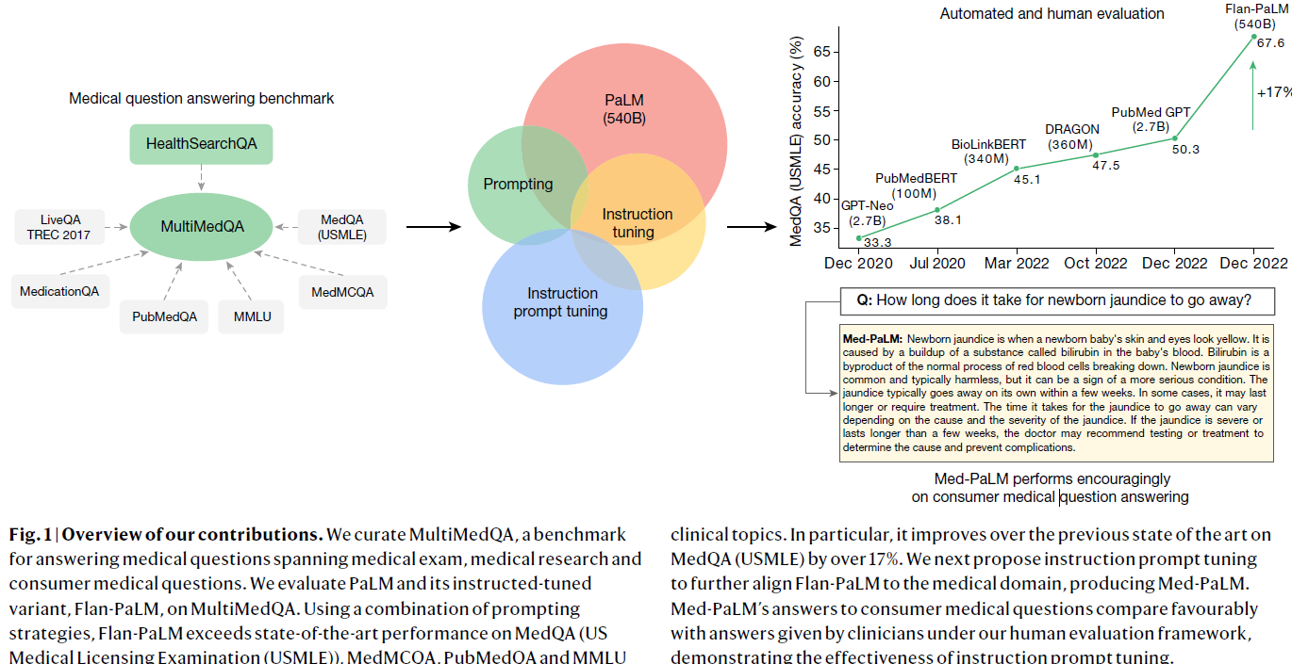
MedQA (USMLE) accuracy

Slide 56
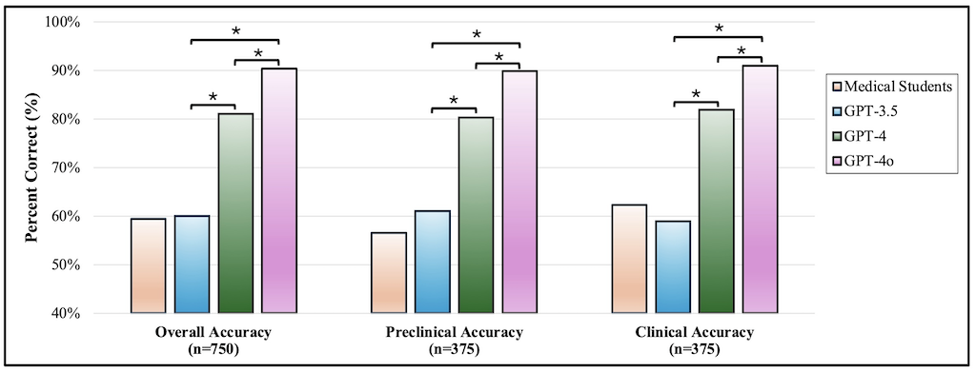
Analysis of ChatGPT models’ and medical students’ performance on USMLE questions (2024)
Figure 1. Analysis of ChatGPT models’ and medical students’ performance on USMLE questions. This figure displays the comparative accuracies of ChatGPT 3.5 (GPT-3.5), ChatGPT 4 (GPT-4), ChatGPT 4 Omni (GPT-4o), and medical students in answering a set of 750 USMLE-style questions. The overall accuracy, preclinical accuracy, and clinical accuracy are shown. Asterisks (*) denote statistically significant differences (P<.05), highlighting the advancements in newer models of the GPT series. The number of questions is indicated for each category: n=750 for overall accuracy, n=375 for preclinical accuracy, and n=375 for clinical accuracy. GPT: Generative Pre-trained Transformer; USMLE: United States Medical Licensing Examination.
https://mededu.jmir.org/2024/1/e63430/

Slide 57
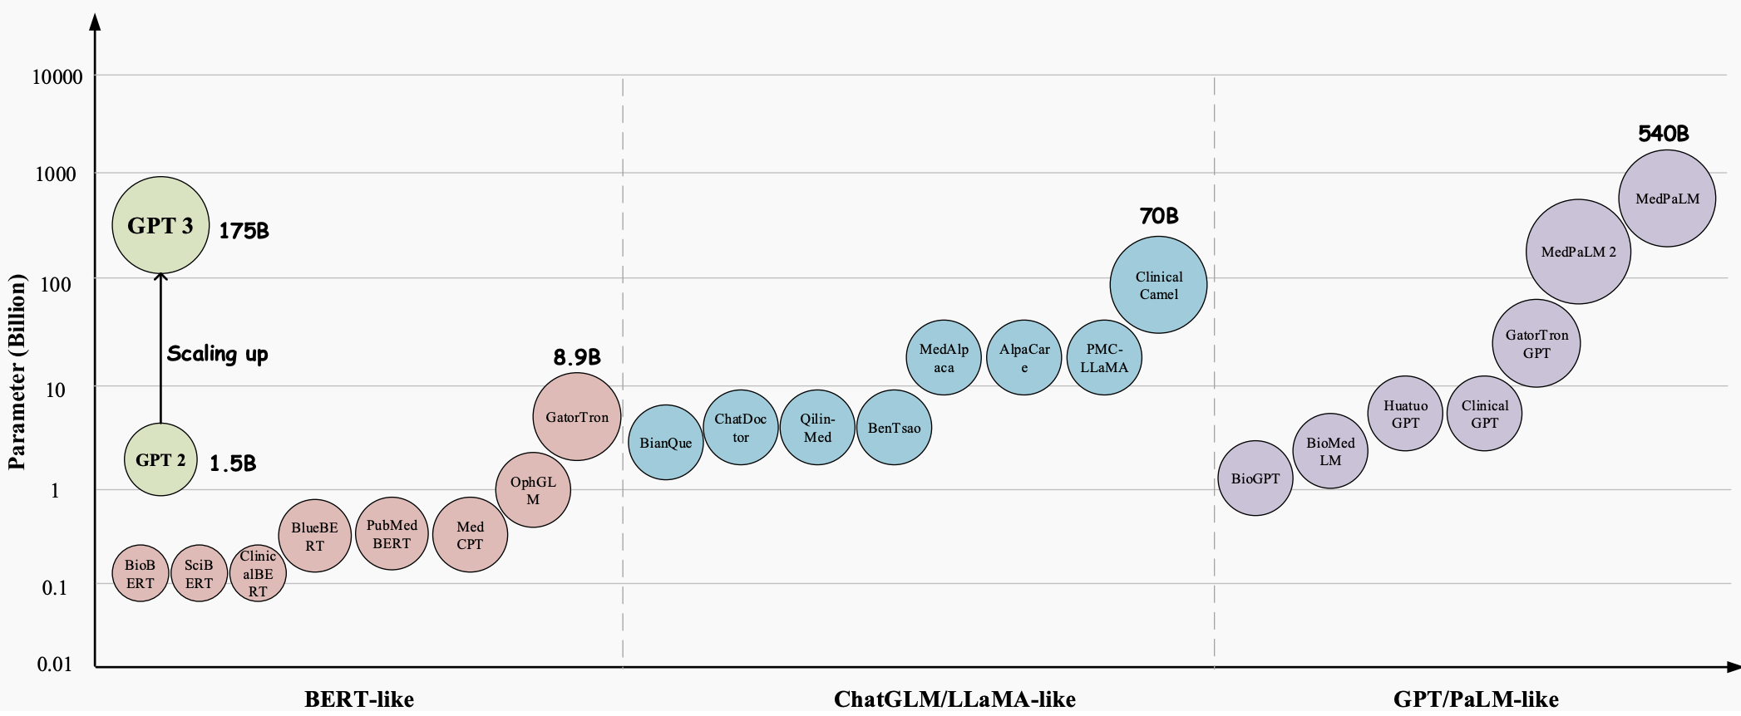
The Open Medical-LLM Leaderboard: Benchmarking Large Language Models in Healthcare
https://huggingface.co/blog/leaderboard-medicalllm

Slide 58
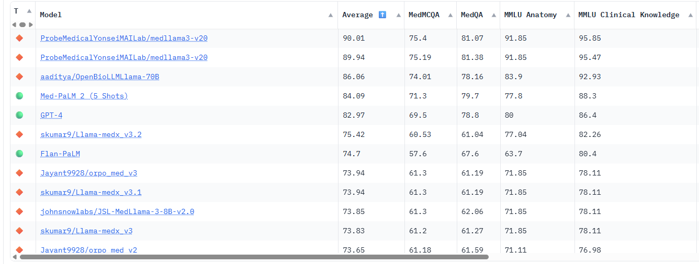
https://huggingface.co/spaces/openlifescienceai/open_medical_llm_leaderboard

Slide 59
Benefits of Medical LLMs
Accuracy: Matches or exceeds human performance in specific tasks (e.g., radiology report analysis).
Scalability: Supports healthcare systems in underserved areas.
Efficiency: Reduces time spent on documentation by up to 50%.
Accessibility: Enables 24/7 patient support via AI chatbots.

Slide 60
Challenges and Limitations
Data Privacy:
  Handling sensitive patient data (HIPAA compliance).
Hallucinations: Incorrect or fabricated facts
Bias and Fairness:
  Risk of biased outputs if trained on unrepresentative data.
Interpretability:
  "Black box" nature makes it hard to explain decisions.
Explainability: Lack of transparency in outputs
Regulatory Hurdles:
  FDA and other bodies require rigorous validation.
Ethical Concerns:
  Over-reliance on AI could undermine human expertise.

Slide 61
Future of Medical LLMs
Personalized Medicine:
  Tailored treatment plans based on genetic and clinical data.
Global Health Impact:
  Support telemedicine in low-resource settings.
Integration with Wearables:
  Real-time health monitoring and alerts via LLMs.
Continuous Learning:
  Models that update with new medical knowledge.
Ethical AI:
  Focus on transparency, fairness, and patient trust.
Multimodal models (text + images + structured data)
Integration into EHR systems
Human-AI collaboration in diagnostics
Open-source medical AI ecosystems

Slide 62
Conclusion
Summary:
  Medical LLMs are transforming healthcare with enhanced decision-making, efficiency, and accessibility.
  Challenges like privacy, bias, and regulation must be addressed.
Call to Action:
  Invest in ethical AI development.
  Foster collaboration between AI experts and healthcare professionals.

Slide 63
References
Singhal, K., et al. (2023). "Large Language Models in Medicine." Nature Medicine.
University of Florida. (2022). "GatorTron: A Clinical Language Model."
HIPAA and AI compliance guidelines (2024).
Dandan Wang, Shiqing Zhang (2024) Large language models in medical and healthcare fields: applications, advances, and challenges, Artificial Intelligence Review (2024) 57:299
https://huggingface.co/blog/leaderboard-medicalllm

